Slide 1
Slow Extraction at GSI and FAIR:
An Overview
D. Ondreka, GSI
5th SX Workshop, MedAustron, 12.02.2024

Slide 2
Contents
Overview of GSI and FAIR
Slow extraction from SIS18 and SIS100
Slow extraction development priorities

Slide 3
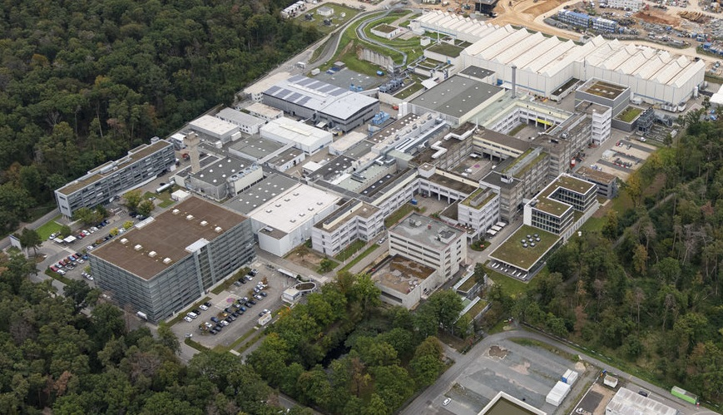
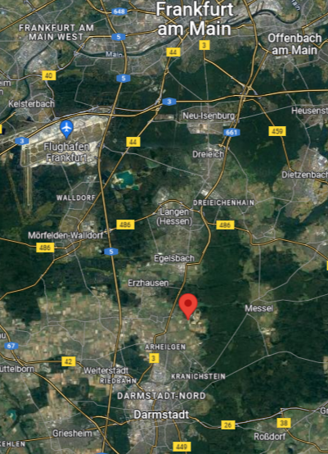
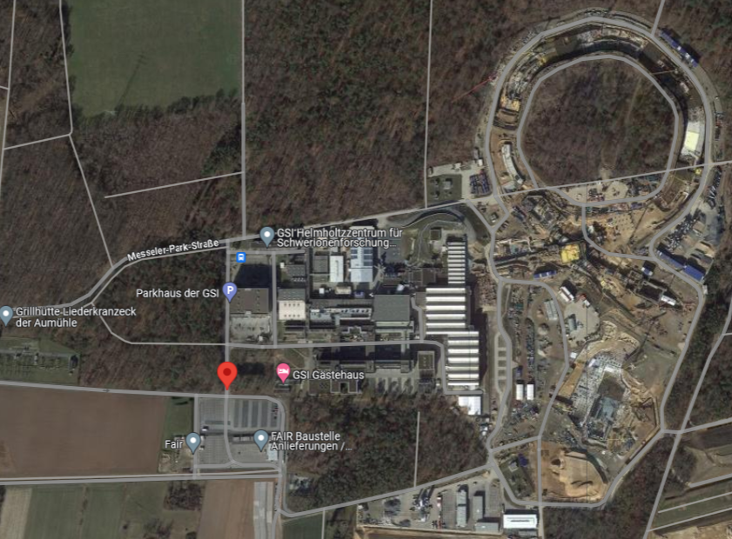
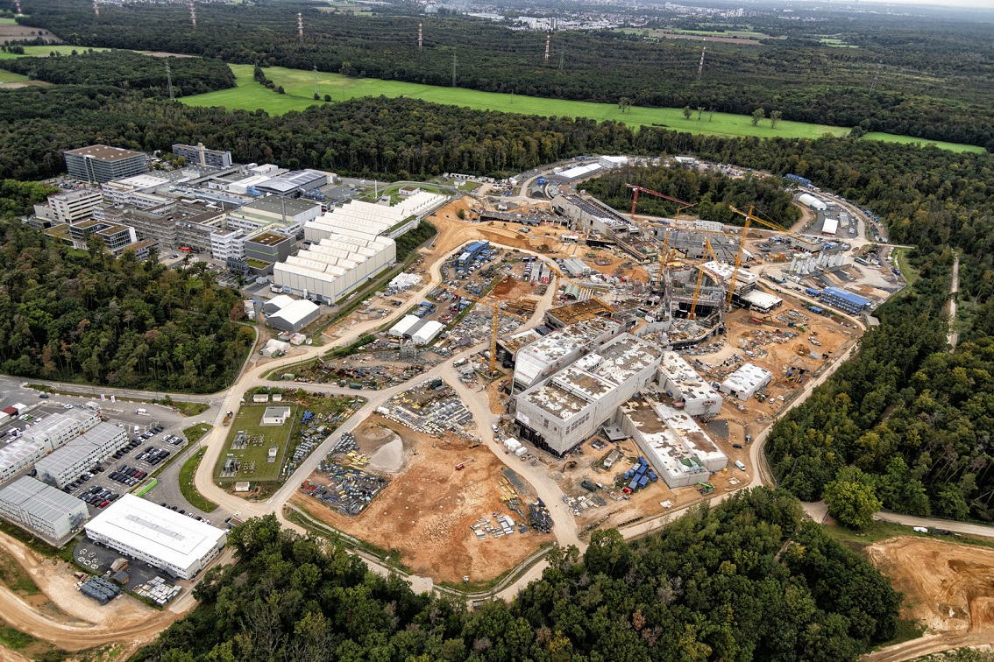
GSI and FAIR: Location

Slide 4
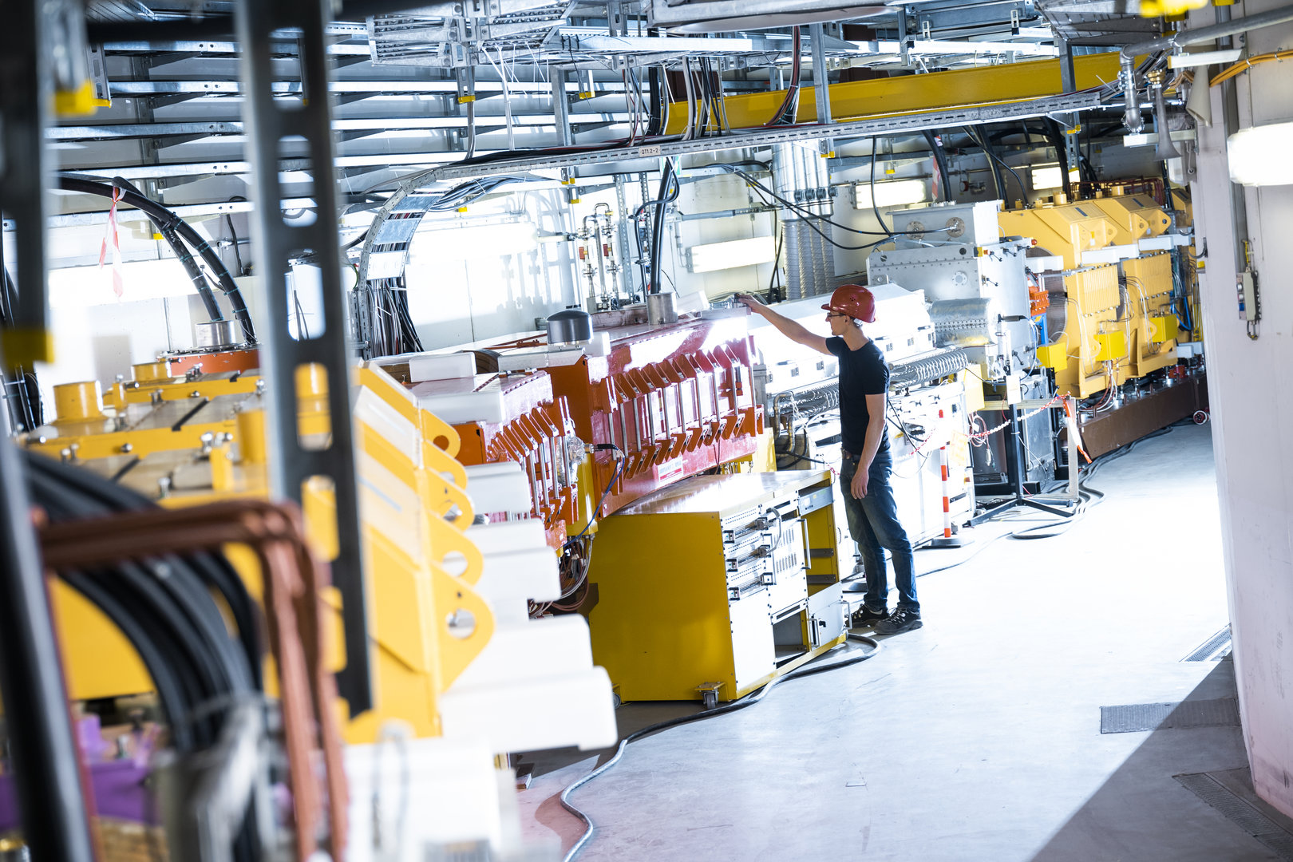
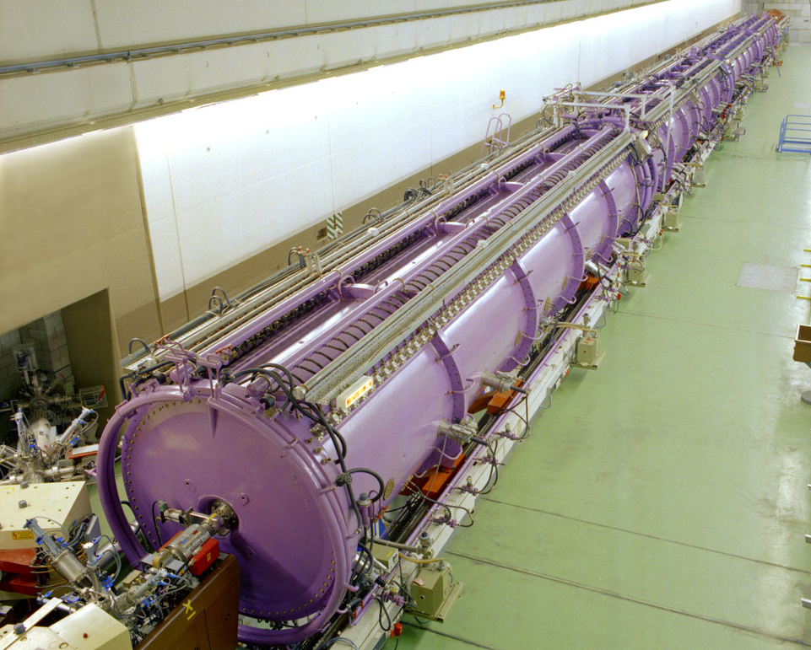
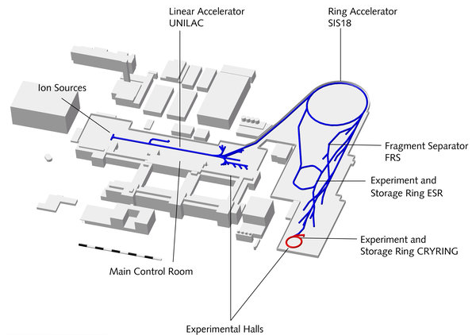
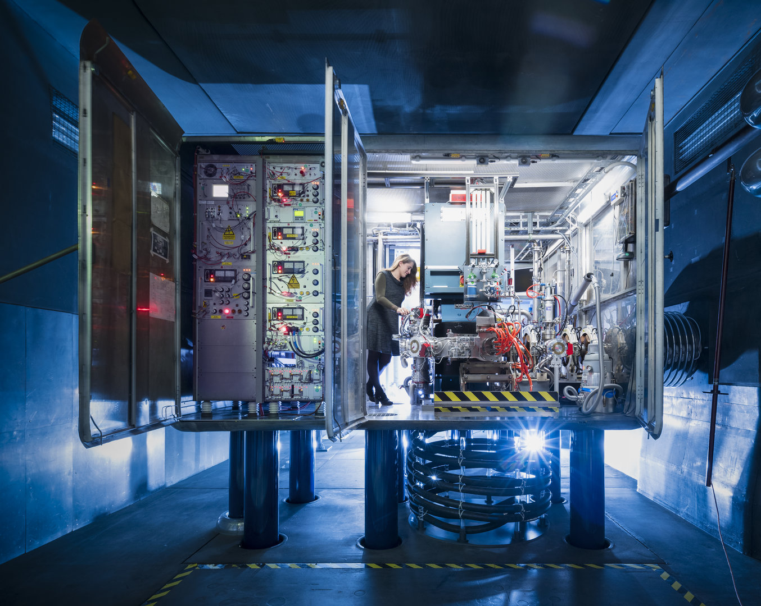
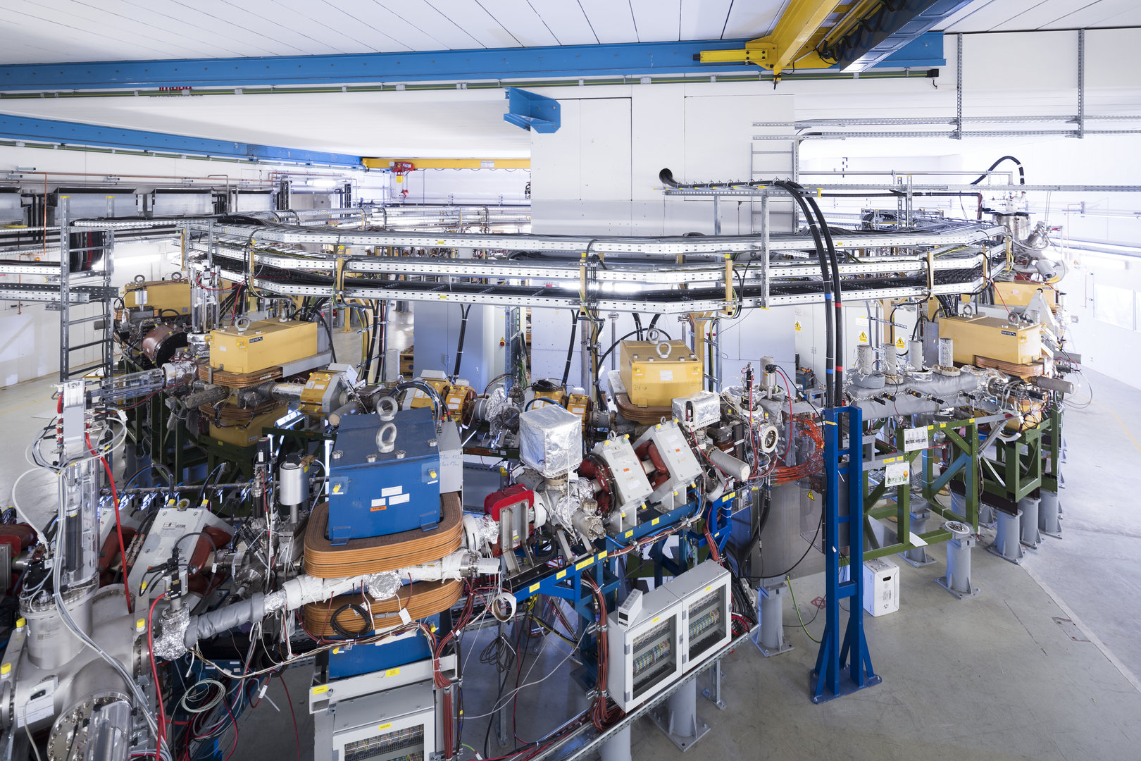
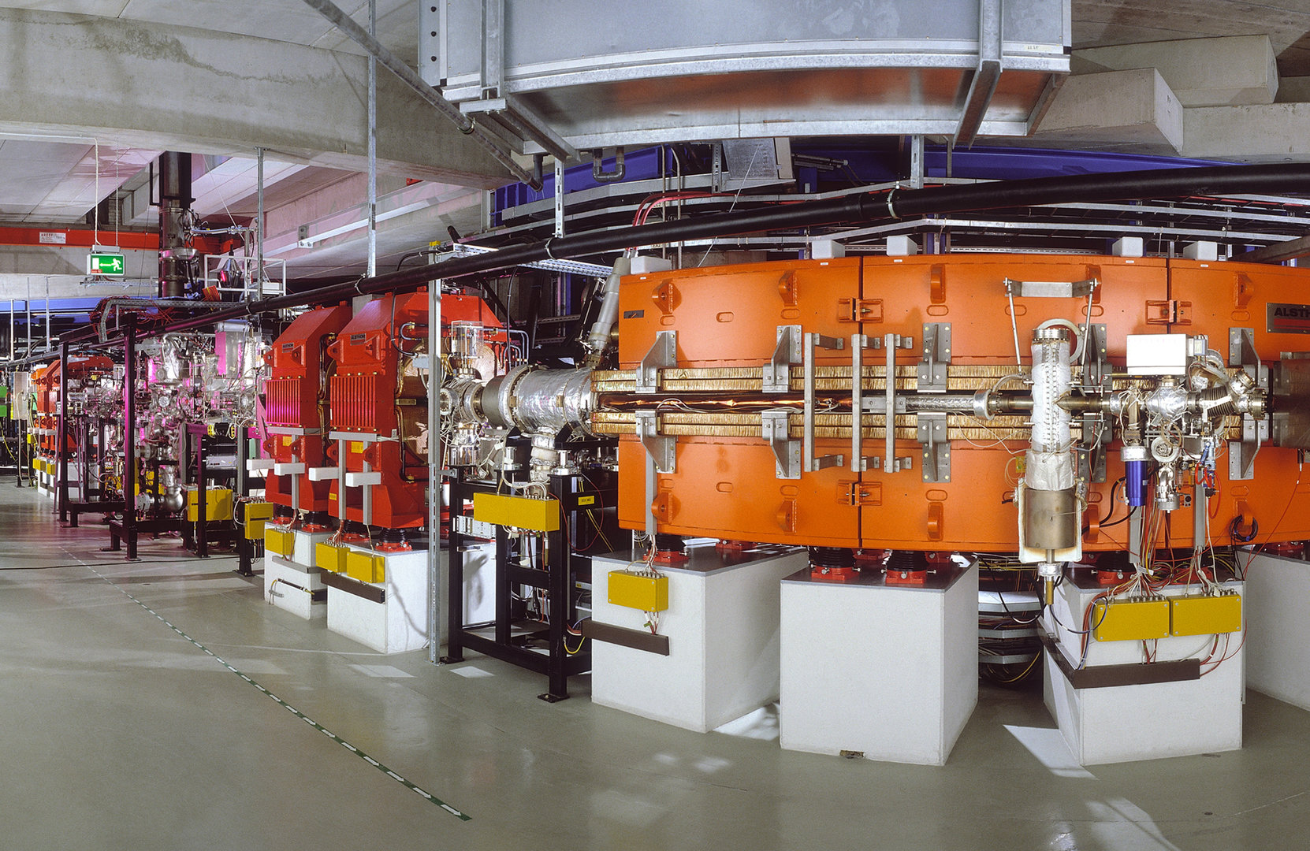
GSI
Heavy ion research since 1969
  About 1500 employees
  About 1200 scientific users/year
Accelerator facility
  Linear accelerator UNILAC
  Synchrotron SIS18
  Storage rings ESR and CRYRING
Capabilities of GSI’s accelerators
  Big variety of ions from p to uranium
  Large range of energies and intensities
  Flexible parallel operation
  Short turn-around times
  Many experimental places
  Slow extraction from SIS18
SIS18
SX Experiments

Slide 5
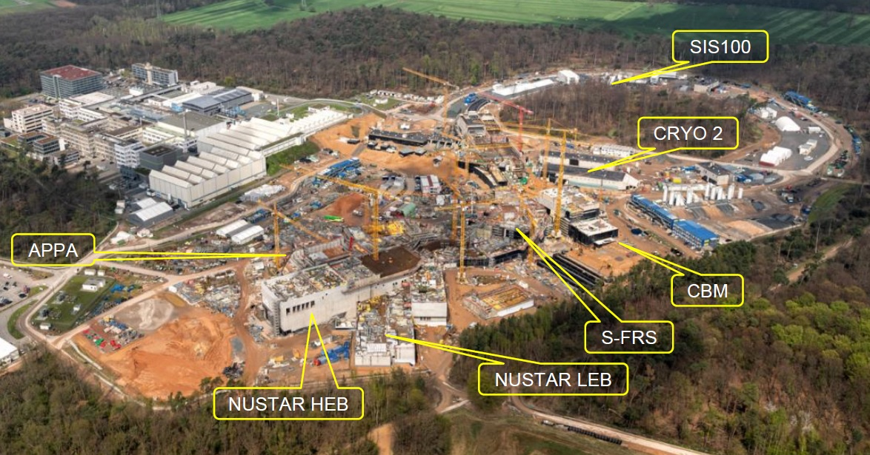
FAIR
Next generation heavy ion research
  Large accelerator and experiment complex
  Built in stages next to GSI site
  Natural extension of experimental program
  Slow extraction from synchrotron SIS100
Performance increase compared to GSI
  Primary beam intensities: 100x
  Secondary beam intensities: 10000x
  Primary beam energies: 10x
SIS100
SX Experiments
Primary Beam Intensities at GSI and FAIR
 |  | p | Ar | Xe | U
Charge number | GSI | 1 | 18 | 48 | 73
 | FAIR | 1 | 10 | 21 | 28
Energy [GeV/u] | GSI | 4.7 | 1.7 | 1.3 | 1.0
 | FAIR | 28.8 | 6.6 | 4.0 | 2.7
Intensity [Ions/s] | GSI | 10¹¹ | 8·10¹⁰ | 2·10¹⁰ | 4·10⁹
 | FAIR | 10¹³ | 10¹² | 5·10¹¹ | 3·10¹¹
Visit FAIR site and buildings on YouTube:
FAIR Construction Site – November 2023

Slide 6
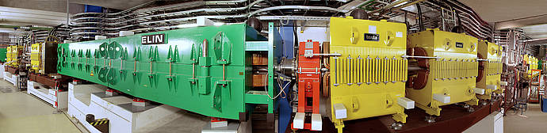
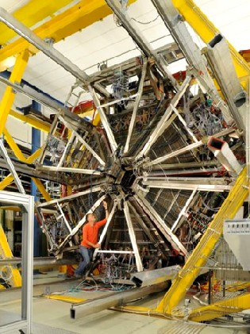
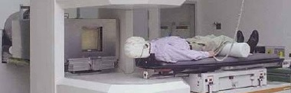

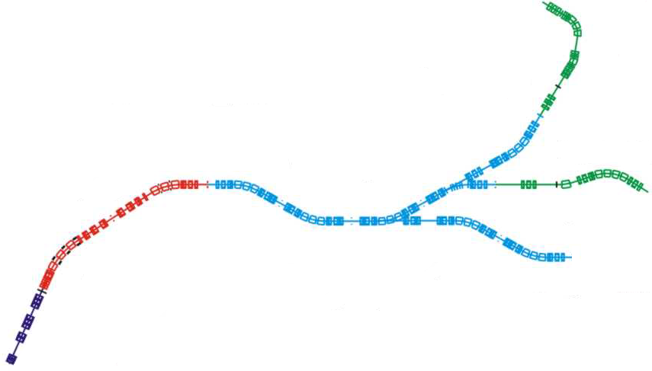
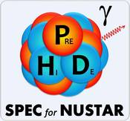



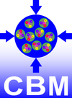


Experiments Requiring
Slow Extraction at GSI and FAIR
Experiments from a wide range of fields
  Hadron physics and strong interactions
  Nuclear and atomic physics
  Material sciences and biophysics
Fixed target experiments
  Primary beams from protons to Uranium
  Frequently rate limited by detection systems
  Typically extraction times of a few seconds
Secondary beam production
  Standard for FRS and Super-FRS
  Also applied for HADES and CBM
  Requires highest intensities of primary beams
High intensity slow extraction for FAIR
  Major challenge for machine protection in SIS100
  Electrostatic septa operated at their limits
Fragment Separator FRS
HADES Detector
Medical Physics Cave
Talk on Tuesday
BIOMAT

Slide 7
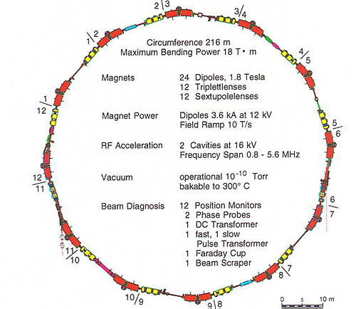
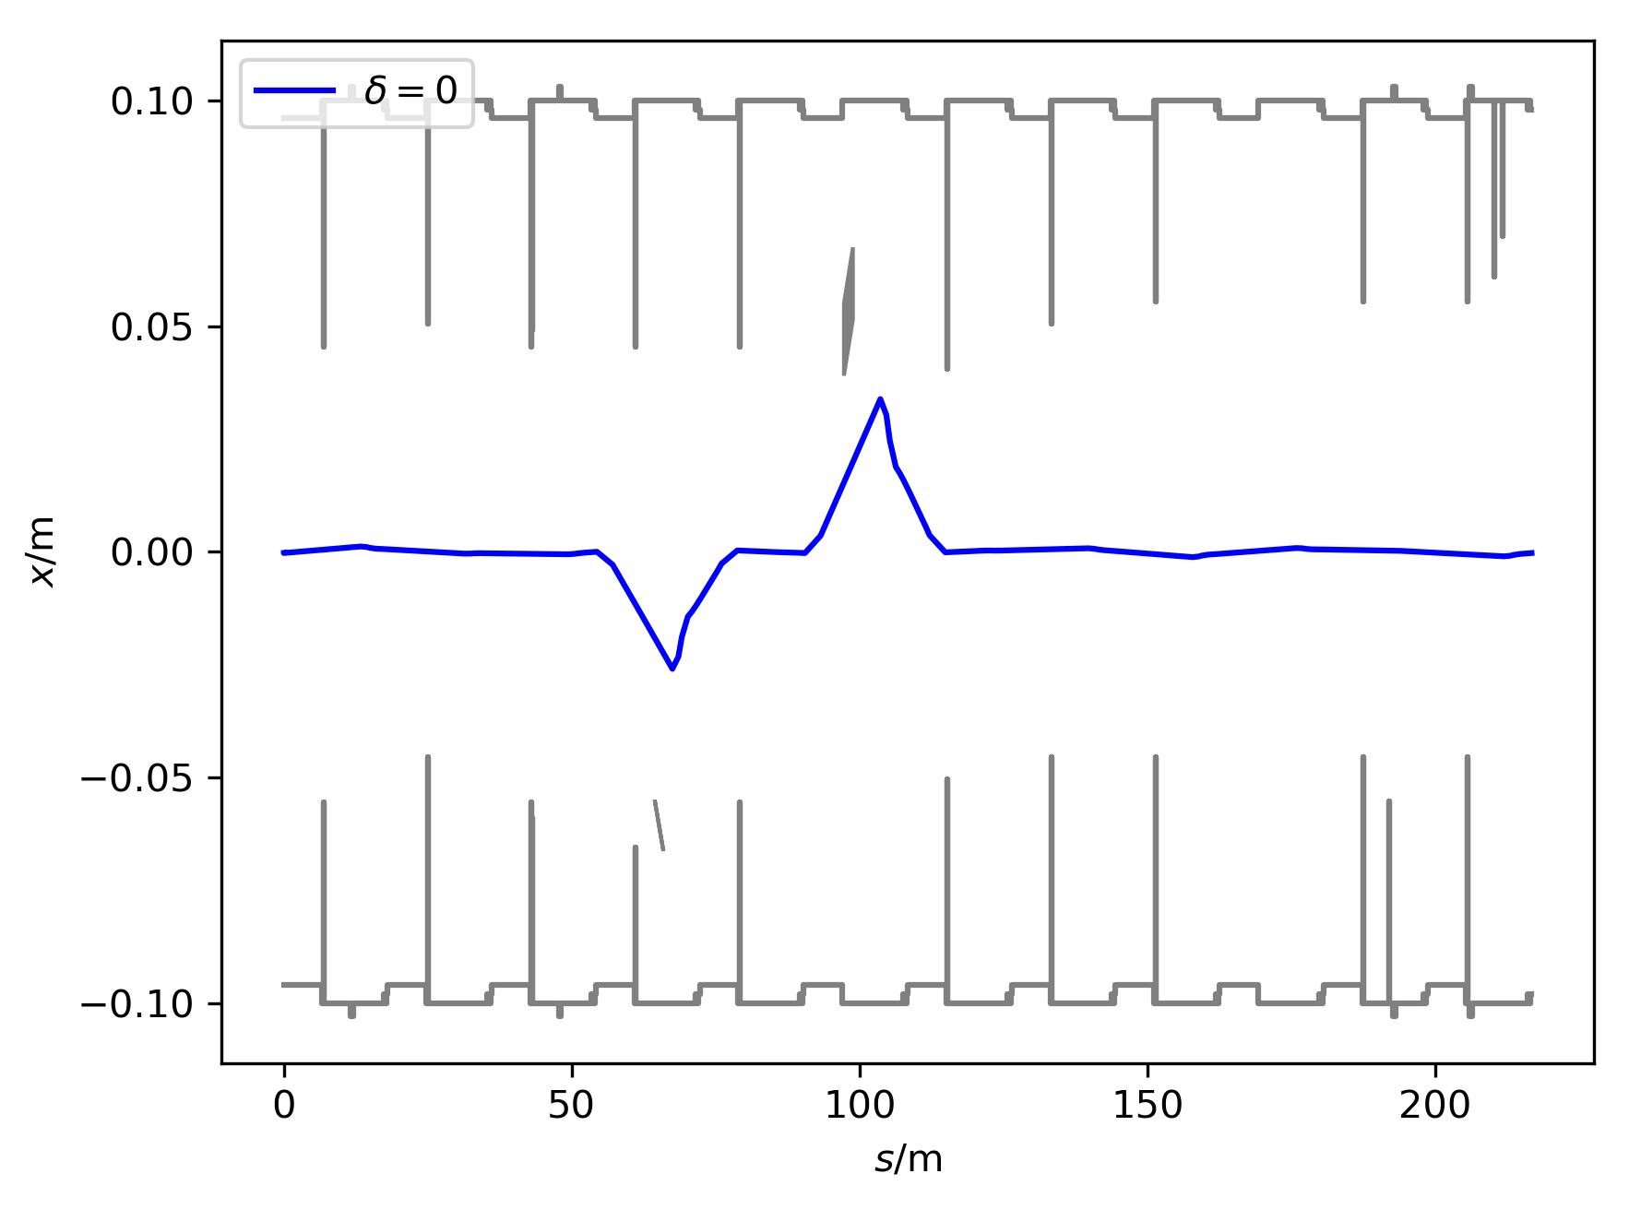
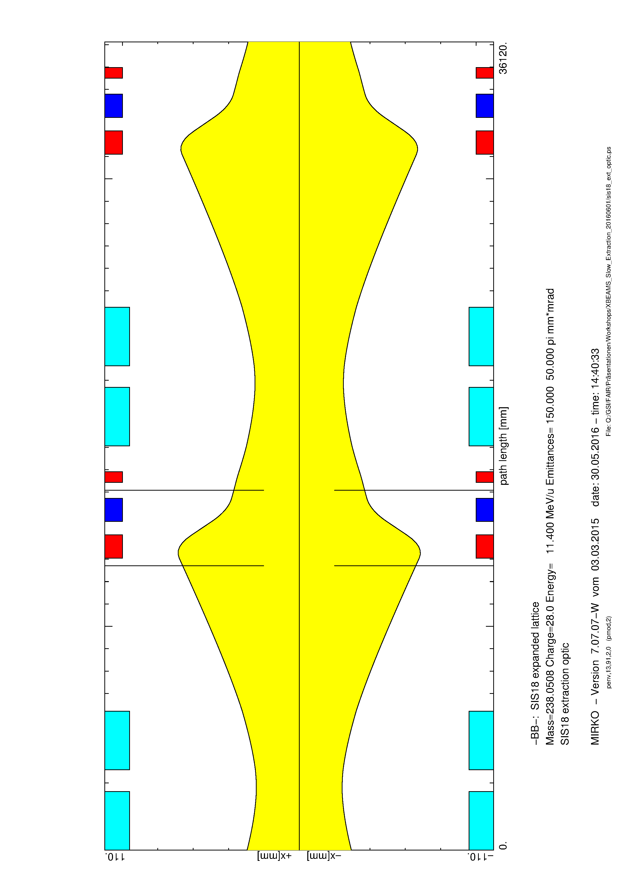
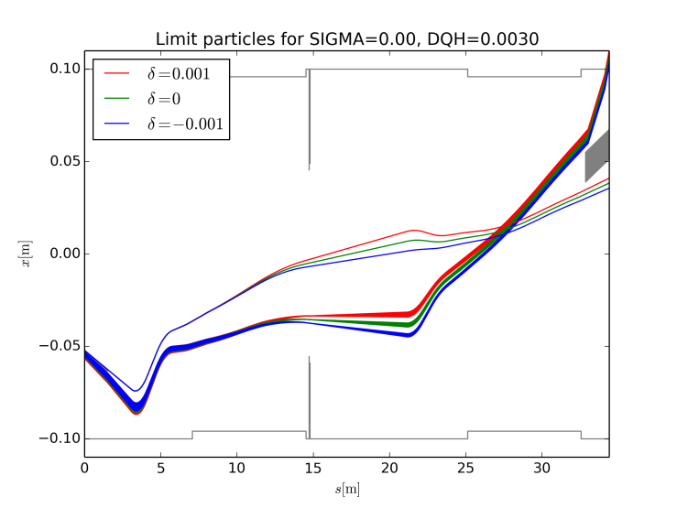
SIS18: SX Overview
Third-order resonant extraction
  Resonance excitation by six sextupoles
  Chromaticity correction optional
  Independent orbit bumps at ES and MS
Standard extraction modes
  Quadrupole-driven extraction
  Transverse RF KO extraction
  Both DC and bunched beams
Extraction devices
  Fast quadrupole pair for quad-driven SX
  ES: 100μm W/Rh wires, 160kV @ 18mm gap
  Horizontal exciter for KO-SX
SX parameters
Hor. tune | 4.33
Hor. chromaticity | -6
Sextupole amplitude | 0.05 m⁻²
Extraction orbit
MS
ES
Extraction optic: horizontal envelopes
Extraction geometry
Sector 2n-1
Sector 2n
outer side
ES
MS
SX1
SX2
inner side

Slide 8
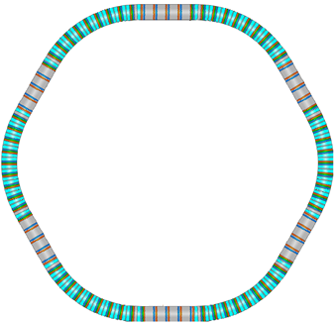
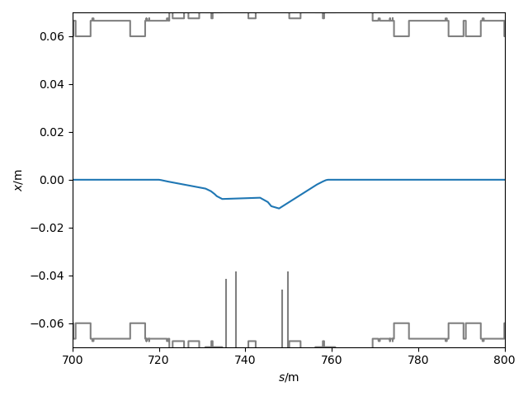
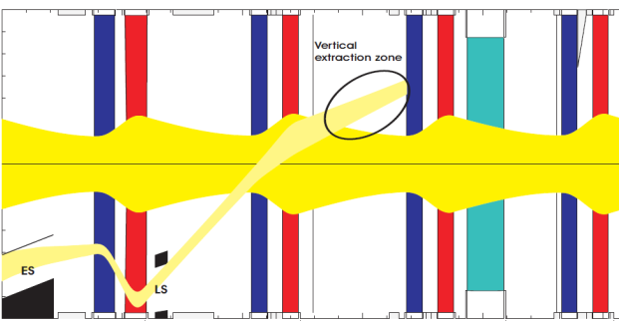
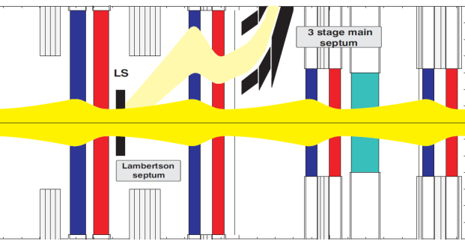
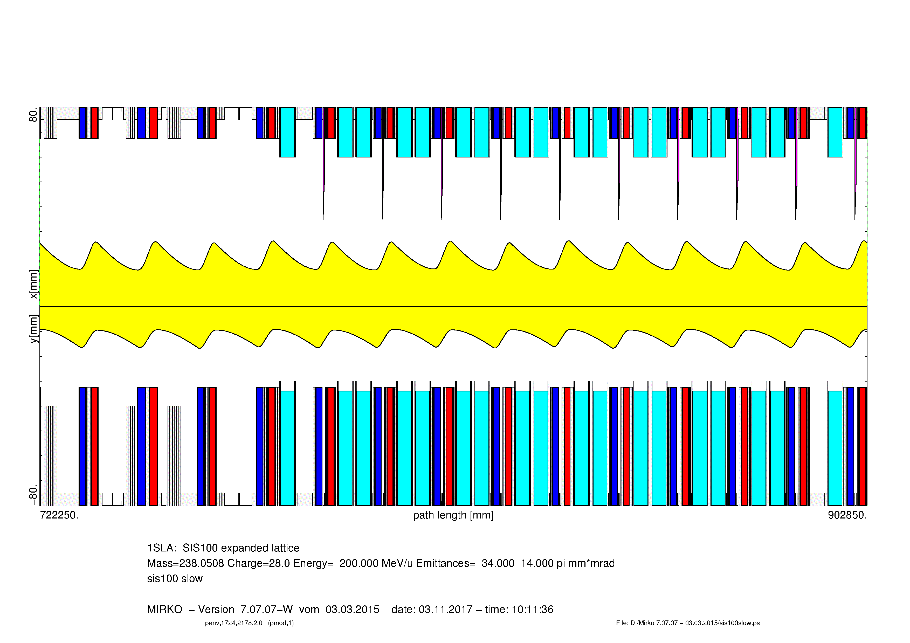
SIS100: SX Overview
Lattice optimized for reference ion U²⁸⁺
  Super-conducting machine for XHV (<10⁻¹² mbar)
  Strong DF focusing for best collimation of U²⁹⁺
  Large tunes (~18) and chromaticities (~ -20)
Third order resonant extraction
  Six NC sextupoles with harmonic distribution
  Chromaticity corrected by 42 SC sextupoles
  Vertical extraction through Lambertson septum
  Single orbit bump at ES/LS
Foreseen extraction modes
  Baseline: transverse RF KO extraction
  Alternative: magnet-driven scheme
  Both DC and bunched beams
Extraction devices
  ES: 100μm W/Rh wires, 180kV @ 20mm gap
  LS: Lambertson septum for vertical deflection
  Horizontal exciter for KO-SX
SX parameters
Hor. tune | 17.33
Hor. chromaticity | -1 (-20)
Sextupole amplitude | 0.5 m⁻²
Magnetic rigidity | 100 Tm
Periodicity | 6 sectors x 14 cells
Circumference | 1083m (= 5 x SIS18)
Ramp rate | 2.5 T/s
RF voltage | 280 kV
Mostly super-ferric magnets
Extraction orbit
MS+LX
ES
LS
Extraction channel (H)
Extraction channel (V)
MS
LX
LX
Slow extraction optic: envelopes
SR
SV
SH
SV
SH
SH
SV
SH

Slide 9
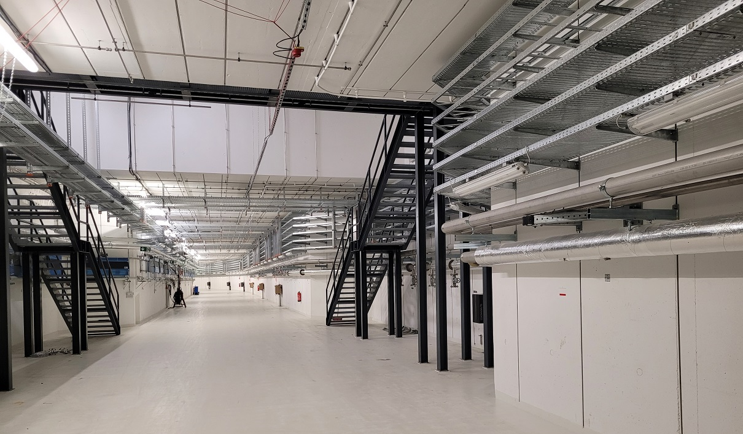
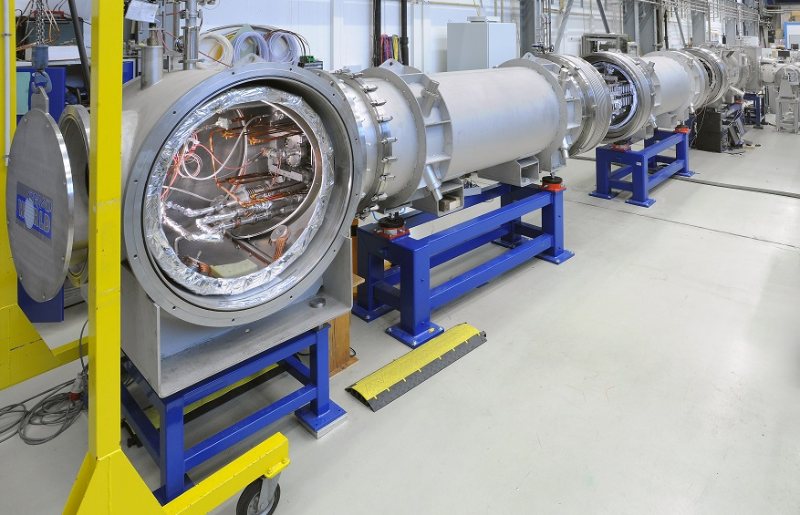
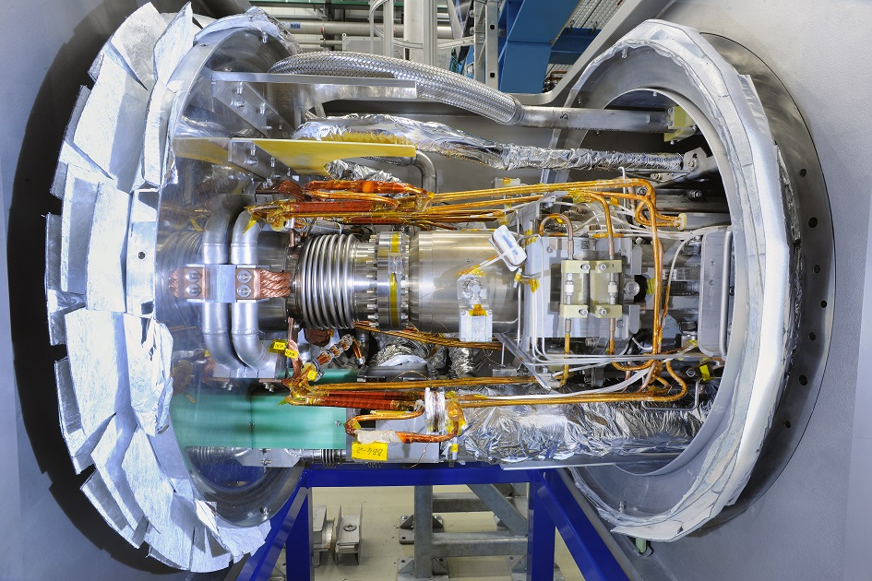
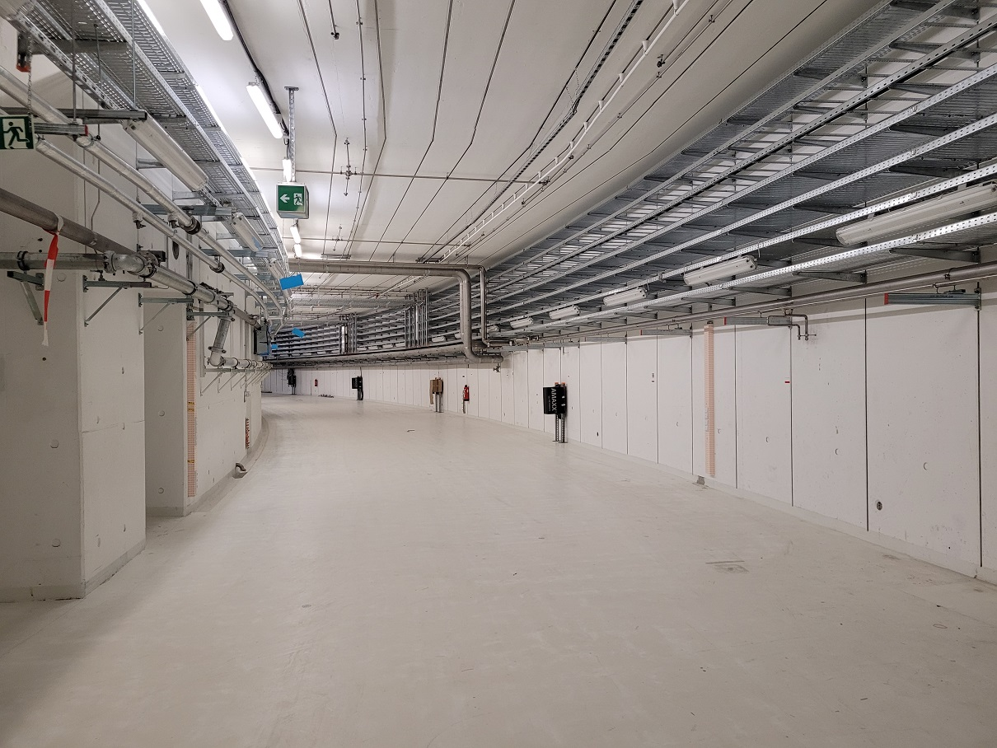
SIS100: Installation coming soon…
Magnet string test
at serial test facility
Components waiting to be installed
Acceleration
cavities
Dipole
modules

Slide 10
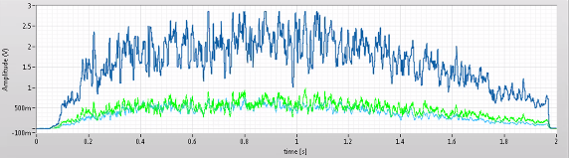
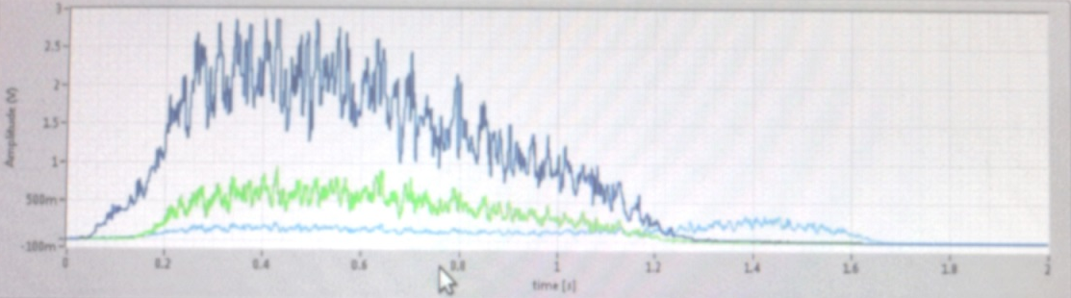
Highlight: SX of Dual Isotope Beam
Mixed carbon/helium beam for ion therapy
  Final goal: online-monitoring of applied dose
    Carbon stopped in tumor, helium exiting patient
  Requires beam with constant mixing ratio
Delivery of mixed ¹²C/⁴He beam from SIS18
  Achieved for the first time world-wide in Nov. 2023
  KO SX with reduced chromaticity used, sufficiently insensitive to mass difference of 6∙10⁻⁴
  Quad-driven SX with natural chromaticity actually separates the two isotopes!
Distribution of isotopes over KO-SX spill
Distribution of isotopes over quad-SX spill

Slide 11
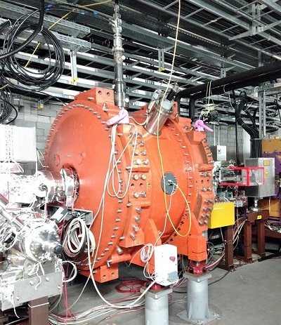
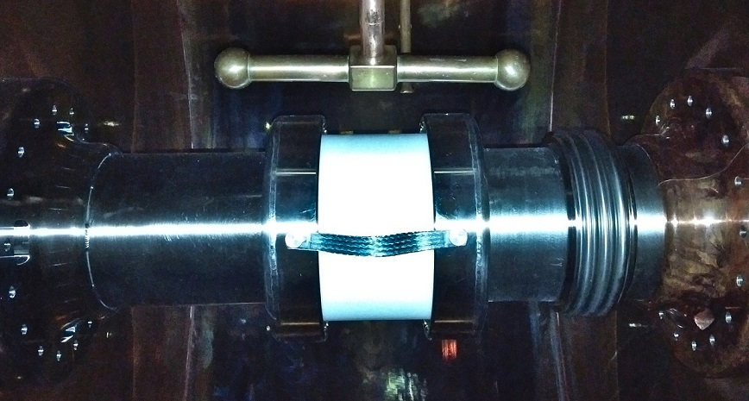
The Big Challenge:
Spill Structure
Top priority for many experiments using SX
  Potential gain of factors in statistics
    Optimized duty-cycle through rectangular spill-shape
    Suppression of spill-ripple at the kHz scale
Significant progress in recent years
  Micro-structure improvements for quad-driven SX
    Smoothing by transit time spread (weak sextupoles)
    Smoothing by bunching at low harmonics
    Smoothing by tune modulation at few kHz
  Backed by simulation studies
  Transferred to operation where possible
Ongoing efforts to improve further
  Many activities embedded in I-FAST.REX
  Exciting new results
Selection of recent publications on spill micro-structure
Study on spill quality and transit times for slow extraction from SIS18 | J. Yang et al. | IPAC 2023
Spill ripple mitigation by bunched beam extraction with high frequency synchrotron motion | S. Sorge et al. | PRAB 26 (2023)
Transverse Excitation and Applications for Beam Control | P. Niedermayer et al. | IPAC 2022
Improvement of Spill Quality for Slowly Extracted Ions at GSI-SIS18 via Transverse Emittance Exchange | J. Yang et al. | IPAC 2022
Sub-ns Single-Particle Spill Characterization for Slow Extraction | T. Milosic et al. | IBIC 2021
Beam Characterization of Slow Extraction Measurement at GSI-SIS18 for Transverse Emittance Exchange Experiments | J. Yang et al | IBIC 2021
Reducing Fluctuations in Slow-Extraction Beam Spill Using Transit-Time-Dependent Tune Modulation | R. Singh et al. | PRA 14 (2020)
Slow Extraction Spill Characterization From Micro to Milli-Second Scale | R. Singh et al. | IPAC 2018
Measurements and Simulations of the Spill Quality of Slowly Extracted Beams from the SIS-18 Synchrotron | S. Sorge et al. | IPAC 2018
New 80MHz spill cavity in SIS18
Poster session
SDR for KO spill feedback at SIS18
Talks on Mon and Wed
Courtesy K. Groß, GSI
Courtesy R. Singh, GSI

Slide 12
Presentations at the Workshop
Category | Title | Presenter | Type
Spill structure | Studies on Spill Micro Structures for SIS100 KO Extraction and Transit Times for SIS18 Tune Sweep Extraction | Stefan Sorge | Talk
 | Knock-out extraction feedback dynamics | Rahul Singh | Talk
 | Tailored excitation signals for RFKO | Philipp Niedermayer | Talk
 | Investigations of transit times for tune scan slow extraction at SIS18 GSI | Jiangyan Yang | Poster
 | A New 80 MHz Cavity in the Heavy Ion Synchrotron SIS18 | Kerstin Groß | Poster
 | The Cryogenic Current Comparator (CCC) for nondestructive spill measurement in the nA range | Thomas Sieber | Talk
Extraction efficiency | SIS100 extraction layout: Influence of non-linear beam dynamics | David Ondreka | Talk
 | Application of numerical optimisers to the particle loss minimization at the SIS18 septum during slow extraction | Olha Kazinova | Talk
Septum protection | Electrostatic septa with heavy ions: challenges for machine protection | Björn Galnander | Talk

Slide 13
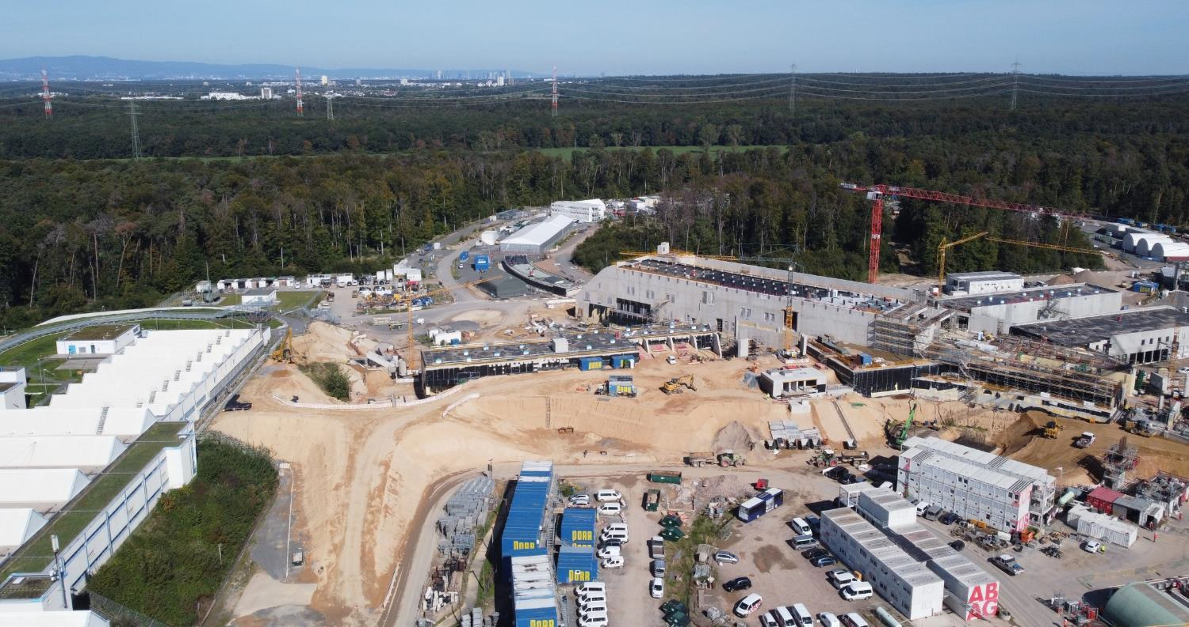
Thanks for your attention!
October 2023
Thanks to all who have contributed and continue to contribute to the success of GSI and FAIR.

Slide 14
TEMPLATE
Whatever

