Slide 1
Knock-out slow extraction spill feedback dynamics at GSI SIS-18
Rahul Singh, Philipp Niedermayer
Slow Extraction Workshop, Wiener Neustadt, 12.02.24
Notes:
1.5h discussion about status of PhD project and future plans
As usual, we will do a hybrid meeting at GSI SB2.2.239b and via Zoom. Please let me know if you are available.
Rahul Singh's Personal Meeting Room
https://gsi-fair.zoom.us/j/5362450666
Meeting ID: 536 245 0666
Passcode: 123456

Slide 2
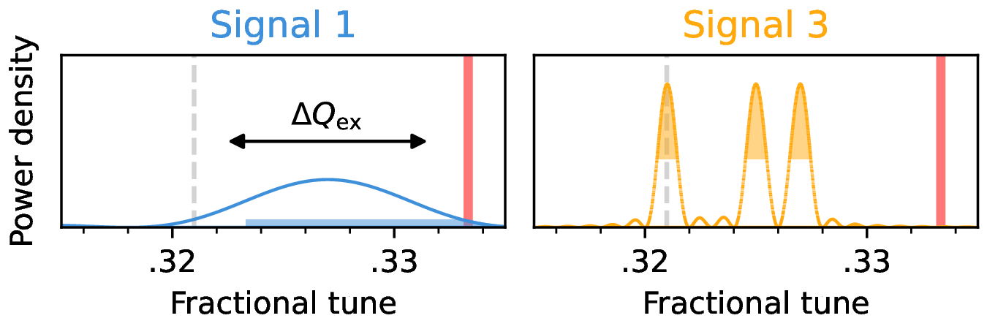
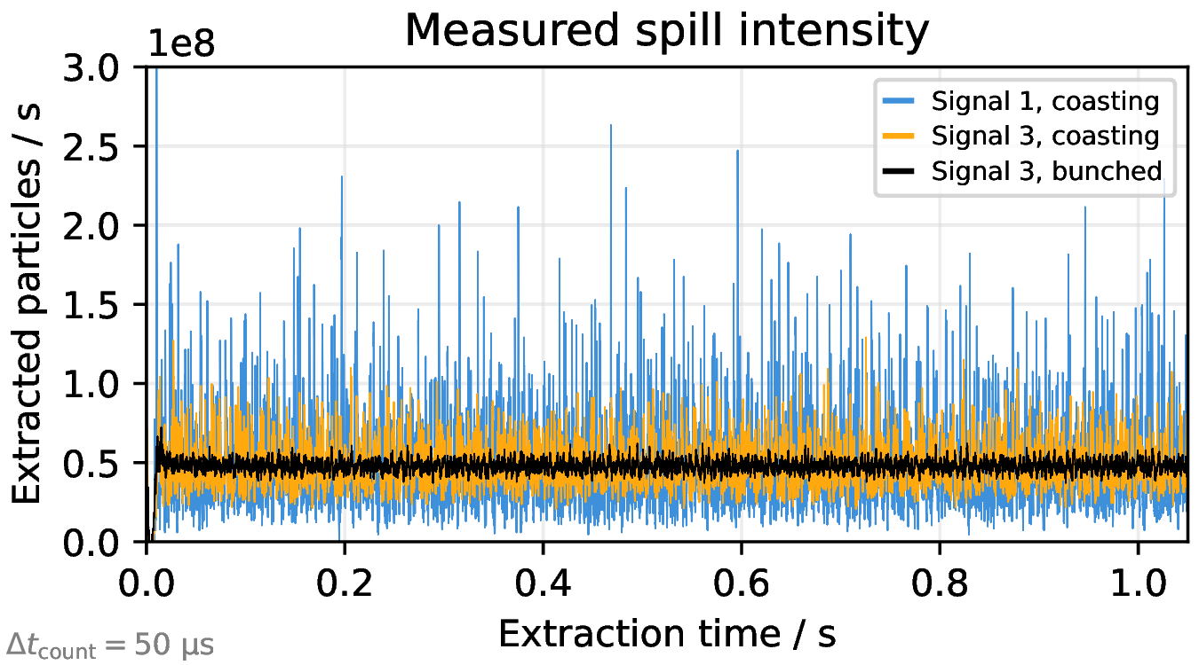
Motivation of spill feedback at GSI
1 wideband RBPSK
3 narrowband RBPSK
PhD project (P. Niedermayer) started two years ago (end of previous slow extraction workshop), one of the goal was finding optimal/flexible waveforms and tool for beam excitation , e.g. tune measurements, KO extraction spill etc.
USRP + GNU Radio SDR framework was selected
Investigations on optimal KO extraction waveform for coasting beams: Tracking simulations followed by experiments at HIT and COSY led to a solution
  → Noise ++ excitation Philipp Niedermayer's talk on Wednesday!
Reasons for KO spill feedback:
  The waveforms suitable for microspill often created undesired macrospill structure. Decoupling from macrospill shape and focus on microspill improvement
  Good experience at HIT with macrospill feedback. Similar extraction settings and hardware at GSI.
  Measurements at HIT
  P. J. Niedermayer et al 2024 J. Phys.: Conf. Ser. 2687 052029

Slide 3
Outline
Layout and first experience with RF KO slow and fast spill feedback systems at GSI SIS-18
Correction bandwidth of the feedback systems
Simulations of KO slow extraction frequency response and feedback
Comparison: Measurements and Simulations
Appetizers: a) Magnet power supply ripples vs excitation signal noise in KO extraction, b) KO extraction with pure sinusoidal excitation

Slide 4
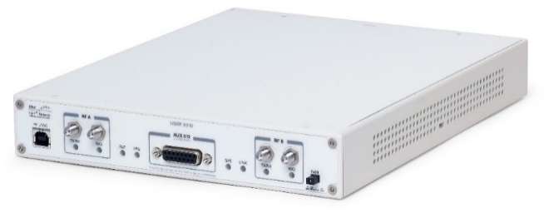
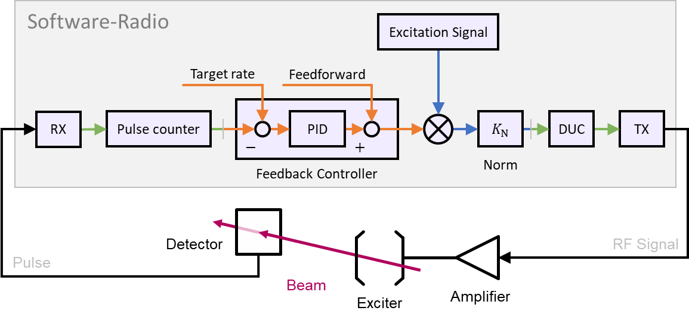
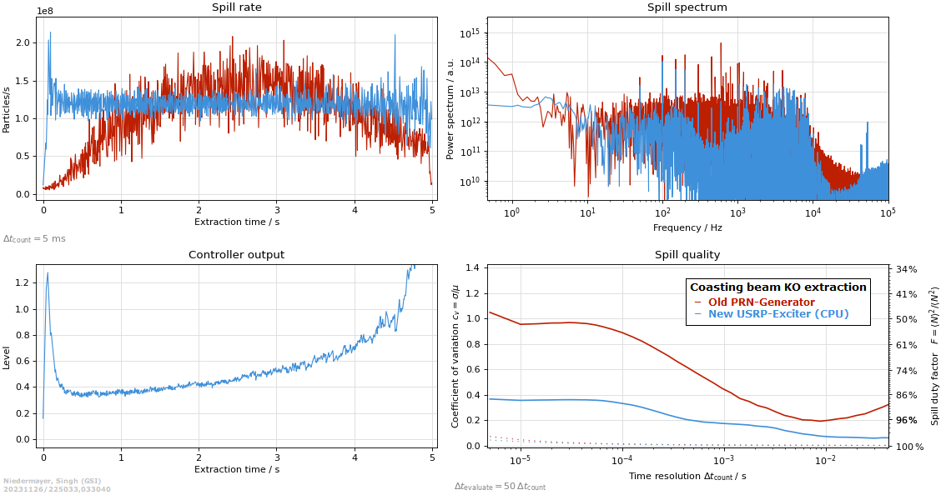
Slow macrospill feedback using generic transceiver+CPU
Ettus USRP X310
200 M Sa/s ADC, 0-6 GHz
KO extraction : Beam is excited/heated out of stable phase space
Amplitude of excitation signal is controlled by a PID tuner in response of measured rate for a flat macrospill
Pulse counter implemented in the FPGA, Feedback logic and excitation signal generation implemented in the CPU. Loop latency minimized to ~ 1 ms
+ Industrial PC
Detectors tested :
Ionisation Chamber
SEM Grid
Plastic Scintillator
LGAD HADES Detector
BLM at E-Septum
Microspill improvement
Macrospill improvement
Recent measurements at GSI (Nov 23)

Slide 5
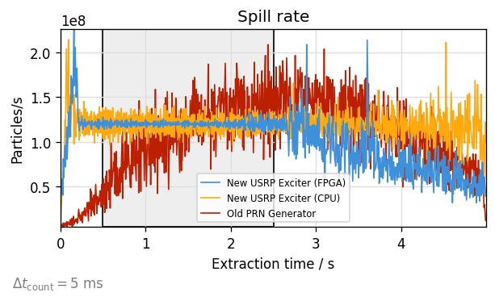
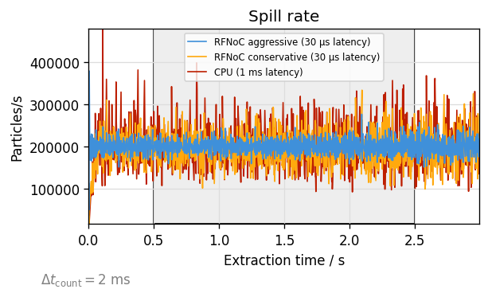
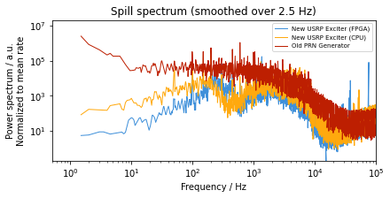
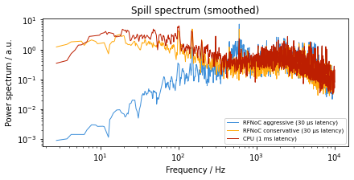
Fast macrospill feedback with RFNoC (FPGA)
FPGA-based feedback for improved robustness and low loop latency
Intense exchange with experts (GRCon23)
  Optimized parameters (buffers, package sizes, …) ~ 30 µs latency achieved
  Pre-recorded excitation signal played back from FPGA (replay block)
Replay block
Old PRN Exciter (no feedback)
CPU Feedback with high latency control parameters
FPGA feedback with low latency control parameters
N7+, 500 MeV/u , 25.11.23
CPU based Feedback
FPGA Feedback with high latency control parameters
FPGA feedback with low latency control parameters
U73+, 200 MeV/u , 10.12.23
~300 Hz correction bandwidth
Recent measurements at GSI

Slide 6
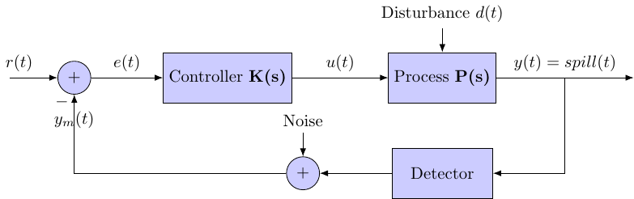
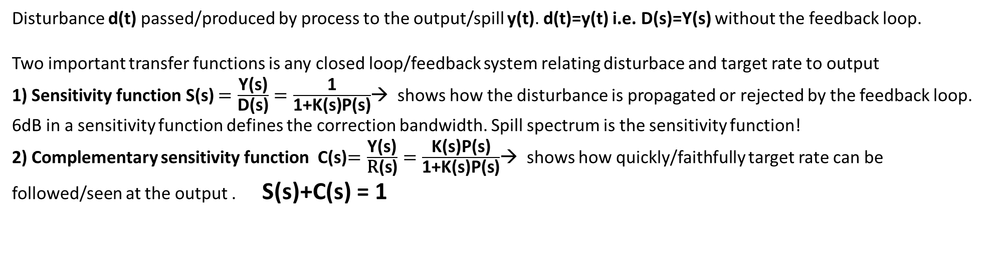
Feedback system characteristics
Controller
Process
s is the laplace variable (can be thought is frequency).
Disturbance d(t) passed/produced by process to the output/spill y(t). d(t)=y(t) i.e. D(s)=Y(s) without the feedback loop.
Two important transfer functions is any closed loop/feedback system relating disturbace and target rate to output
1) Sensitivity function S(s) $=\frac{\text{Y}\text{(}\text{s}\text{)}}{\text{D}\text{(}\text{s}\text{)}}=\frac{\text{1}}{\text{1+}\text{K}\text{(}\text{s}\text{)}\text{P}\text{(}\text{s}\text{)}}$→ shows how the disturbance is propagated or rejected by the feedback loop. 6dB in a sensitivity function defines the correction bandwidth. Spill spectrum is the sensitivity function!
2) Complementary sensitivity function C(s)$=\frac{\text{Y}\text{(}\text{s}\text{)}}{\text{R}\text{(}\text{s}\text{)}}=\frac{\text{K}\text{(}\text{s}\text{)}\text{P}\text{(}\text{s}\text{)}}{\text{1+}\text{K}\text{(}\text{s}\text{)}\text{P}\text{(}\text{s}\text{)}}$→ shows how quickly/faithfully target rate can be followed/seen at the output . S(s)+C(s) = 1

Slide 7
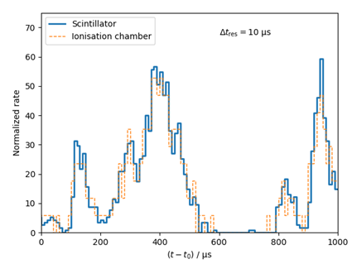
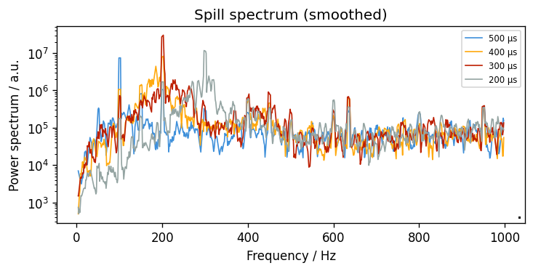
Correction bandwidth of the feedback system
What limits the correction bandwidth ?
Controller delay/latency ~30 us – Should it be reduced further?
Detector delay -- 100 m transit from septum to detector + few ns PMT delay and 200 m cables to DAQ. Altogether < 5 us
KO Slow Extraction process response?
Spill spectrum a direct measure sensitivity function
measurements with N⁷⁺ 500 MeV/u
Idea: Modulate the exciter kick amplitude at various frequencies and measure spill oscillation amplitude and phase w.r.t kick
→ Should provide process "DC" gain, delay and frequency response

Slide 8
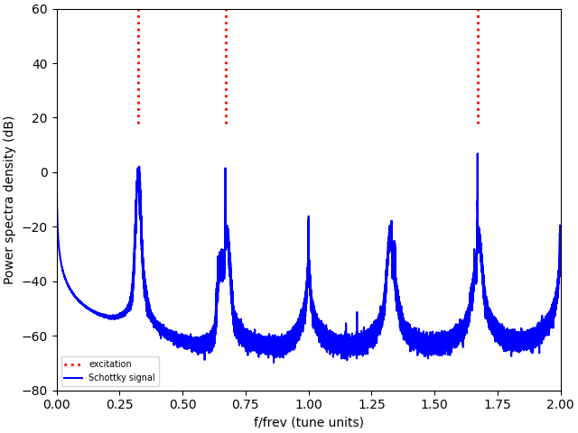
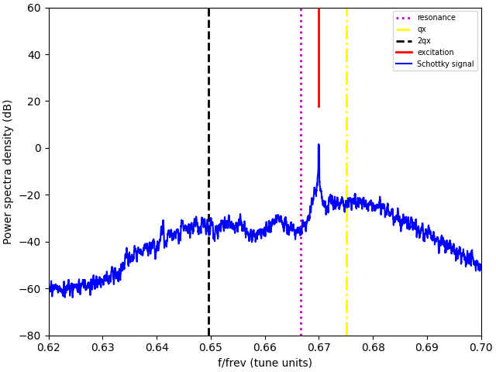
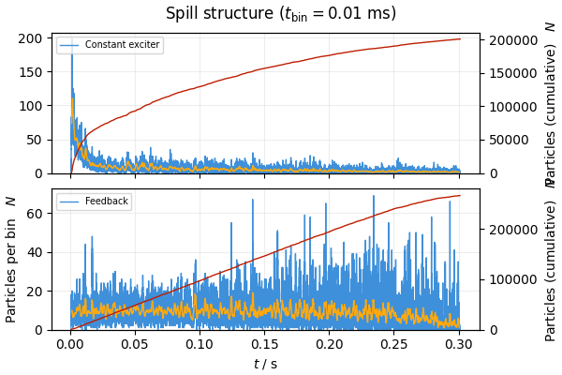
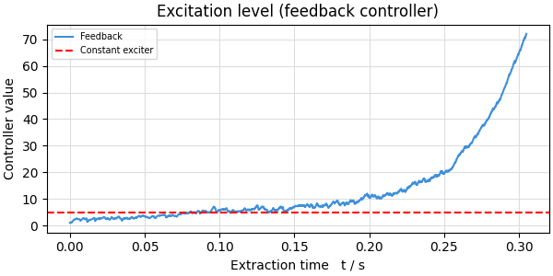
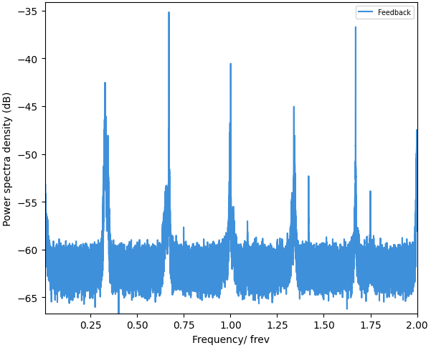
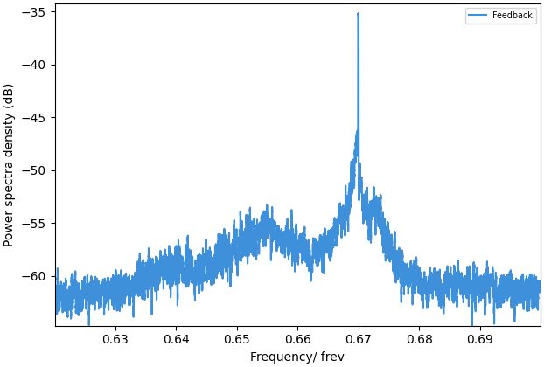

Simulations of KO frequency response
Methodology : Xsuite, 0.3 s(320000 turns), 3e5 particles e.g. target rate 1e6/s, machine settings same as a N⁷⁺ 500 MeV/u experiment
, transverse emittances, 1 mm-mrad
Excitation Noise++ (q1=0.325, dq1 = 0.015, q2=0.67, q3=1.671)
Each spill run requires about 40 min using 8 GPUs in parallel
Schottky
Spectrum
$$\frac{∆p}{p}(σ)={1∗10}^{−3}$$
Without feedback
Spill
Spectrum

Slide 9
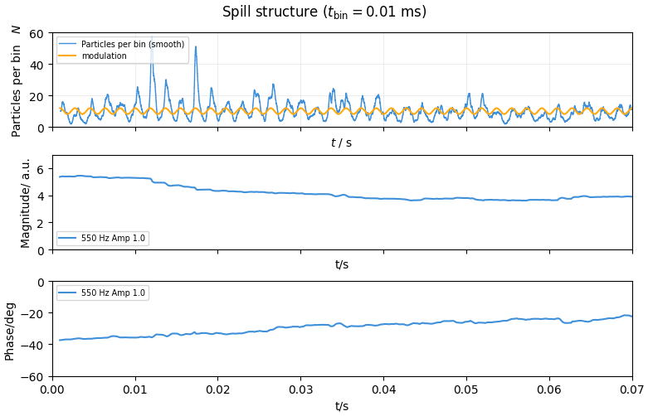
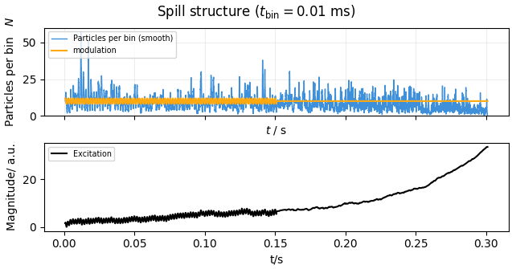
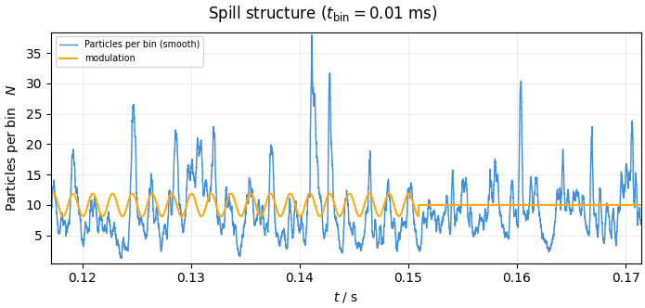
KO frequency response
80 ms sliding calculation window
Response gets faster during the spill
Excitation signal amplitude is modulated for first half (150 ms) of the spill (1 amplitude unit ~ 0.3 urad )
Applied on top of recorded amplitude curve given by the feedback . No feedback during frequency response measurements!
Performed at various frequencies (90 Hz- 5kHz). Magnitude and phase calculated in 80 ms sliding windows.
End of modulation

Slide 10
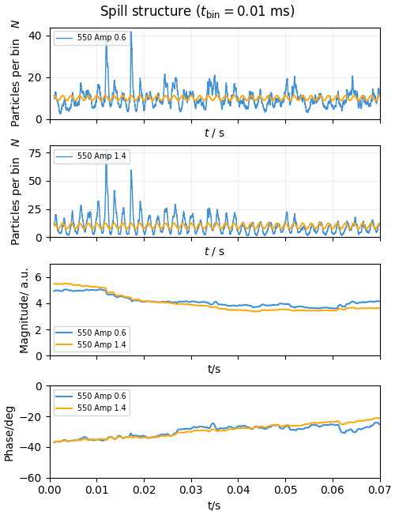
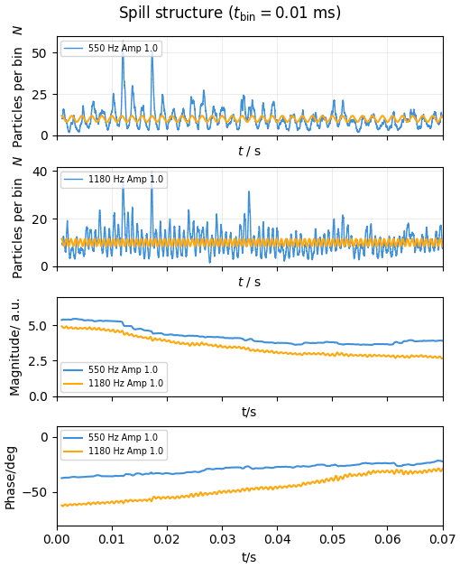
KO frequency response
Magnitude and phase responses for various excitation amplitudes
The frequency response is stable w.r.t to amplitude of excitation in the simulated range , e.g. 60 nrad to 0.5 urad kick amplitudes
Amplitude insensitivity makes the frequency responses comparable to transfer functions in Linear Time Invariant (LTI) systems

Slide 11
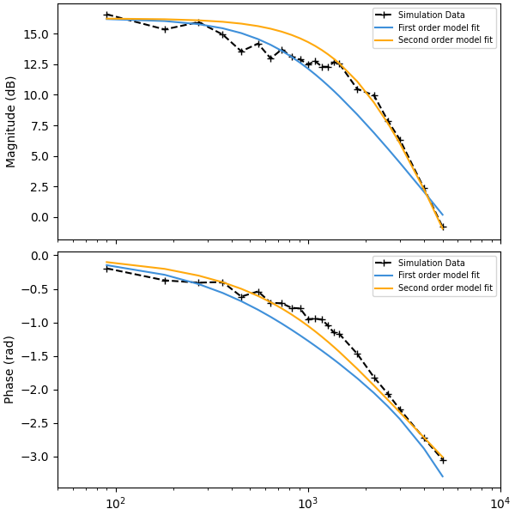
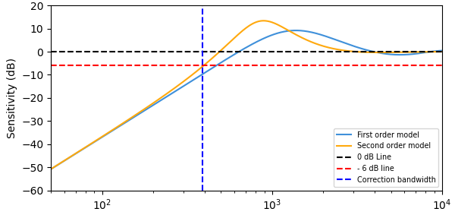
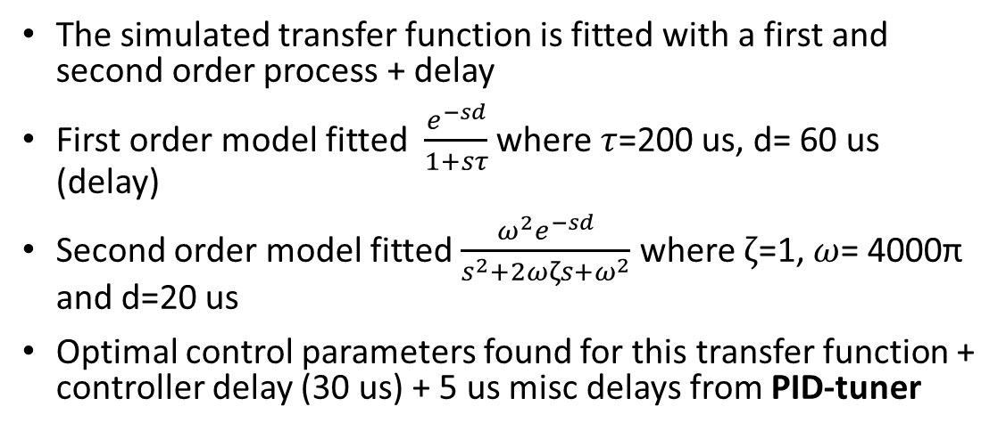
KO transfer function
The simulated transfer function is fitted with a first and second order process + delay
First order model fitted $\frac{e^{−sd}}{1+sτ}$ where $τ$=200 us, d= 60 us (delay)
Second order model fitted $\frac{ω^{2}e^{−sd}}{s^{2}+2ωζs+ω^{2}}$ where $ζ$=1, $ω$= 4000π and d=20 us
Optimal control parameters found for this transfer function + controller delay (30 us) + 5 us misc delays from PID-tuner
390 Hz

Slide 12
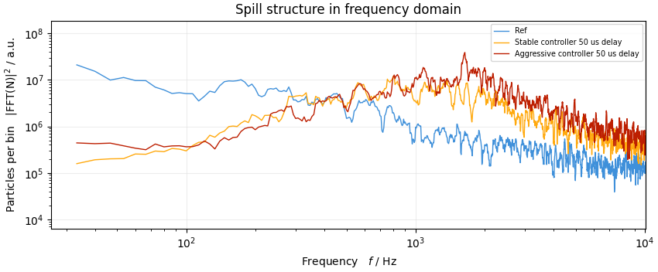
Comparison : Measurement and simulations
Measurements
Simulations
Correction bandwidth for simulated transfer function
Comparable correction bandwidth in simulations and measurements ~ 250-300 Hz for the most aggressive yet stable controller values
The correction bandwidth is given by process transfer function and controller delay. Reducing controller delay further can help!
Results more compatible with a second order model fit
390 Hz

Slide 13
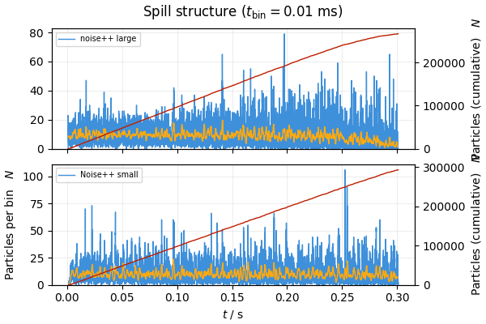
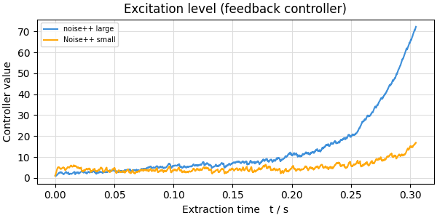
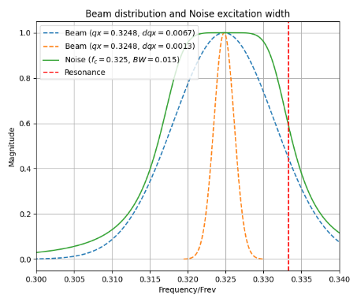
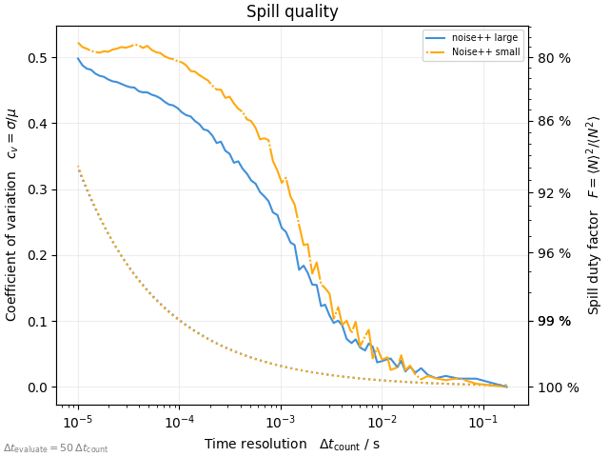


Spill for different beam momentum spreads
$$\frac{∆p}{p}(σ)={1∗10}^{−3}$$
$$\frac{∆p}{p}(σ)={2∗10}^{−4}$$
Beam momentum has a significant impact on the power required for beam extraction for any given excitation settings
Spill quality is comparable for both momentum spreads for same excitation signal and machine settings

Slide 14
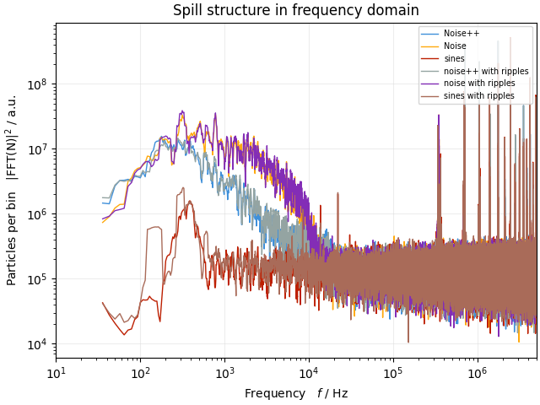
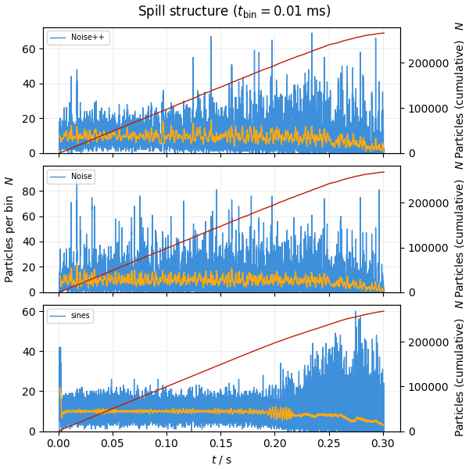
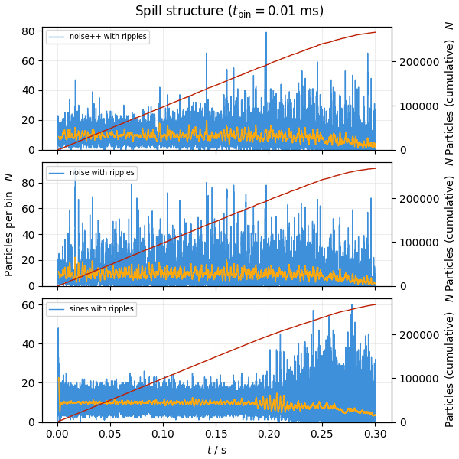
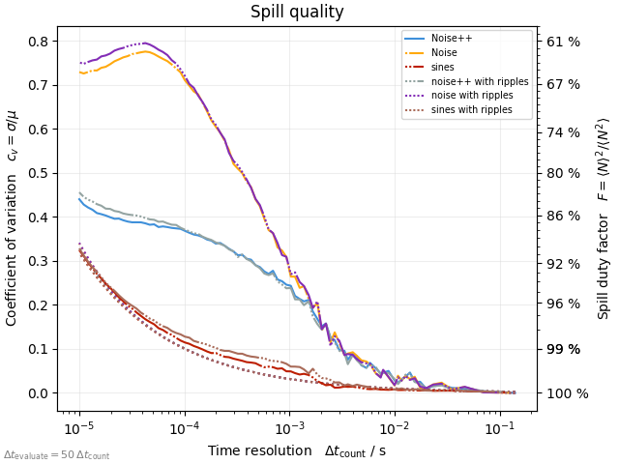
Appetizer: Spill quality and power supply ripples
Beam extraction with three excitation signals → significantly different spill quality
Noise (q1=0.325, dq1 = 0.015),
Noise++ (q1=0.325, dq1 = 0.015, q2=0.67, q3=1.671)
Sines 5 sinusoids [q1:q5]=[0.321,0.677,1.325,1.673,2.329]
Simulations with and without magnet ripples → minimal effect!
Sub-Poissonian until 300 Hz with sines→ more in P. Niedermayer's talk

Slide 15
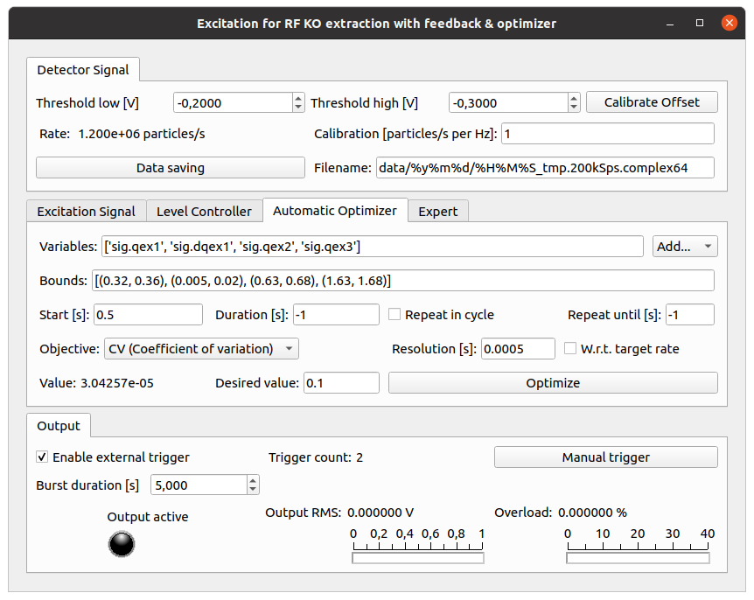
Summary
Two feedbacks (CPU and FPGA based) are implemented to tackle macrospill shape. The correction bandwidth of 300 Hz observed → determined by transfer function and controller delay.
KO transfer function is given by beam, machine parameters, e.g. bunching and perhaps excitation parameters → still needs a systematic study
The feedback system are based on commercial Ettus/NI USRP hardware and can be easily integrated into any facility. The code is published https://git.gsi.de/p.niedermayer/exciter
Coasting beam: Recent HADES experiment run!
Thank you for attention!

Slide 16
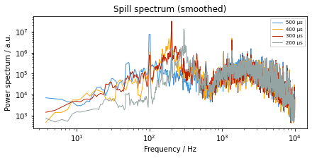
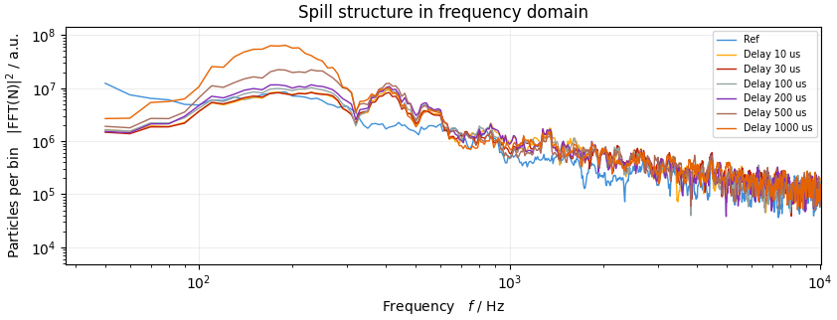
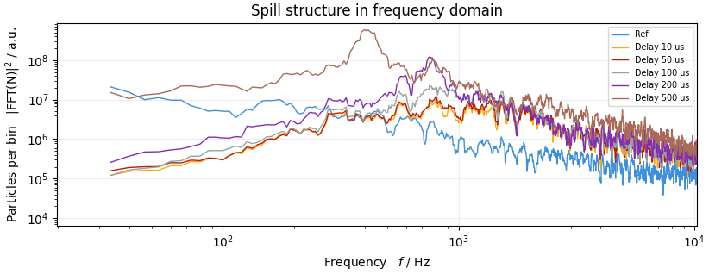
Comparison : Effect of delay
Weak controller settings with delay
Measurements: Delay or deadtime was introduced in the feedback loop. Parameters were optimized until instability observed
Simulations: Optimal controller parameters found for low delay and loop delay increased progressively → unstable feedback loop
Aggressive controller settings with delay

