Slide 1
Beam ripple studies at MedAustron
Florian Kühteubl 5th Slow Extraction Workshop 12.02.2024

Slide 2
MOTIVATION & METHODS
Ripples are important for clinical treatment
Constant particle flux required
Intensity ripples slow down treatment
Safety aspects
Good understanding of ripples & ripple mitigation is needed for optimised machine performance
Ripple measurements
Quality Intensity Monitor (QIM)
Detector provided by CIVIDEC© with high sampling rate
Ripple transfer function measurement
 | QIM | CIVIDEC
Position | HEBT | Isocenter
Sampling rate | 25 kS/s | 78 MS/s

Slide 3
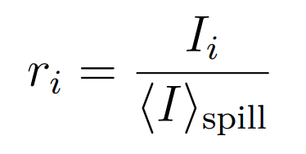
Beam quality Parameter
See talk „IFAST-REX Slow Extraction Survey” from this morning!
Peak to mean ratio r: Intensity divided by mean intensity of the spill
Ripple factor RF: Windows of 10ms Ratio of maximum and mean intensity in each window
Duty factor DF: Windows of 10ms Mean value and standard deviation
Amplitude of 4 kHz ripple

Slide 4
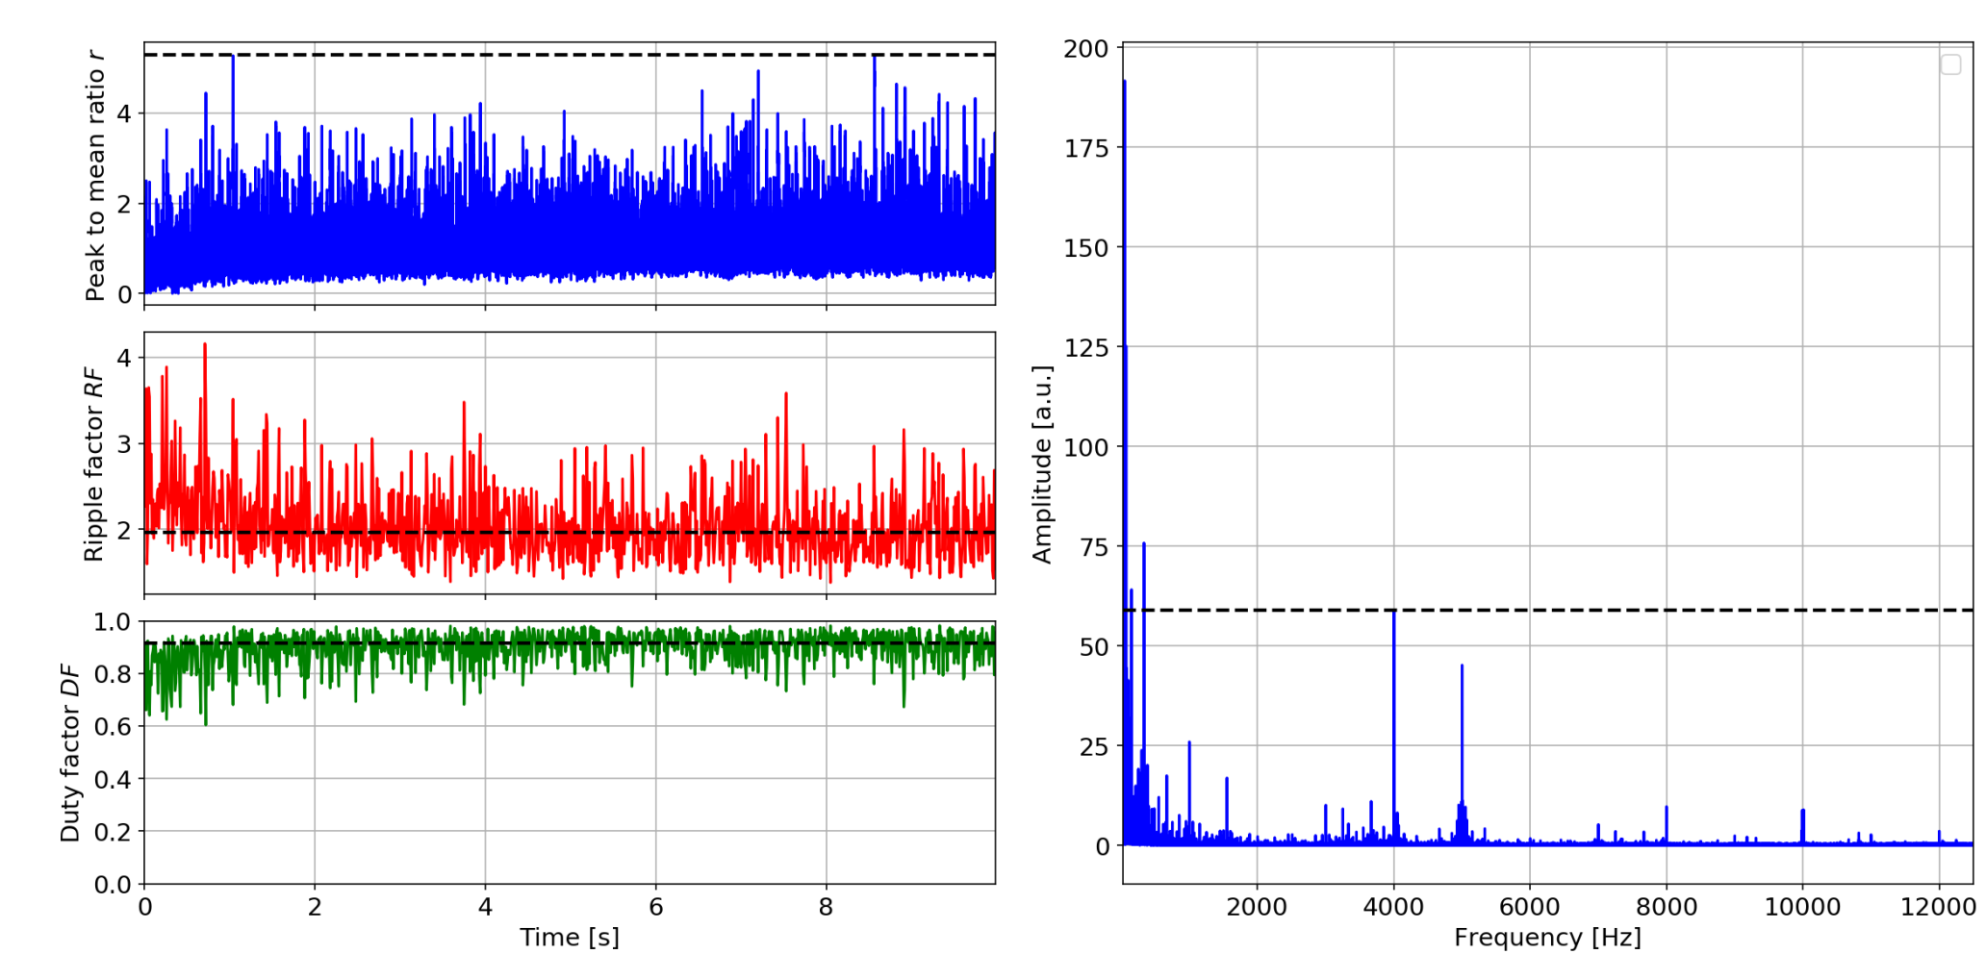
Beam quality at MedAustron
Proton, 252.7 MeV, 10s, EBC

Slide 5
Ripple structure at MedAustron Low frequency
Proton, 252.7 MeV, 10s, no ripple mitigation

Slide 6
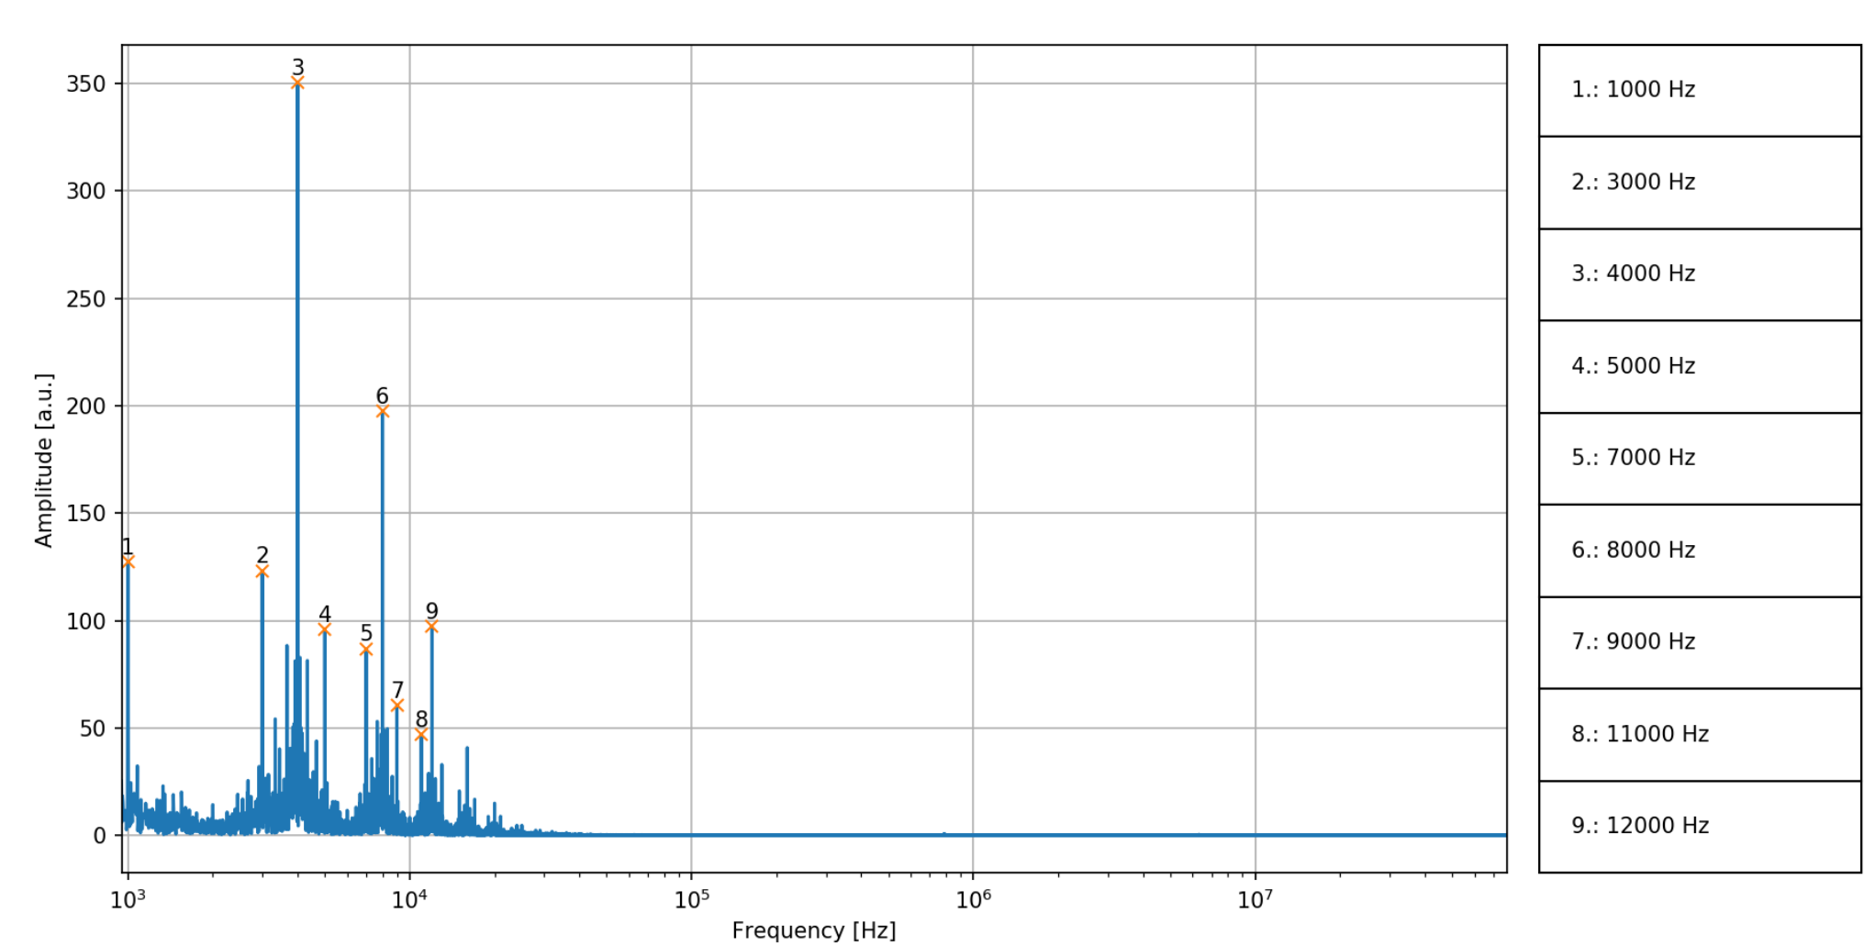
Ripple structure at MedAustron High frequency
Proton, 252.7 MeV, 10s, no ripple mitigation
Data taken with CIVIDEC© detector

Slide 7
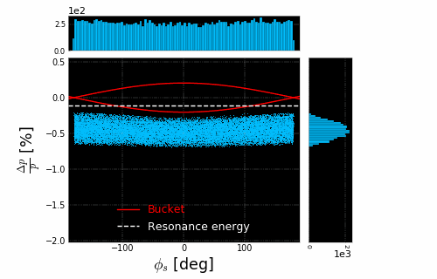
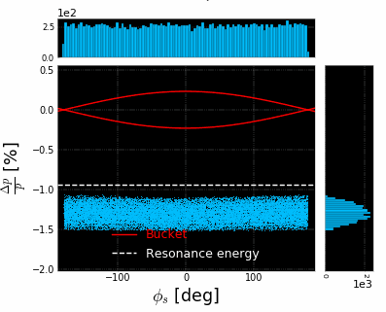
Ripple Mitigation: Empty Bucket Channeling
Channeling
„Tune Wobbling“
Simulation with BLonD by Fabien Plassard

Slide 8
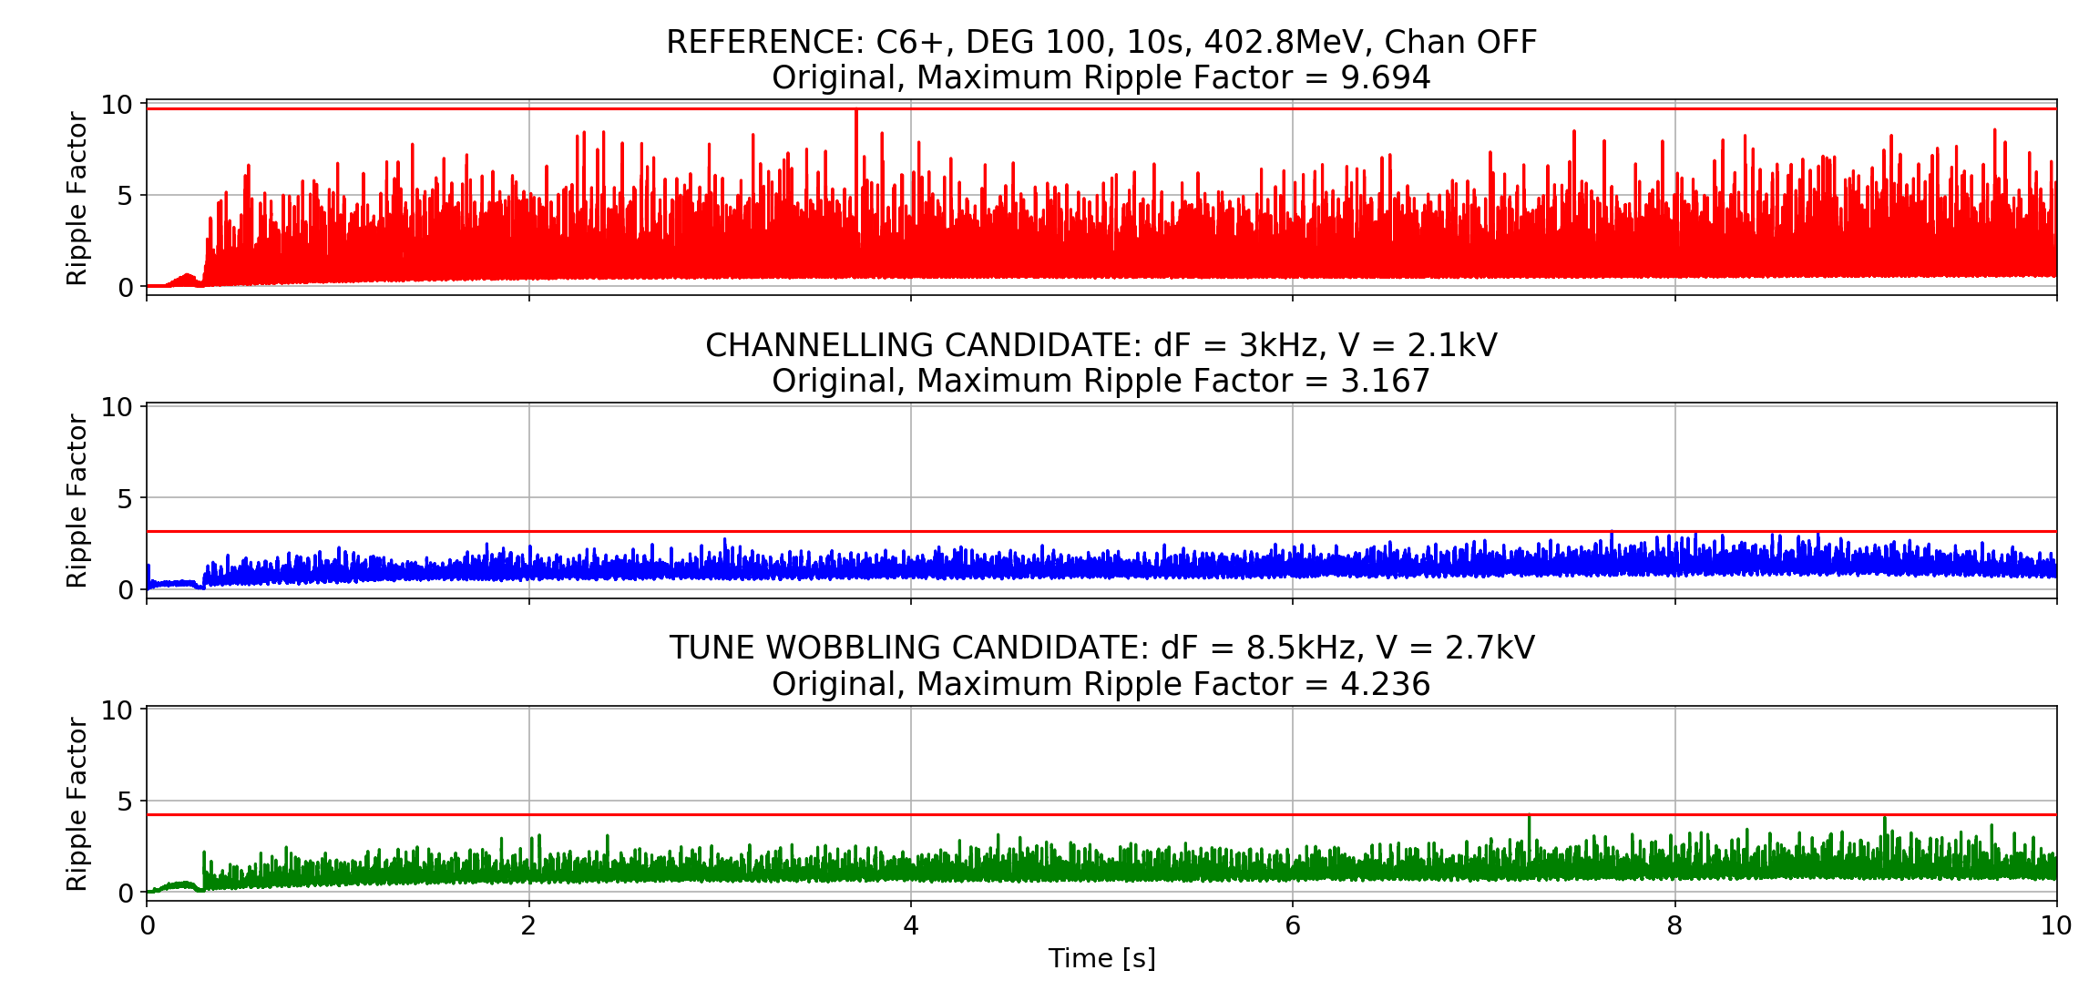
Ripple Mitigation: Empty Bucket Channeling

Slide 9
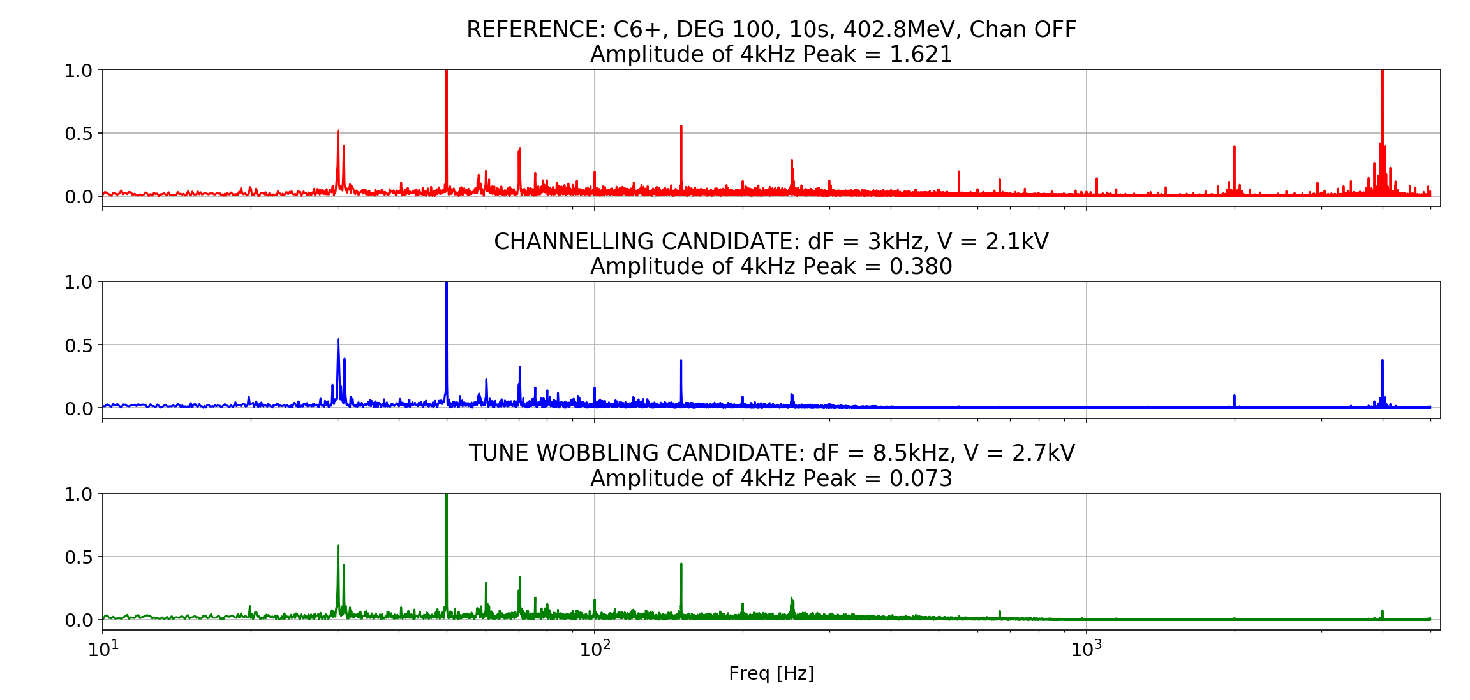
Ripple Mitigation: Empty Bucket Channeling

Slide 10
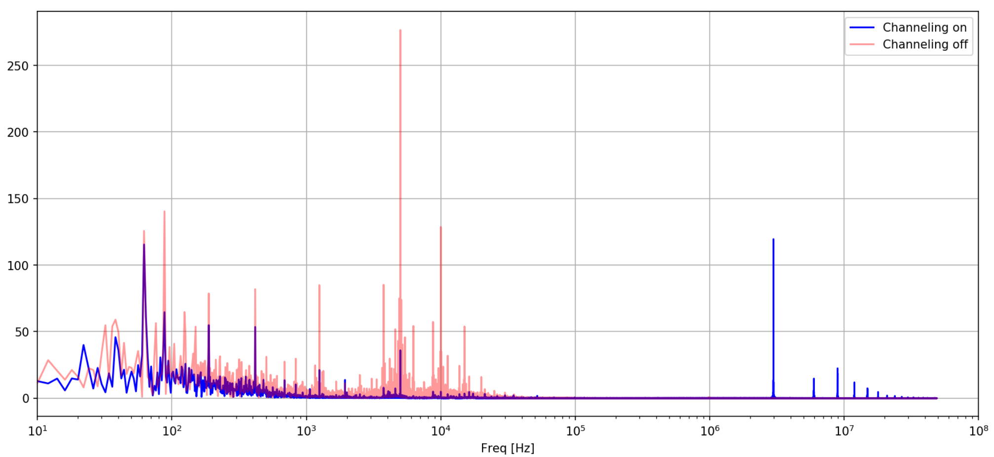
Ripple Mitigation: Empty Bucket Channeling
Data taken with CIVIDEC© detector

Slide 11
RF Knockout (unbunched FM)
Modulation frequency = 100 Hz Data taken with QIM
Dual FM

Slide 12
RF Knockout Beam quality for unbunched FM

Slide 13
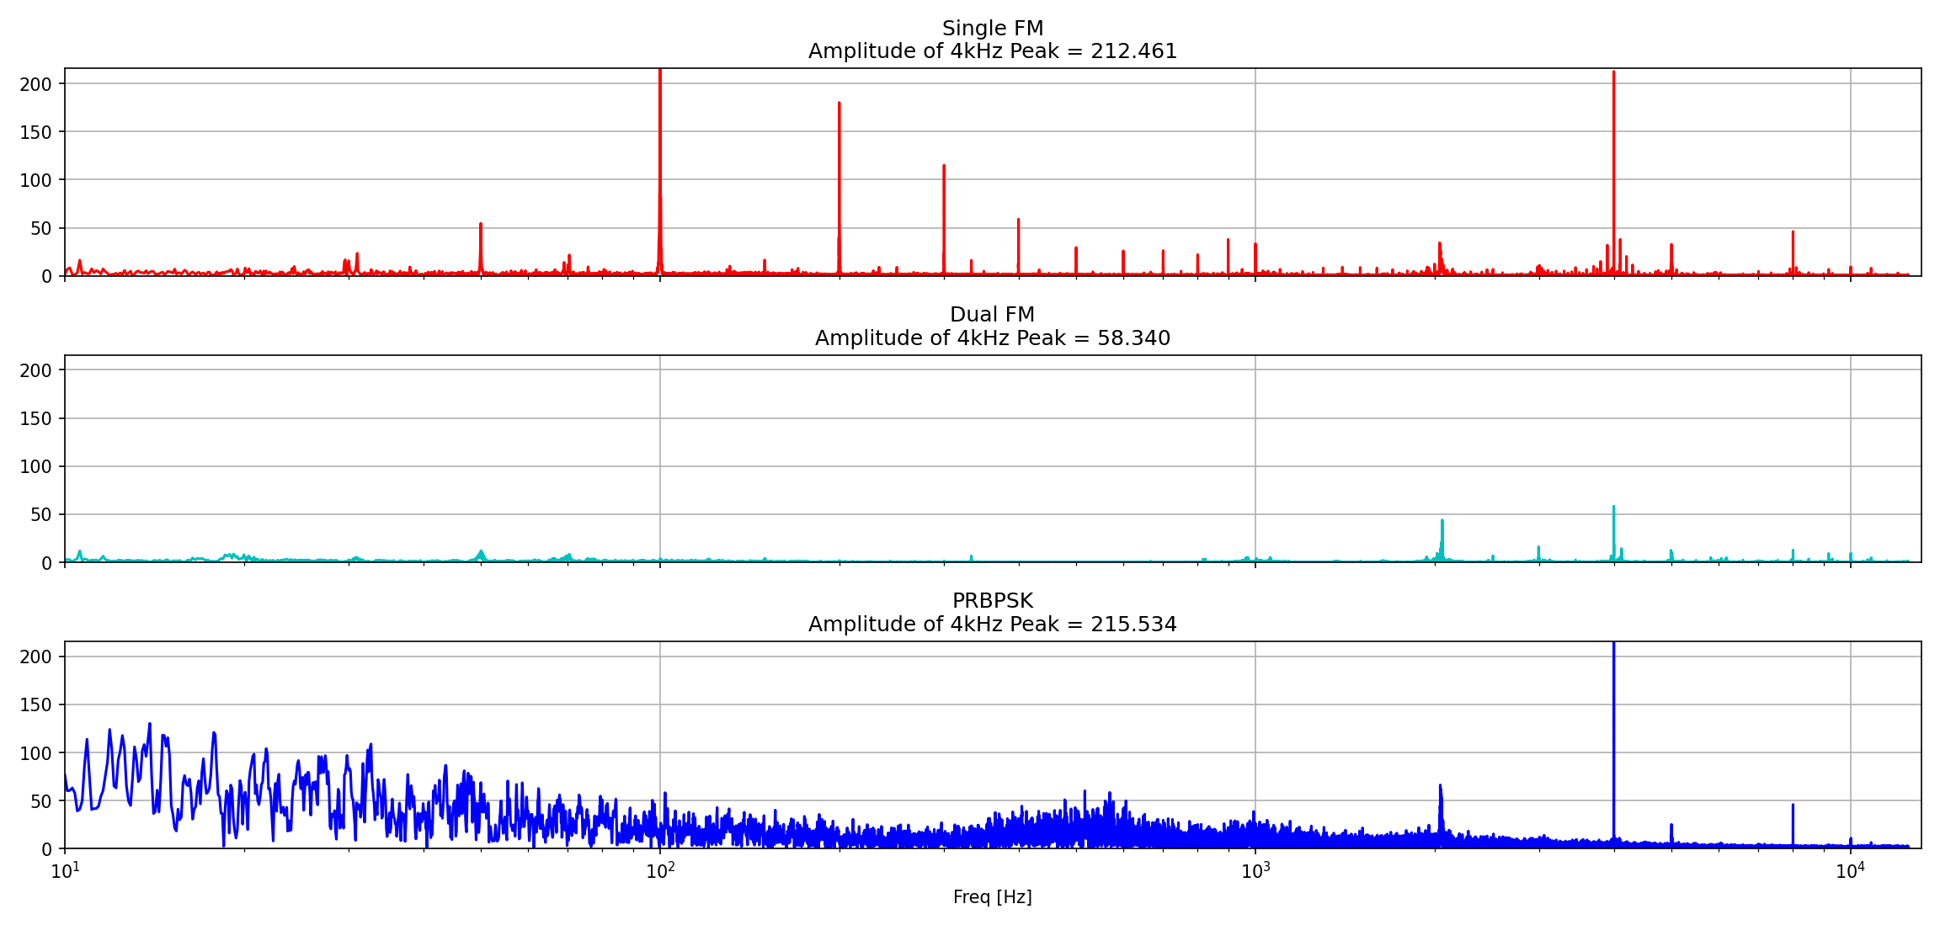
RF KNOckout Excitation pattern

Slide 14
RF Knockout (bunched PRBPSK)
Random phase shifts by $π$ Data taken with QIM

Slide 15
Constant optics slow extraction
Further optimisation ongoing!
Magnet ramp by -0.4% Data taken with QIM
Intensity drift to be compensated!

Slide 16
Phase displacement extraction
Further optimisation ongoing!
Frequency ramp from 3.5 kHz to 0 Hz, $V_{Bucket}=500 V$ Data taken with QIM
Optimisation needed for constant intensity!

Slide 17
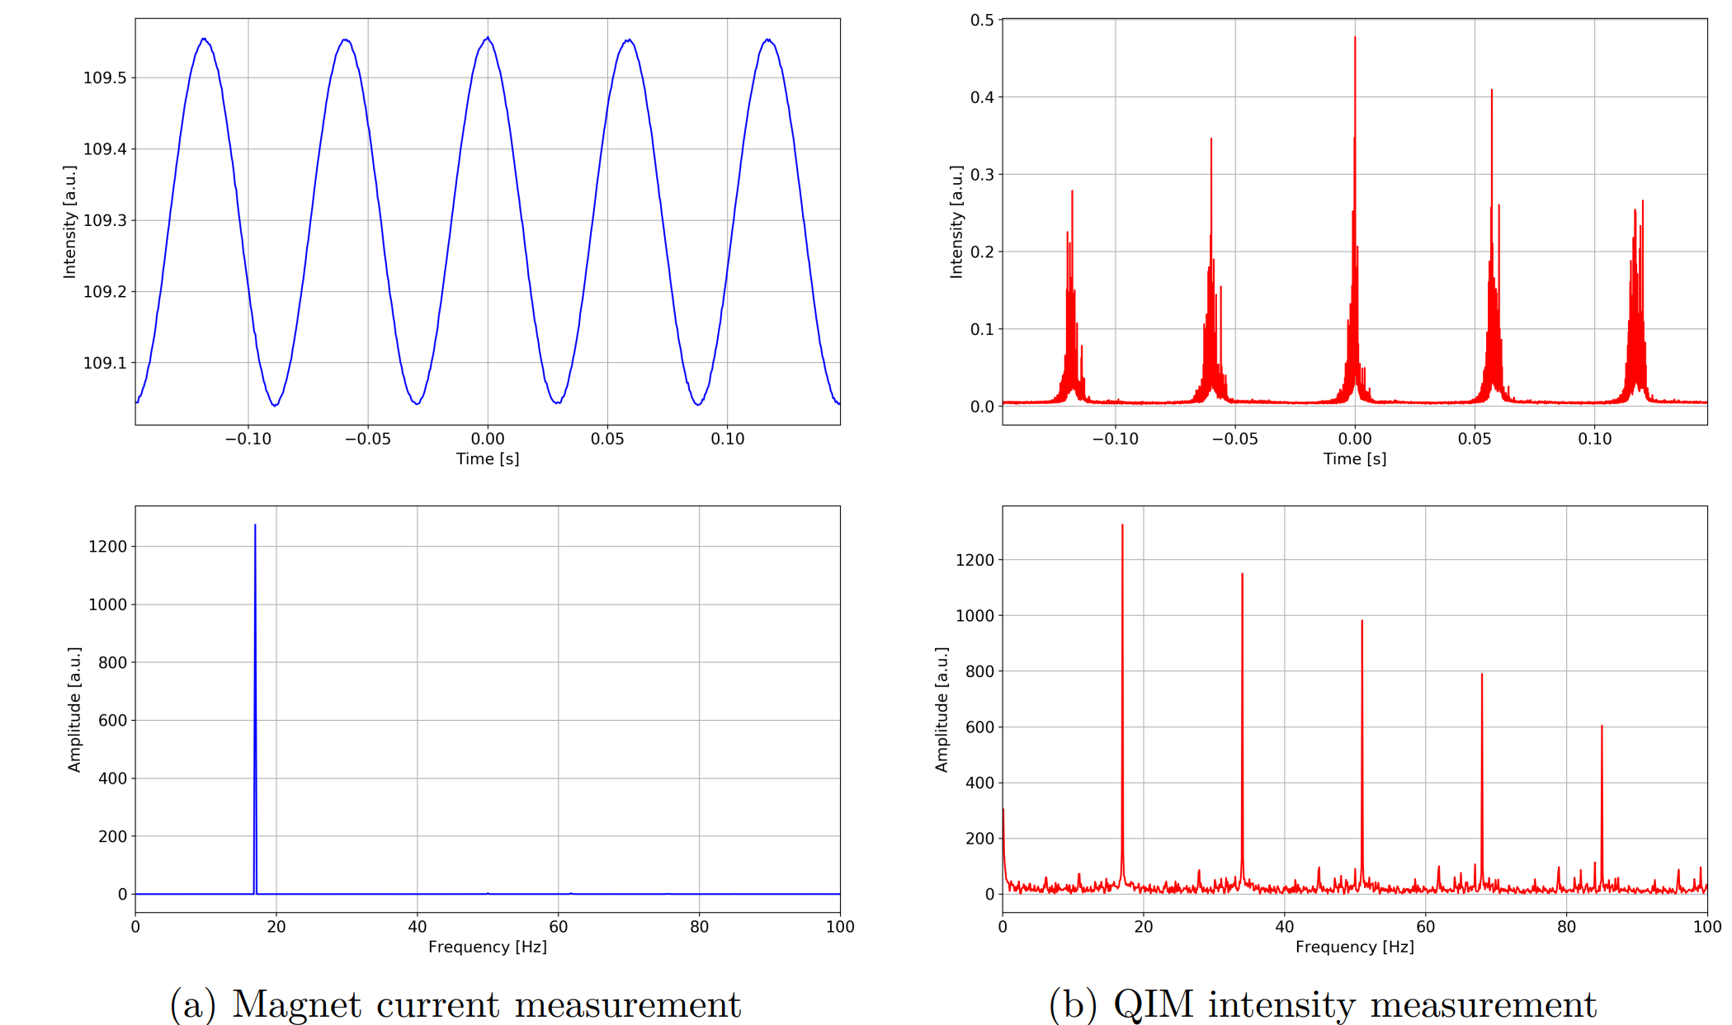
Ripple transfer function
Ripples with $A_{0}$ and $f_{0}$ induced to the power converter of the magnet
Ripples with A_0 and 𝑓_0 induced to the power converter of the magnet
Intensity ripples in the extracted beam
Ripple transfer function for different magnet families
$$RTF\left(f_{0},A_{0}\right)=\frac{A_{spill @ f_{0}} }{A_{0}}$$

Slide 18
Betatron Core with EBC

Slide 19
Conclusion & Outlook
Empty Bucket Channeling reduces ripple factor by 67%
„Tune Wobbling“ suppresses mainly 4 kHz ripple
Betatron Core extraction with Empty Bucket Channeling close to optimised
Beam quality for RF Knockout depends on excitation method and modulation frequency
Ripples for COSE look very promising
Most critical components for ripple mitigation are dipoles and quadrupoles
Time-dependent simulations with Xsuite framework
Further optimisation of COSE and PDE

Slide 20
Thank You!
Laurids Adler
Felix Feichtinger
Lorenz Fischl
Xavier German
Greta Guidoboni
Katrin Holzfeind
Clemens Maderböck
Thomas Margreiter
Mauro Pivi
Fabien Plassard
Dale Prokopovich
Elisabeth Renner
Valeria Rizzoglio
Claus Schmitzer
Ivan Strasik
Alexander Wastl
Michael Benedikt
Rebecca Taylor
Pablo Andreas Arrutia Sota
Matthew Fraser
CIVIDEC

Slide 21
UnBunched RFKO with FM

Slide 22
Bunched RFKO with FM

