Slide 1


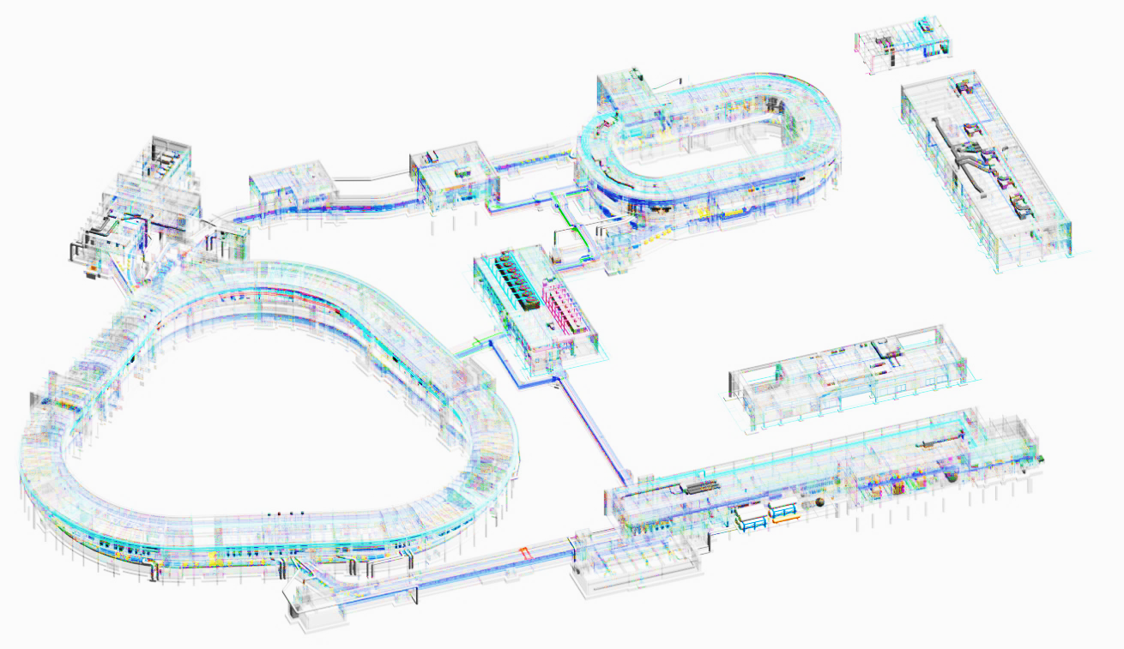
5th Slow Extraction Workshop
Challenges and status of HIAF
(High-Intensity heavy ion Accelerator Facility)
in China
Guodong Shen
On behalf of HIAF Design Group
Institute of Modern Physics (IMP)
Chinese Academy of Sciences (CAS)
Feb. 14, 2024

Slide 2
Outline
Brief introduction to the HIAF
Challenges and key components
Present status and schedule
Summary
Notes:
In my talk, I will give a brief introduction of HIAF project. The major challenges and development of key components will be reported. And then the status of series production and the schedule in the coming years. Finally a short summary will be presented.

Slide 3
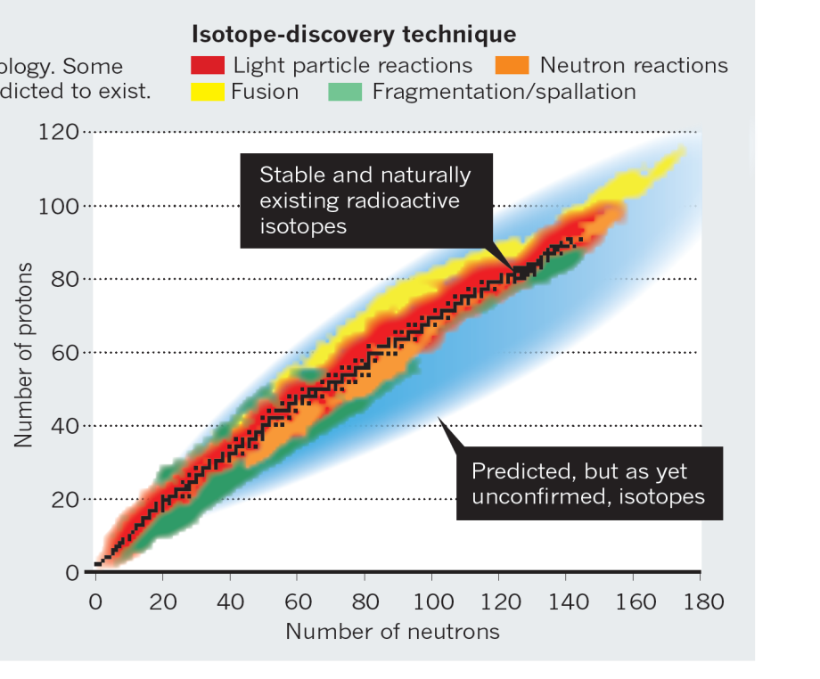
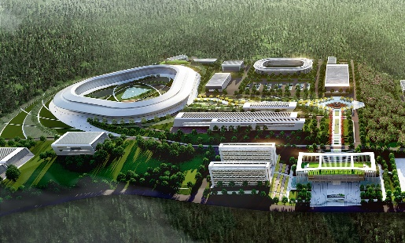
Brief introduction to the HIAF
Fascinating and crucial questions
To explore the limit of nuclear existence
To study exotic nuclear structure
To understand the origin of the elements
To study the properties of High Energy
and Density Matter
……
Available today
Next-generation facilities being constructed or proposed worldwide:
SPIRAL2 at GANIL in Caen, France
FAIR at GSI in Darmstadt, Germany
FRIB at MSU in the U.S.
NICA at JINR, Dubna, Russia
EURISOL in Europe
High Intensity Heavy-ion
Accelerator Facility
HIAF in China

Slide 4
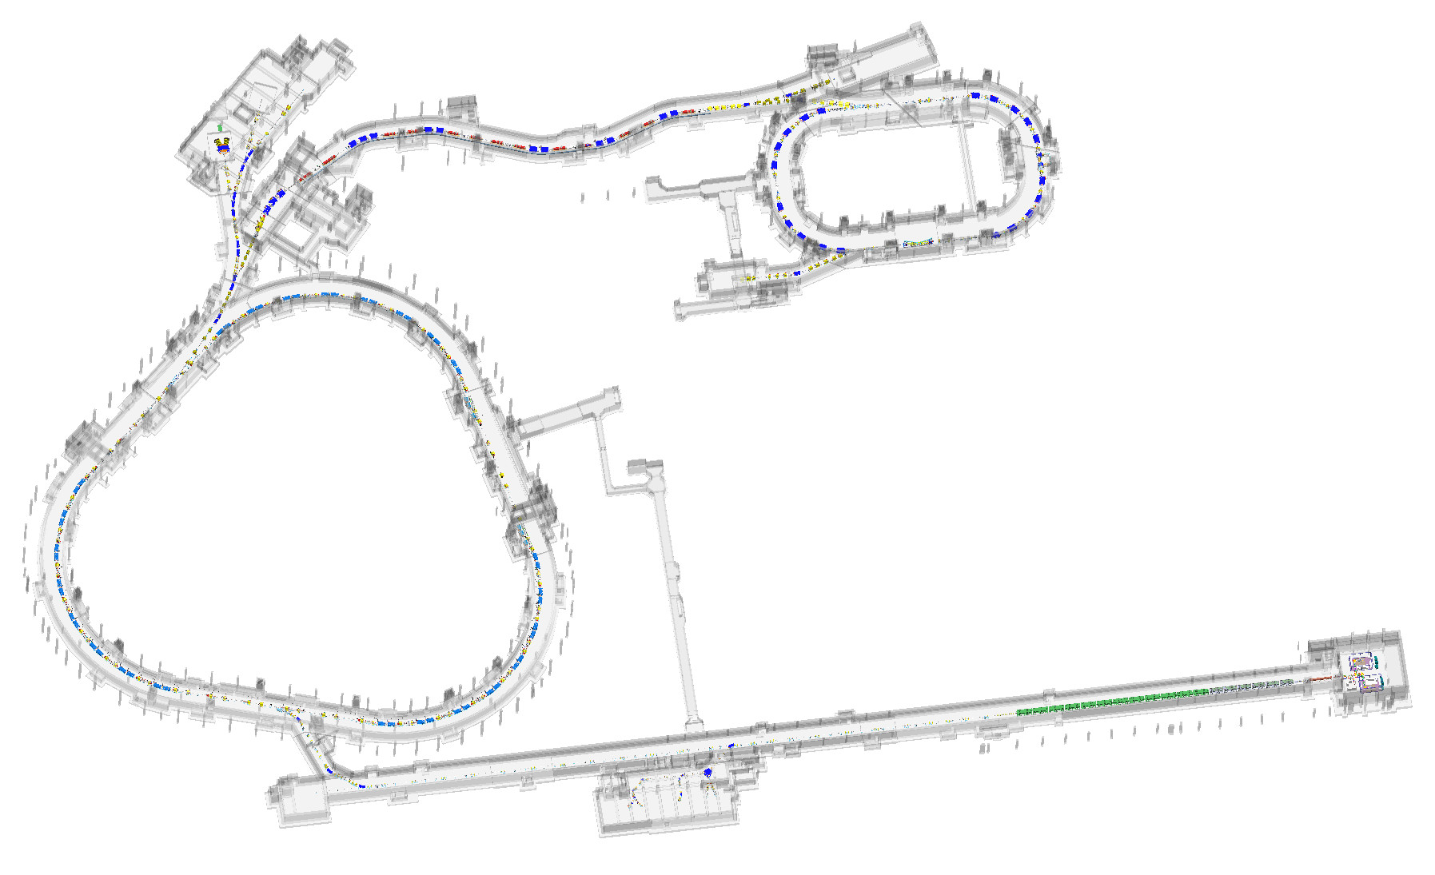
Brief introduction to the HIAF
High Intensity Heavy-ion Accelerator Facility (HIAF)
HFRS: Fragment Separator
Length: 192 m
Rigidity: 25 Tm
Pre + Main separator
resolution power: 1100
External Target Terminal
SRing: Spectrometer ring
Circumference: 277.3m
Rigidity: 13-15 Tm
Electron/Stochastic cooling
Two TOF detectors
Four operation modes
High Energy Multi-disciplinary Terminal
High Energy Density Terminal
SECR: Super-conducting ECR Ion Source
Energy: 14keV/u
RF frequency: 45GHz
The 4th generation SC ECR Ion Source
0.05pmA ²³⁸U³⁵⁺
BRing: Booster ring
Circumference: 569.1 m
Rigidity: 34 Tm
High intensity (²³⁸U³⁵⁺,1e11 ppp)
Two planes painting injection
Fast ramping rate（3Hz）
iLinac: Superconducting linac
Length:100 m
Energy: 17 MeV/u(U³⁵⁺), 48MeV/u(H₂⁺)
Low Energy Multi-disciplinary Terminal

Slide 5
Brief introduction to the HIAF
HIAF main parameters
To provide very high intensity heavy ion beam
 | SECR | iLinac | BRing | HFRS | SRing
Length / circumference (m) | --- | 114 | 569.1 | 192 | 277.3
Final energy of U (MeV/u) | 0.014 (U³⁵⁺) | 17 (U³⁵⁺) | 835 (U³⁵⁺) | 800 (U⁹²⁺) | 800 (U⁹²⁺)
Max. magnetic rigidity (Tm) | --- | --- | 34 | 25 | 15
Max. beam intensity of U | 50 pμA (U³⁵⁺) | 28 pμA (U³⁵⁺) | (1~2)×10¹¹ppp (U³⁵⁺) | ------- | (2~5) ×10¹¹ppp (U⁹²⁺)
Operation mode | DC | CW or pulse | fast ramping (12T/s, 3Hz) | Momentum-resolution 1100 | DC, deceleration
Emittance or Acceptance (H/V, π·mm·mrad, dp/p) |  | 5 / 5 | 200/100, 0.5% | ±30mrad(H)/±15 mrad(V), ±2% | 40/40, 1.5% (normal mode)
High intensity beam preparation remains a top priority of dynamics research.

Slide 6
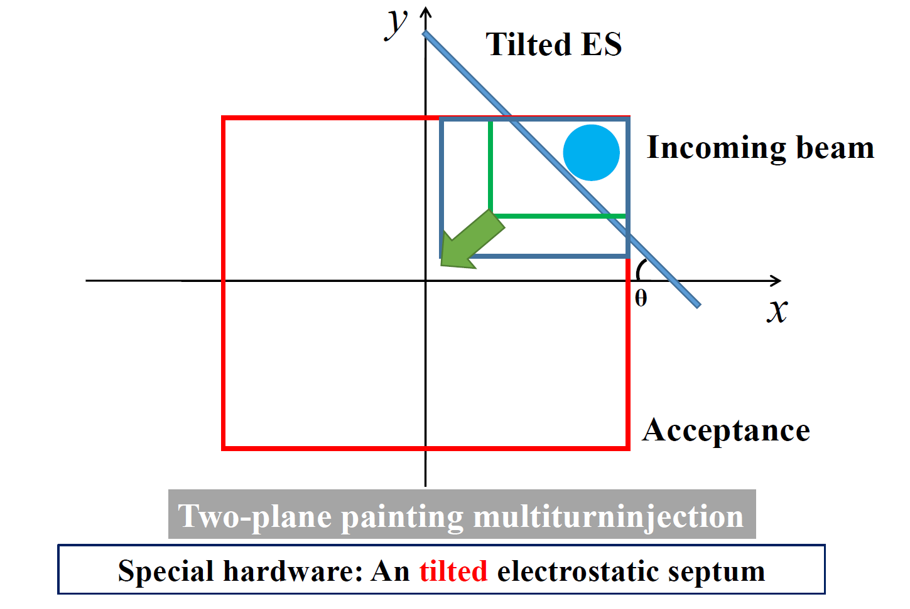
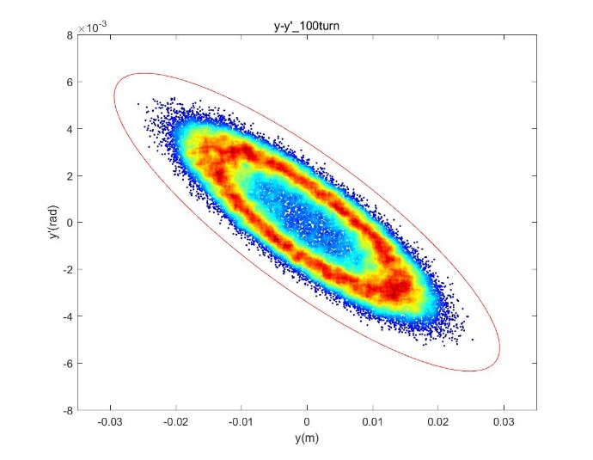
Challenges and key components
Issue 1: How to accumulate high intensity heavy ions in BRing?
Challenges:
High Injection Gain (>56 to achieve 1e11 for U35+)
Low beam loss (<5% due to dynamic vacuum)
Solution:
Two-plane painting injection exploits H&V phase space to improve injection gain.
Emittance increases following correlated painting arise lots of aperture loss.
An elaborate injection parameters optimization and artful ES collimator is essential to fulfill the design requirement.
Ions | Plane | Gain | Intensity W/O SC
²³⁸U³⁵⁺ | H | 26 | 4.6×10¹⁰
 | V | 13 | 2.3×10¹⁰
 | H+V | 80~100 | (1.4~1.8)×10¹¹
100 turn
Gain = 60
Uncontrolled loss = 2.1%
Hollow phase space
→ emittance increasement
ES collimator

Slide 7
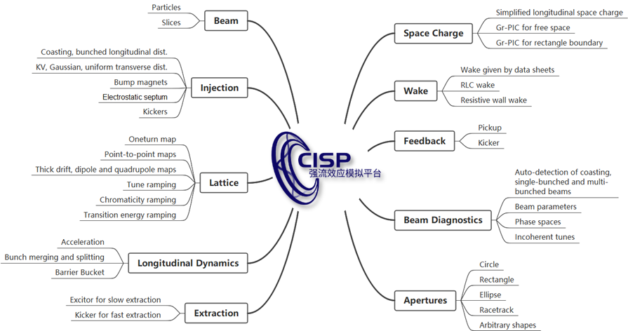
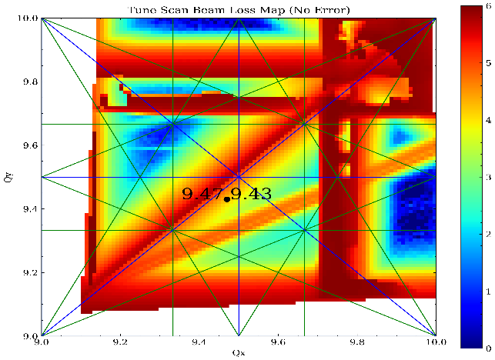
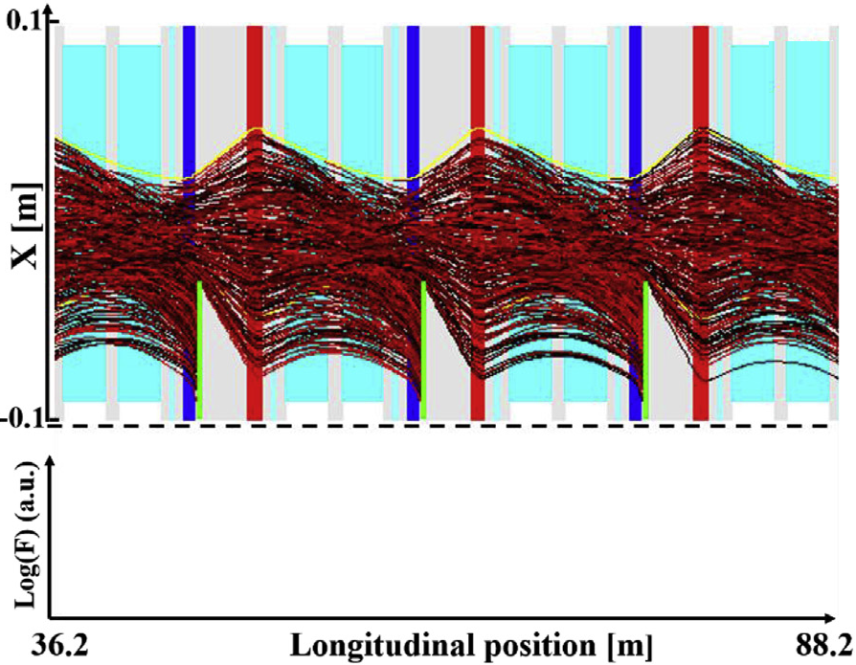
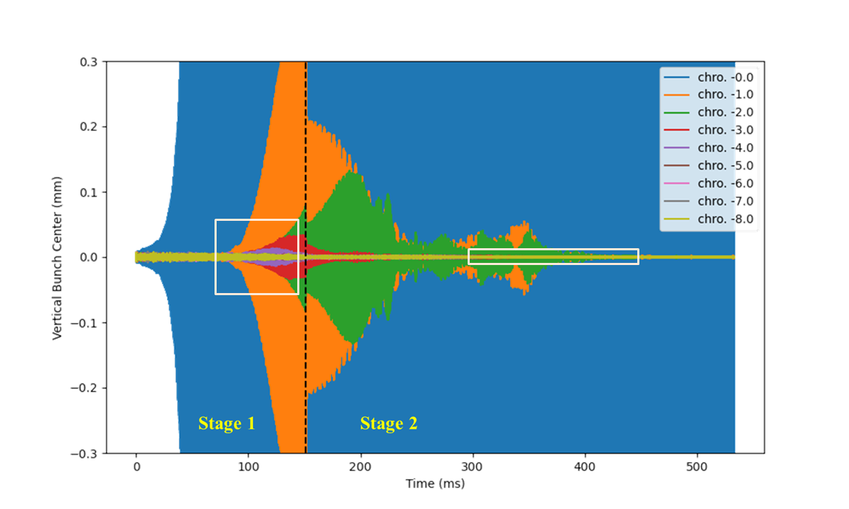
Challenges and key components
Issue 2: How to deal with serious beam loss?
Challenges:
Space Charge effect, dynamic vacuum effect and collective instability dominate intensity limitation.
A dedicated simulation platform CISP-GPU is developed for coupling high intensity dynamics research.
Stabilization efforts are performed to achieve the intensity goal.
tune scan with SC and real magnet
loss distribution of dynamic vacuum
stabilization of collective instability
Fast ramping (12T/s) is essential to suppress beam loss. High performance requirement to power supply, RF system and vacuum chamber.

Slide 8
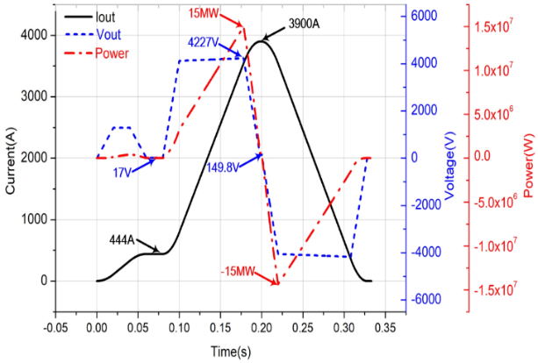
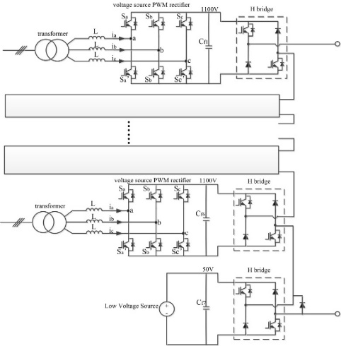
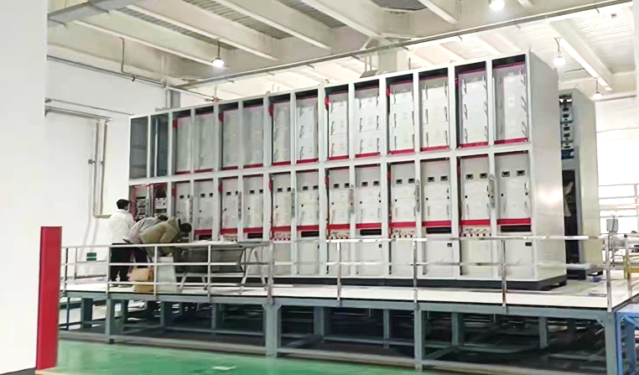
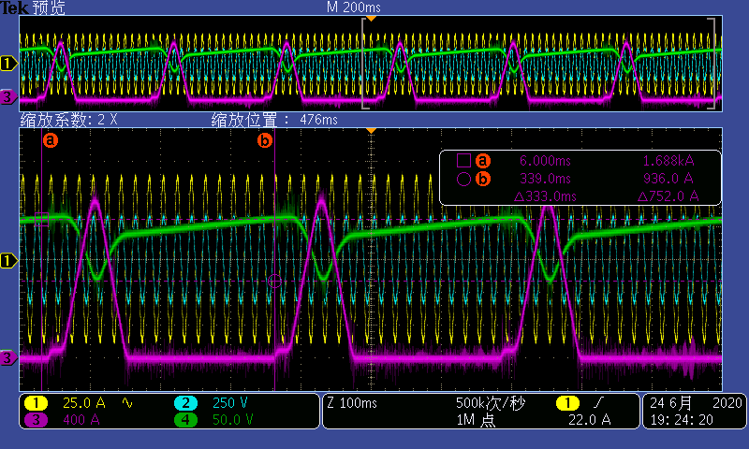
Challenges and key components
Key component 1: Full energy storage fast cycling power supply
Challenges:
A high ramping rate (38000A/s)
A broad dynamic range of I, high precision(±1e-4)
Shock to the power grid(±180MW in total)
Breakthrough:
Innovative topology based on full-energy store and excitation voltage switched.
Capacitor for full-energy store, excitation voltage switched for high precision.
The first of series verified the key technology and design successfully.
High voltage source
Low voltage source
Topology of PS
First of series
First of series test results

Slide 9
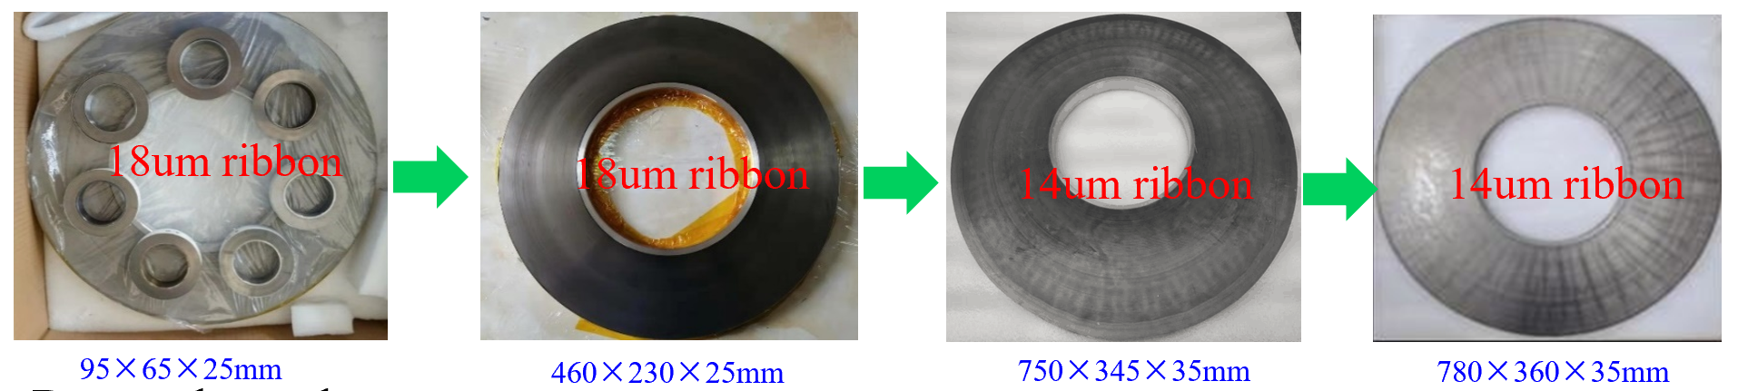
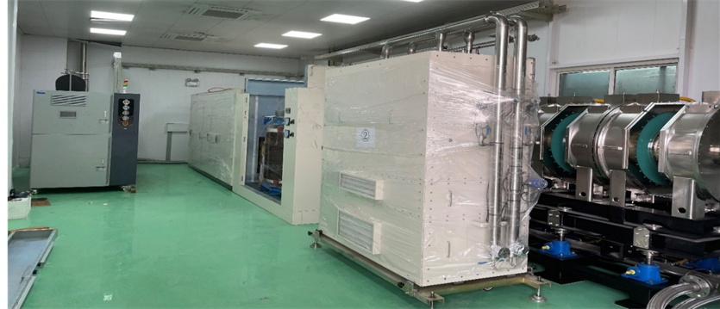
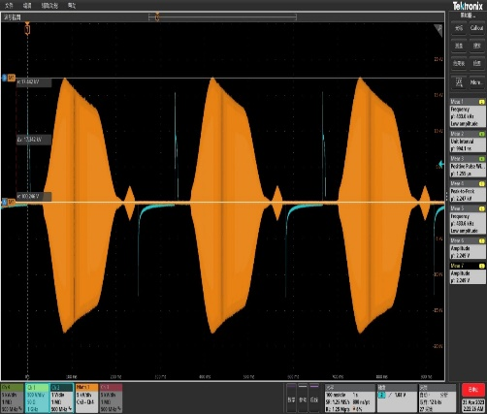
Challenges and key components
Key component 2: Nanocrystalline soft magnetic alloy loaded cavity
Challenges:
Wide band (p-U, 0.3~2.1MHz)
High Voltage (12T/s, 285kV)
Fast response (bunch compression, 10μs)
Fabrication of MA core module and core cooling at intense power dissipation are not established.
Breakthrough:
Over ten years exploration from small(φ90), medium (φ460), to large (φ780) MA core.
International leading level key parameters.
The performance and reliability demonstrate well in the protype.
Magnetic alloy loaded cavity
Test result of key parameters
FOS MA system
60kV, 3Hz test

Slide 10
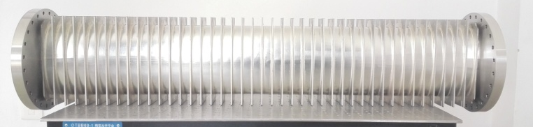
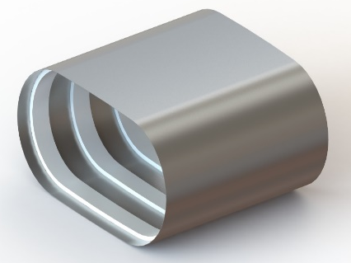
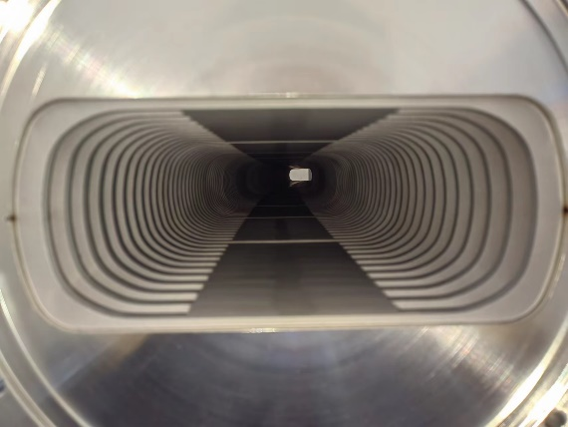
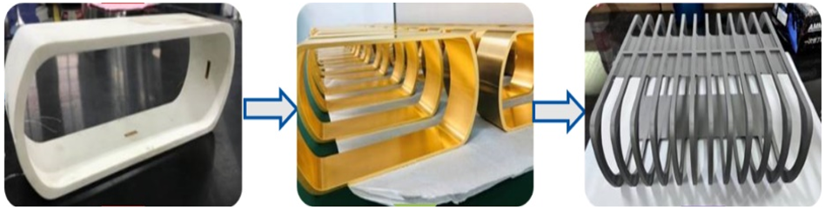
Challenges and key components
Key component 3: Lined thin-walled vacuum chamber
Challenge:
Ribs supported thin wall chamber: Special material P506 steel or thick ribs(~12mm stainless steel for BRing)
Ceramic chamber: Vitreous bonding, cannot bake
Breakthough:
A novel ceramic ring lined thin wall vacuum chamber are designed for HIAF.
Excellent compressive property of ceramic.
The reliability and vacuum performance increase remarkably by 3 iterations.
0.3mm stainless steel
Ceramic
Thickness: 5mm
Thickness: 4mm
Thickness: 4mm
1st Gen
99% Ceramics
2nd Gen
ZrO₂, Au coating
3rd Gen
TC4, NEG coating
Side view

Slide 11
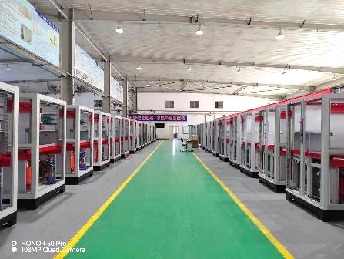
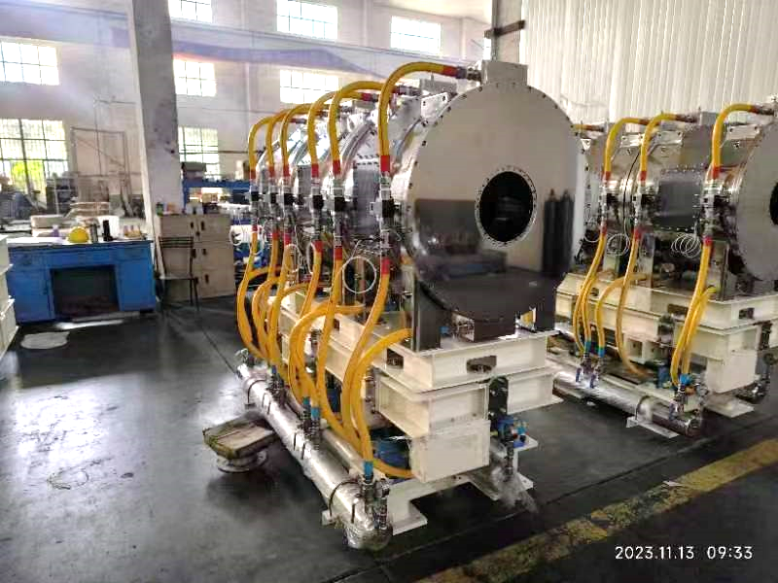
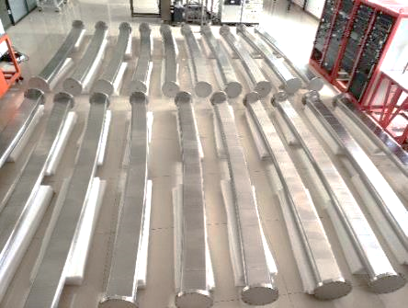
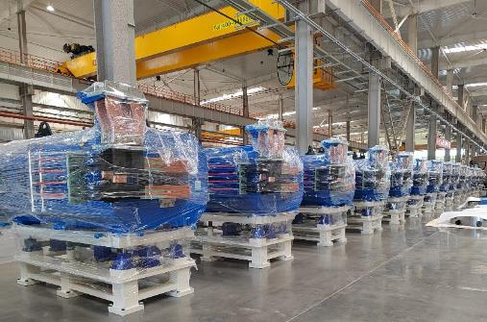
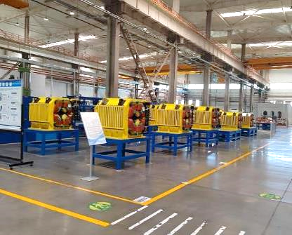
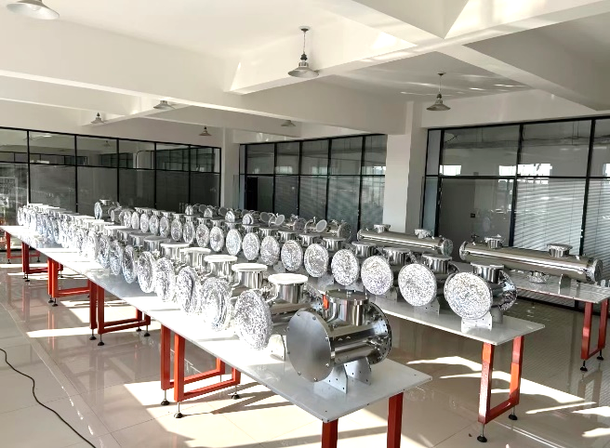
Present status and schedule
More than 50% of the hardware series fabrication are completed. The series installation and joint commissioning will start in Feb. 2024.
Power supplies
MA loaded cavities
Dipole vacuum chambers
Dipole magnets
Quadrupole magnets
BPMs

Slide 12
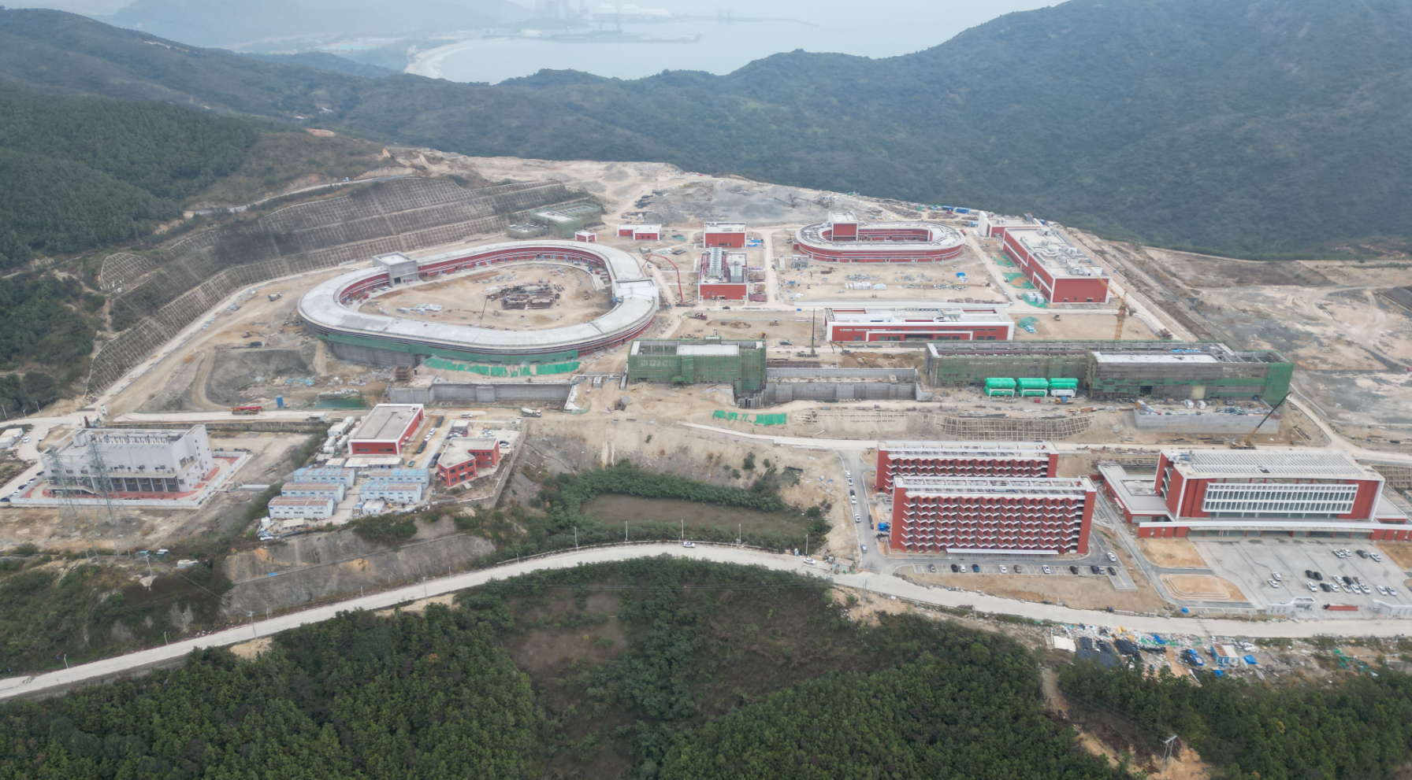
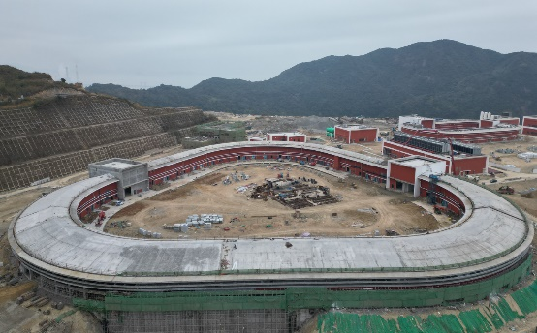
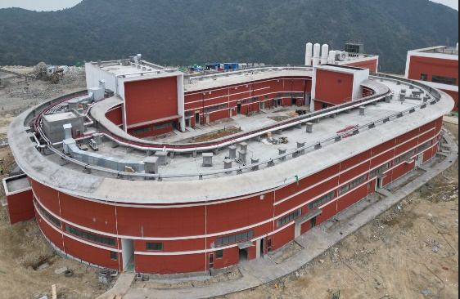
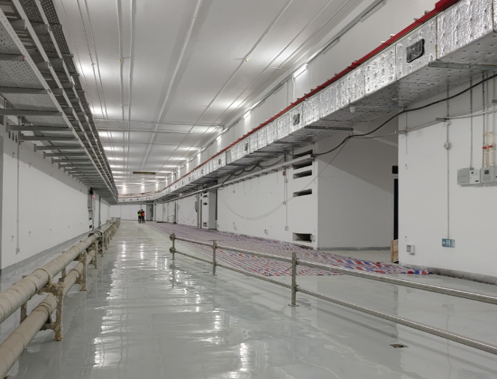
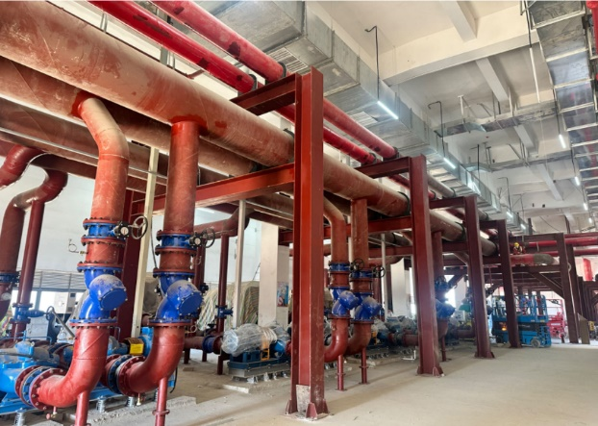
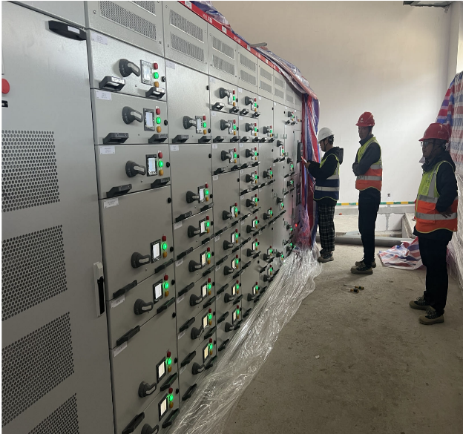
Present status and schedule
The civil construction and supporting facilities is in the closeout phase. They will accomplish in Apr. 2024.

Slide 13
Present status and schedule
HIAF construction time schedule
2019 | 2020 | 2021 | 2021 | 2022 |  | 2023 |  |  | 2024 |  | 2025 |  |  | 2026
Civil construction
 |  | Electric power, cooling water, compressed air, network, cryogenic, supporting system, etc. | Electric power, cooling water, compressed air, network, cryogenic, supporting system, etc.
ECR design & fabrication |  |  |  |  | SECR installation and commissioning
 | Linac design & fabrication |  |  |  |  |  | iLinac installation and commissioning |  |  |  | Day one exp | Day one exp
Prototypes of PS, RF cavity, chamber, magnets, etc. |  |  |  | fabrication |  |  |  |  | BRing installation & commissioning |  |  |  | Day one exp
 |  |  |  |  |  |  |  |  | HFRS & SRing installation & commissioning |  |  |  |  |  | Day one exp
 |  |  |  |  |  |  |  | Terminals installation
The first ion beam provided by FECR is at the middle of 2024;
The low energy ion beam of iLinac is expected at the middle of 2025;
The high energy ion beam from BRing is in September of 2025
The Day One Experiment in SRing will be in April of 2026

Slide 14
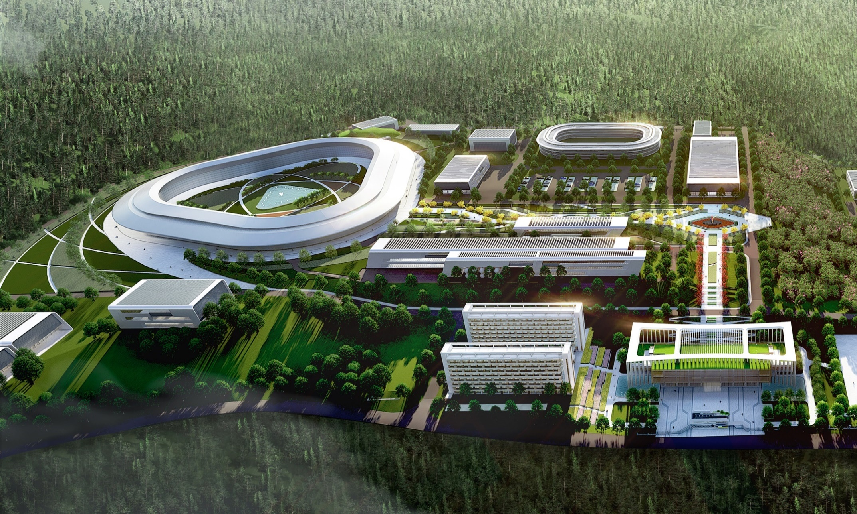
High-Intensity Heavy Ion Accelerator Facility-HIAF
World-class scientific user facility for international scientists and researchers
HIAF welcome all of you !!!
Huizhou, 2025

