Slide 1
First Experience with Slow Extraction Commissioning at Fermilab Delivery Ring
V.Nagaslaev
5th SX Workshop, Wiener Neustadt
February 11, 2024

Slide 2
Beam Facilities at Fermilab (SX Workshop-2022)
Ext. Beamlines
Proton Source
Muon Campus
Delivery Ring
120GeV transport
Neutrinos
8GeV transport
Recycler
Main Injector
Muon Campus delivers beams for g-2 until Shutdown-2023
Mu2e commissioning will follow

Slide 3
The Muon to Electron conversion experiment (Mu2e)
Separate the background both in space and time
Transport
Solenoid
Detector
Solenoid
Production
Solenoid
CLFV discovery would indicate the BSM physics
Sensitivity 10000 times below the previous experimental limits
Slow spill beam delivery is required
Beam Flash
Stopped μ⁻
Signal
Timing diagram: quiet time between bunches is crucial

Slide 4
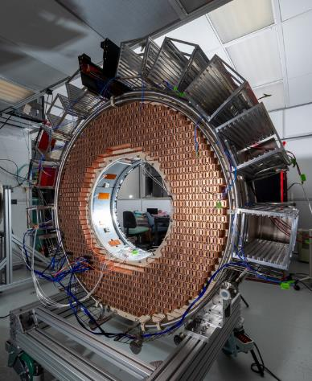
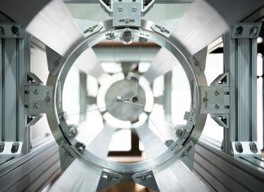
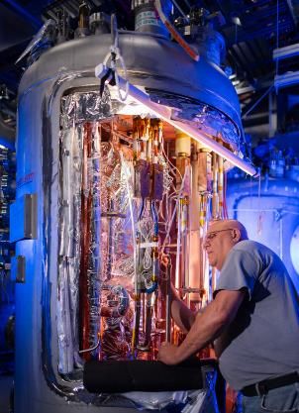
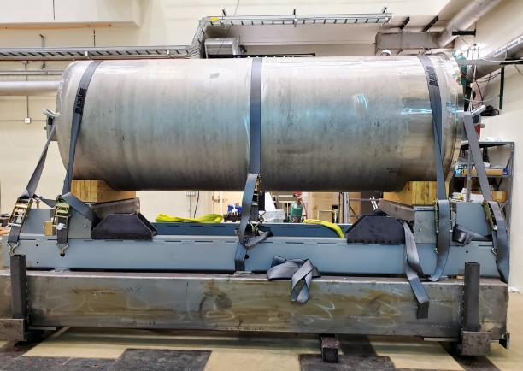
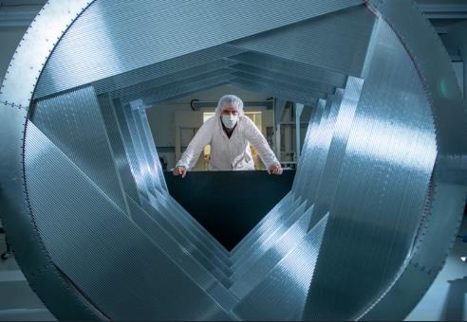
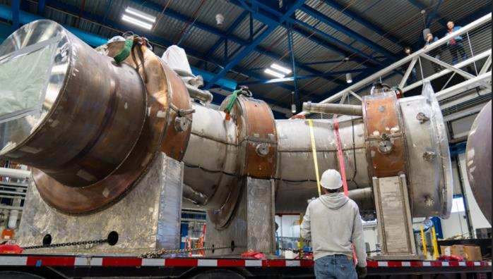
The Muon to Electron conversion experiment (Mu2e)
Separate the background both in space and time
Transport
Solenoid
Detector
Solenoid
Production
Solenoid
CLFV discovery would indicate the BSM physics
Sensitivity 10000 times below the previous experimental limits
Slow spill beam delivery is required
Beam Flash
Stopped μ⁻
Signal
Timing diagram: quiet time between bunches is crucial

Slide 5
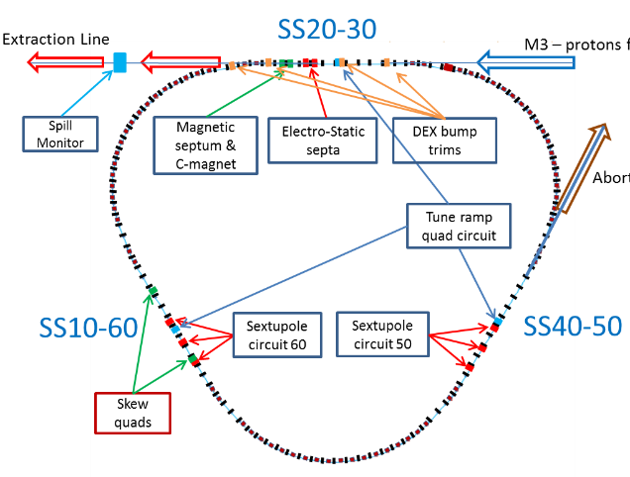
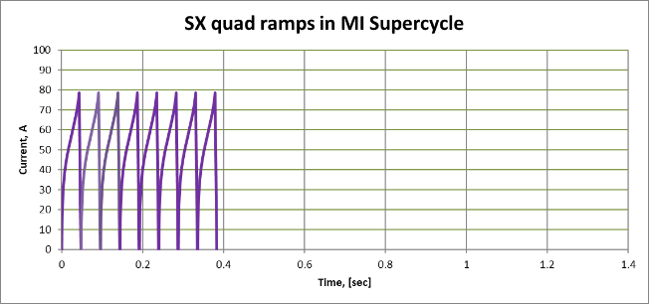
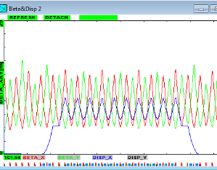
Mu2e SX characteristics
Main design parameters:
Beam power 8kW
Spill intensity 1e12p
Efficiency >98%
Spill duration 43ms
Delivery Ring:
Circumference 505m (T_{r}=1.7usec)
FODO lattice, β_{max}=15m
Dispersion suppressed in SS
Bunched beam, single bunch H=4
Extraction:
3rd integer, Q_{x}=29/3
Quad driven squeeze
Spill corrections: Quads + RFKO
Beam abort in the end of spill
Beam emittance:
Unnorm., 95% E_{X,Y}=1.6 π*mm*mr
Acceptance A_{X,Y} =36 π*mm*mr

Slide 6
Mu2e SX characteristics
Main design parameters:
Beam power 8kW
Spill intensity 1e12p
Efficiency >98%
Spill duration 43ms
Delivery Ring:
Circumference 505m (T_{r}=1.7usec)
FODO lattice, β_{max}=15m
Dispersion suppressed in SS
Bunched beam, single bunch H=4
Extraction:
3rd integer, Q_{x}=29/3
Quad driven squeeze
Spill corrections: Quads + RFKO
Beam abort in the end of spill
Beam emittance:
Unnorm., 95% E_{X,Y}=1.6 π*mm*mr
Acceptance A_{X,Y} =36 π*mm*mr
Ring
ESS1
ESS2
MS1
MS2
Beam line

Slide 7
Slow Extraction (SX) operation planning for Mu2e
Electrostatic Septa (ESS) are the last pieces needed for SX commissioning
Full scale ESS Prototype commissioned in 2020
Production ESS1 and ESS2 are in preparation
SX schedule:
G-2 experiment scheduled to stop by the end of FY23 (shutdown)
Install 2 septa in the tunnel during the FY23 shutdown
Mu2e schedule assumed beginning SX operations in FY24
Plan change:
Decision made in 2022 to install the septum prototype in the tunnel
Limited commissioning of SX before the 2023 shutdown
The F23 summer shutdown at Fermilab extended to March 2024

Slide 8
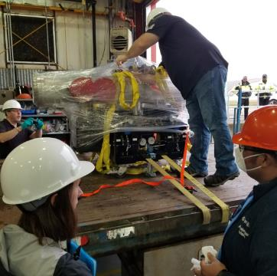
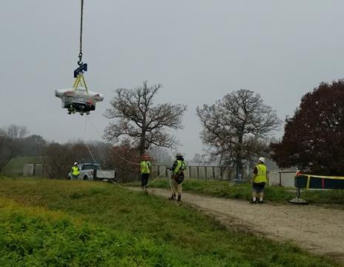
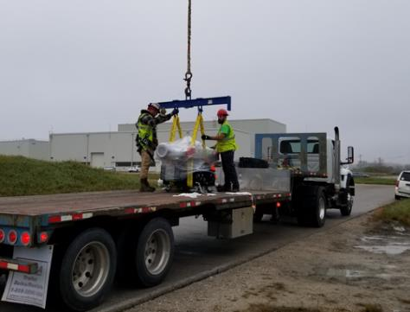
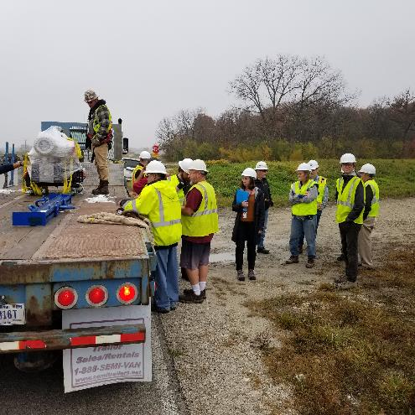
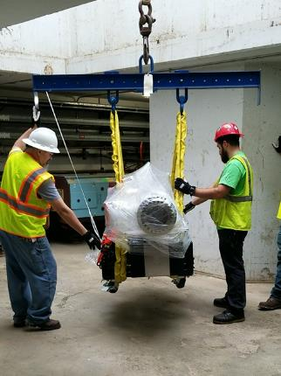
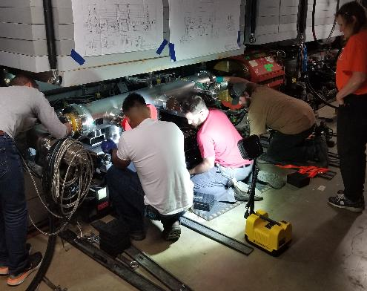
Experience with the ESS Full Scale Prototype (FSP)
Septum installed in the DR in the end of November 2022

Slide 9
Main issues:
Slow Extraction studies started by Mar-24-2023
Septum internal issues limited available HV to 75%
Slow emittance blow up (~1 sec) – due to poor vacuum
Fast emittance blow up (~1 msec) – not yet understood
Vacuum controls implemented in December 2022
HV PS not available until available by Mar-01-2023
Instrumentation issues with SEM beam profile monitors in M4
M4 spill monitors not fully available until July 2023
Beam Position monitors (BPMs) not available until July 2023
Operations stopped in July 2023 for the summer shutdown
Only a few days for full studies available!

Slide 10
Resonant Extraction studies:
Ramping up the resonance and extract
Steering the beam
Resonance TBT orbits

Slide 11
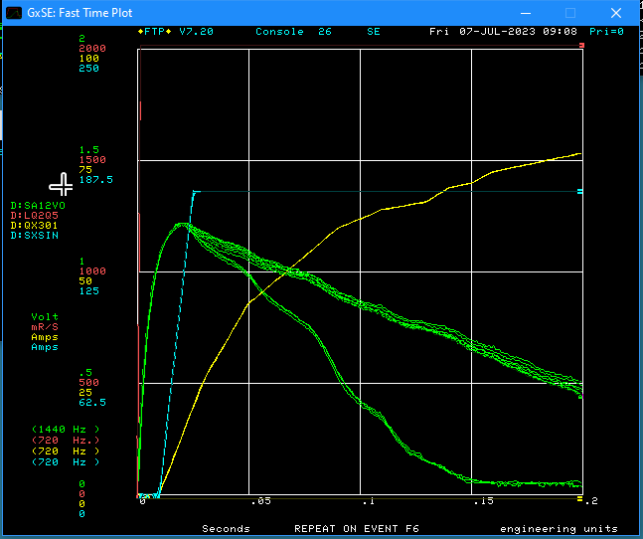
Ramping up and Extracting

Slide 12
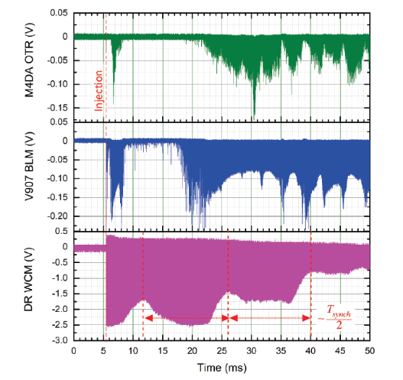
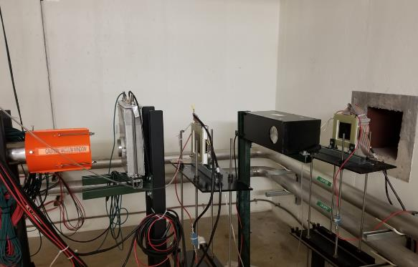
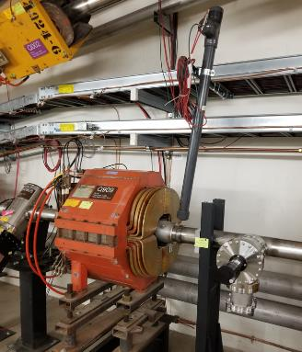
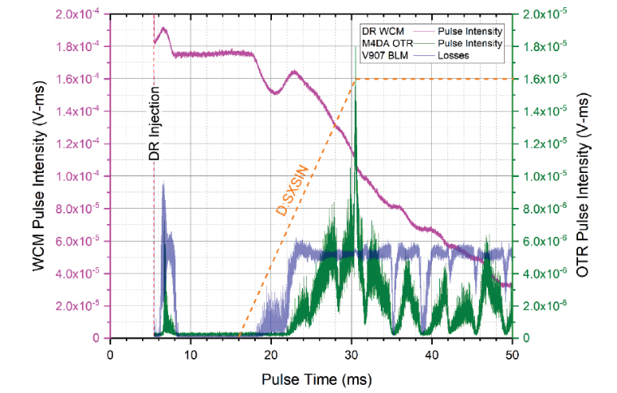
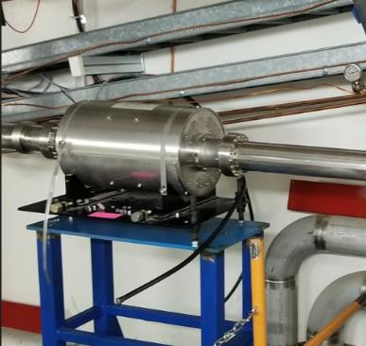
Spill Monitoring:
OTR style monitor at the beam absorber
SC-counter at 907
Wall-Current Monitor

Slide 13
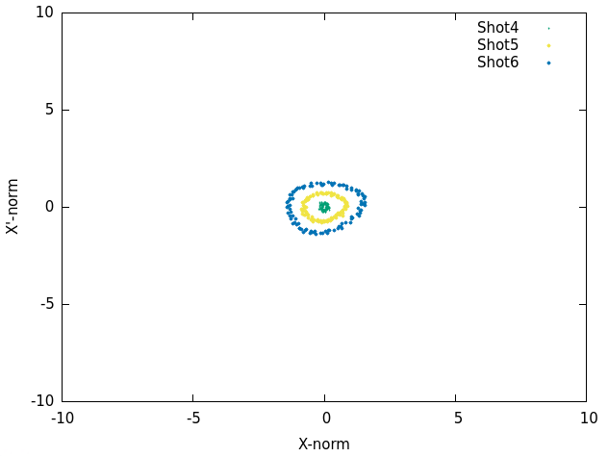
Resonant TBT orbits:

Slide 14
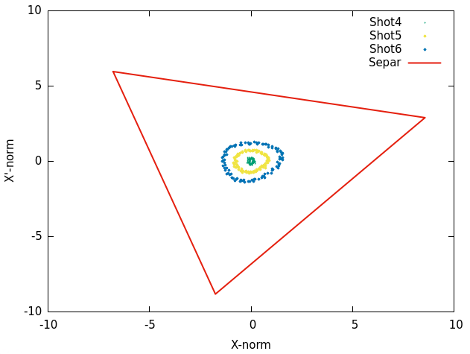
Resonant TBT orbits:

Slide 15
Summary - What’s accomplished
Experience with driving the resonance extraction
Initial experience with tuning the extraction orbits
Observation of the resonance phase
Completion of the vacuum system
Completion of the 1st phase HVPS
Completion of the TBT BPM system
Experience with the installation design/implementation
Establishing the spill monitoring devices (phase I)
Identification of the instrumentation issues
Identification of the beam dynamics issues
Looking forward to continue commissioning in FY24

