Slide 1
Welcome to the 5th Slow Extraction Workshop
Co-Chairs: Dale Prokopovich, Mauro Pivi & Peter Forck

Slide 2
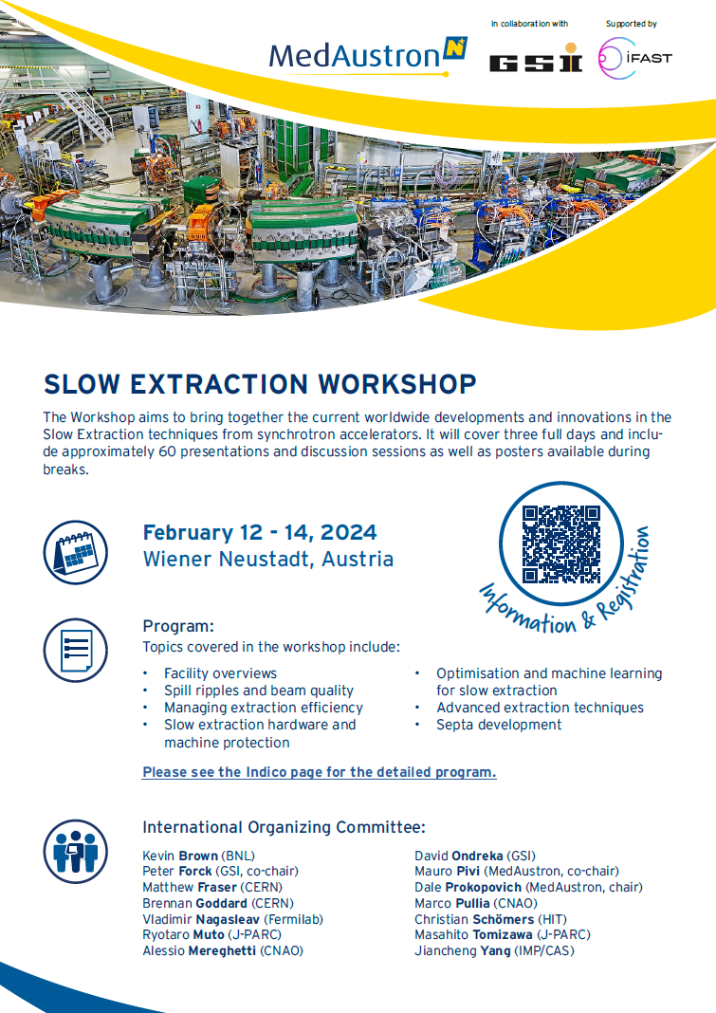
Welcome
We as the organisers, want to thank everyone for travelling to Wiener Neustadt and participating in this workshop!
There is a general information pamphlet (where to eat, transport, etc.) available on the Indico page as well as some hardcopies available at the reception desk
In case of any questions arising during the workshop, then please approach Mauro, Peter or Dale at any point and we will be more than happy to help

Slide 3
Comparison to Previous SE Workshops
Date | Location | Attendees | Duration | 1st day | 2nd day | 3rd day | Sum
2016 June 1st to 3rd | GSI | 53 | 2.5 days | 11 talks 1 discussion | 11 talks 1 discussion | 3 talks 1 discussion | 25 talks 3 discussion
2017 November 9th to 11th | CERN | 56 | 2.7 days | 17 talks | 18 talks 1 discussion | 1 discussion 1 summary & survey 1 tour | 35 talks 2 discussion 1 survey 1 tour
2019 July 22nd to 24th | Fermilab | 56 | 3 days | 14 talks | 14 talks | 7 talks (2 parallel sessions) 1 discussion 1 ‘homework’ & survey 1 tour | 35 talks 1 discussion 1 ‘homework’ 1 tour
2022 January 24th to 28th | J-PARC remote | 89 | 5 days 2:30 h/day | 5 talks | 7 talks | 7 talks 4th & 5th day: 6 talks 1 discussion | 31 talks 2 discussion

Slide 4
Comparison to Previous SE Workshops
Date | Location | Attendees | Duration | 1st day | 2nd day | 3rd day | Sum
2016 June 1st to 3rd | GSI | 53 | 2.5 days | 11 talks 1 discussion | 11 talks 1 discussion | 3 talks 1 discussion | 25 talks 3 discussion
2017 November 9th to 11th | CERN | 56 | 2.7 days | 17 talks | 18 talks 1 discussion | 1 discussion 1 summary & survey 1 tour | 35 talks 2 discussion 1 survey 1 tour
2019 July 22nd to 24th | Fermilab | 56 | 3 days | 14 talks | 14 talks | 7 talks (2 parallel sessions) 1 discussion 1 ‘homework’ & survey 1 tour | 35 talks 1 discussion 1 ‘homework’ 1 tour
2022 January 24th to 28th | J-PARC remote | 89 | 5 days 2:30 h/day | 5 talks | 7 talks | 7 talks 4th & 5th day: 6 talks 1 discussion | 31 talks 2 discussion
2024 February 12th to 14th | MedAustron | 59 | 3 days + welcome reception and site visit on adjacent days | 23 talks 1 tutorial 2 discussion | 20 talks 2 discussion | 16 talks 4 discussion | 59 talks 8 discussion 1 tutorial 9 posters 1 tour (4th day)

Slide 5
Organising committees
International Organising Committee Members
Kevin Brown (BNL)
Peter Forck (GSI, co-chair)
Matthew Fraser (CERN)
Brennan Goddard (CERN)
Vladimir Nagaslaev (Fermilab)
Ryotaro Muto (J-PARC)
Alessio Mereghetti (CNAO)
David Ondreka (GSI)
Mauro Pivi (MedAustron, co-chair)
Dale Prokopovich (MedAustron, co-chair)
Marco Pullia (CNAO)
Christian Schömers (HIT)
Masahito Tomizawa (J-PARC)
Jianchen Yang (IMP/CAS)
Local Organising Committee
Petra Wurzer
Dale Prokopovich
Mauro Pivi

Slide 6
Presentations
Talks need to be uploaded to Indico not later than 17:00 the day before the presentation or, in case of issues, please send it via email to Mauro, Peter or Dale and inform them (upload from USB stick is not possible)
Session chairs & presenters:
Please respect the other presenters and keep track of time for the presentations
This mornings presentations are 10 minutes and the rest of the workshop are 20 minutes
Session chairs: There is a timing PowerPoint available on the Indico site if you wish to use it
The talks will be arranged on the presentation computer for a fast change to the next talk
Abstracts: Serve as a durable documentation of the contributions (if not done, please submit it)

Slide 7
Workshop information
Lunch will be provided downstairs in the Genusswerk restaurant from 13:00-14:00 (included in conference fee)
Coffee breaks are in the adjacent room (10:30-11:00 & 16:00-16:30)
Posters are open for discussion during the coffee and lunch breaks
If you use the coffee area during presentations, please keep the noise down to prevent interruption of the ongoing talks

Slide 8
Social Dinner and MedAustron tour
Social dinner is at 19:30 on Tuesday the 13th at Gasthaus zum Dom in the city centre
A bus is available at 18:50, leaving from the front of the Plaza Inn Hotel to take participants to the dinner and return after the end of dinner at 22:00
Prior to the tour of MedAustron you will be required to fill in a Radiation Protection form and listen to a short RP induction at the close of the workshop on Wednesday afternoon
If the form or induction are not completed then you will unfortunately not be able to participate in the tour

Slide 9
Thank you for coming and Enjoy the Workshop!

