Slide 1
CNAO Overview
M. Pullia, A. Mereghetti, P. Meliga, L. Falbo

Slide 2
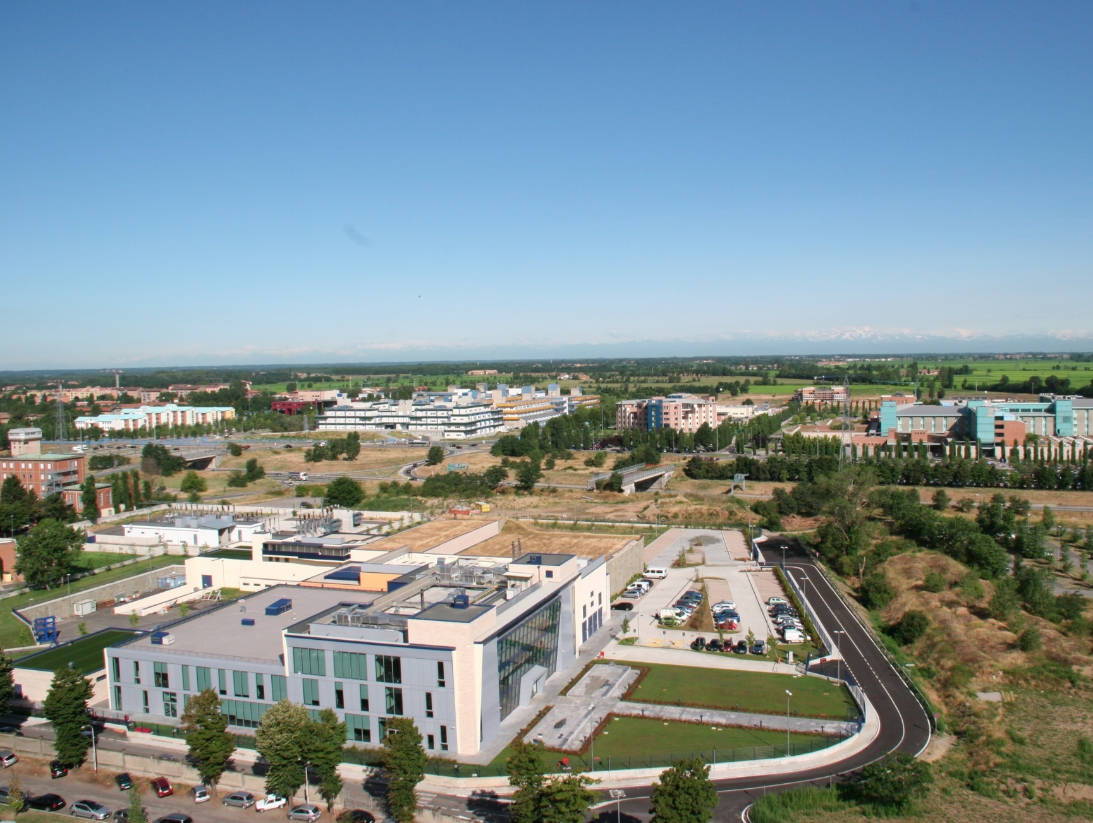
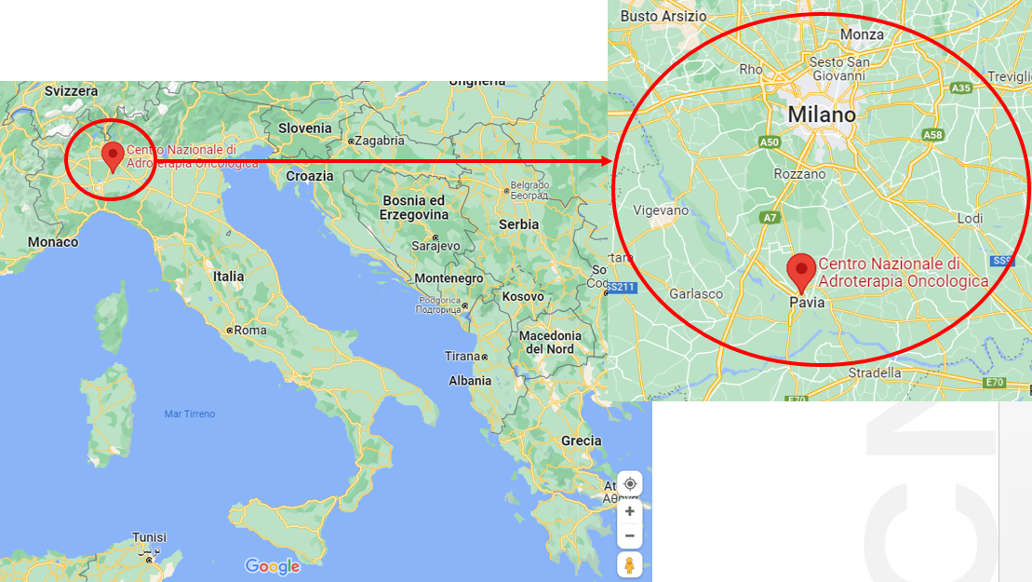
CNAO National Center for Oncological Hadrontherapy
Not-for-profit private foundation
Created by the Italian Ministry of Health in 2001
With the purpose to introduce hadrontherapy in clinics, pursue research and education
Located in Pavia
The Board is formed by 14 Institutions:
5 hospitals
3 universities
2 research institutes
2 public entities (Ministry of Health and Town of Pavia)
2 bank foundations

Slide 3
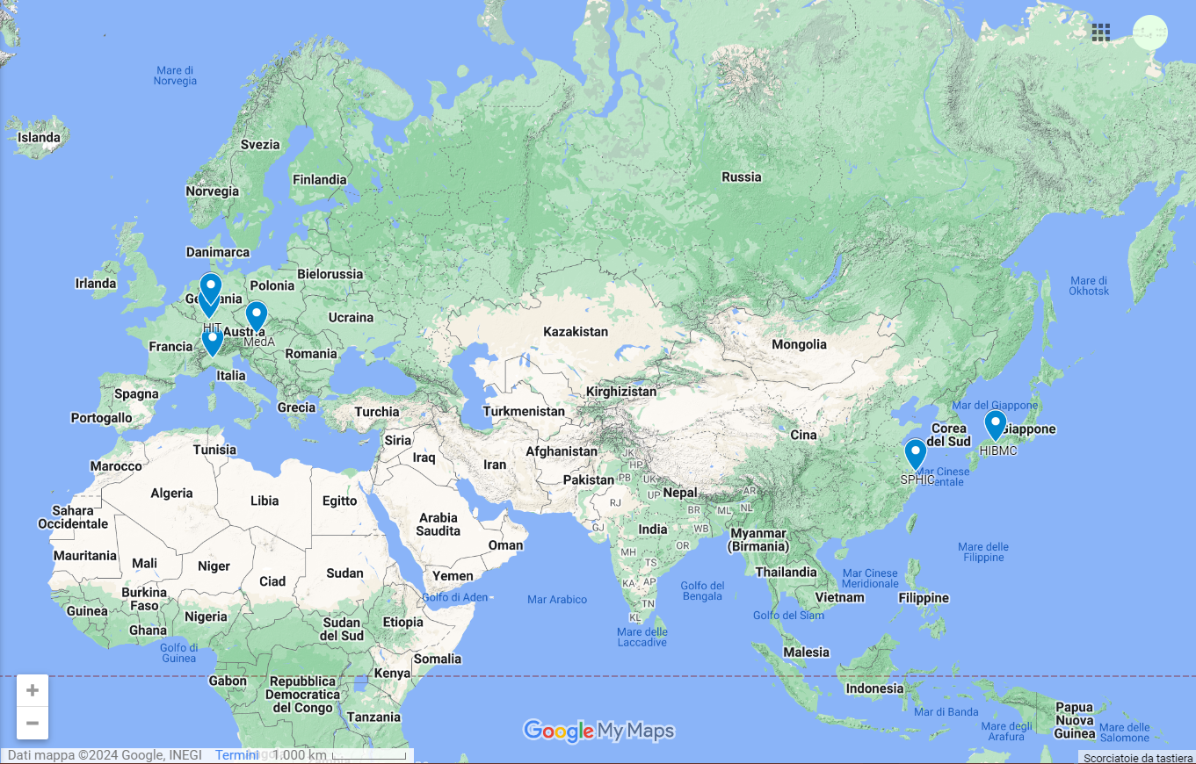
One of the six therapy centers with p and C beams

Slide 4
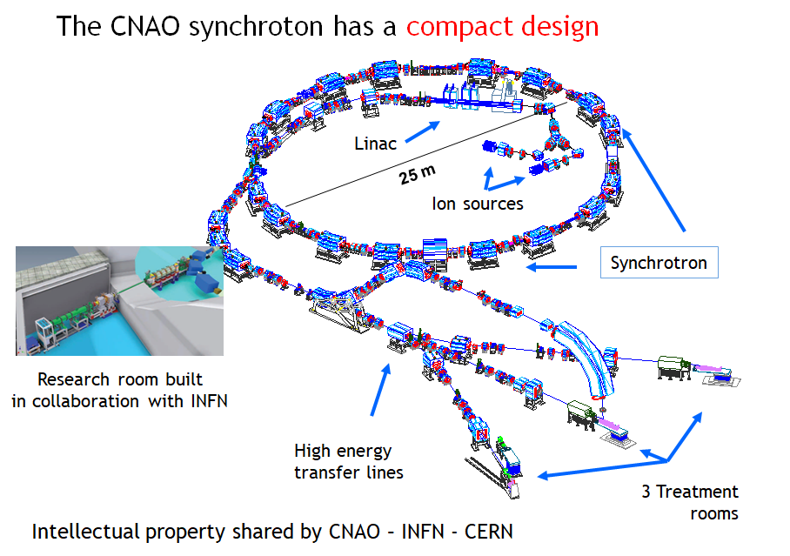
CNAO accelerator system
PIMMS Family
Accelerated ion p, C
Energy range (MeV/u) 60-225 (p) (30-320mm)
120-400 (C) (30-270mm)
4900 patients treated
3 treatment rooms
+1 experimental room

Slide 5
Implementation of RFKO in addition to betatron
Amplitude-momentum
selection
RF-KO
Amplitude
Amplitude
Being implemented
for multi energy
extraction studies
Standard method
at CNAO
(b)
(c)
Δp/p
Δp/p
X’
X’
X_{ES}
X_{ES}

Slide 6
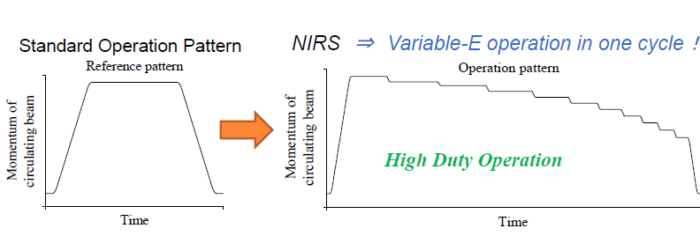
Treatment execution with Multi Energy Extraction
Use remaining beam after slice completion
(Courtesy K. Noda – CAS Medical)
Saved
time
Saved
time
1 s
Sync

Slide 7
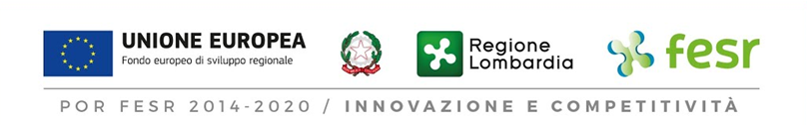
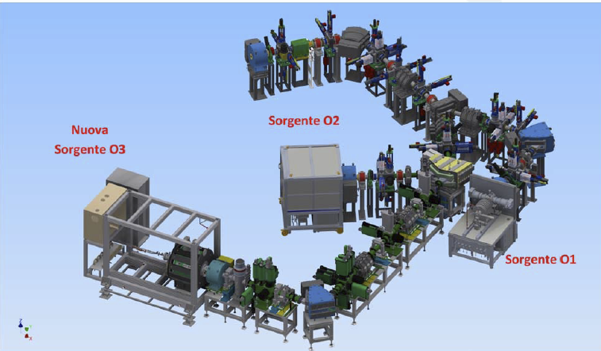
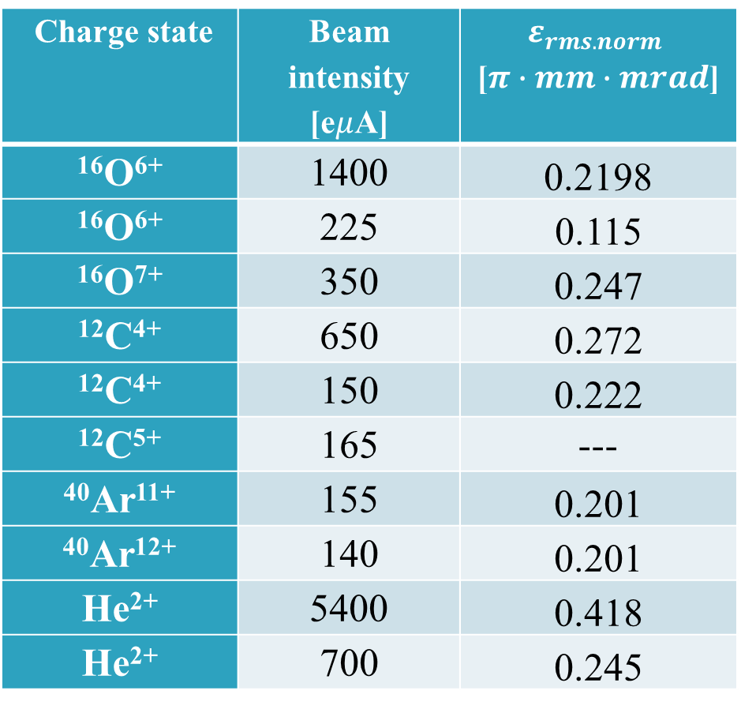
New source
Aisha 2 at CNAO – He, Li, O, Fe
Aisha 1 in INFN LNS
Courtesy of L. Celona

Slide 8
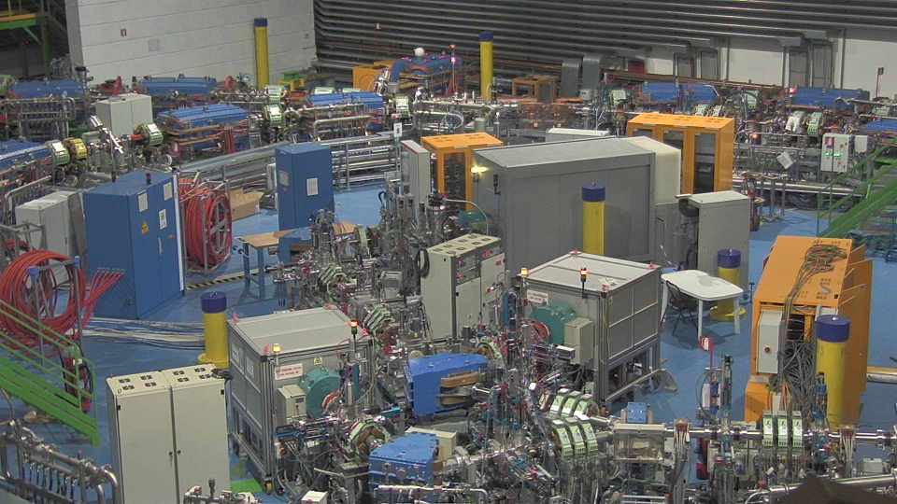
New source

Slide 9
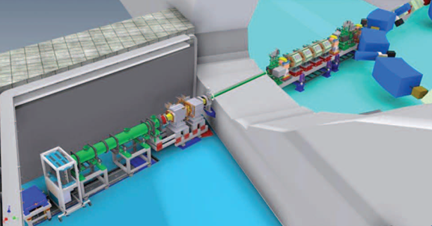
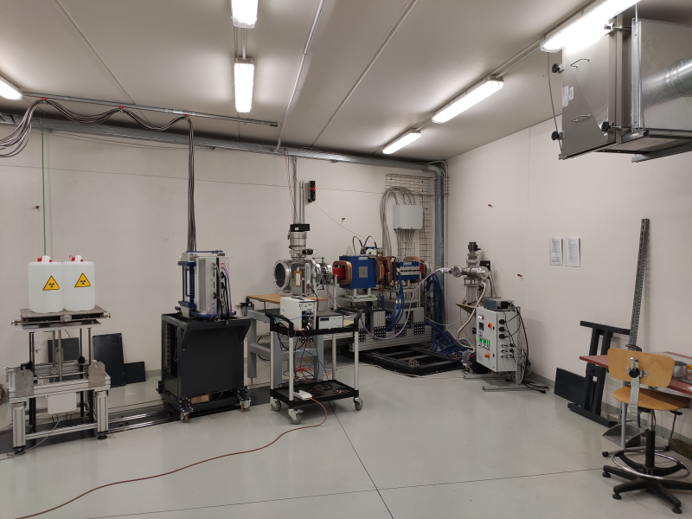
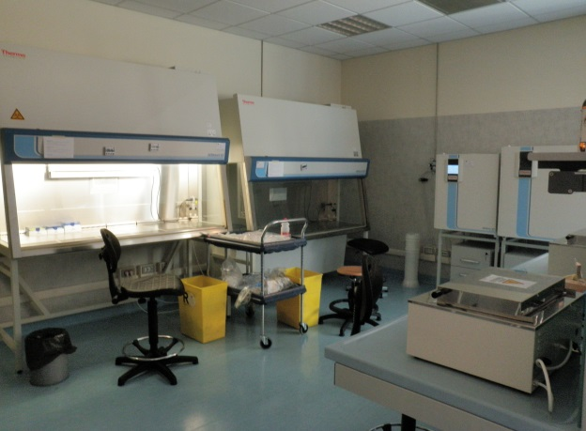
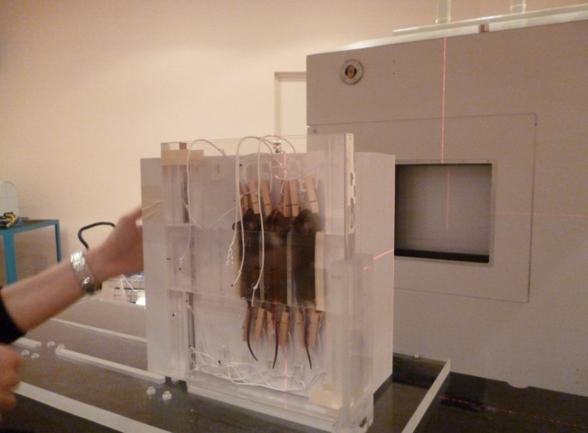
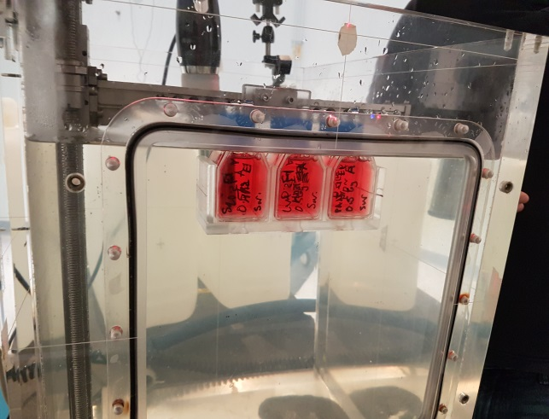
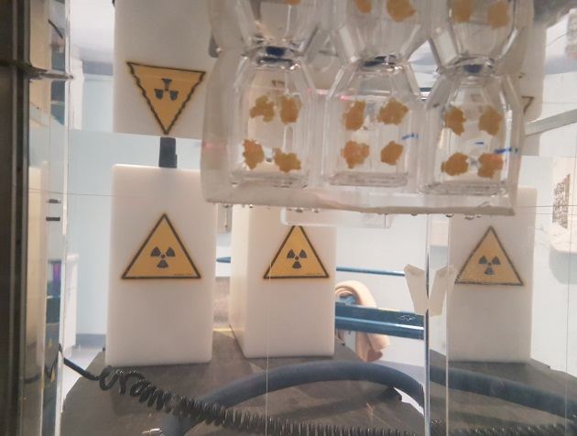
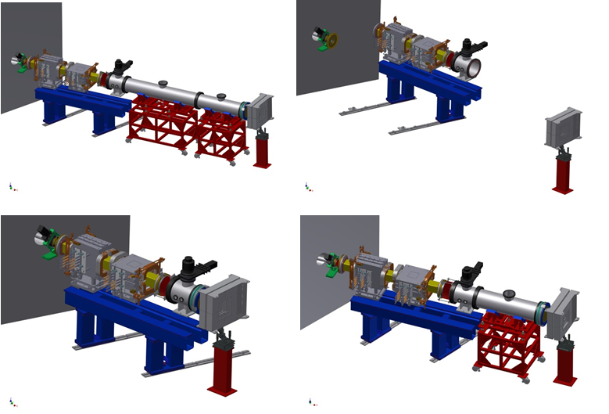
CNAO experimental room and facility
Biological laboratory with all the
necessary equipment to prepare
and process cell samples is
available on site.
Small animal irradiation is possible
taking advantage of the nearby
animal house facility of the
University of Pavia
Multiple configuration
Accessible during treatment
Experiments can be installed
for many days
DDS customization possible

Slide 10
Available beams
FWHM ~10 mm
(particle and energy
dependent)
Irradiation field
< 200 x 200 mm²
[iso4]
Max distance
downstream target
< 5.5 m
[iso1]
Protons
60-250 MeV
< 10¹⁰ p/spill
Carbon
120-400 MeV/u
< 4 x 10⁸ C/spill
I
~1s
~2s
En.1
En.2
En.3
t
Low intensities (10³ part/s) possible

Slide 11
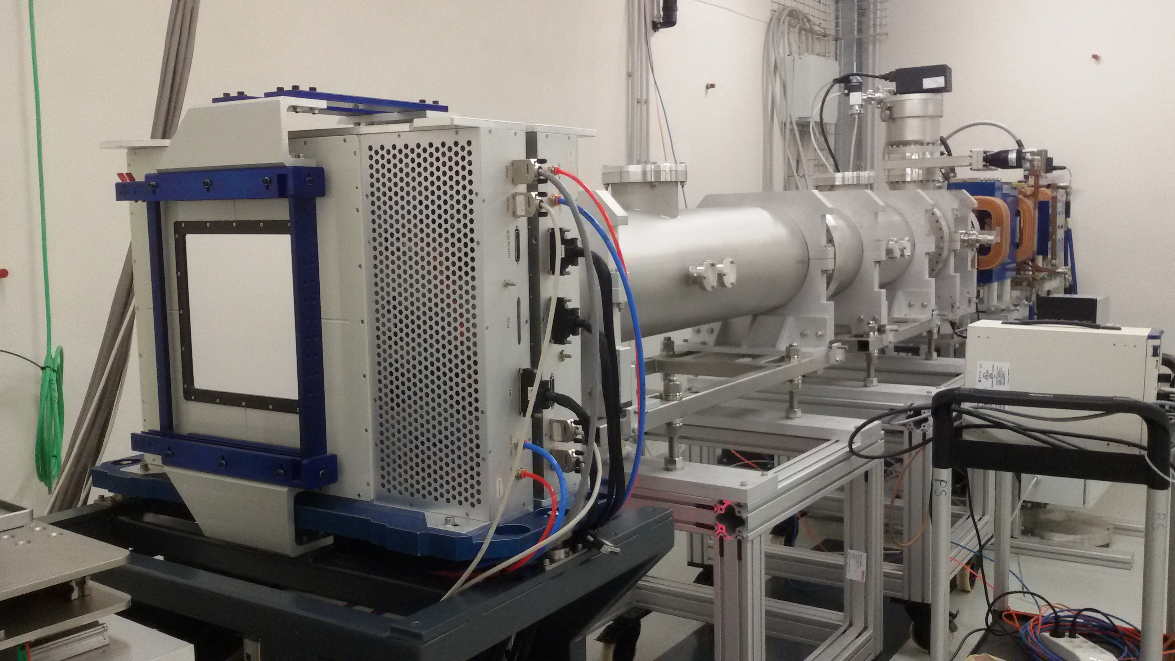

Low intensity Monitor for XPR
Monitor for intensities up to 10⁵ – 10⁶ part/s
It measures intensity, position and size
It can replace one of the DDS boxes in the nozzle
Ita can work both as standalone detector and as
DDS monitor for low intensity “treatments”
128 + 128 scintillating fibers 1 mm wide
Commercial boards (CAEN) based DAQ
Collaboration with INFN Roma - SBAI
Under construction

Slide 12
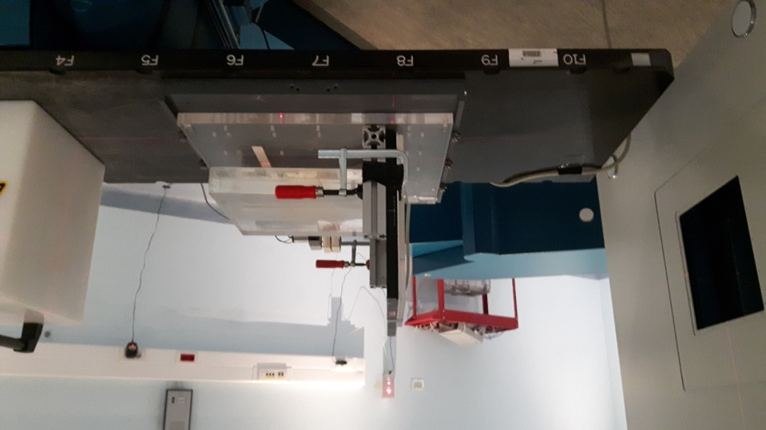
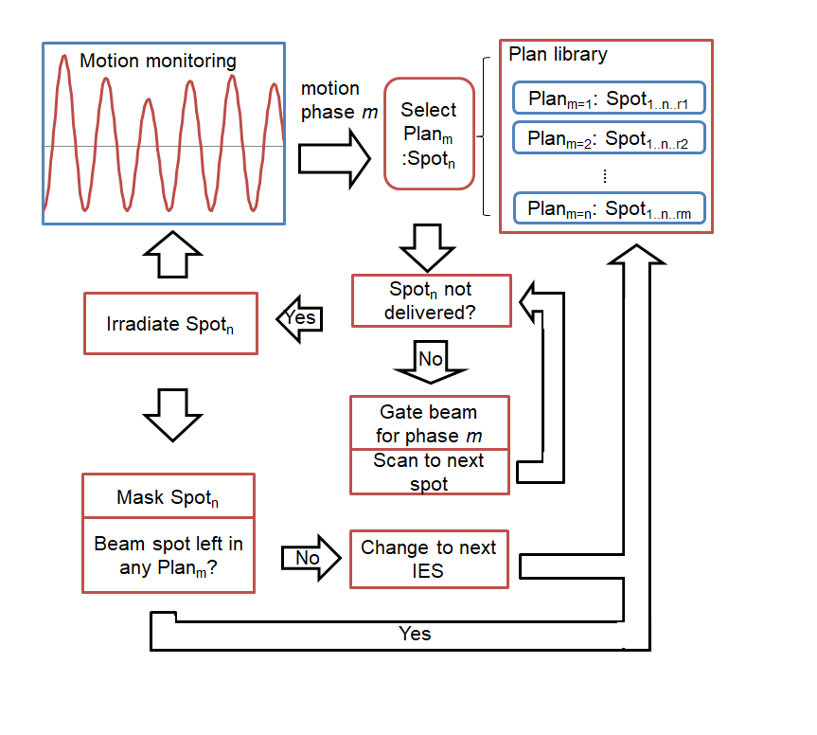
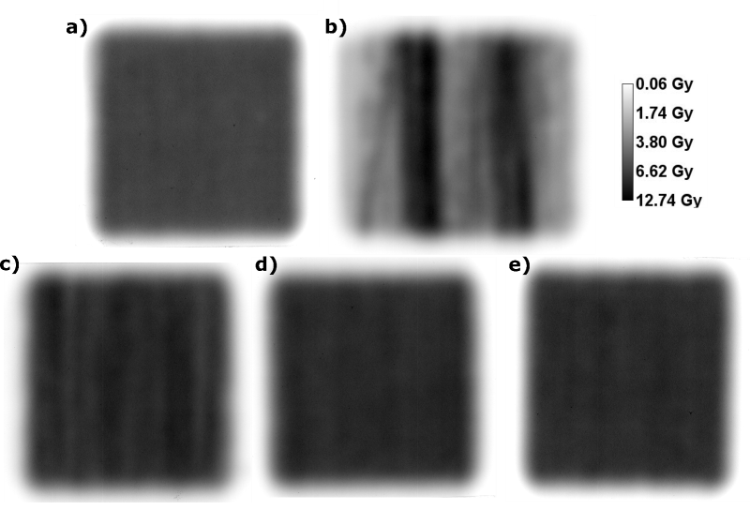

New DDS
Collaboration with GSI for 4D treatment: compensation of breath related
tumour movement. Subdivide treatment in respiratory phases.
Standard treatment
Standard treatment on moving detector
Treatment subdivided in 10 phases
Notes:
E’ stata instaurata una collaborazione con il centro GSI per lo sviluppo di un nuovo sistema di distribuzione della dose
per compensare il movimento del tumore durante il ciclo di respirazione.
Per ogni fase respiratoria si costruisce un piano che rilascia un parte della dose totale e
durante il trattamento il piano erogato cambia in base alla fase istantanea fino al completamento del piano totale.

Slide 13
Typical research activities
Many reasearch activities on technical, preclinical and translational subjects
Typical research subjects carried out at CNAO are aimed at improving treatment
  Improving the understanding of biological mechanisms
  Improving the knowledge of basic physical processes
  Improving the technical performance of the accelerator system
  Improving the technical performance of the dose delivery
    Motion management and 4D delivery
    Range verification (Inside PET, HeCheck, prompt gamma,…)
  Providing new types of radiation (new weapons to the clinician)
Collaborations with many institutions

Slide 14
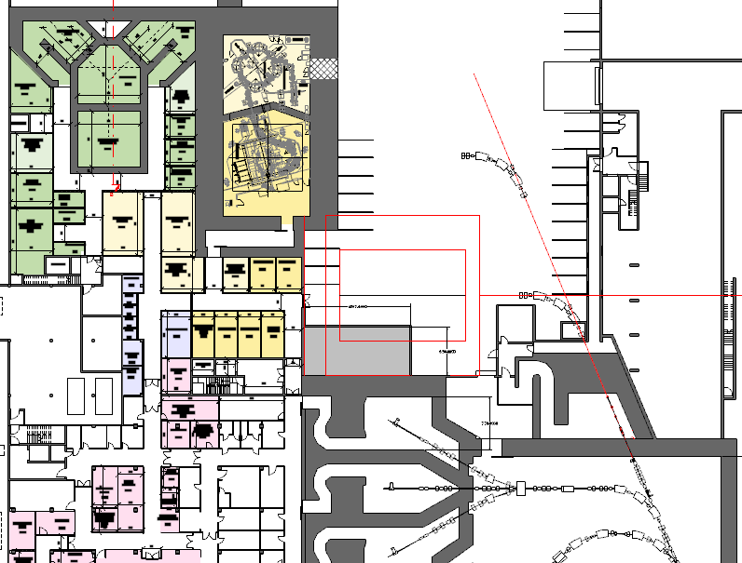
CNAO Expansion phase 1-2
BNCT:
1 treatment room
1 experimental room
p gantry
New XPR
BNCT
Carbon gantry

Slide 15
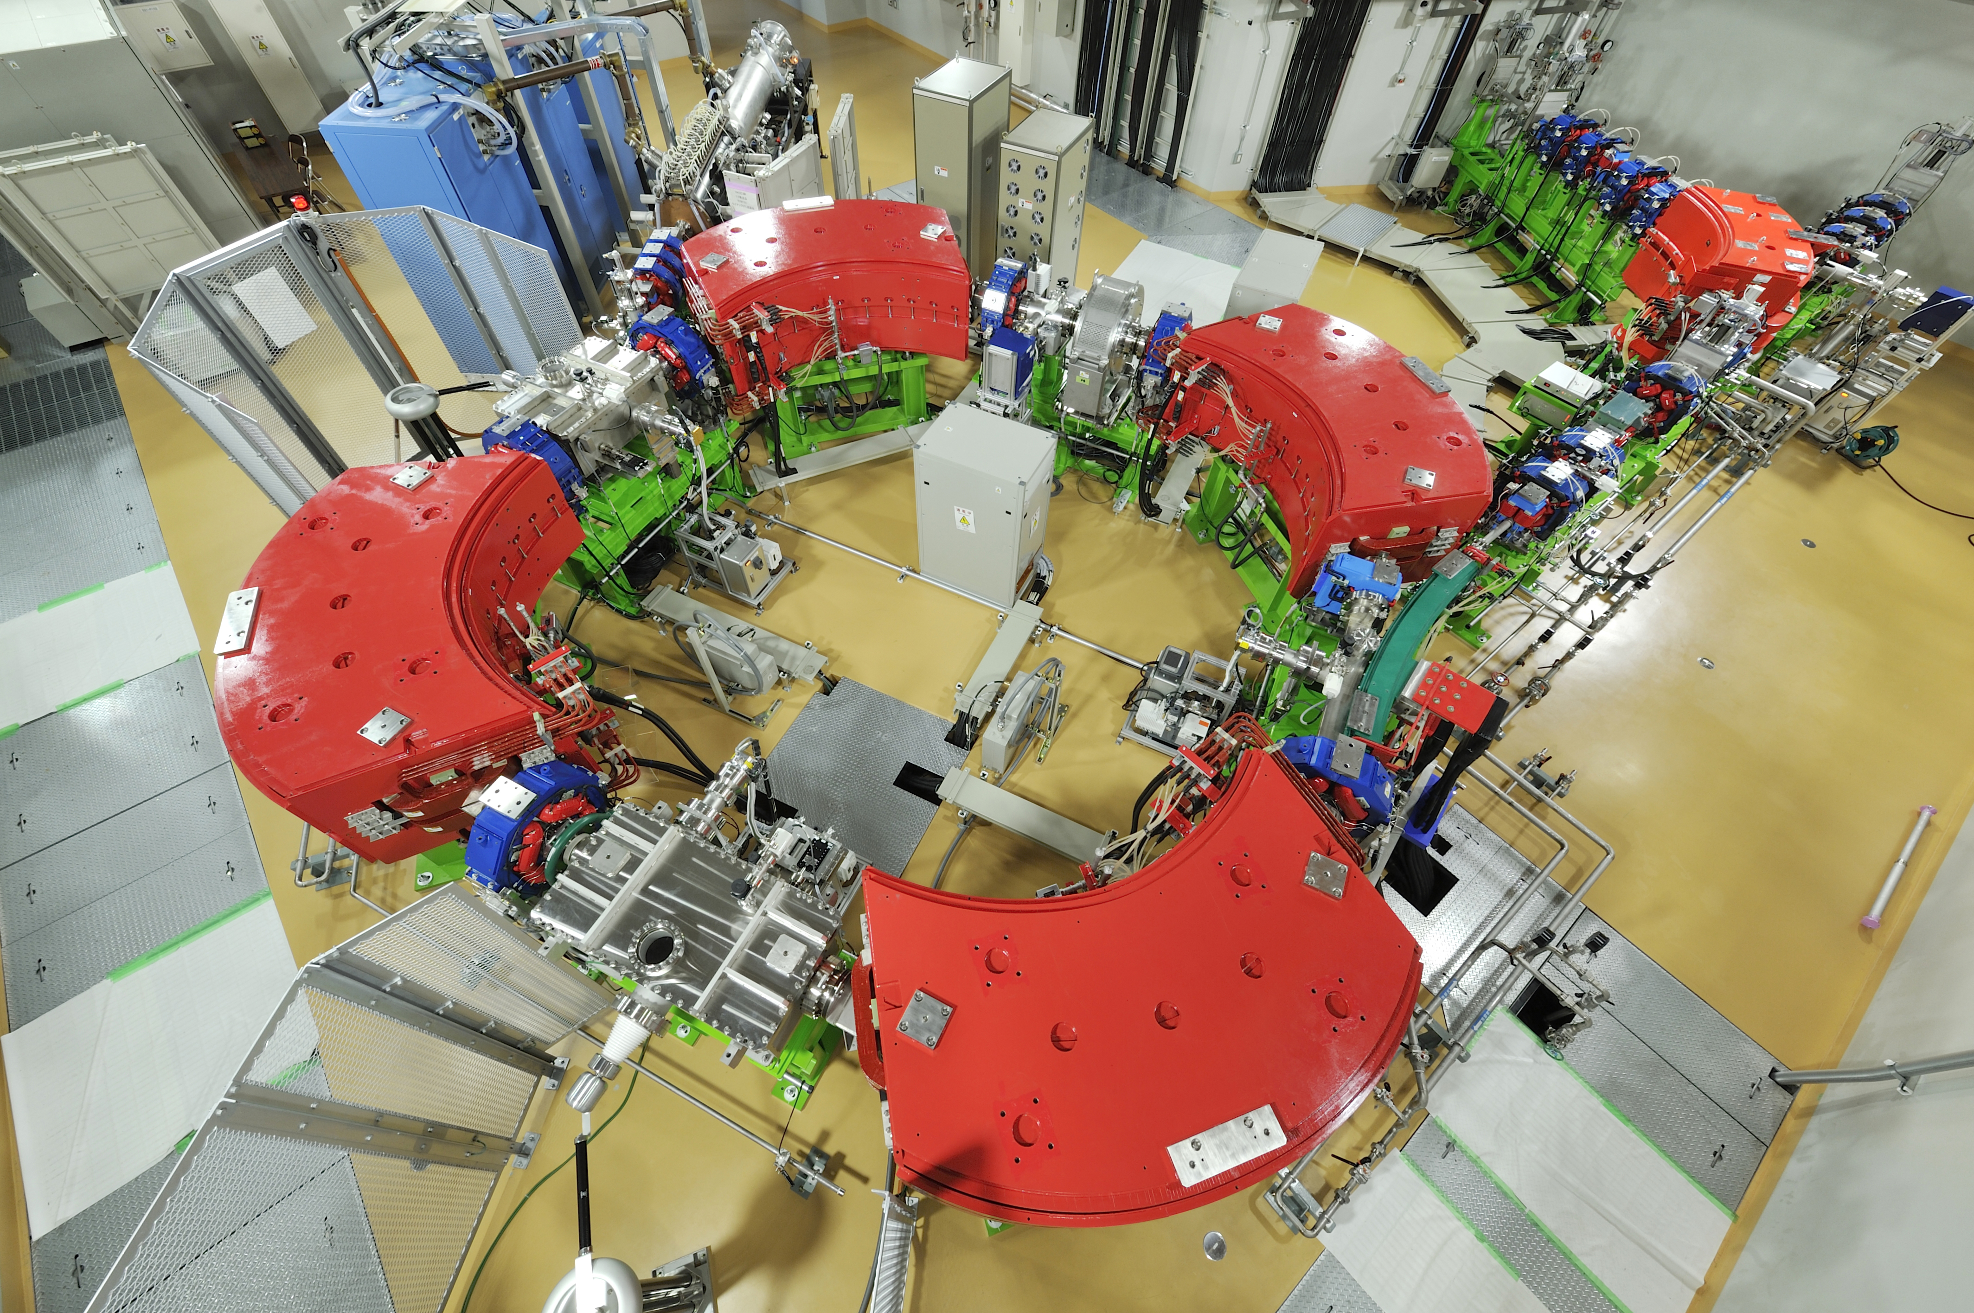
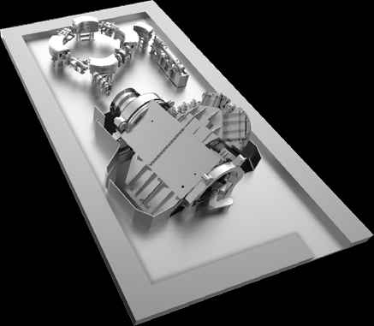
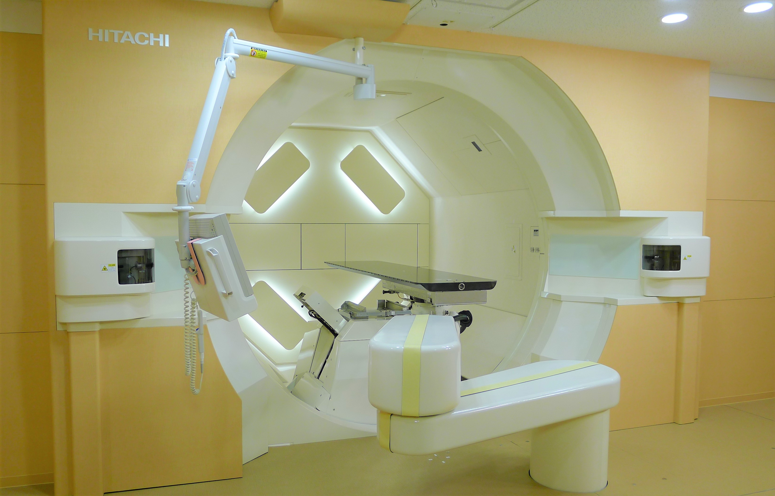
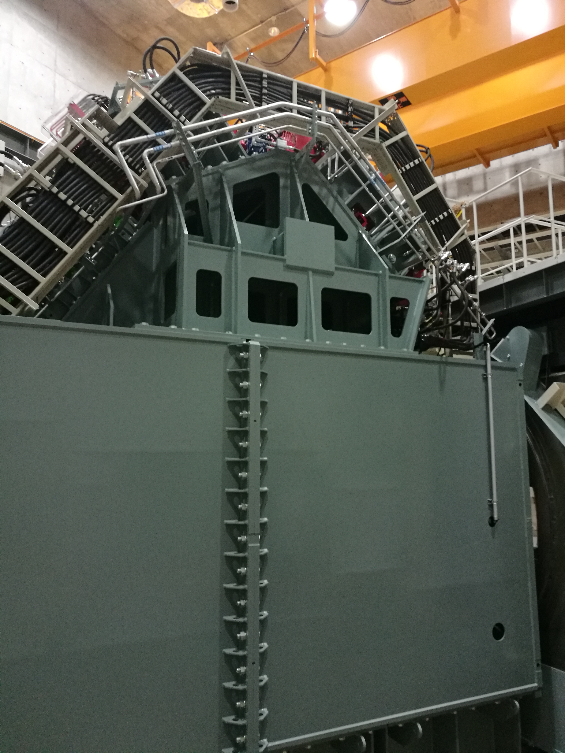
Single room facility with gantry for protons
Synchrotron room
Installation to begin in a few weeks
Treatment room
360°isocentric gantry
(Field size: 30x40 cm²)

Slide 16
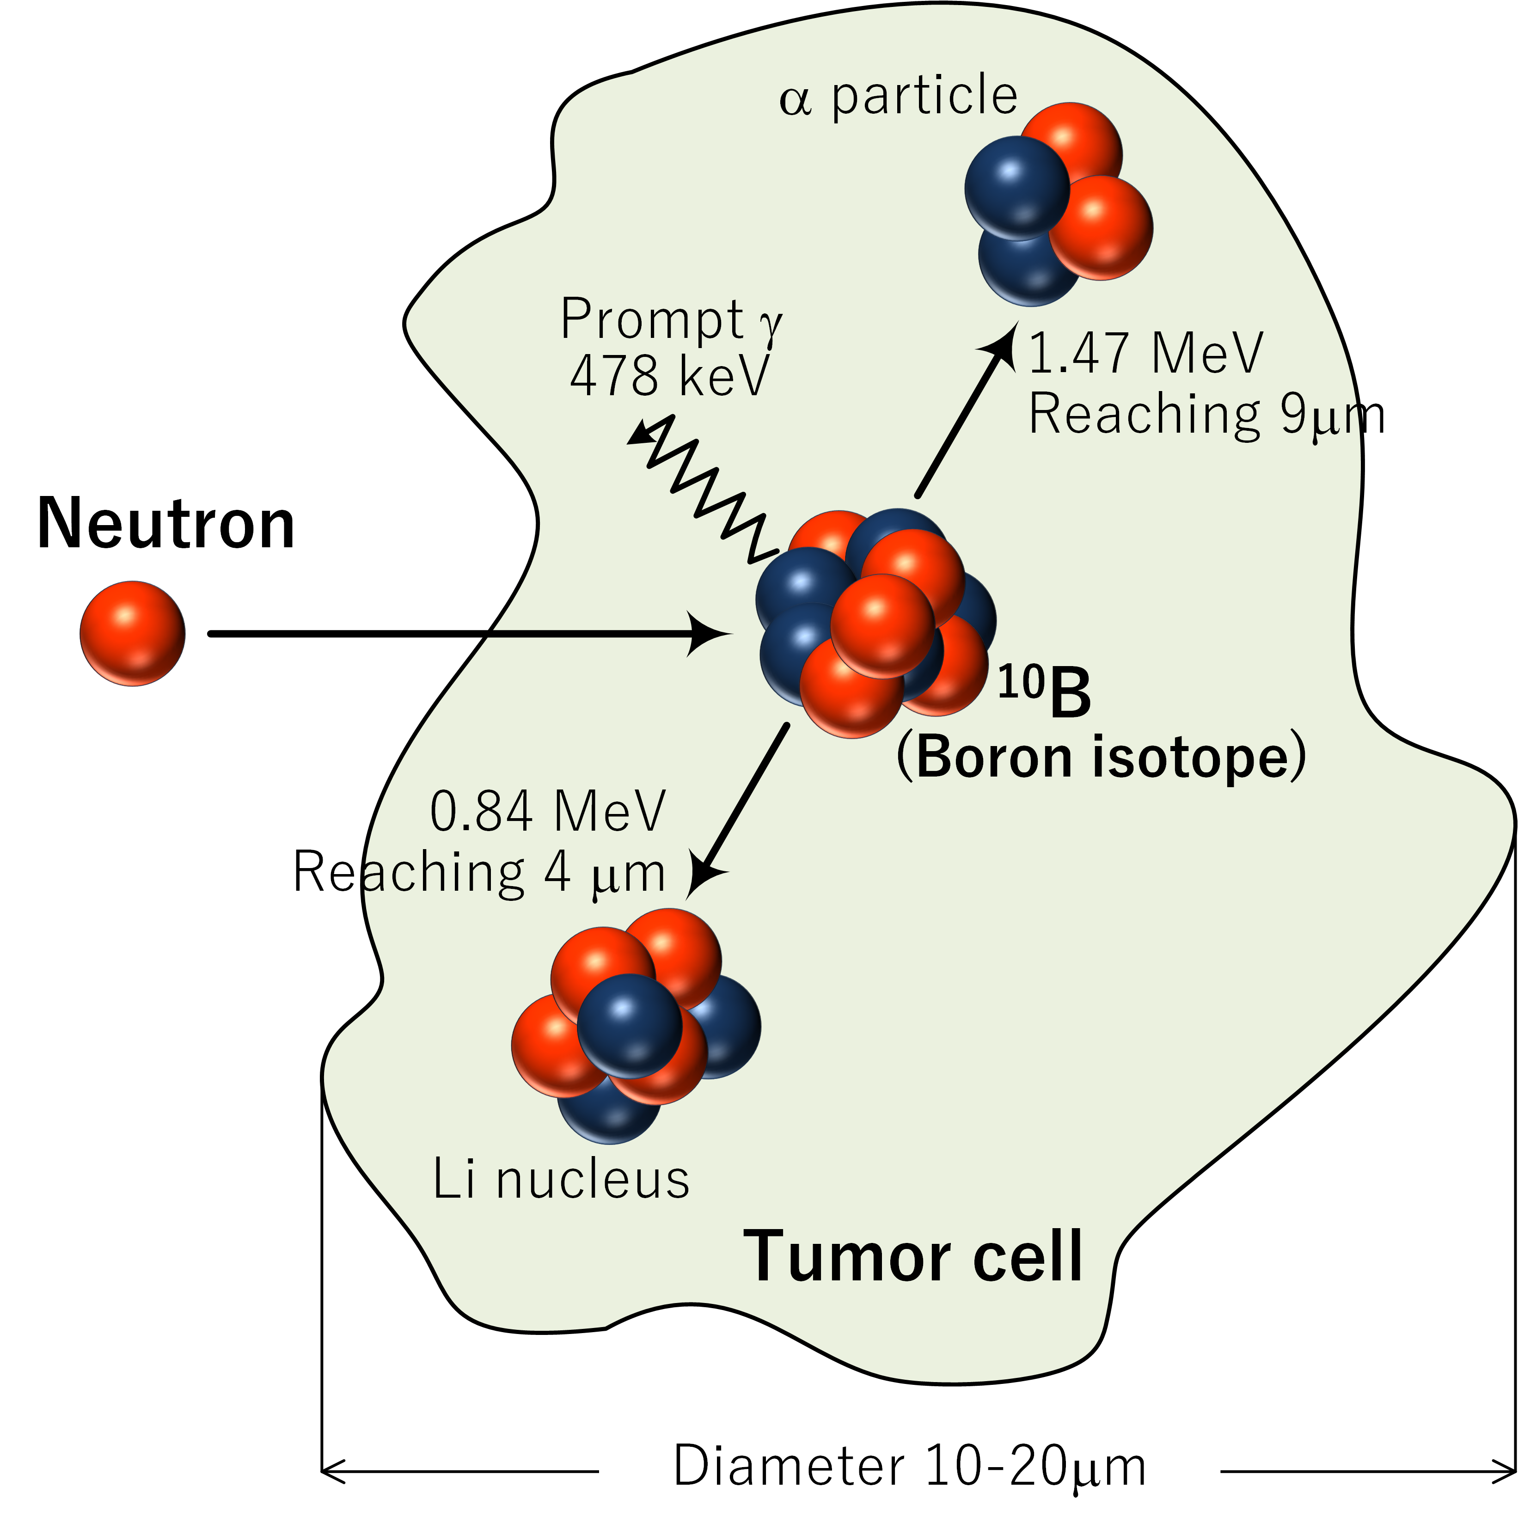
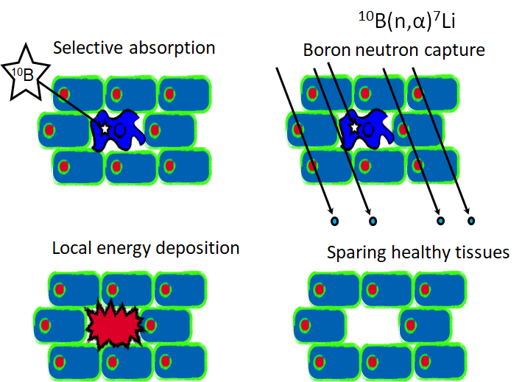
BNCT
Boronated drug that selectively reaches the tumour cells and avoids the healthy tissues
Accelerator driven neutron production
First Approved BNCT Drug (in Japan), May 2020
Notes:
STELLA PHARMA will launch
Steboronine®, the World's First BNCT Drug,
on May 20, 2020

Slide 17
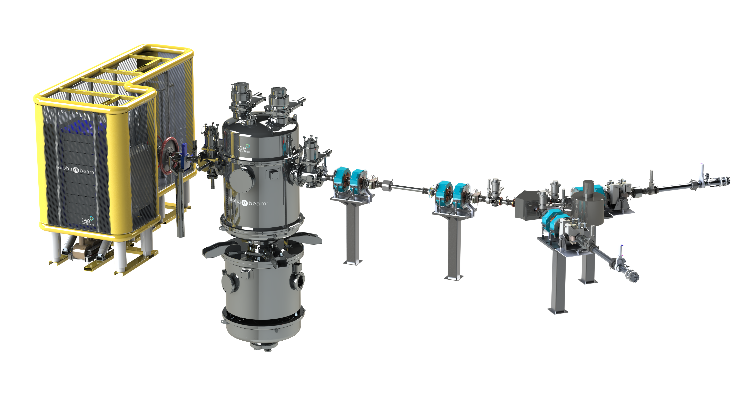

Accelerator based BNCT
Collaboration agreement signed September 2020
Proton energy 2.5 MeV
Intensity 10-15 mA
p-Li reaction
Notes:
neutron yield at 10 mA
8.9 × 10¹² [s⁻¹]
Avg neutron energy 0.55 MeV at 0°
$N={10}^{9}$[/cell], $Φ=1.8×{10}^{16}$ [m⁻²] (30 minutes irradiation by flux ${10}^{9}$[n/cm²/s ]):
$P(0)=e^{−6.84}=0.001$ (mostly fired)
$P\left(0\right)=\frac{{\left\langle n\right\rangle }^{0}e^{−\left\langle n\right\rangle }}{0!}=e^{−\left\langle n\right\rangle }$ $= e^{−NσΦ}$
$N={10}^{9} \text{[/}\text{cell}\text{], }Φ=1.8×{10}^{15}\text{ [}\text{m}\text{−2}\text{] }\text{(30 }\text{minutes} \text{irradiation} \text{by} \text{flux} {10}^{8}\text{[}\text{n}\text{/}\text{cm}\text{2}\text{/}\text{s}\text{ ])}\text{:}$
$P(0)=e^{−0.684}=0.505$ (the half is not fired)

Slide 18
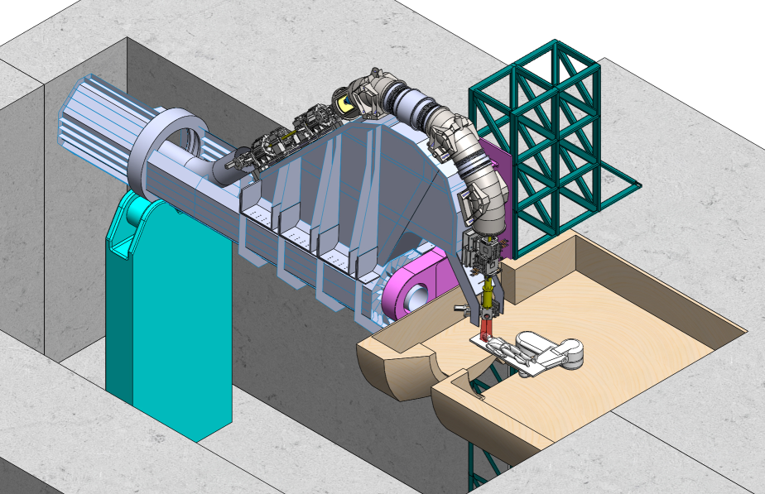

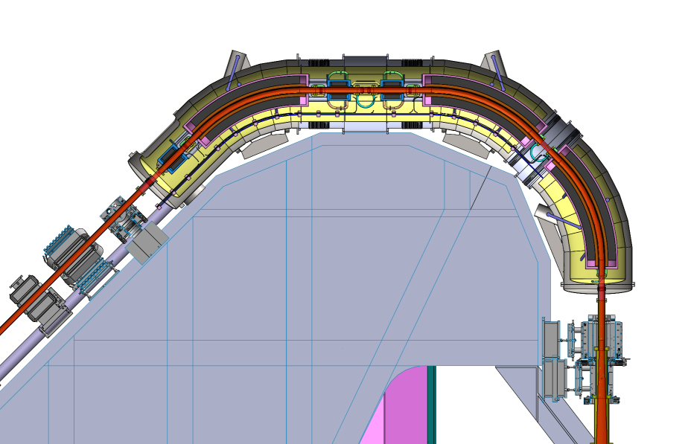
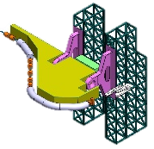
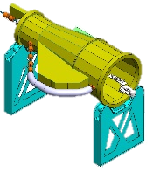
SC Gantry
SIGRUM
CNAO-CERN-INFN-MedAustron collaboration
HITRI+ and IFAST

Slide 19
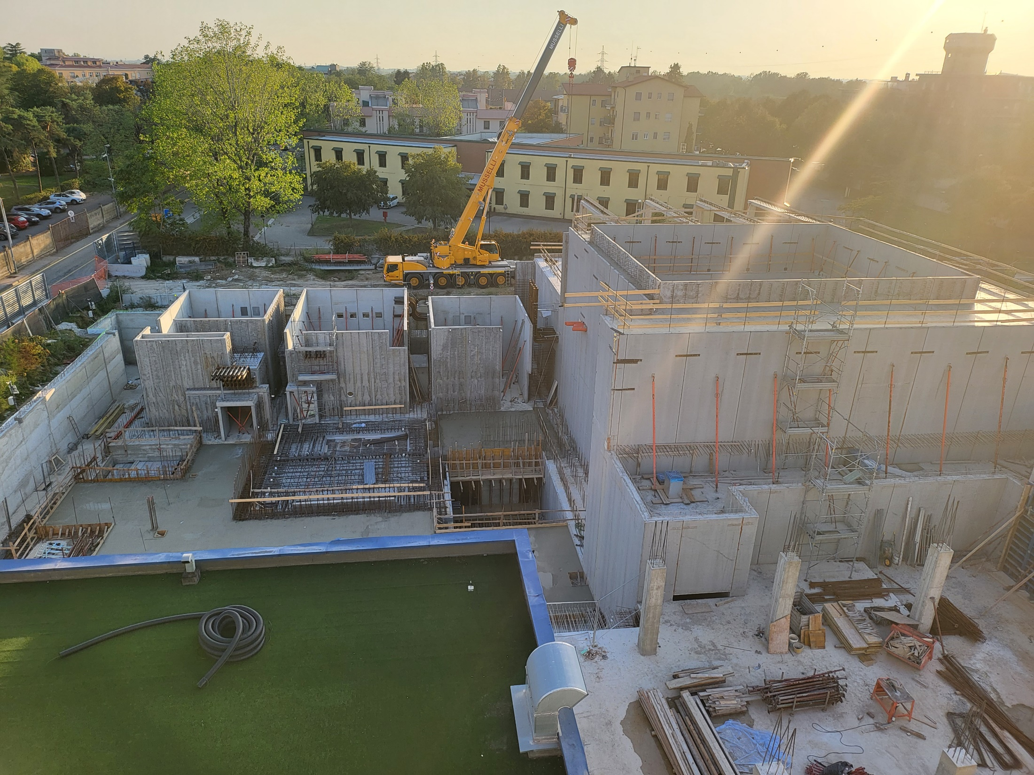
Thank you for your attention

