Slide 1
Medaustron facility overview
Greta Guidoboni
5th Slow Extraction Workshop
Wiener Neustadt
12/02/2024

Slide 2
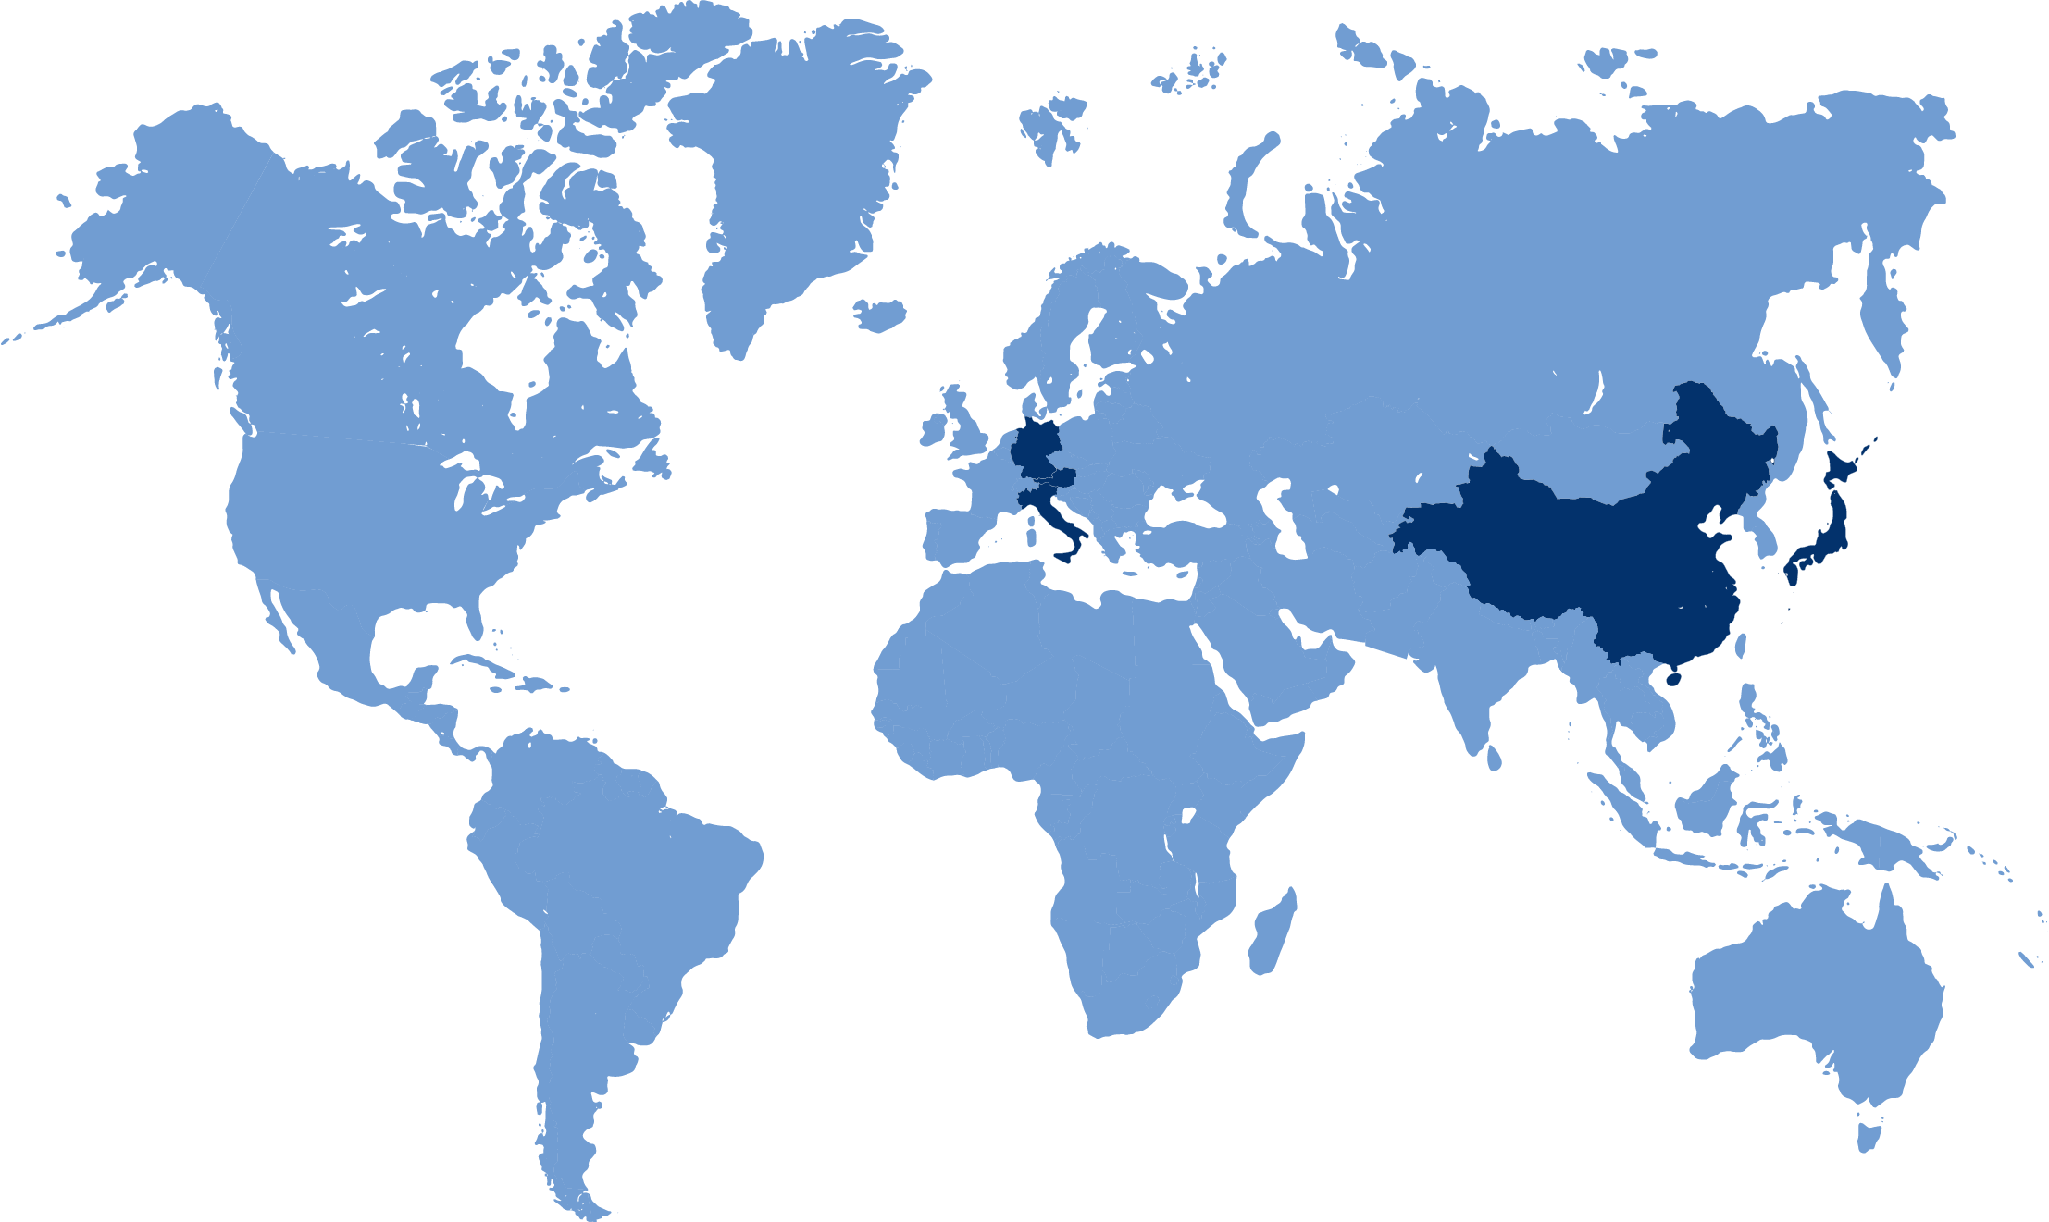
introduction
Austria
(MedAustron)
Germany
(HIT and MIT)
Japan
(HIBMC)
Italy
(CNAO)
China
(SPHIC)
One of the 6 centers, worldwilde, providing Proton and Carbon Ion therapy
https://www.ptcog.site/index.php/facilities-in-operation-public

Slide 3
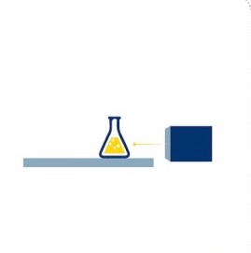
Company History
Ground breaking
Reorientation: MedAustron – therapy and research
EIA process
Company foundation EBG
CE certification & 1st patient
MedAustron feasibility and design studies
Building finished
2005
2009 - 2010
2011
2013
1989 - 1994
1996 - 2000
2014 - 2016
2016
1995
1998 - 2004
2007
2012
2007 - 2012
Signing basic agreement on realisation Rep. of Austria - Federal State of Lower Austria – city of Wiener Neustadt
Start accelerator installation
AUSTRON feasibility study (research facility neutron spallation)
Start Start research program
Proton-Ion Medical Machine Study
Cooperations CERN & CNAO: design, tendering, manufacturing of accelerator components
Commissioning, preparation certification

Slide 4
Medaustron IN FEW NUMBERS
26%
20%
16%
16%
12%
5%
3%
2%
<1%
<1%
<1%
<1%
CNS
Head & Neck
Re-Irradiation
Pediatrics
Sarcoma
Skull Base
Prostate
Gastrointestinal (upper)
Gastrointestinal (lower)
Gynecological Tumors
Urogenital Tumors
Breast/Mamma-Ca<
Since 2016:
> 2000
Patients
> 50,000
Single Fractions
TEAM
~300 employees from 20 different countries
Values as of September 2023

Slide 5
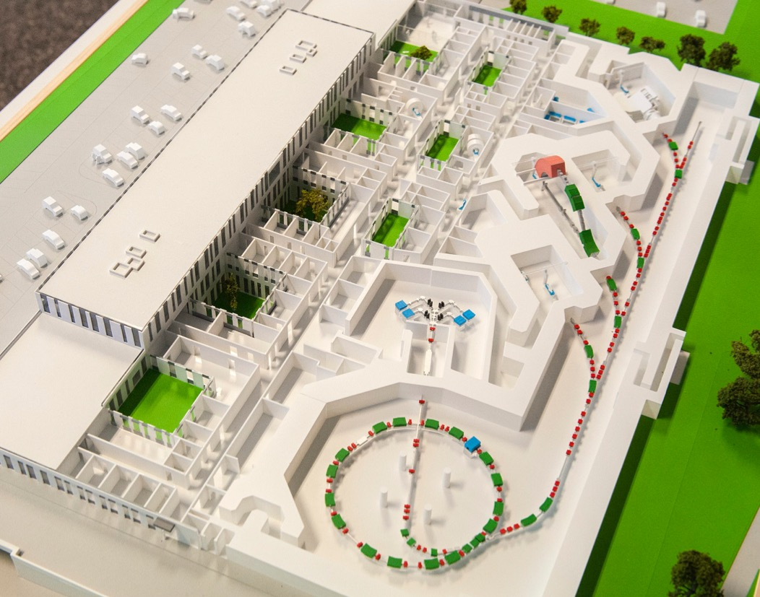
Facility overview
TOUR ON THURSDAY!
Irradiation Rooms Three rooms for patient treatments
IR4 – Gantry and rotator
Proton
IR3 – Fixed beam line
Horizontal
Proton and Carbon
Research Irradiation room for non-clinical use
IR2 – Fixed beam line
Hor + Ver
Proton and Carbon
Ion Sources and linear accelerator
S1 → p
S2 → C
S3 → He
IR1 – Fixed beam line
Hor
Proton, Carbon and
Helium ions!
140 m
Synchrotron
Circ. ~77 m

Slide 6
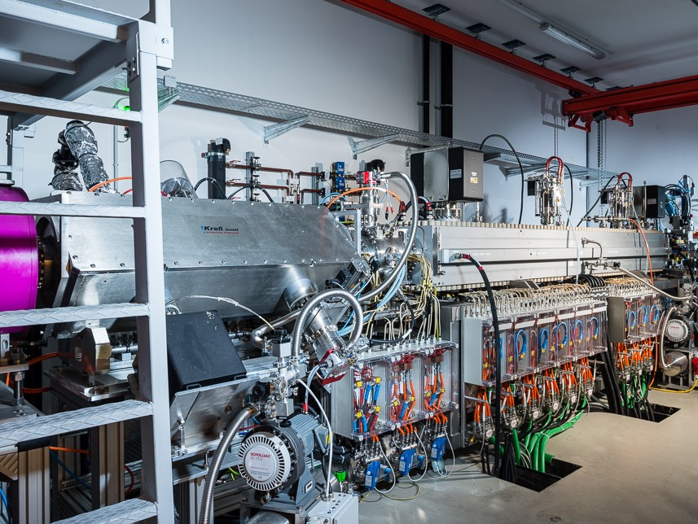
Linear accelerator

Slide 7
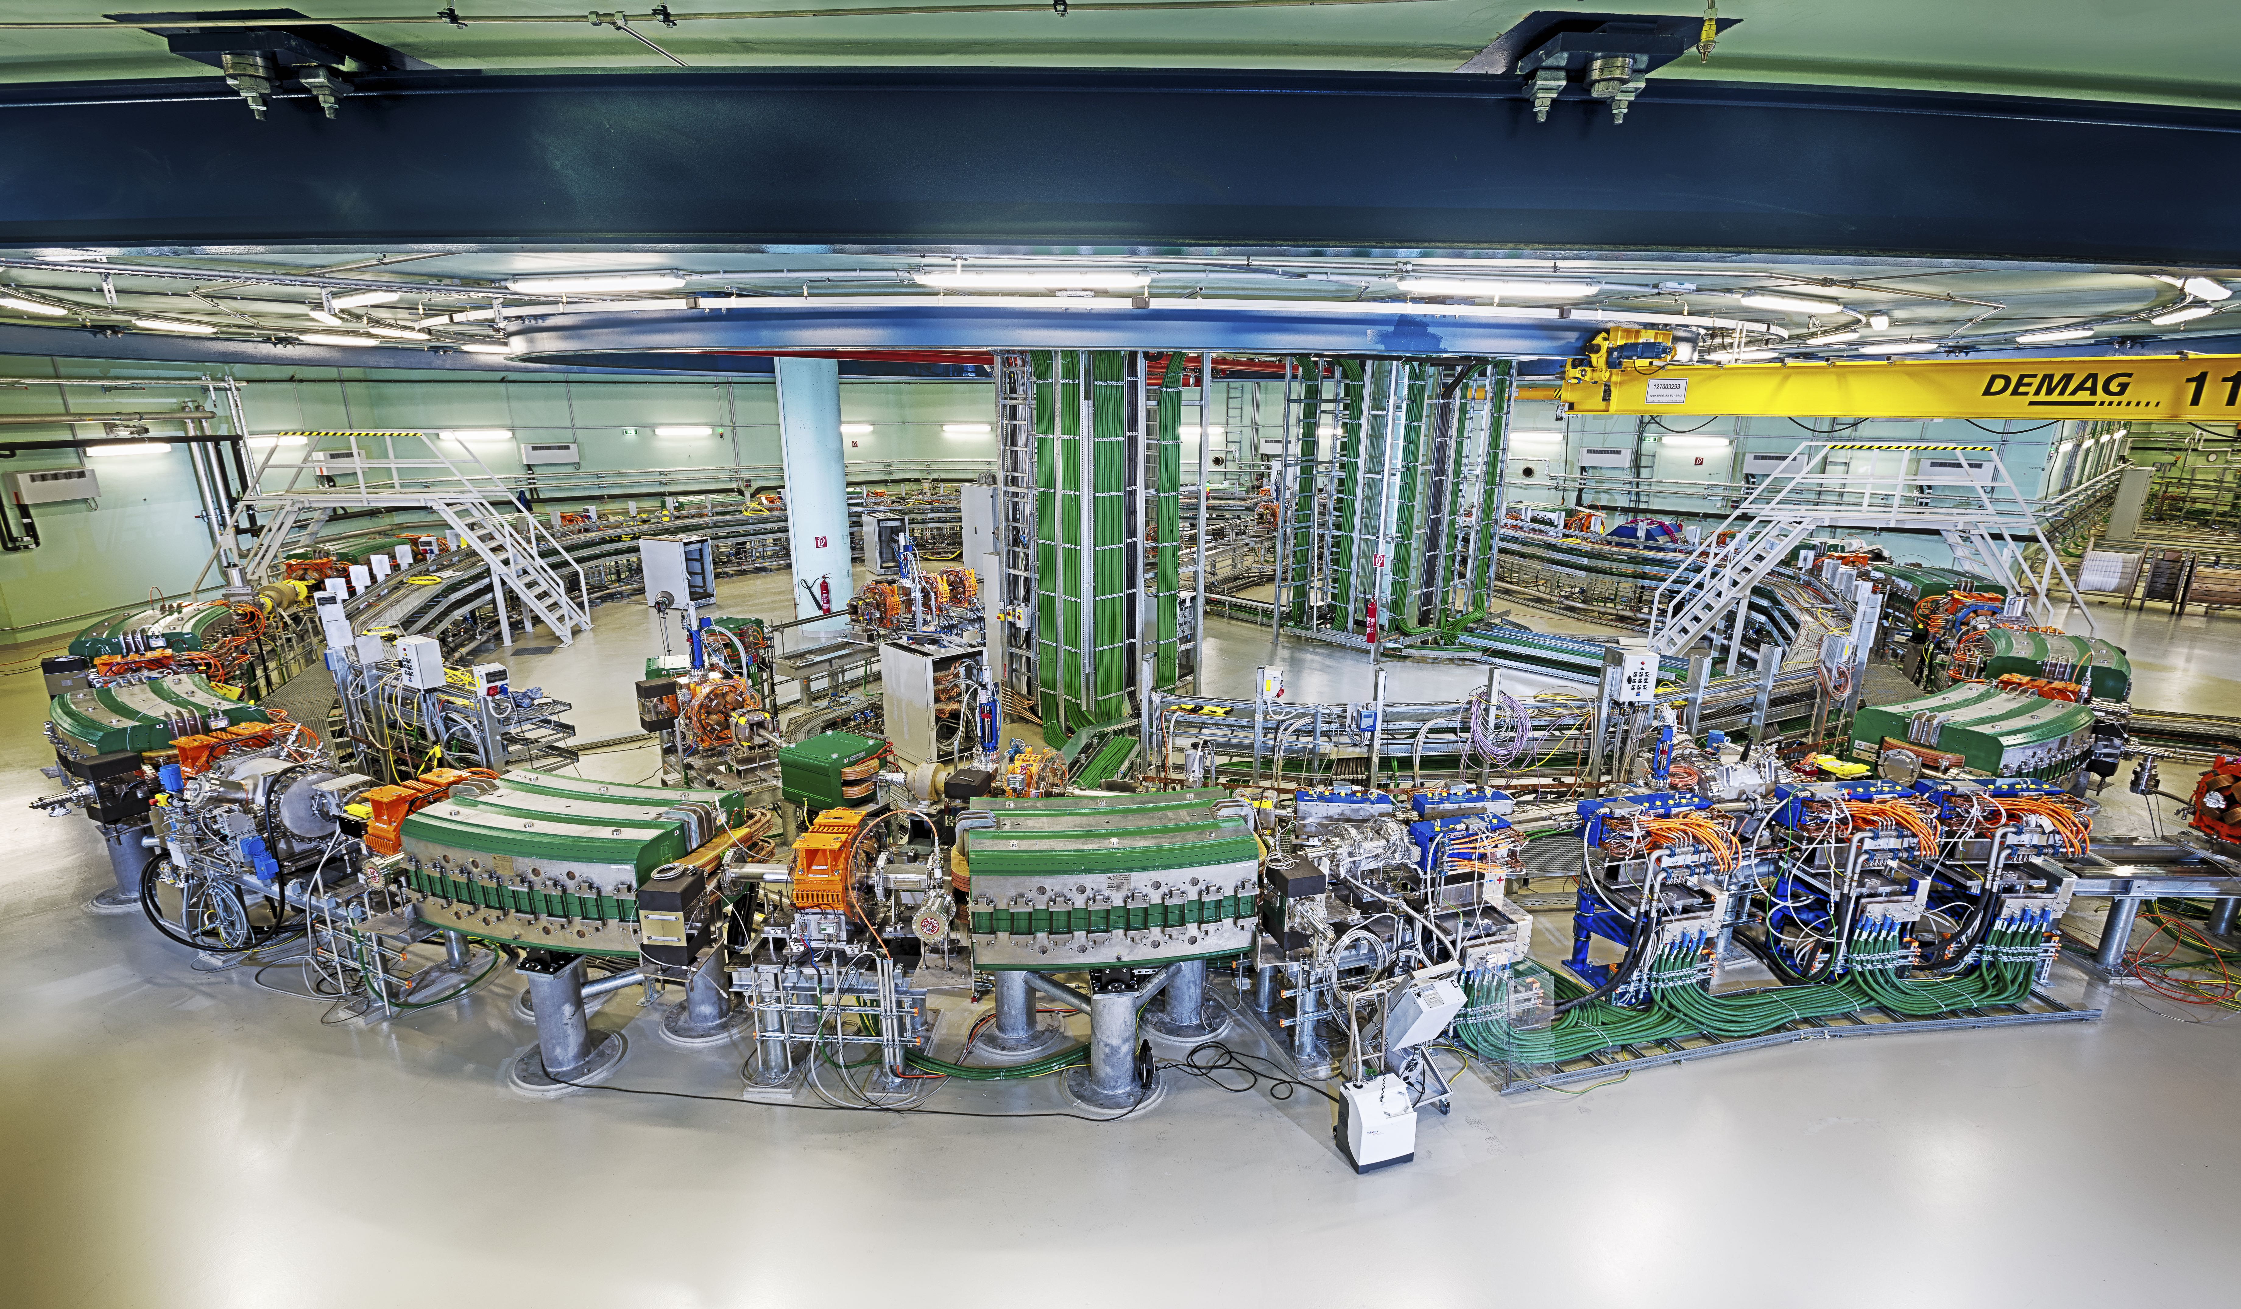
Synchrotron

Slide 8
high energy transfer line HEBT

Slide 9
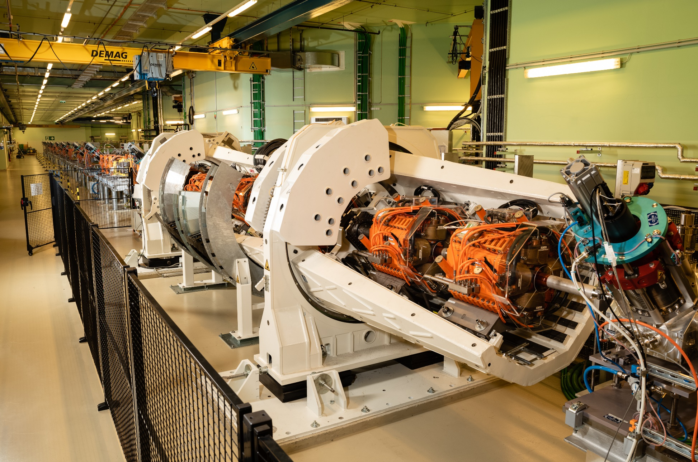
Rotator and Proton GANTRY
World-wide first Rotator system
7 quadrupoles
Rotating synchronously with the Gantry
→ Beam parameters at the isocenter are independent from Gantry angle
M. Pivi at al, IPAC’22 https://accelconf.web.cern.ch/ipac2022/papers/thpoms002.pdf

Slide 10
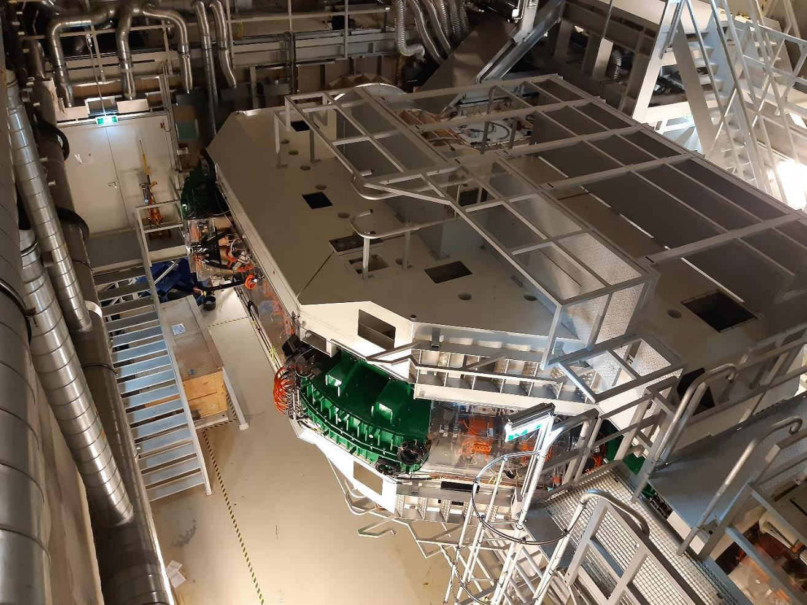
Rotator and Proton GANTRY
Weight ~ 220 tons

Slide 11
Rotator and Proton GANTRY

Slide 12
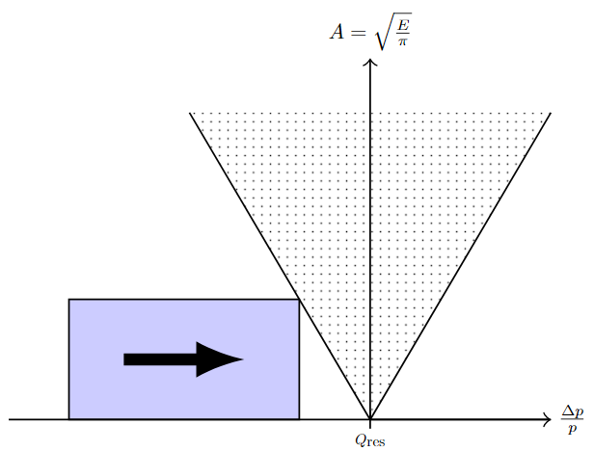
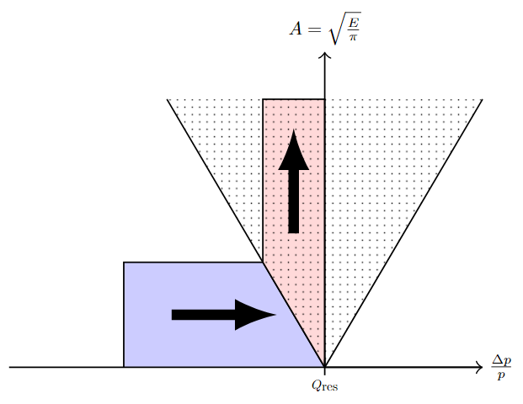
Slow extraction at medaustron
CURRENT STATUS
Slow extraction based on:
third order integer resonance
using a Betatron core to drive beam into unstable region with resonant sextupole to enlarge the stopband
RF channeling for all particle types
Clinical extraction times of 10 seconds (0.1-30 seconds available for research & development)
Downward operation (from MAX to MIN energy)
p → 252.7 - 62.4 MeV, (800 MeV only for research)
C → 402.8 – 120.0 MeV/n
He → 402.8 – 40.0 MeV/n (under commissioning)

Slide 13
Slow extraction at medaustron
STUDIES and FUTURE DEVELOPMENTS
General overview
Within the IFAST-REX collaboration
Florian Kühteubl (MedAustron and TUW)
“IFAST-REX slow extraction survey”
RFKO future implementation
Efficiency increase (less losses and chopping)
Necessary for Multi Energy Extraction and Dynamic Intensity Control
Markus Wolf (MedAustron)
“Development of a RF system for Slow Extraction signal generation and measurement”
Fabien Plassard (MedAustron)
“Beam loss optimization for slow extraction at MedAustron”
“Simulation of multi-energy extraction with RFKO”
Studies and applications
In collaboration with CERN and TUW
Florian Kühteubl (MedAustron and TUW)
“Beam ripple studies at MedAustron”
“Slow extraction developments at MedAustron”
Elisabeth Renner (TUW)
“Simulation study of mixed He2+/C6+ beam slow extraction for online range-verification”

Slide 14
Thanks for your attention and enjoy the workshop!
Rosenmontag!
In Wiener Neustadt city center → https://konditorei-ferstl.at/

Slide 15
Areas of research
Clinical • translational • scientific

Slide 16
RESEARCH AT MEDAUSTRON
CLINICAL
RESEARCH
INTERDISCIPLINARY ONCOLOGY RESEARCH
TRANSLATIONAL & SCIENTIFIC
RESEARCH
Registry study
Clinical studies
Creating more evidence in particle therapy
Radiation Oncology
Medical Physics
Teaching and research site of the Karl Landsteiner University
Radiation Biology
Med. Radiation Physics
Accelerator Physics
Particle Physics
In cooperation with Medical Universities Vienna & Graz, Technical University Vienna, HEPHY and FH Wr. Neustadt

Slide 17
Non-clinical research at medaustron

Slide 18
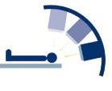
MILESTONES
P
C
He
C
P
P
P
C
C
P
2023
2022
Carbon ions horizontal beam line II
HBL-IR3
2019
2020
Start Proton Gantry &
Helium Commissioning
GBL-IR4
2018
Carbon ions vertical beam line
VBL-IR2
2017
Vertical beam line
VBL-IR2
Start treatment & research – carbon ions
HBL-IR2/IR3
2016
Pediatric treatments,
2nd room
HBL-IR2
Start treatment & research – protons
HBL-IR1/IR3

