Slide 1
Status of the Combined target project and Cryopump developments
Christian Mannweiler
Institut für Kernphysik
WWU
13th June 2023

Slide 2
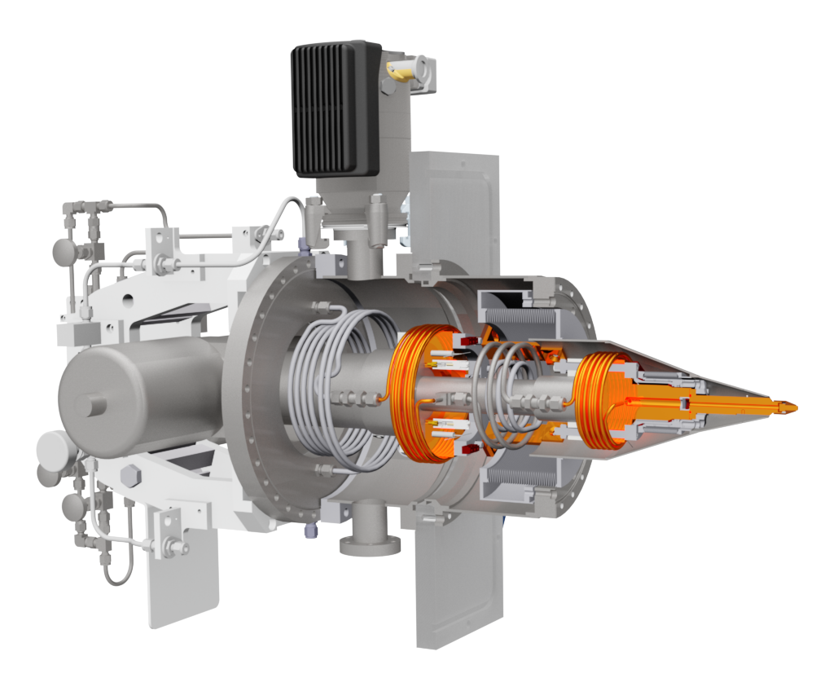
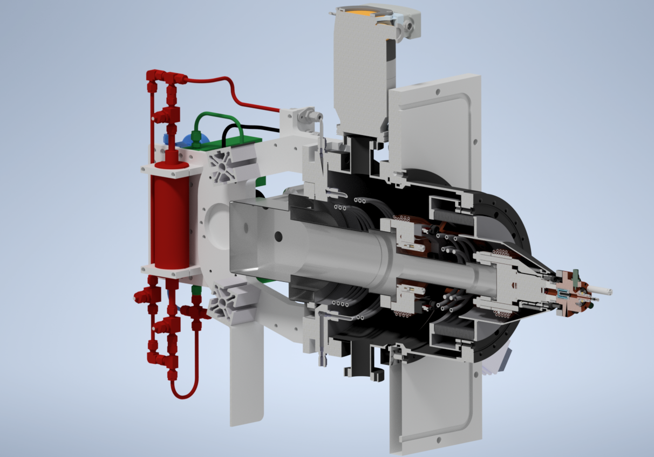
Two topics
The Combined target
The Cryopump

Slide 3
Previously…
We are working on transforming a Cluster-jet target into a pellet target:
 | Cluster-jet target | Droplet/Pellet target
Temperature | 20-50 K | 15-20 K
Gas pressure | 5-18 bar | 0.5-1.5 bar
Nozzle design | Laval nozzle | Aperture
Further requirements |  | Piezo vibrator
Can easily be fulfilled by our pre-existing Cluster-jet target systems
Requires adaptation of our Cluster-jet target system

Slide 4
Previously…
Simple process:
Only major change is performed at the nozzle system

Slide 5
Hydrogen pellet generation was achieved
First stable operation (>3h) of the pellet target achieved!
Operational parameters:
Nozzle diameter: 10µm
Gas pressure: 0.8 bar
Nozzle temperature: 16 K
Piezo frequency: 485,5 kHz
Pellet diameter: 12 µm (calculated)
However, this success has proven to not be reliably reproducible. There are still several challenges to be overcome

Slide 6
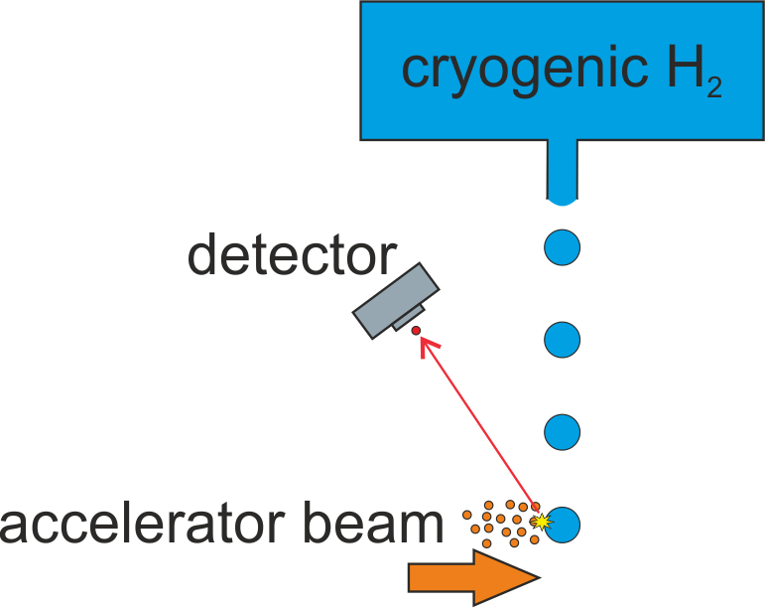
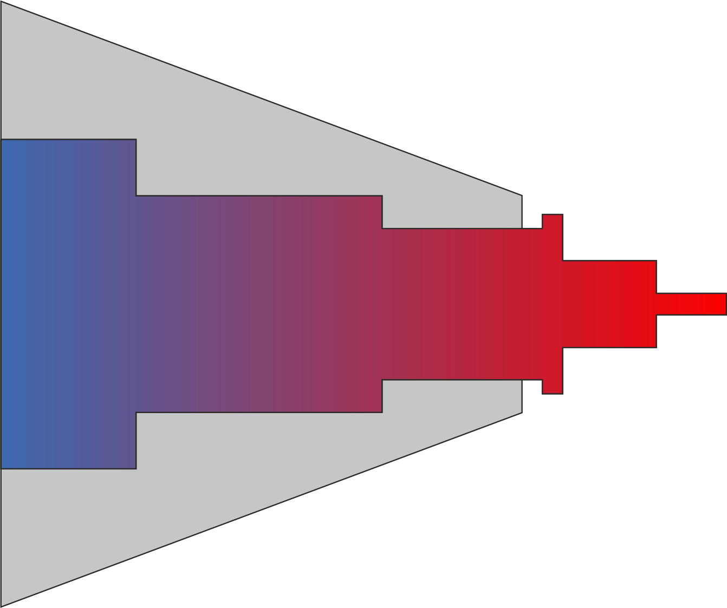
The Combined target status
There are two major challenges:
Nozzle clogging
Transfer of sufficient cooling power to the nozzle

Slide 7
Nozzle clogging
Issues created by nozzle clogging:
Frequent disruption of operation, lengthy downtime
Stable operation periods of months highly desirable for PANDA
Unstable operating conditions (gas flow, vacuum chamber pressures etc.) greatly increases the difficulty of interpreting operational parameters

Slide 8
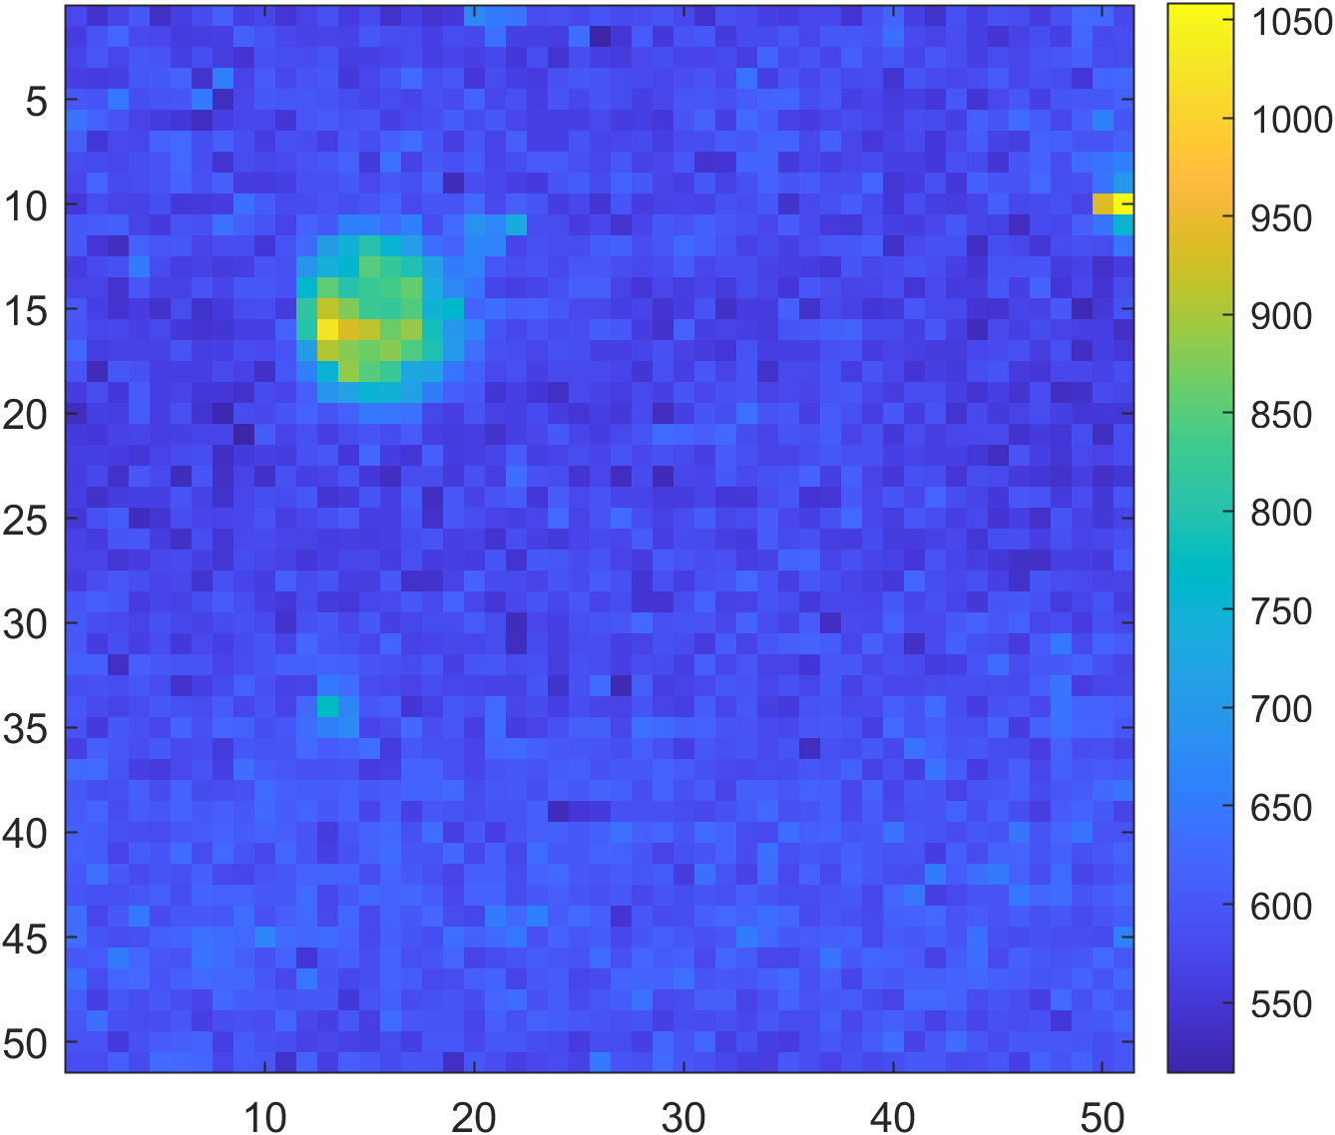
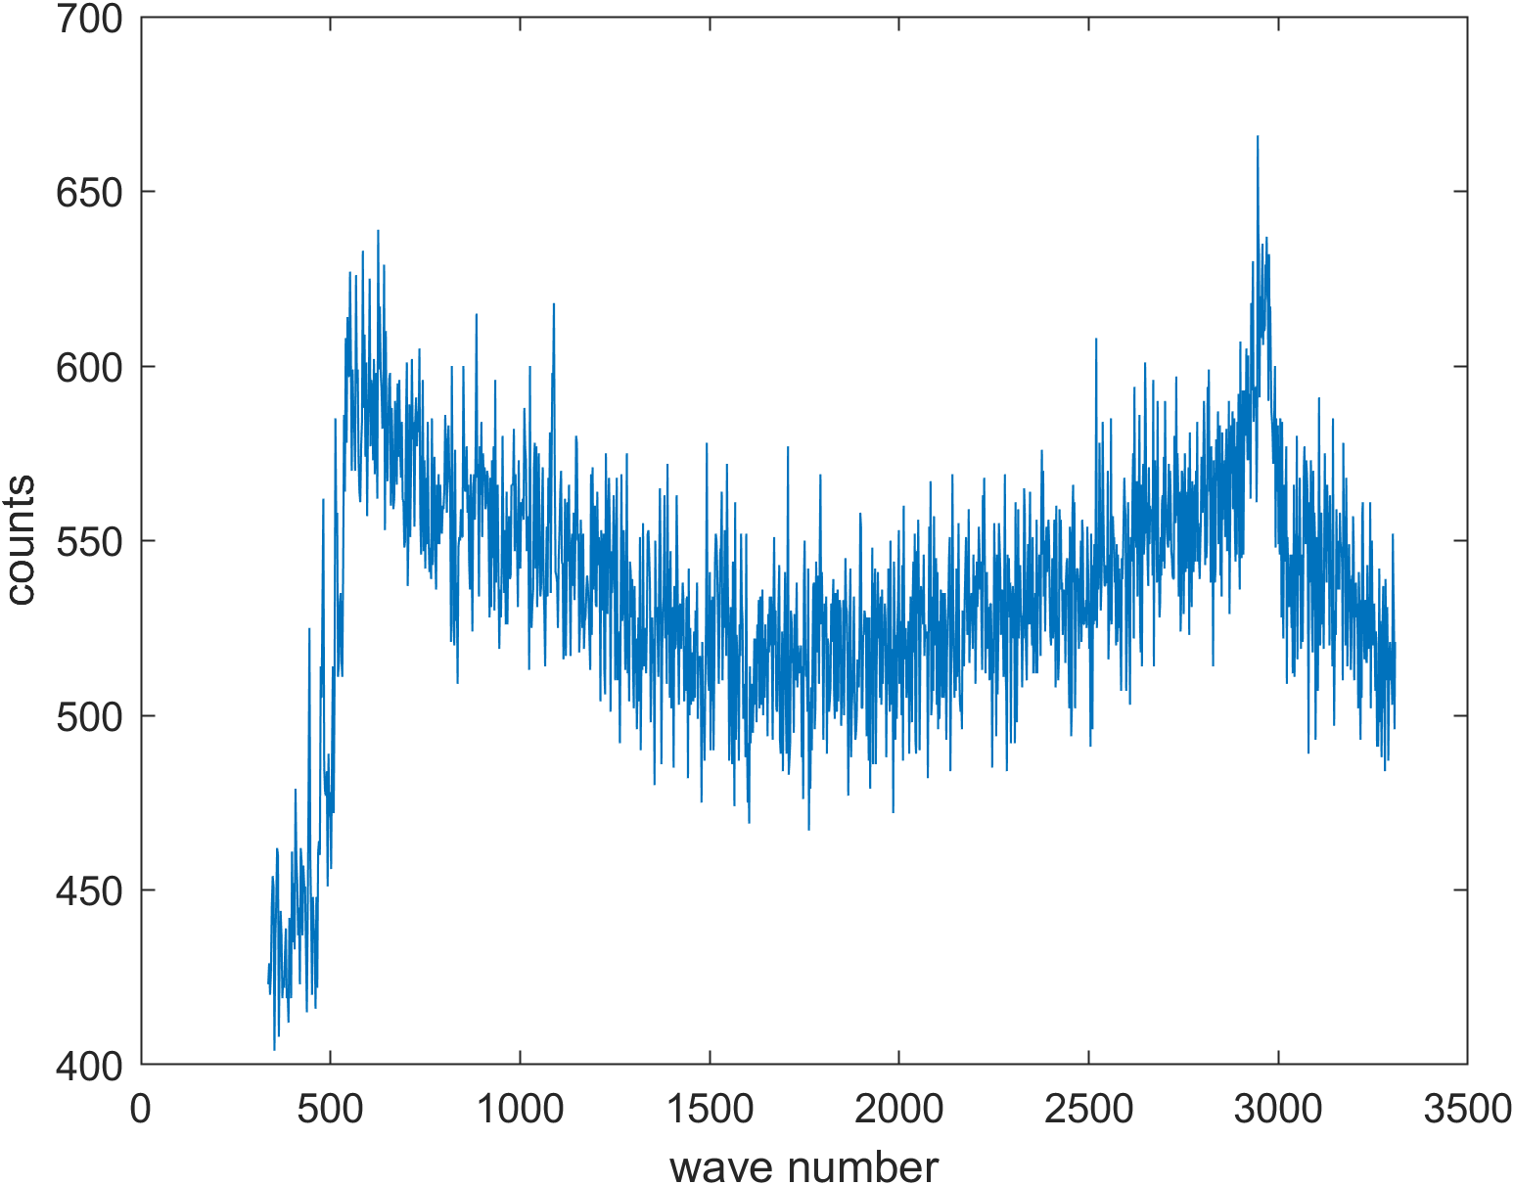
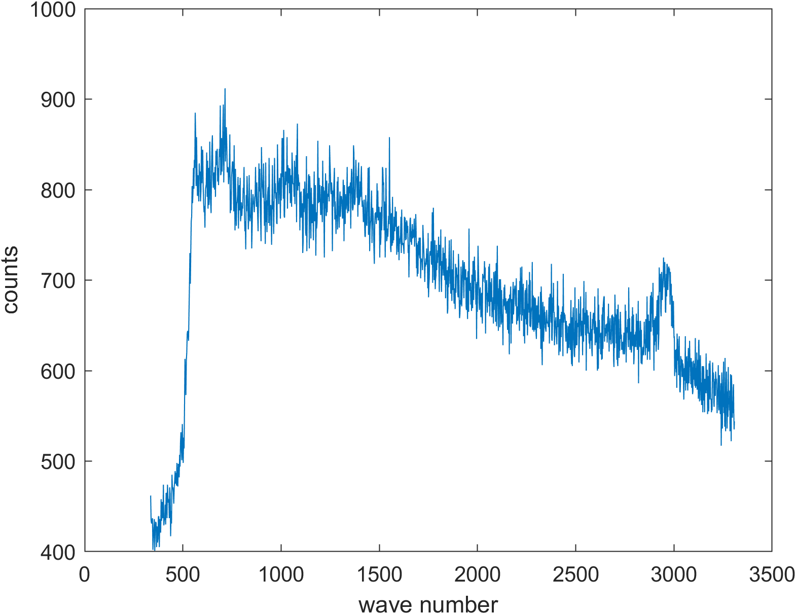
Combatting nozzle clogging
Analysis of the impurities:
Raman-microspectroscopy (with the kind support of AG Fallnich from the WWU)
10µm

Slide 9
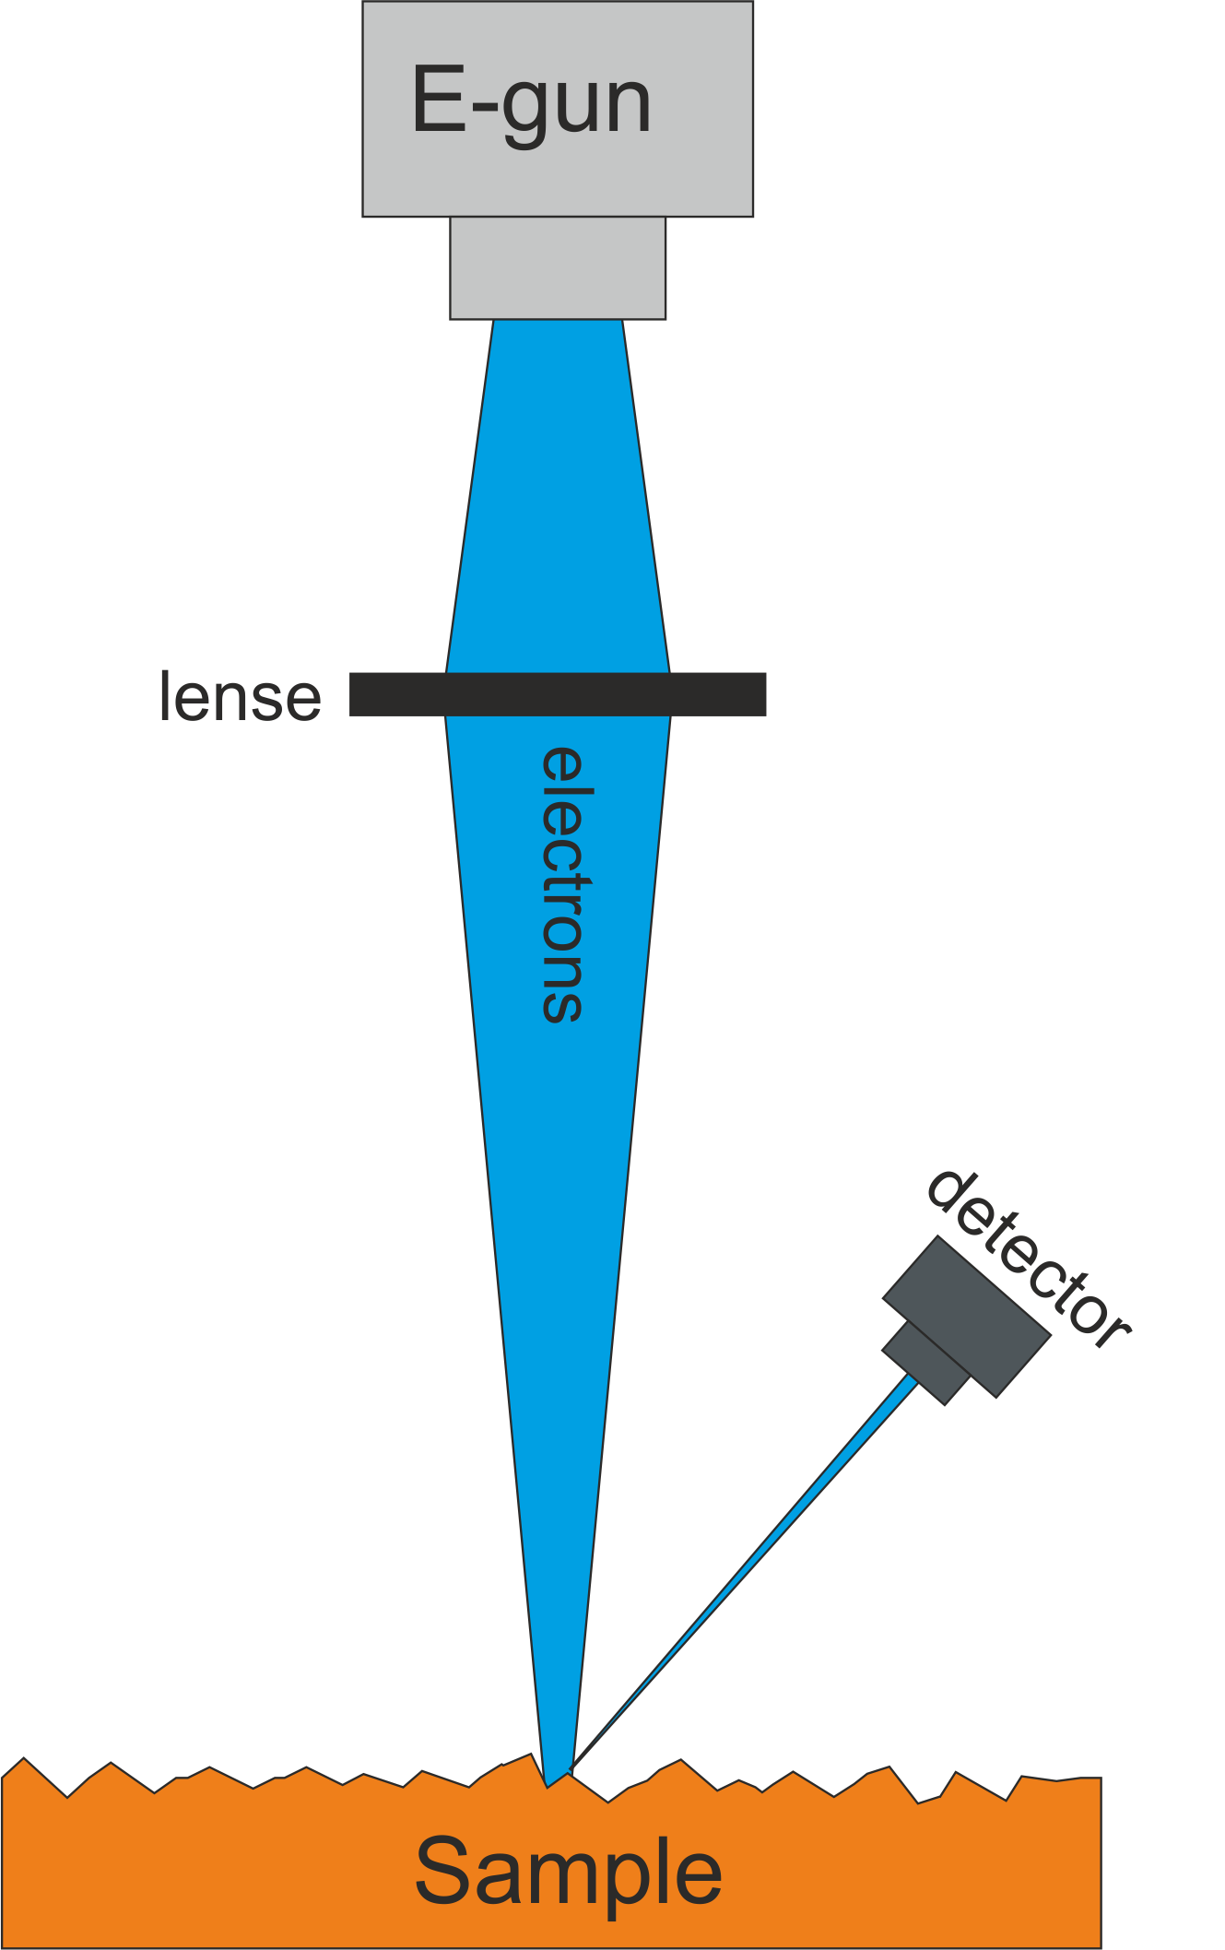
Nozzle clogging analysis
Raman spectrum is typical for metals but does not allow for more specific identification
Next step: Energy dispersive X-ray spectroscopy
The nozzle is imaged using electron microscopy
The characteristic X-ray spectrum is excited by the incident electrons
Elemental make-up can be determined with high precision

Slide 10
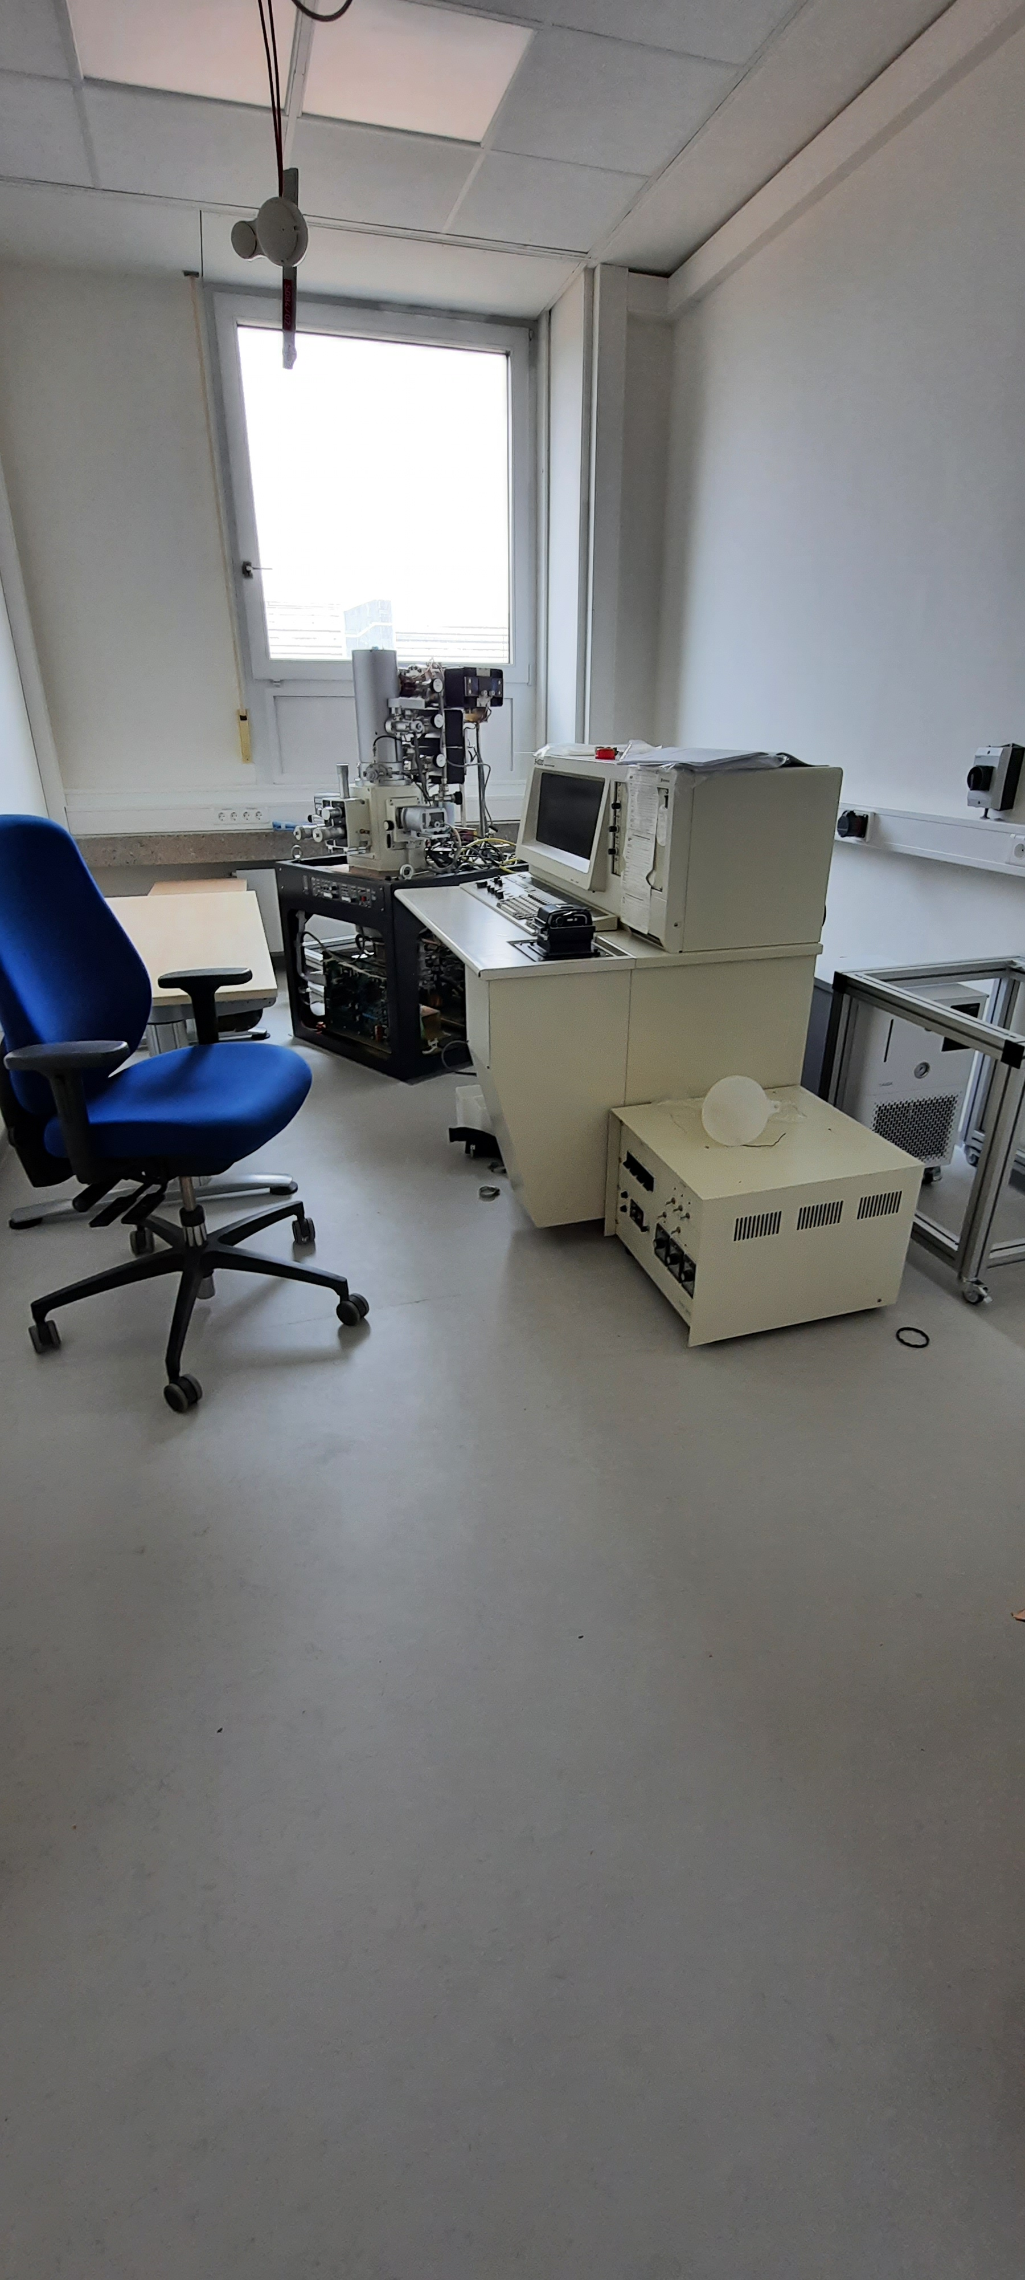
Nozzle clogging analysis
Raman spectrum is typical for metals but does not allow for more specific identification
Next step: Energy dispersive X-ray spectroscopy
The nozzle is imaged using electron microscopy
The characteristic X-ray spectrum is excited by the incident electrons
Elemental make-up can be determined with high precision

Slide 11
A first step forward
Before the target is operated it is “cryo flushed“ for several days
Promising increase in stability of the operating conditions
Allows for a better analysis of target parameters

Slide 12
The Combined target status
There are two major challenges:
Nozzle clogging
Transfer of sufficient cooling power to the nozzle

Slide 13
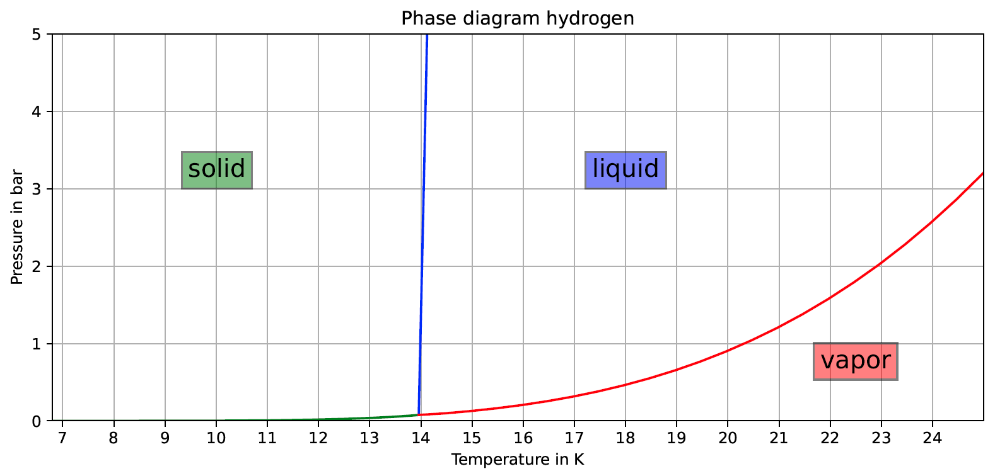
The cooling issue
Cold stage temperature
Piezo head temperature
As a response, heat shielding was installed around the nozzle

Slide 14
Installation of heat shielding
Recent measurements have shown that this is not enough to cool down a completely free nozzle

Slide 15
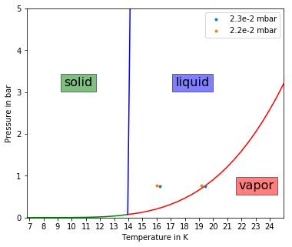
The cooling issue
The target has issues crossing the vapour curve
Even a slight improvement in the chamber pressure can help.

Slide 16
The next steps
The experimental setup is currently being reworked
Installation of additional pumping power (~factor 10 better vacuum)
Test of the pumping station for the new beam dump
Further tests with cold flushing
Redesign of the piezo head

Slide 17
Two topics
The Combined target
The Cryopump

Slide 18
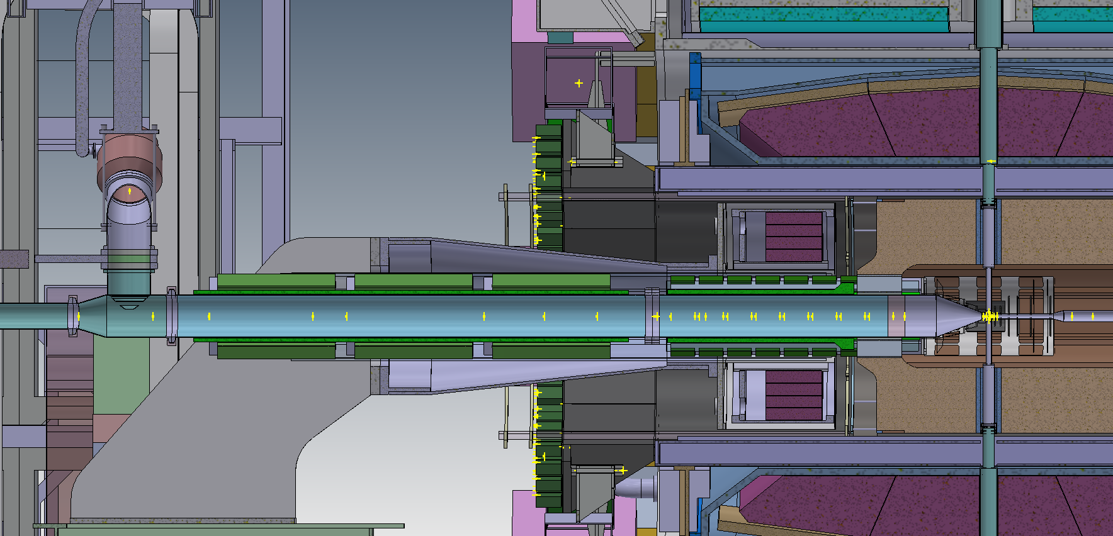
Location of the Cryopump
≈3m
anti-proton beam
IP
Cryopump position

Slide 19
Status of the cryopump
Basic design is completed

Slide 20
Status of the cryopump
Basic design is completed
Pump is designed to be modular
Technical drawings are currently in progress

Slide 21
Thank you for your attention

