Slide 1
Final Design of the PANDA Target Beam Dump
Philipp Brand
WWU Münster, Institut für Kernphysik, Germany
PANDA collaboration meeting, Prague, June 12 – 16, 2023

Slide 2
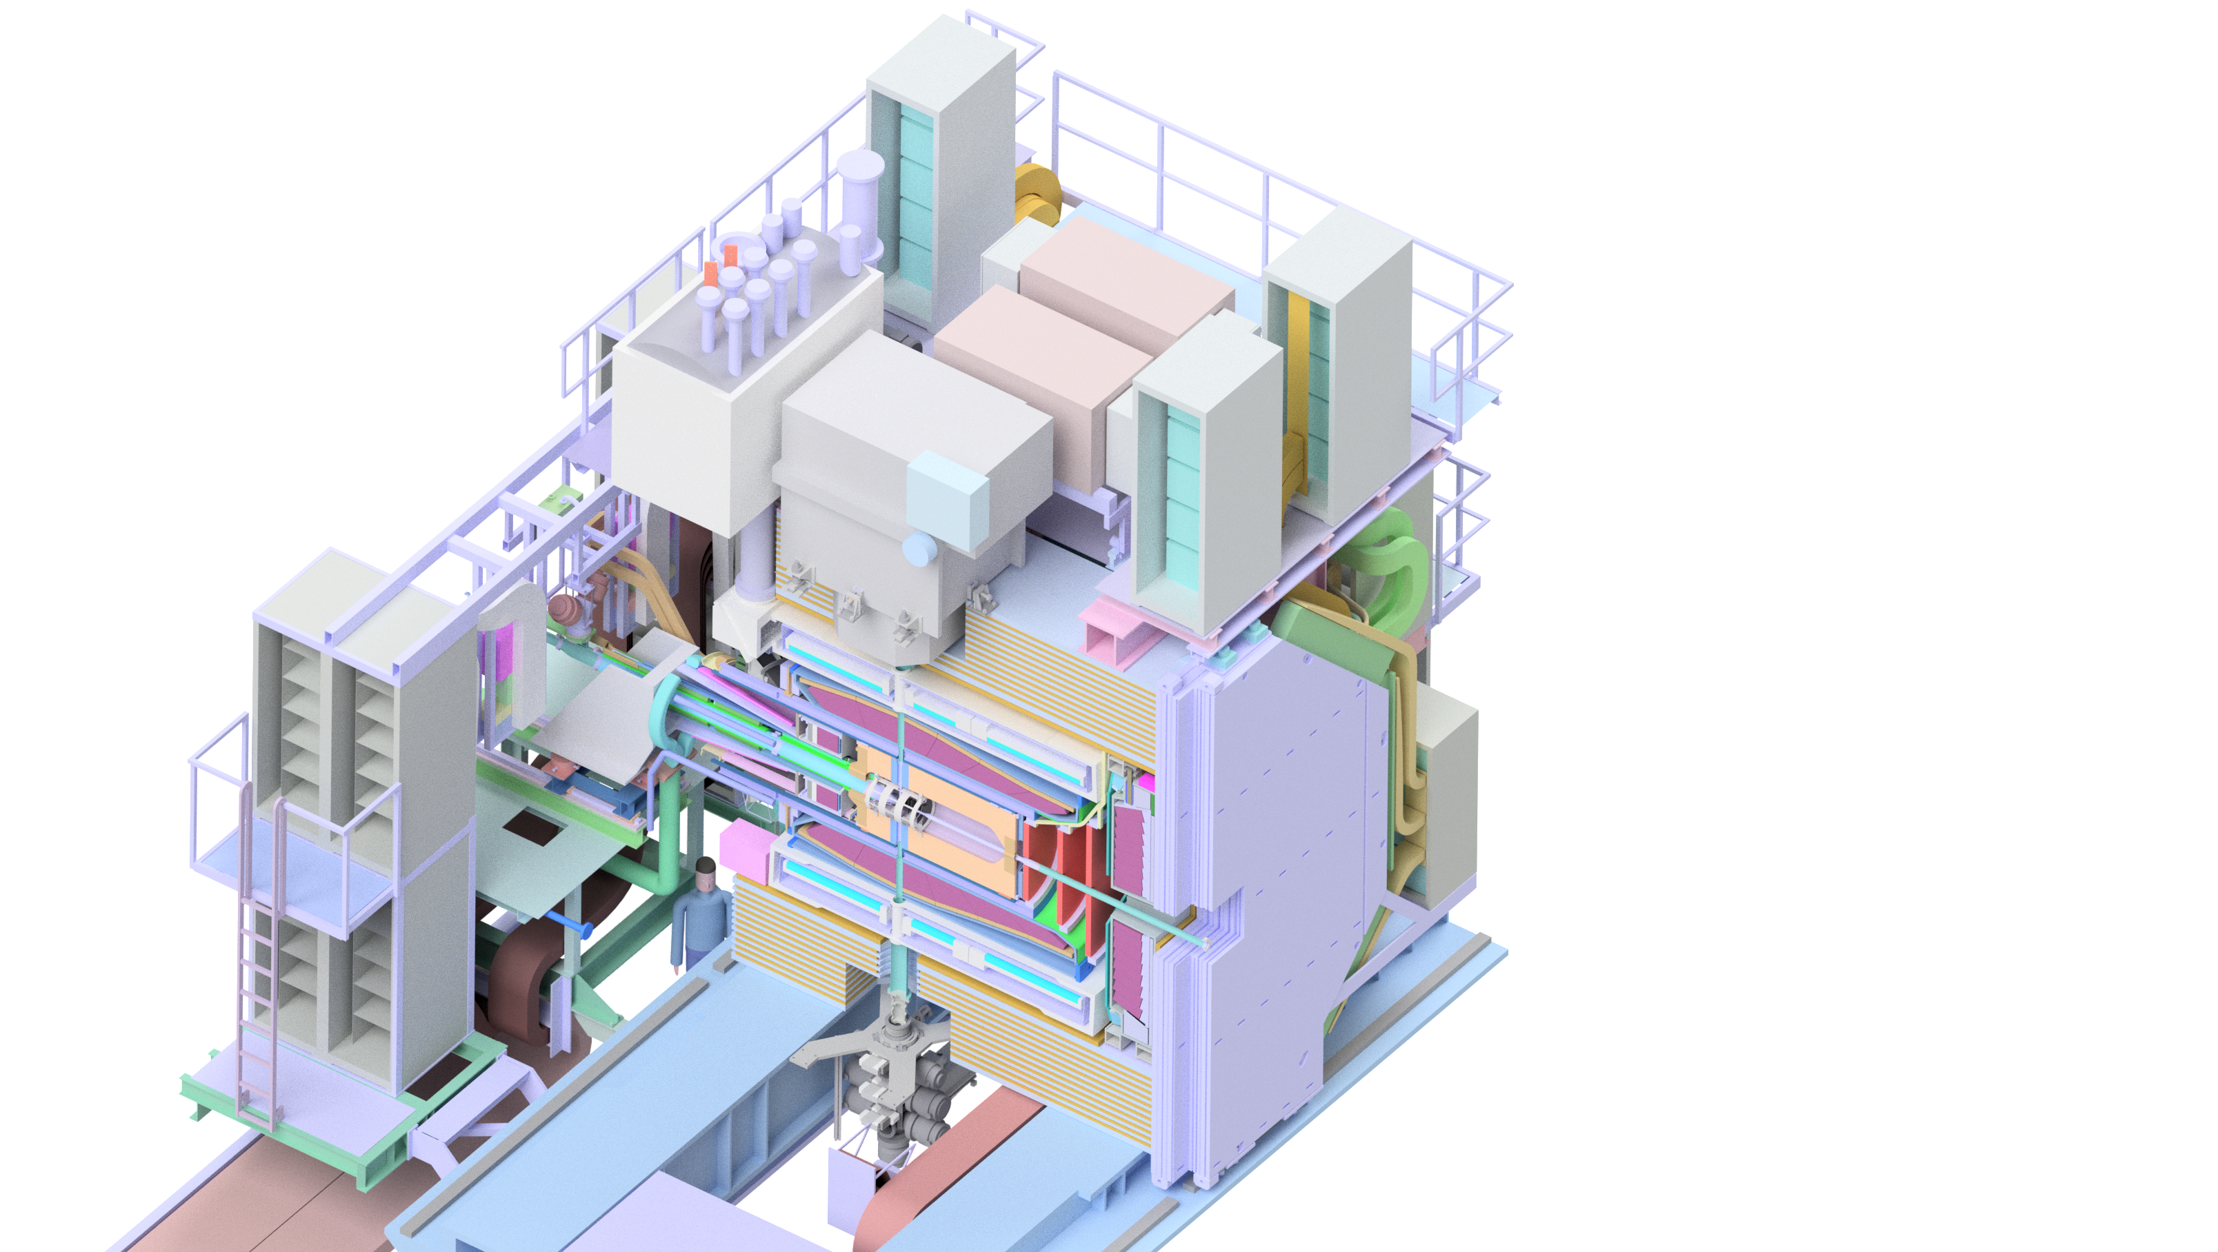
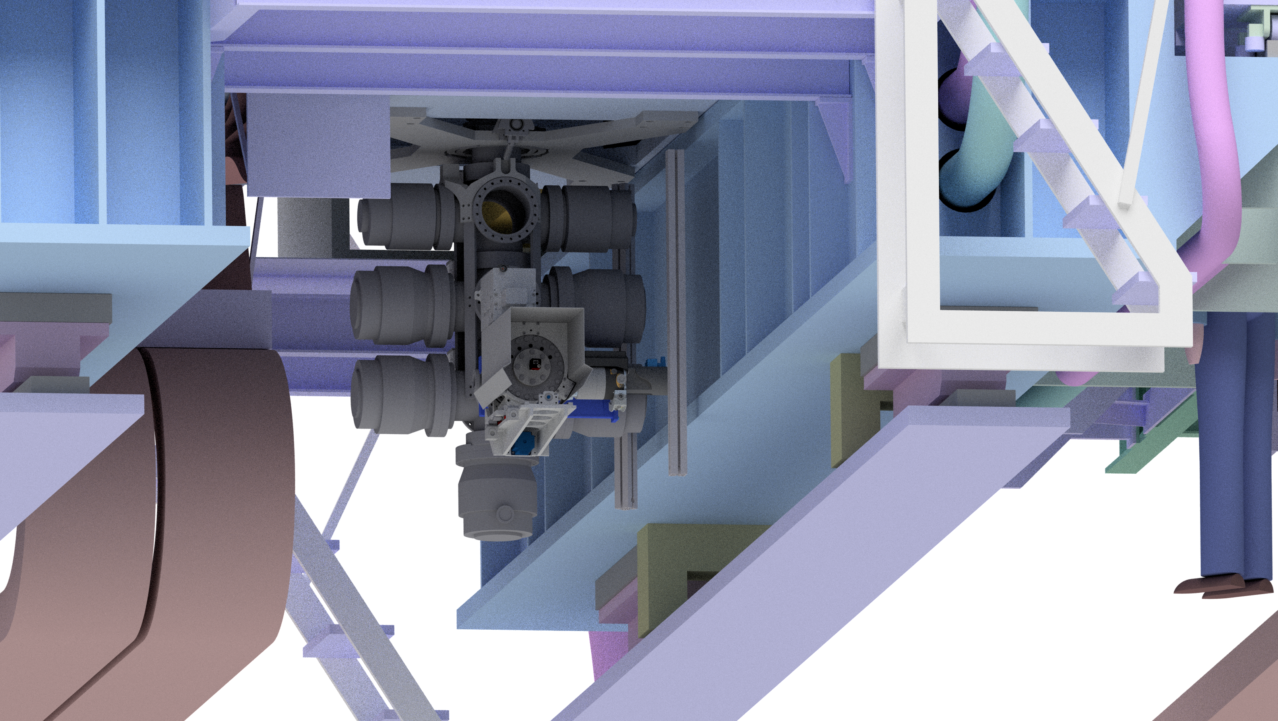
The Beam Dump System

Slide 3
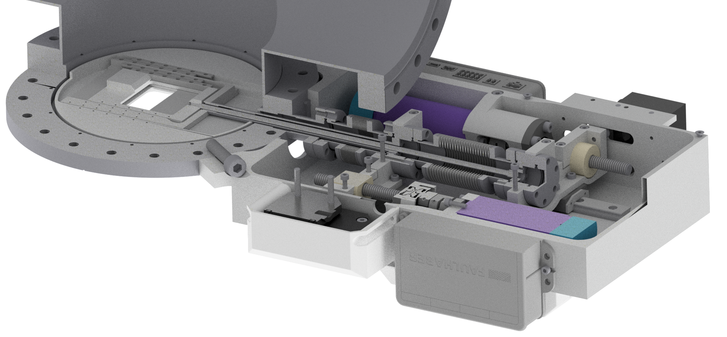
The Beam Dump System
Similar to current design (3 stages, 7 pumps)
3 orifices with variable size
motor drives
1250 mm
movable slit orifice with adjustable size

Slide 4
The Beam Dump System
Similar to current design (3 stages, 7 pumps)
3 orifices with variable size
Can be equipped with several monitor systems
Absolute thickness monitor system (AMS)
Movable MCP system for 2D beam visualization and cluster velocity measurement
Design finished; some parts already available
AMS
CCD
MCP
Prism

Slide 5
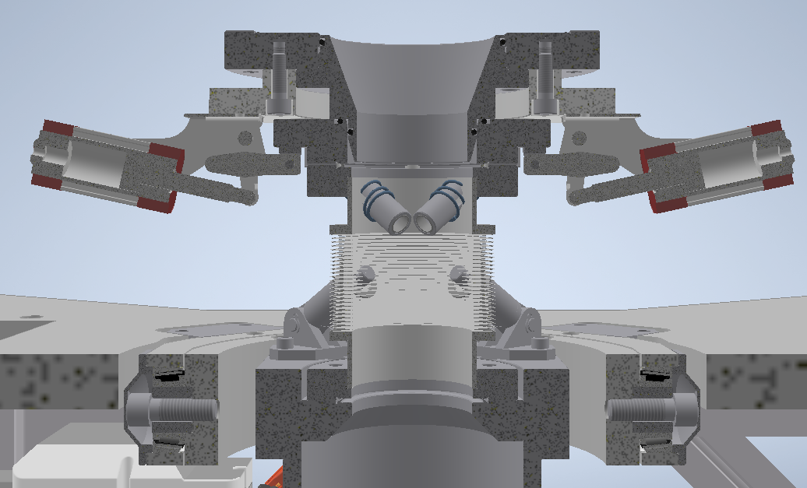
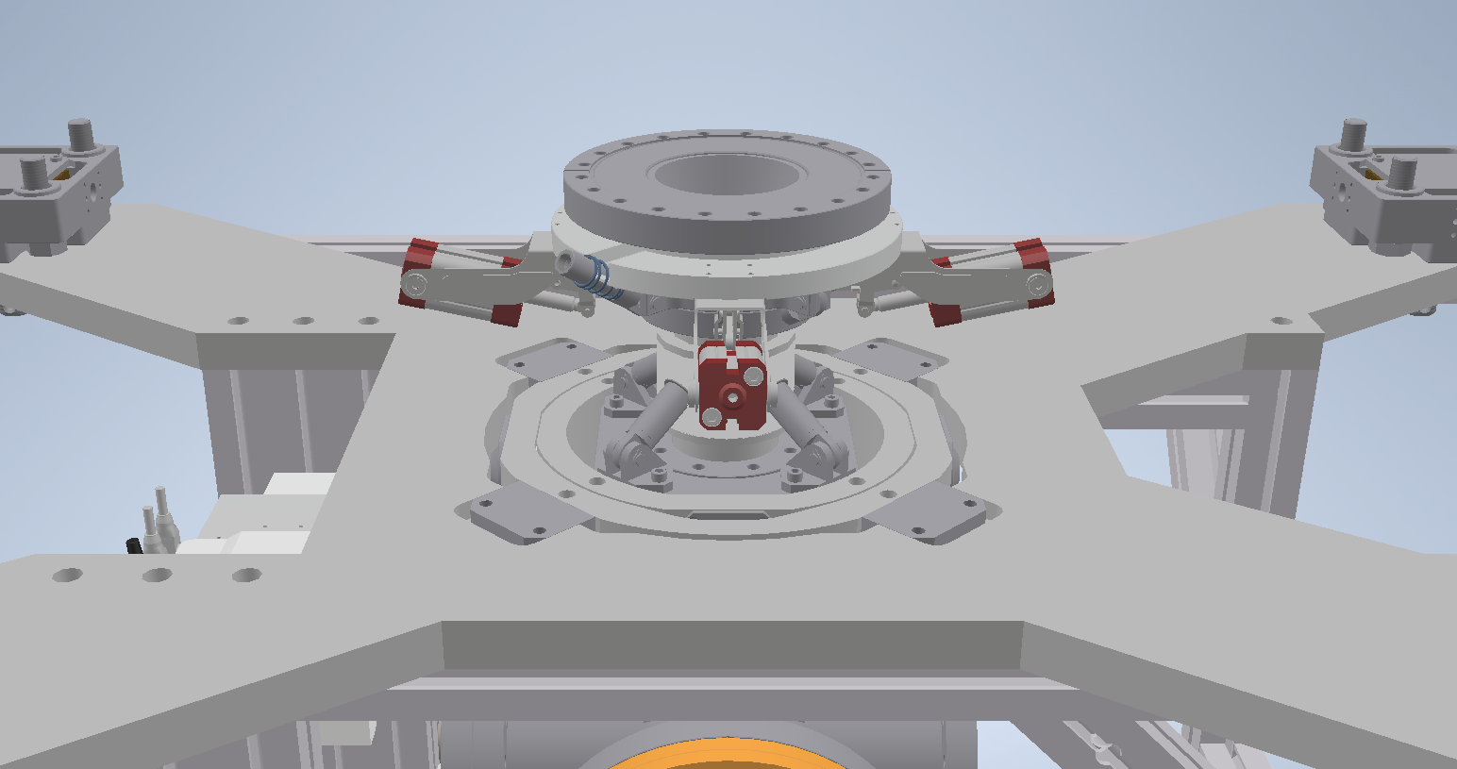
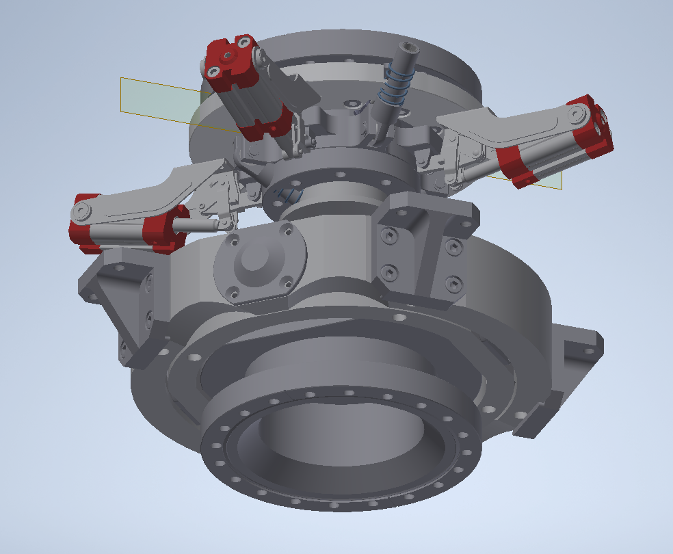
The Beam Dump System
Beam dump will be connected to target beam line by self-developed snap connector

Slide 6
The Beam Dump System

Slide 7
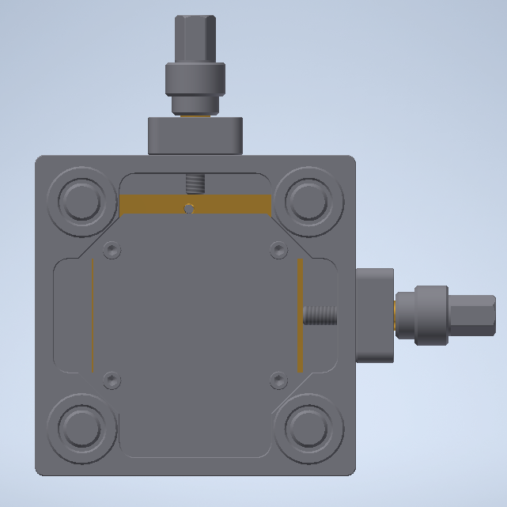
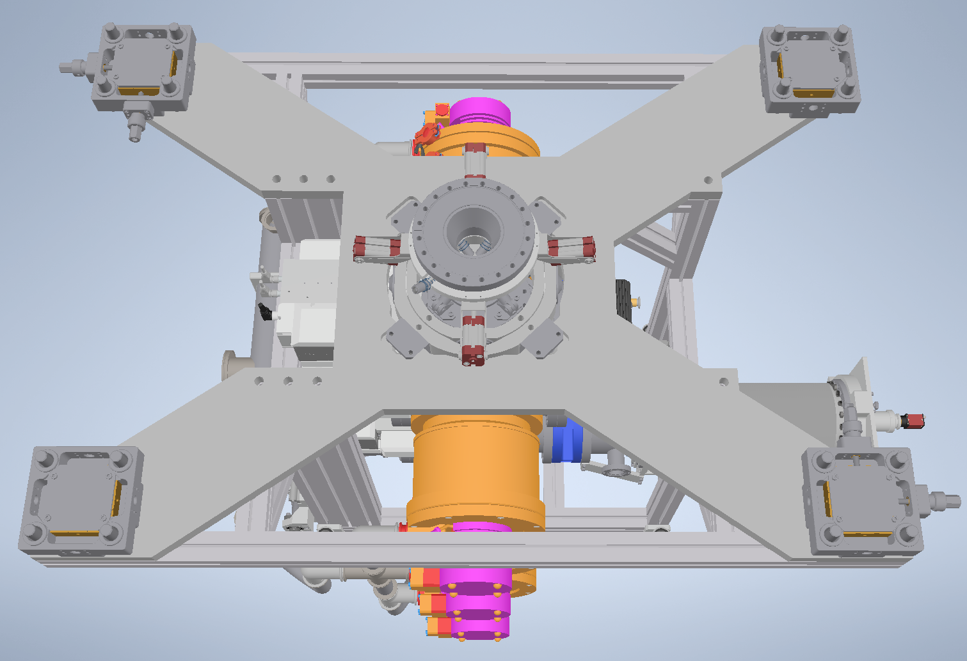
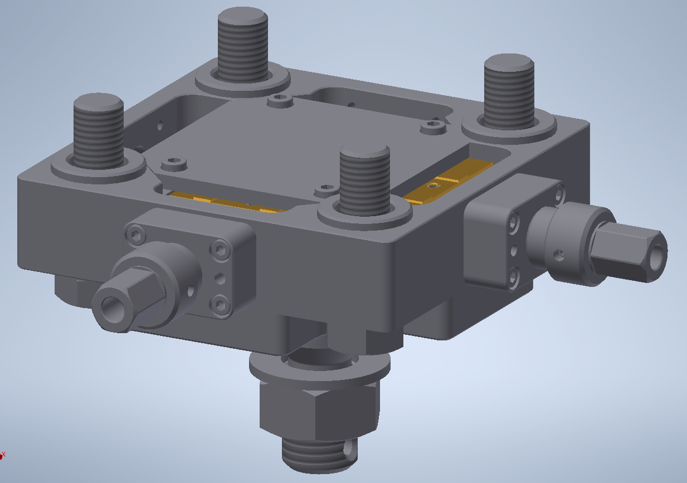
The Beam Dump System
Beam dump will hang below the solenoid at four defined points, exact position can be adjusted

Slide 8
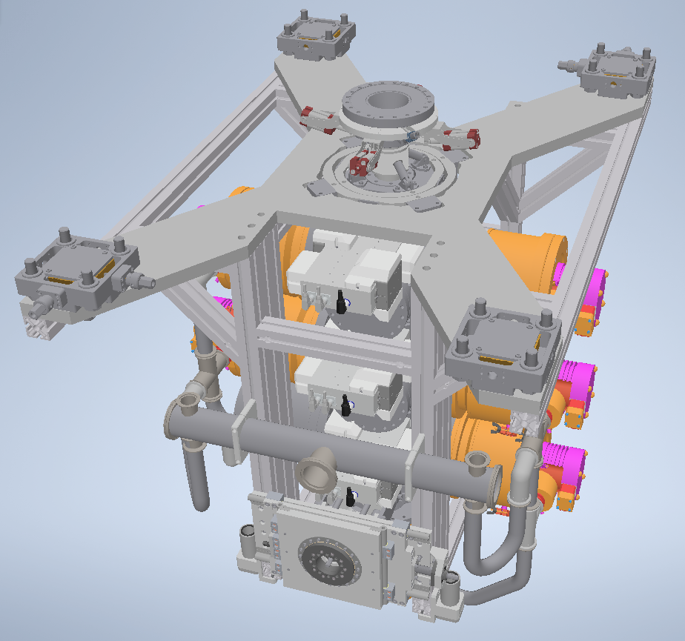
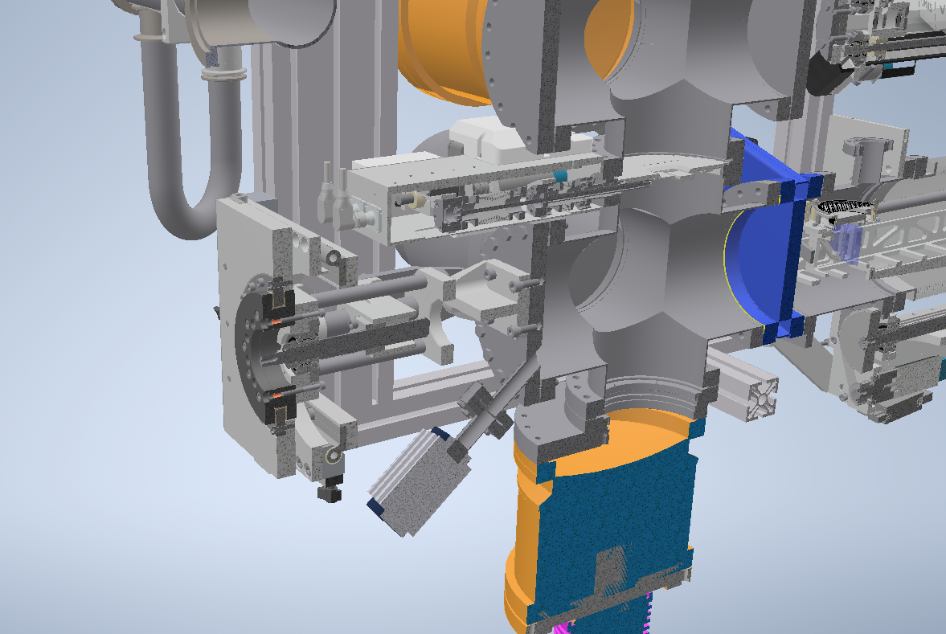
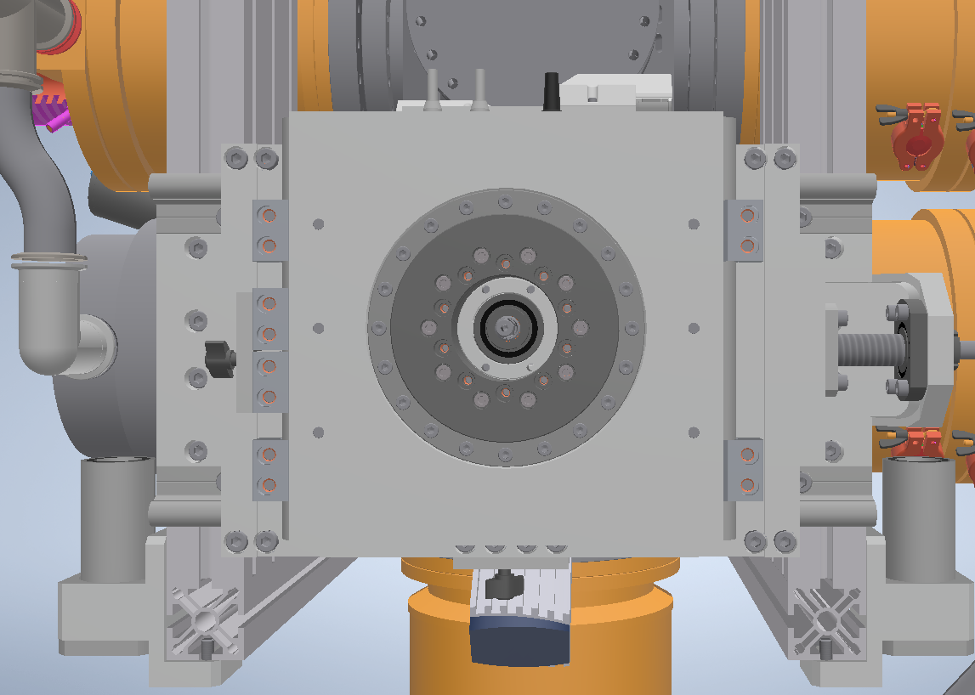
The Beam Dump System
Complete system can be tilted for perfect adjustment

Slide 9
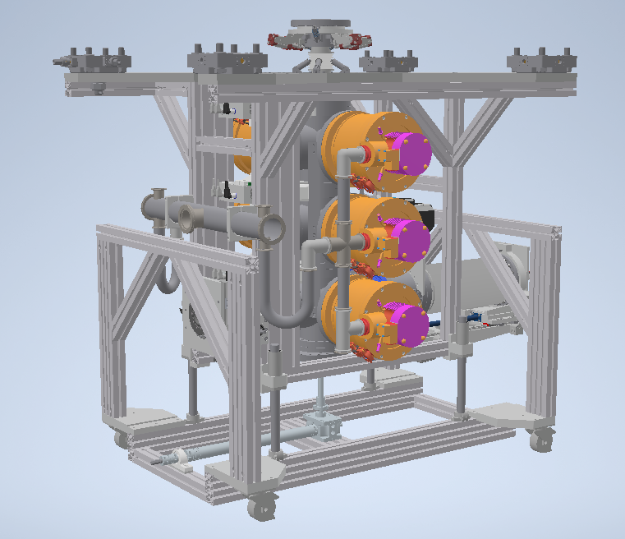
The Beam Dump System
Complete system can be moved and lifted by a transport frame
Last turbo pump has to be removed for this (limited height below the solenoid)

Slide 10
The new Pumping Station
Rotary vane pump and roots pump
Remote controllable (pumps, pneumatic valves, gate valves)
Movable for easy access in maintenance
Placed under detector directly next to beam dump
Separate ventilation line with clean gas
98cm
98cm
125cm

Slide 11
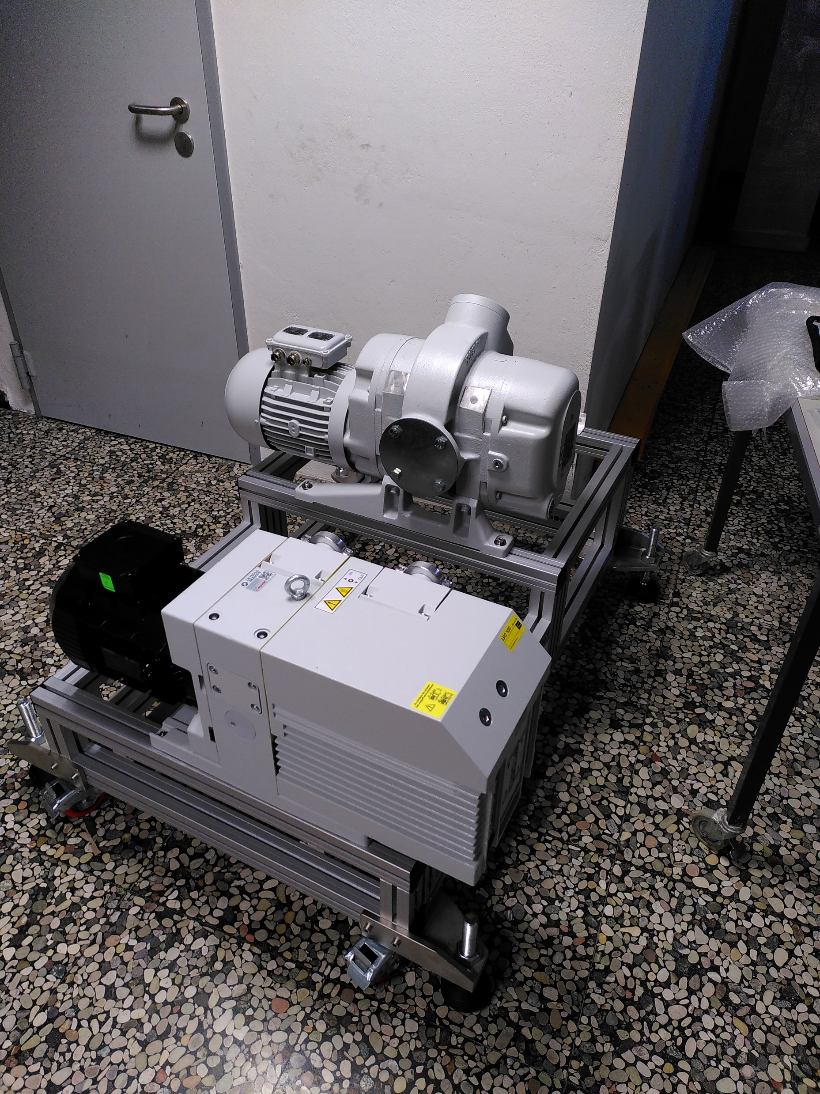
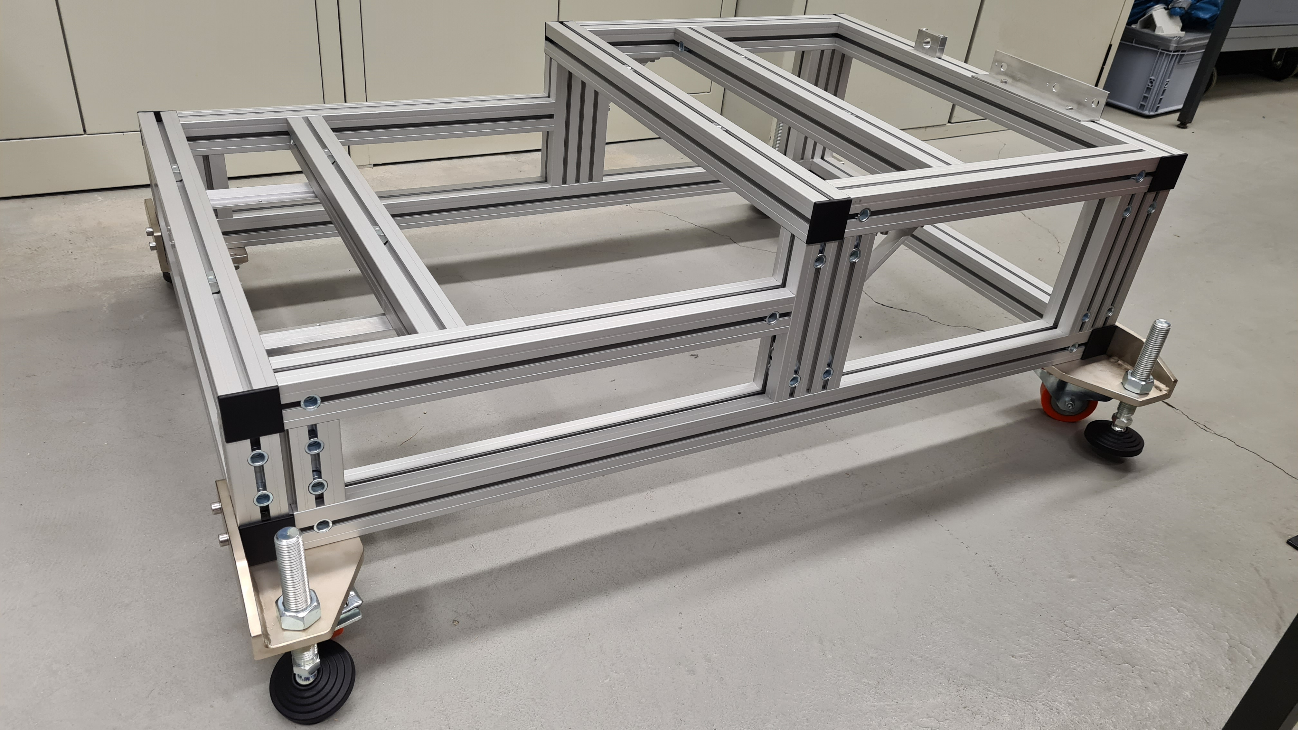
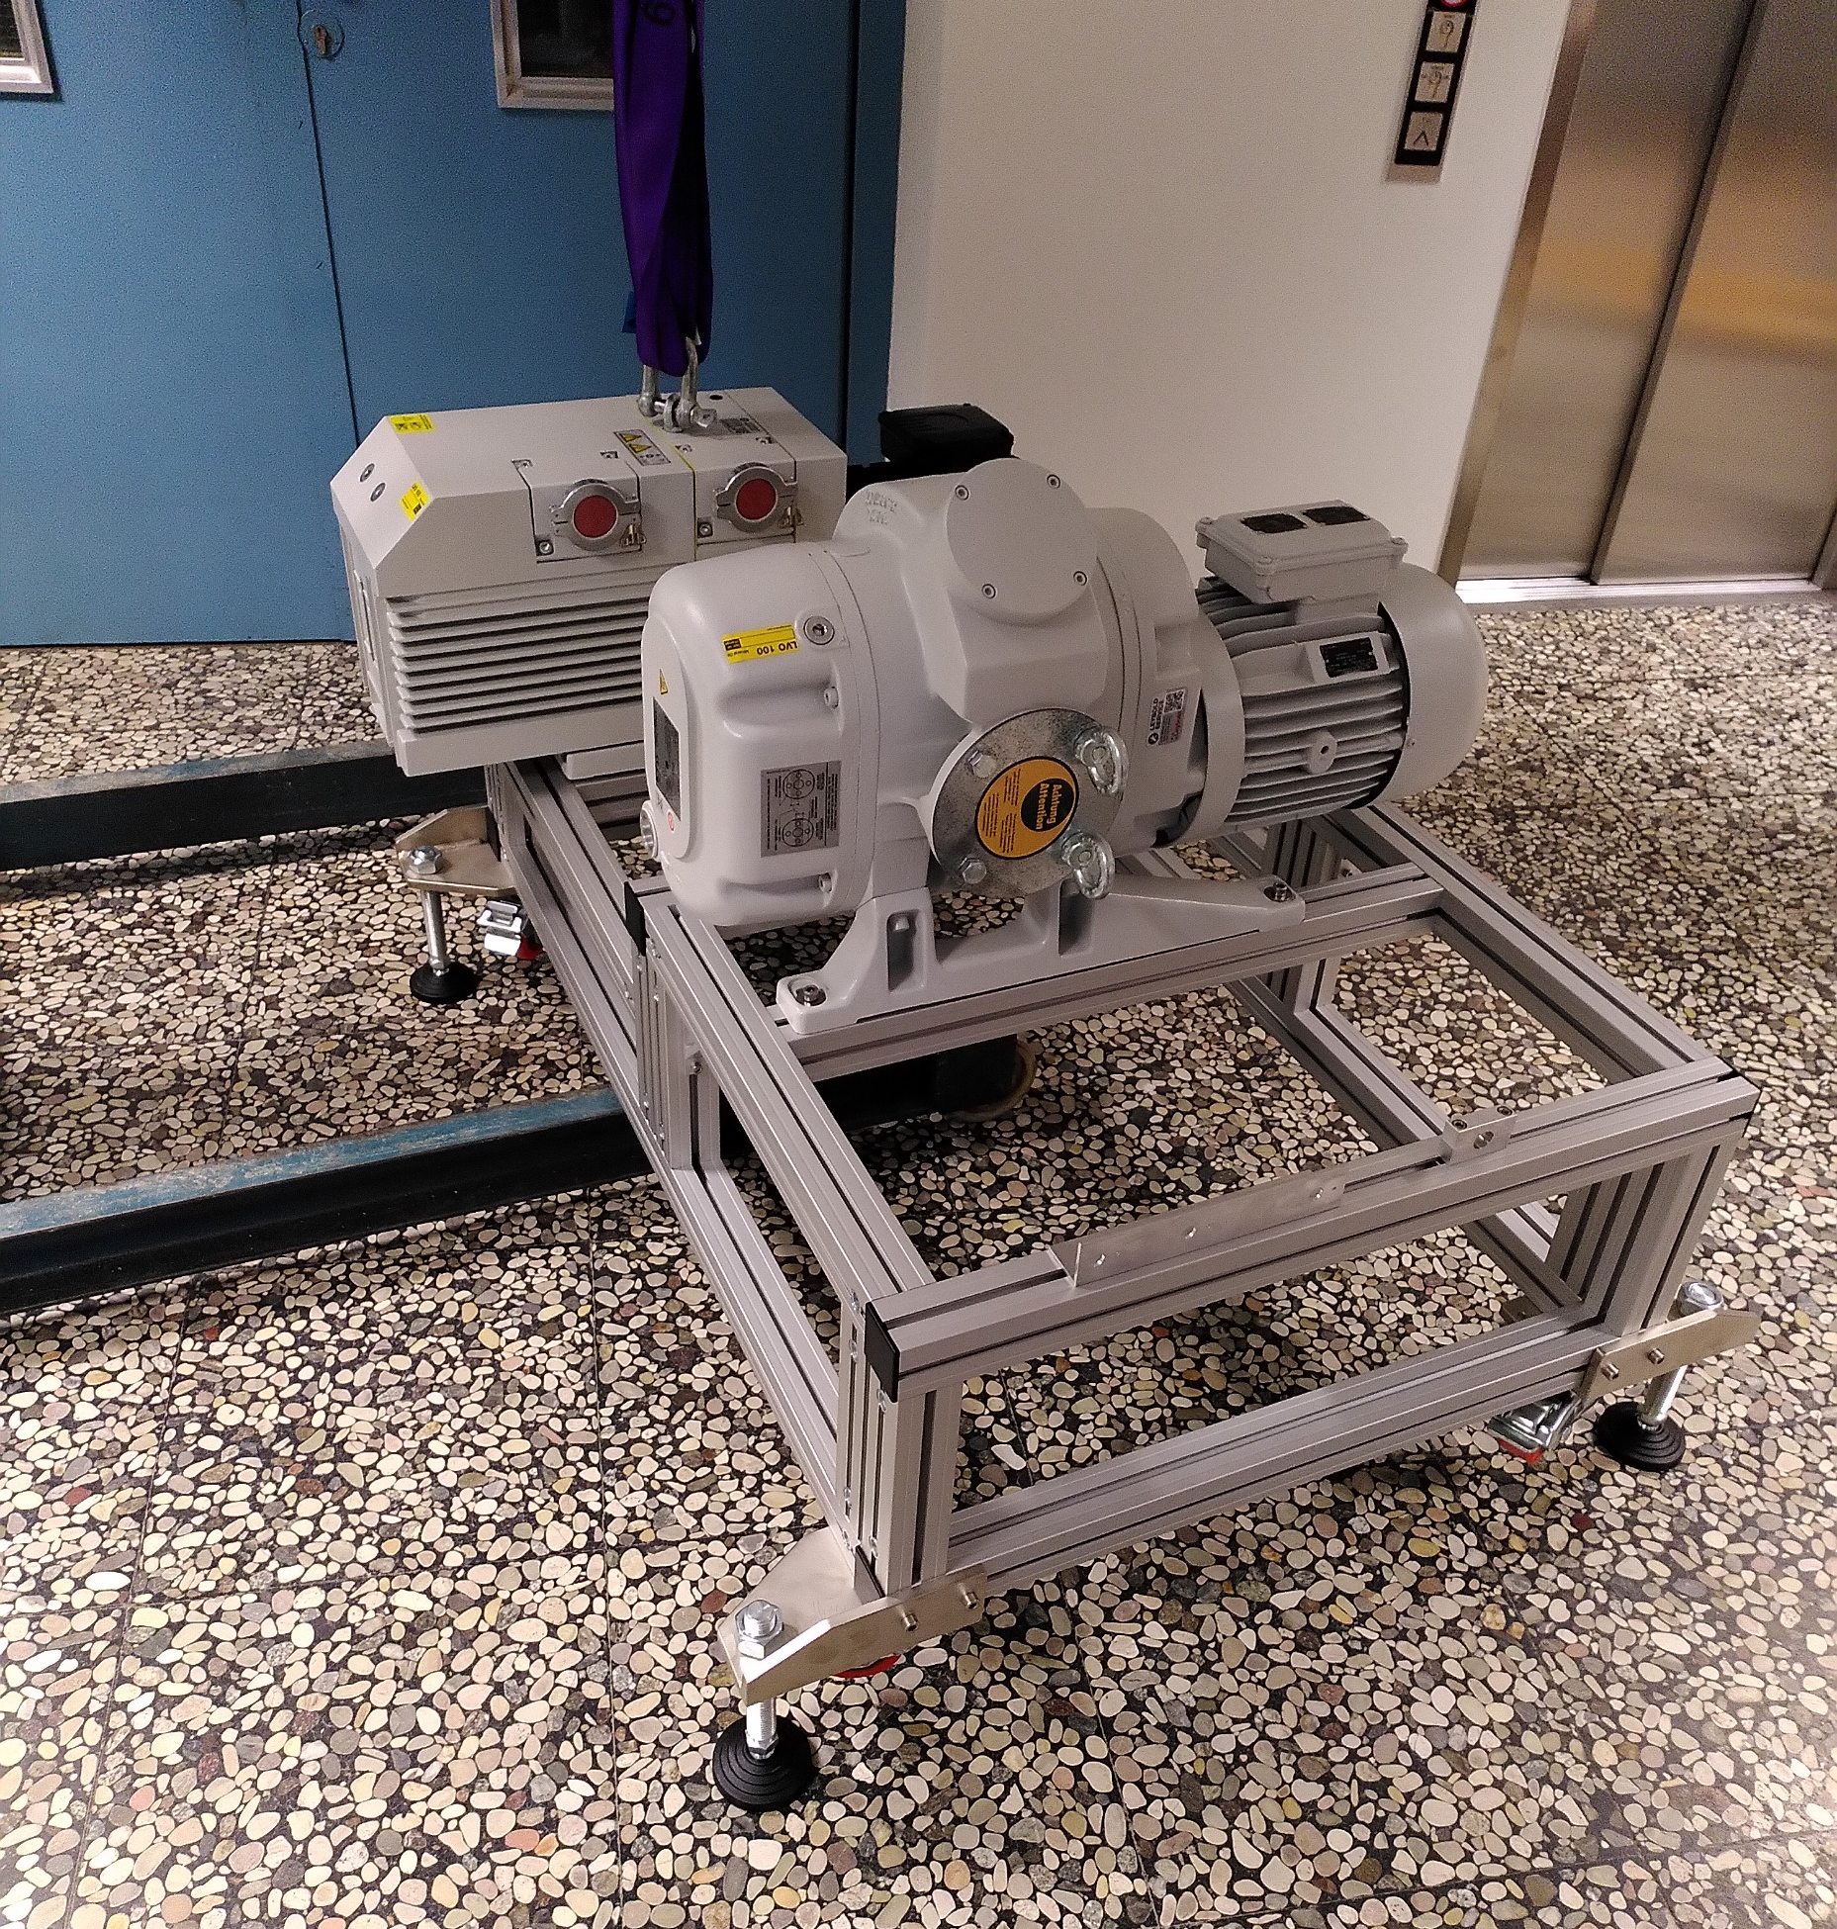
Current progress
Construction of pumping station has started last week
Next step: Installation of pipes, valves, …

Slide 12
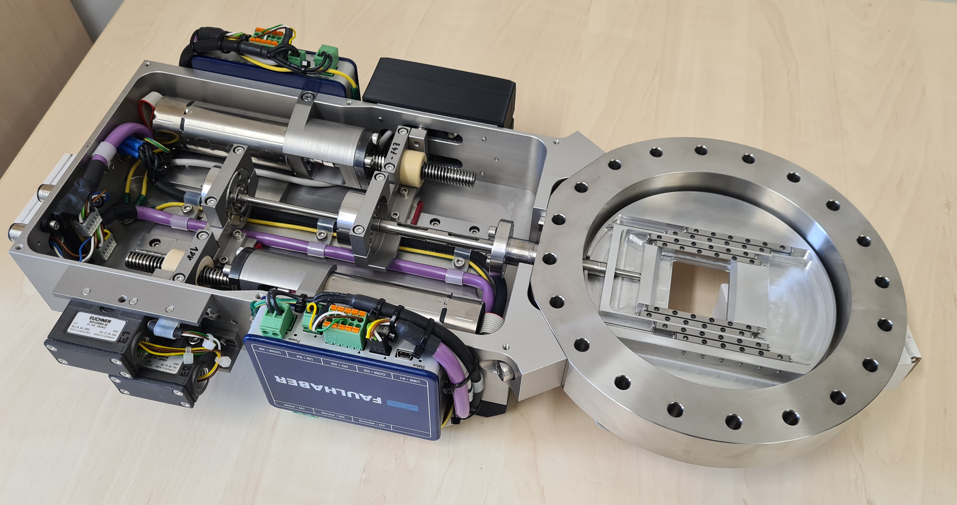
Current progress
Construction of pumping station has started last week
Next step: Installation of pipes, valves, …
First orifice system has been mounted
Next step: Commissioning and control of motors

Slide 13
Current progress
Construction of pumping station has started last week
Next step: Installation of pipes, valves, …
First orifice system has been mounted
Next step: Commissioning and control of motors
Simplified MCP system has been mounted (see following talk by H. Eick)
AMS
CCD
MCP
Prism

Slide 14
Thank you for your attention!

Slide 15
Backup

