Slide 1
Central Tracker
Cabling and Mechanics

Slide 2
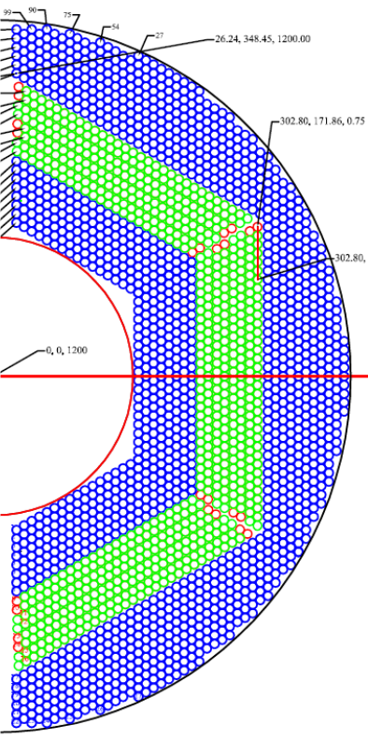
STT Layout
One semi-barrel of STT
21-27 layers, from inner to outer radius:
8 Axial layers
4 Skewed double-layers (±2.89°)
5 Axial layers + 6 axial outer filling layers
2× 2050 straws with 1200mm length
2× 240 skewed straws with diff. length
4636 straws in total
All straws close-packed with <20µm gaps
Active volume ~ 85% (of cylindr. vol. 160/410mm)
X/X₀ ~ 1.25% (²/₃ tube wall + ¹/₃ gas)

Slide 3
Geometrical constraints
The Central Tracker (CT) has to fill a cylindrical volume surrounding the MicroVertex Detector and the target-beam cross pipe.
Geometrical constrains are:
int. Ø 150 mm, ext. Ø 418 mm,
length 1500mm + 150 mm upstream for electronics and services
This volume is split in two halves by the target-beam cross pipe.
y
y
150
150mm
4200mm
150mm
1500mm
x
z

Slide 4
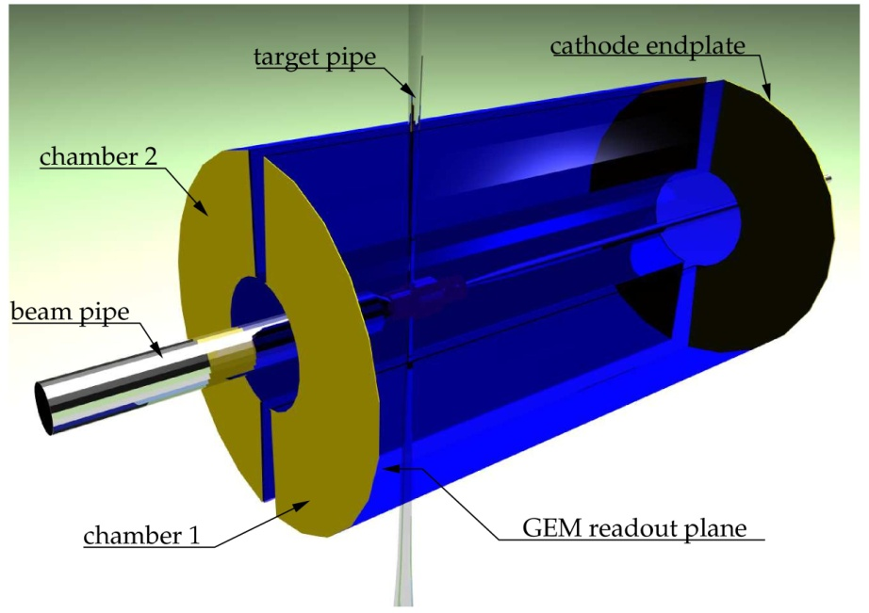
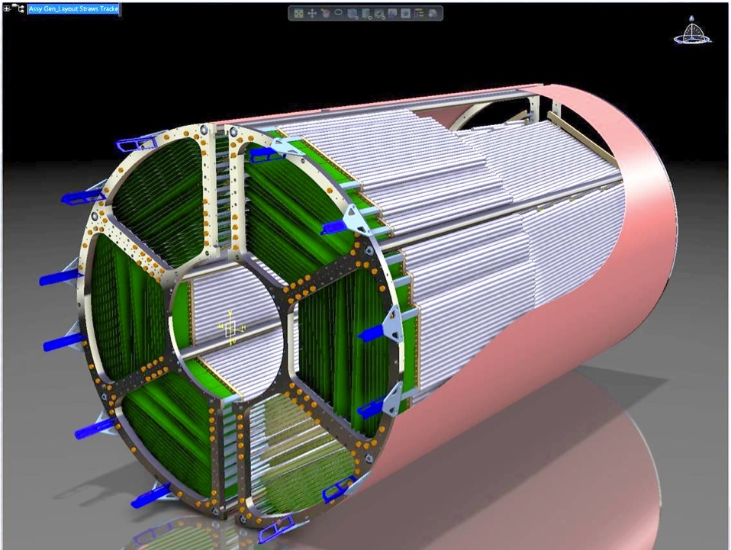
Present layout
Presently, two options are under developments. Both have to fit the same physical and mechanical requirements. We can therefore figure out a unique mechanical solution.

Slide 5
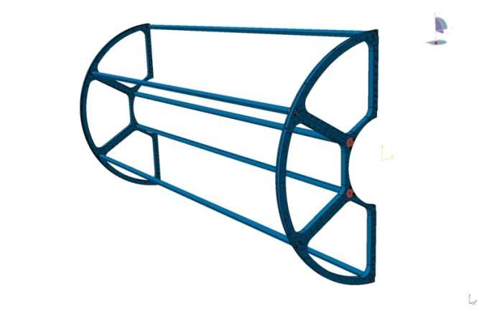
STT detector assembly
Following the idea of a STT made of planar double-layers a Light Mechanical Frame has been designed
If the material of the Support Structure will be Aluminum:
Density 2.7g/cm³
Young’s modulus: 70 GPa
Radiation Length (X_{o}): 9 cm
Thermal expansion:24 ppm/°C
Total weight of the structure is 8.2 kg
Internal bars can be removed

Slide 6
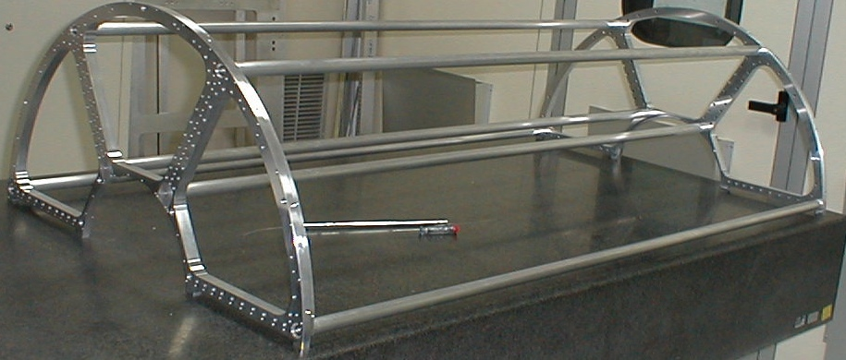
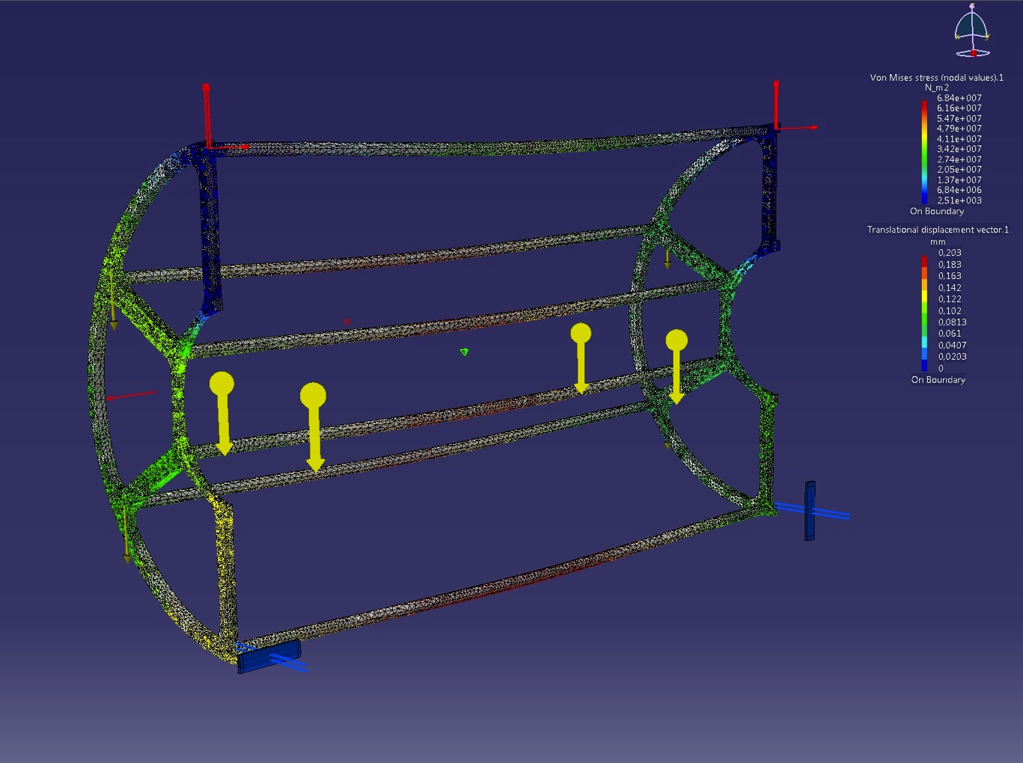
Support Structure prototype
FEM analysis results:
maximum deflection 0.03 mm

Slide 7
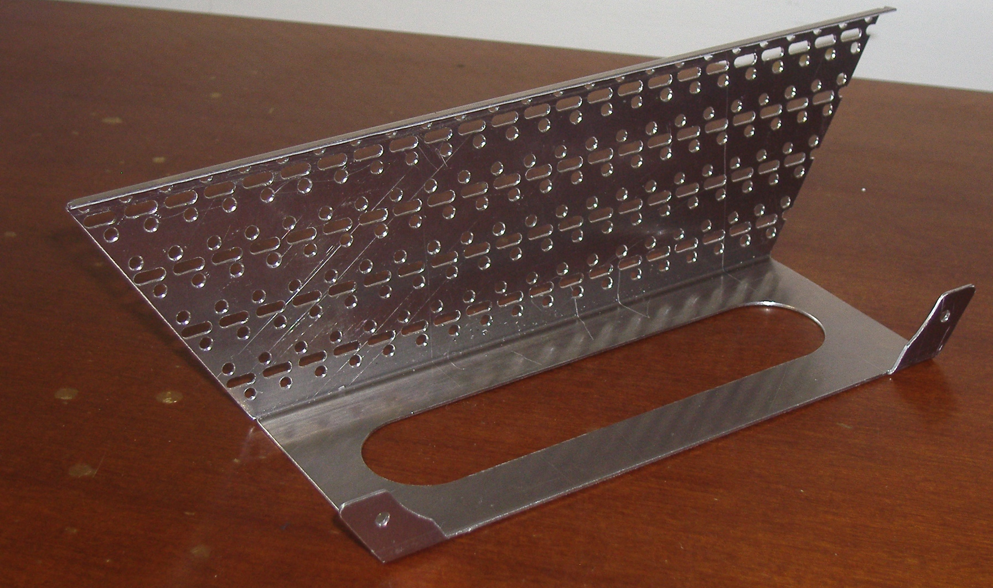
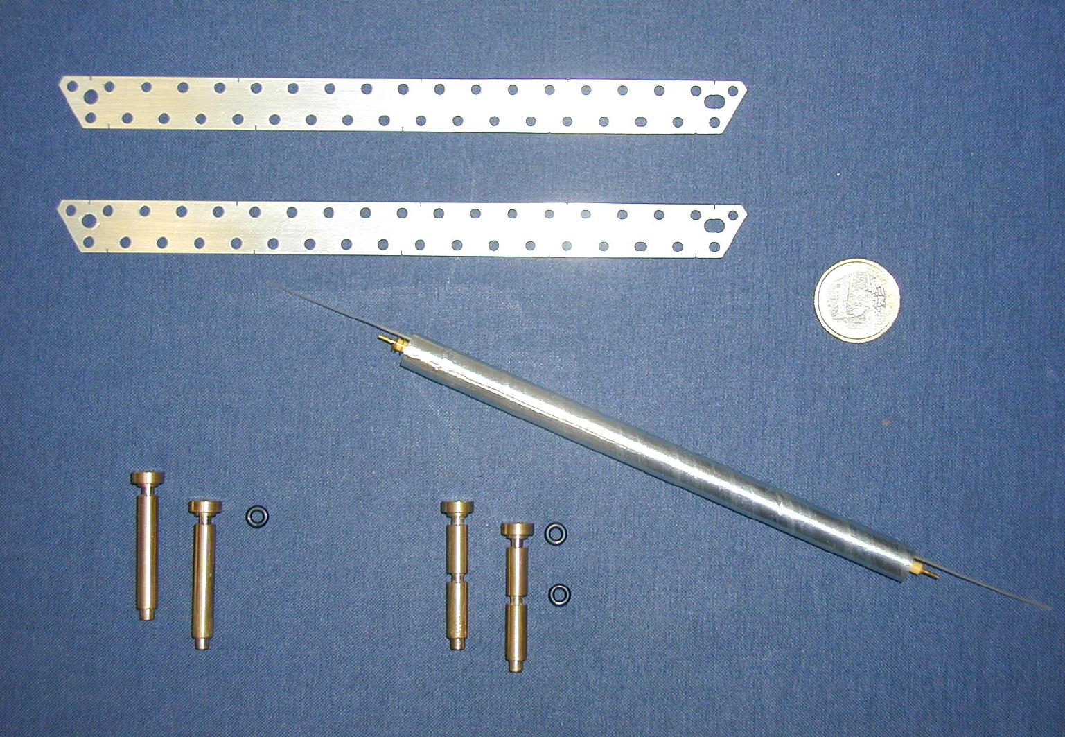
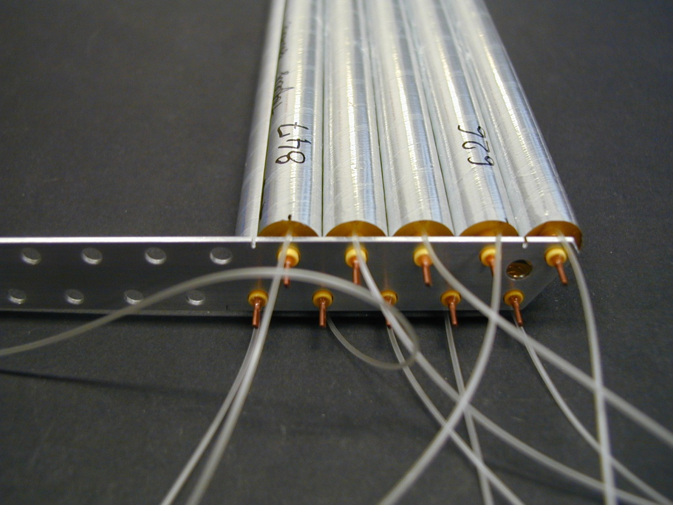
Band prototypes
STT support frame
Fixing pin

Slide 8
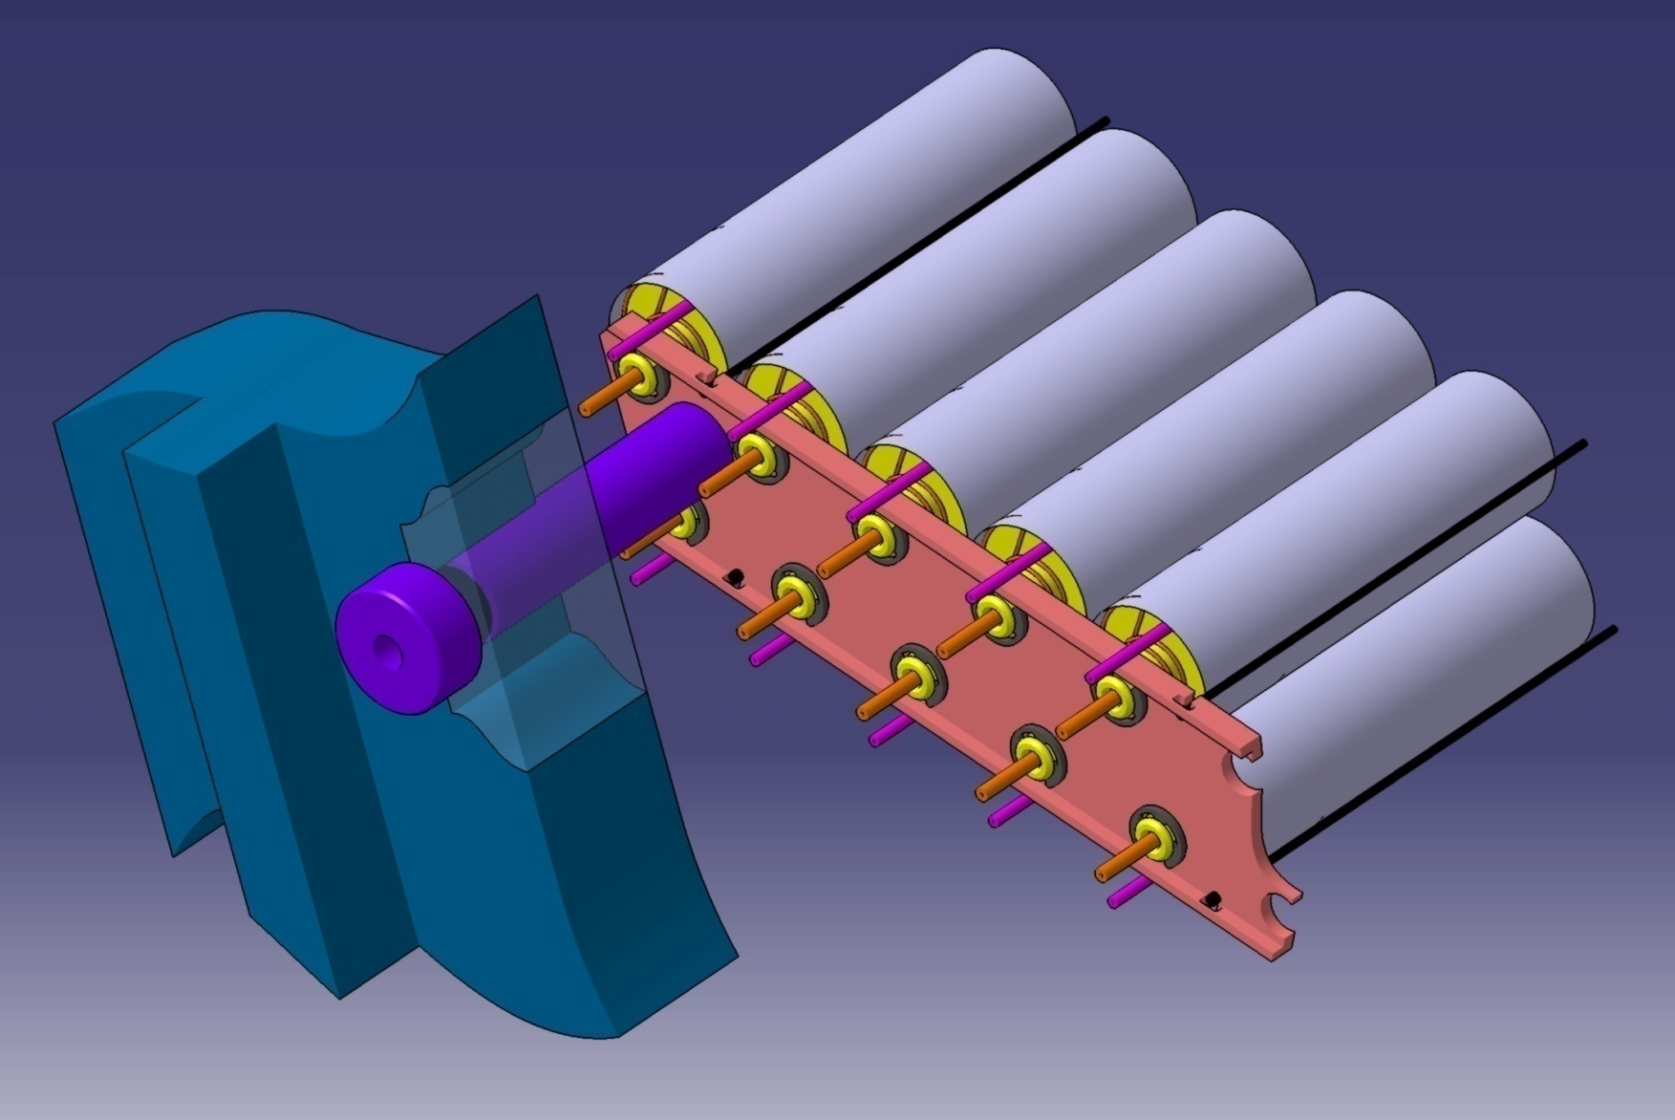
New fixing pin
Some minor refinements have been studied to reinforce the edge bands of the straw modules and to test new fixing tools for the end-plugs
Notes:
Threaded = filettati
Nut = dado

Slide 9
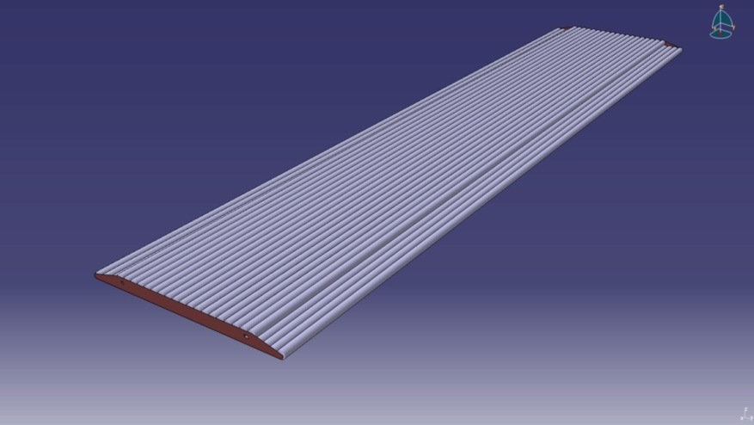
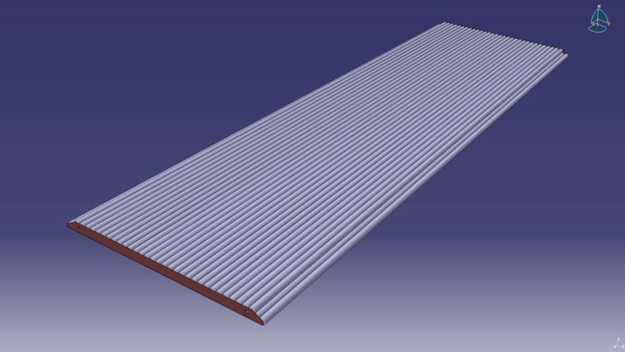
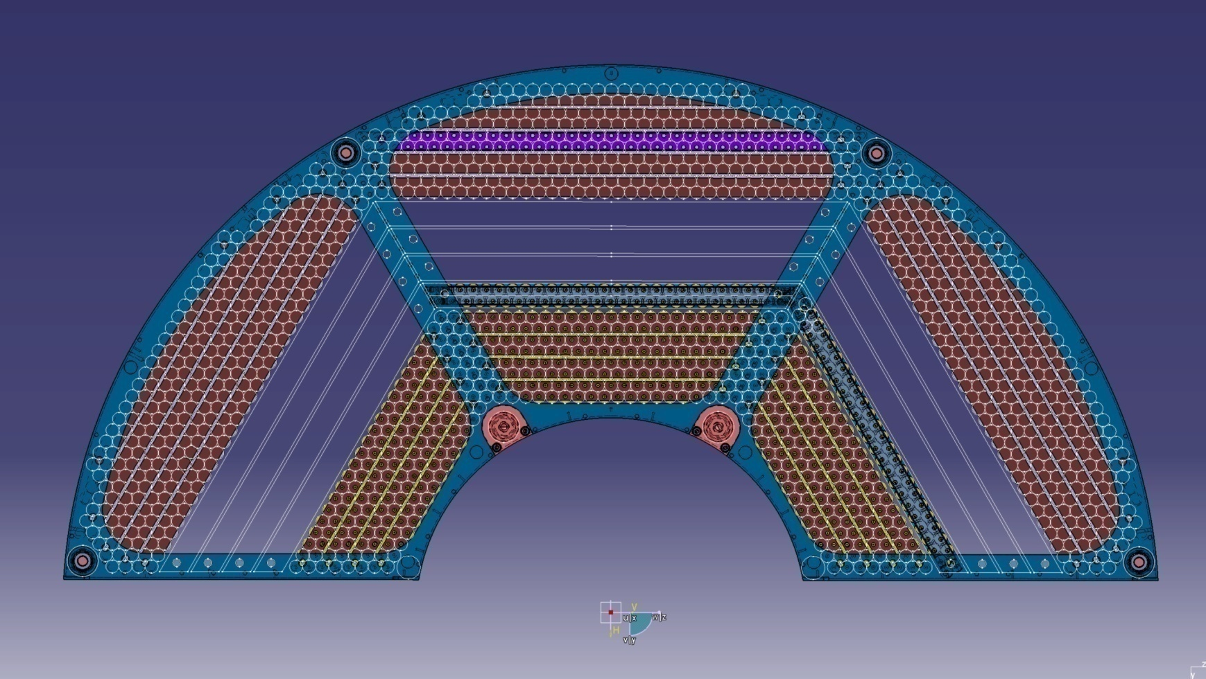

Slide 10
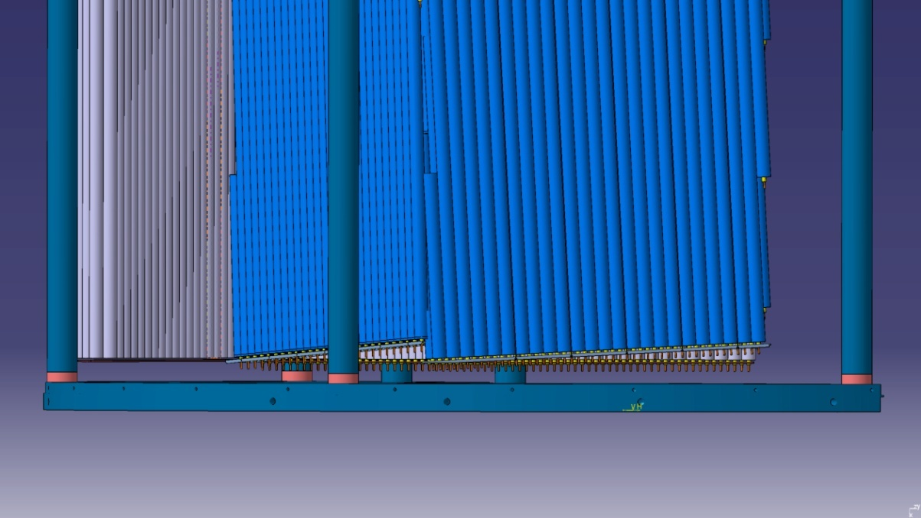
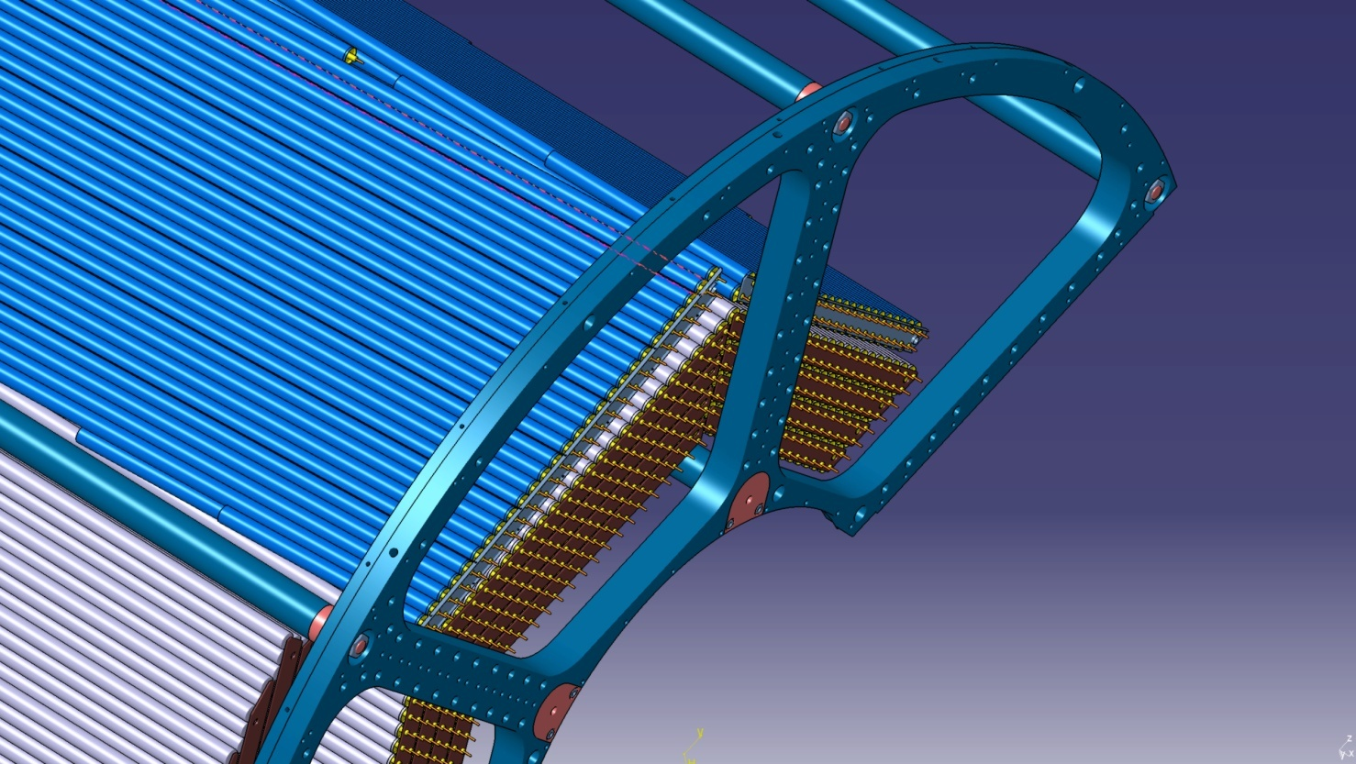

Slide 11
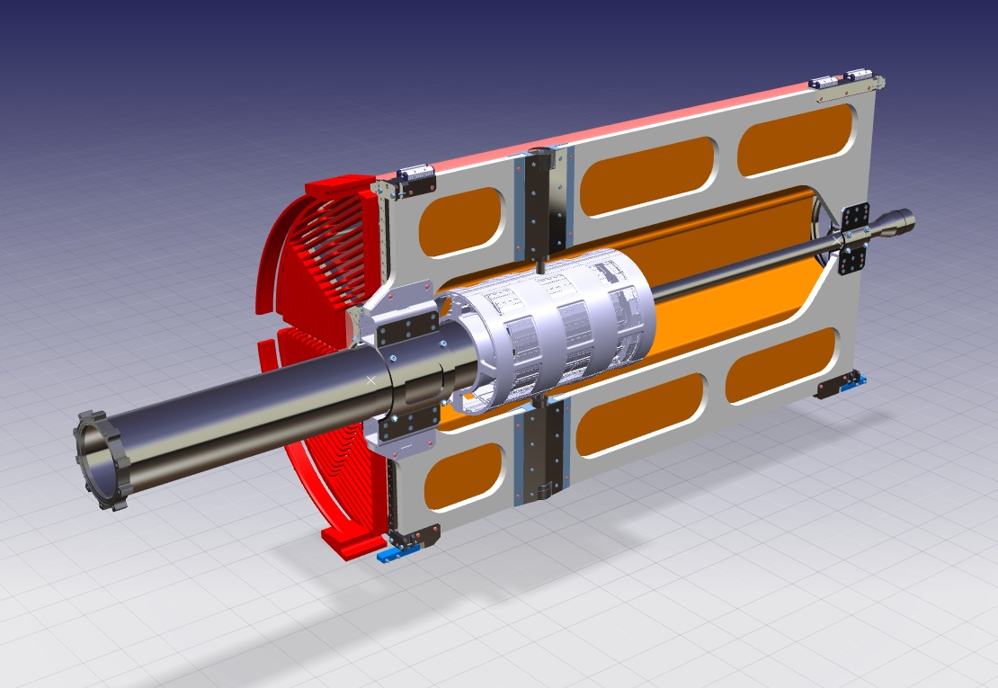
INFN-LNF - SPAS
CENTRAL TRACKER MECHANICS
-StrawTracker, Vertex Det., Cross Pipe are supported by a CENTRAL SUPPORT FRAME
CENTRAL SUPPORT FRAME PROTOTYPE: DONE !
STRAW SUPPORT FRAME PROTOTYPE: DONE !
AUXILIARY INSERTION STRUCTURE PROTOTYPE: DONE !
VERTEX PROTOTYPE: UNDER DEVELOPMENT;
CROSS-PIPE PROTOTYPE: PLANNED IN THE NEXT MONTHS.

Slide 12
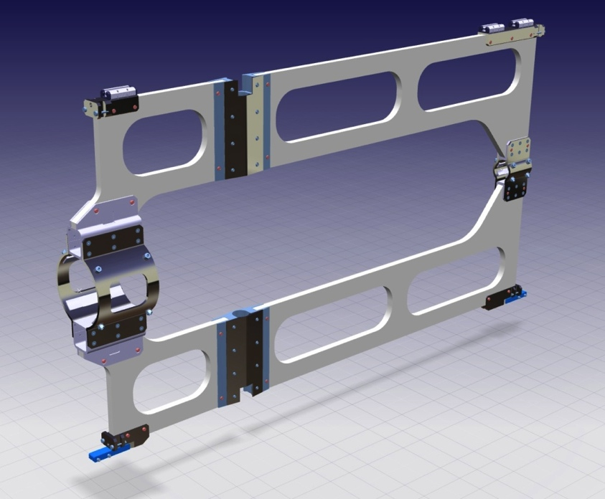
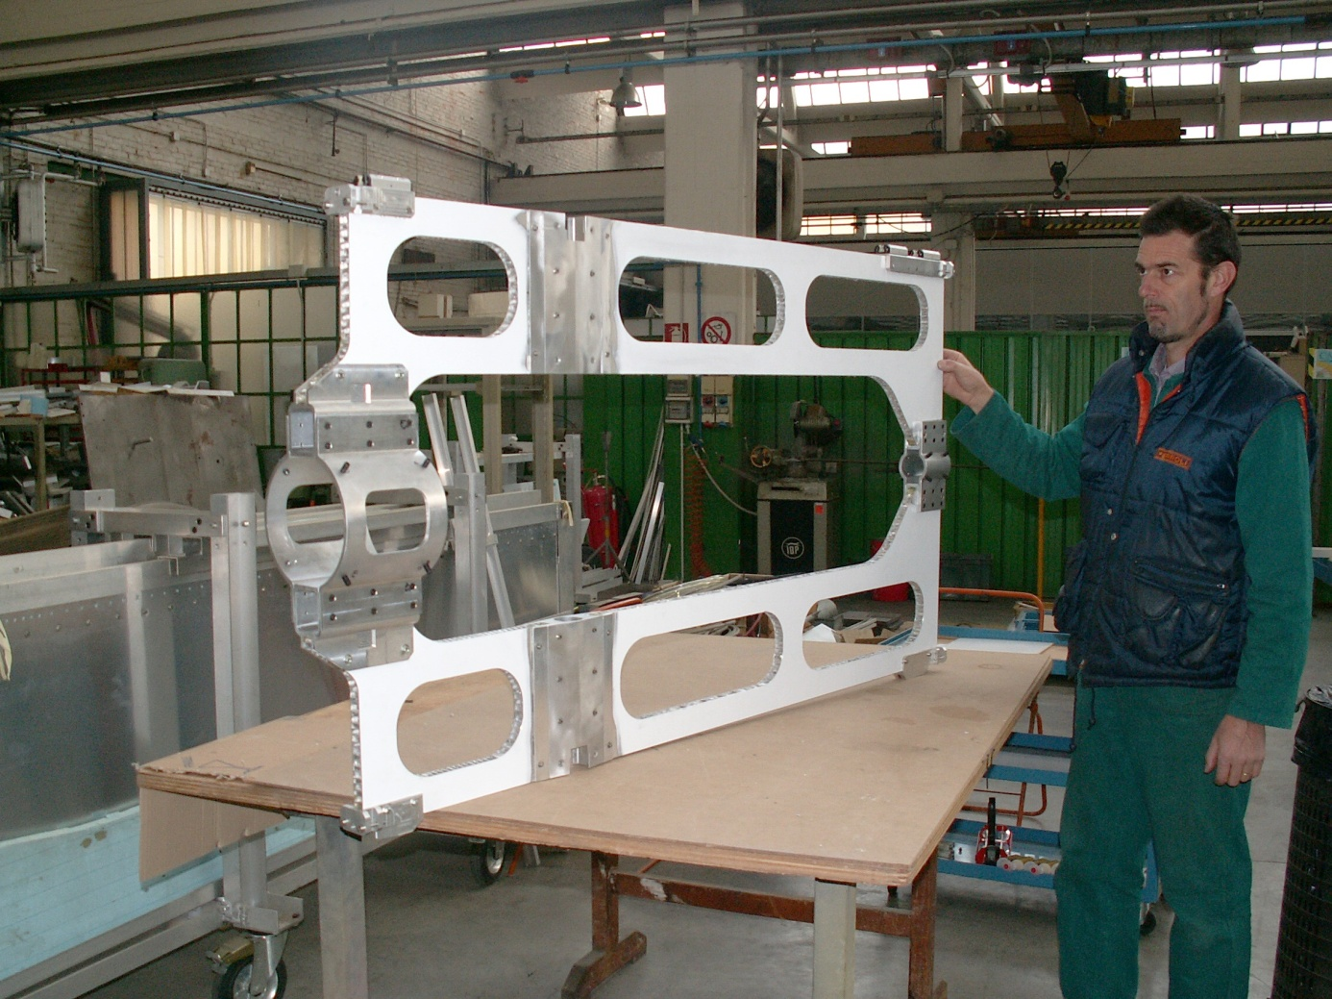
INFN-LNF - SPAS
CENTRAL TRACKER MECHANICS
-CENTRAL SUPPORT FRAME PROTOTYPE-
-CENTRAL SUPPORT FRAME IDEA.
THE PROTOTYPE OF THE CENTRAL SUPPORT FRAME HAS BEEN REALIZED IN THE INFN TURIN WORKSHOP.

Slide 13
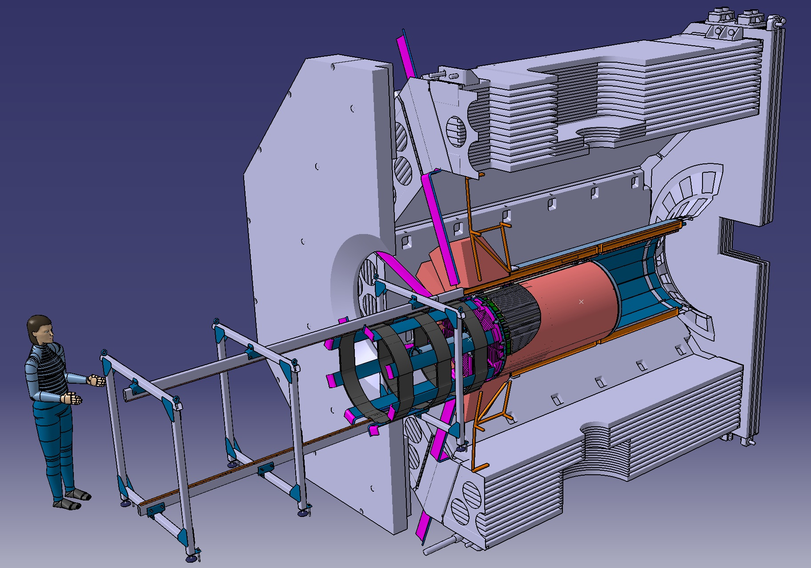
External support structure for assembly and insertion: Feb 2011
2000mm
1500mm

Slide 14
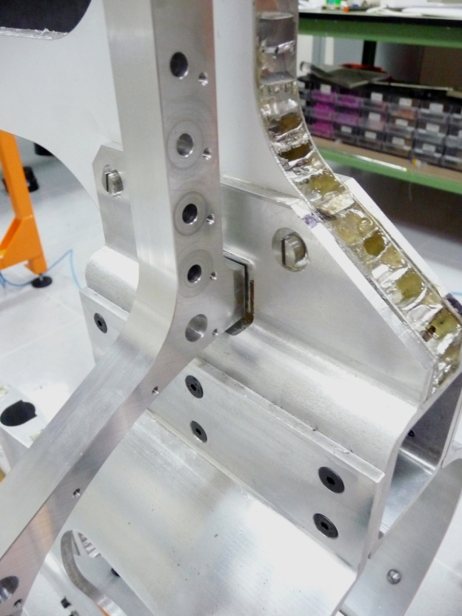
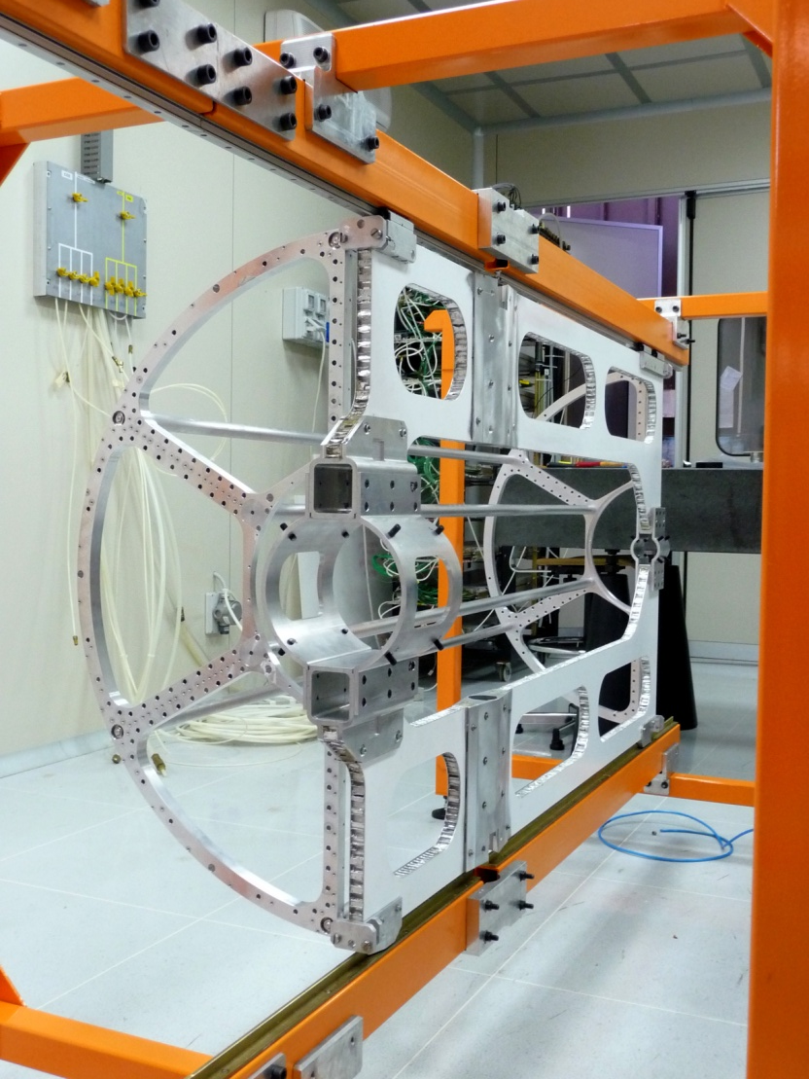
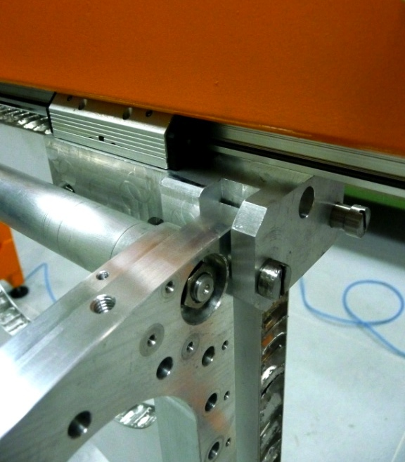
INFN-LNF - SPAS
CENTRAL TRACKER MECHANICS
-AN AUXILIARY INSERTION STRUCTURE IS NEEDED;
-CENTRAL SUPPOR FRAME PROTOTYPE;
-STRAW SUPPORT FRAME PROTOTYPE.

Slide 15
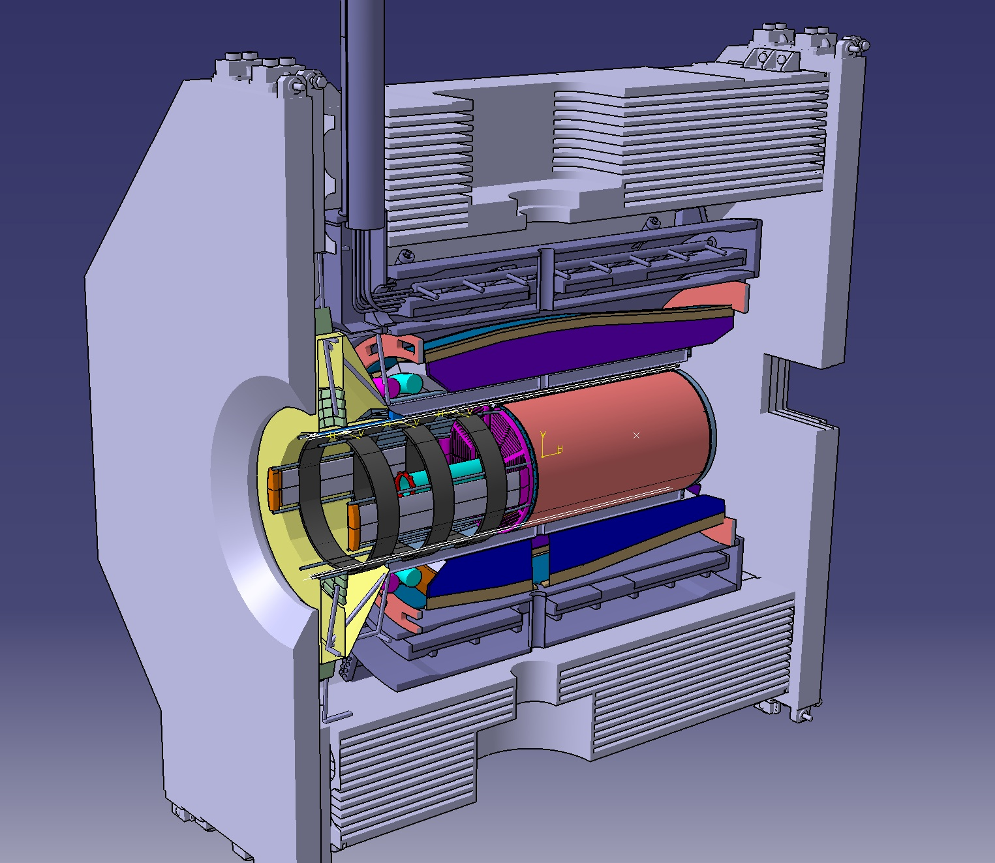
New Layout for Cable Routing after the March 2011 Meeting
Patch Panels
1500mm

Slide 16
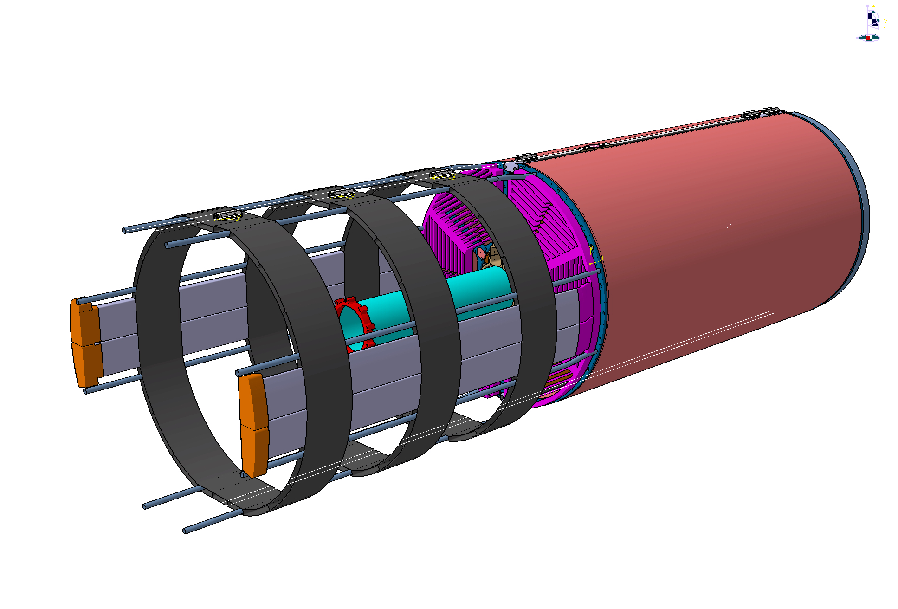
STT Cable Routing system

Slide 17
Weight and Cabling for one half of STT
-Half STT houses ~2100 straws + preams + HV
• straw weight less than 6 Kg
• frame structure 9 Kg
• 5 kg preamp boards + short cabling, 2100ch × 10cm, + HV
• 5 kg gas manifolds
TOTAL WEIGHT ~ 25 Kg
-FEE boards (discriminators, TDC, …)
• cooling system ?
TOTAL WEIGHT ~ 20 kg?
-10m cables
• gas tubes: 2.7 kg 20 rilsan tubes (10in-10out) (5 mm , ~13.2 g/m, 1× gas line per 100 straws)
• signal cables:17 kg signal coax cables, 2100ch × 10m × 0.5mm 0.83 g/m
• HV cables: 80 kg for 60 HV channels (~1 mainframe), 3.5mm coax 130 g/m
• LV cables: 9.6 kg 64 LV double-cables 2.5mm x 10m 15g/m
TOTAL WEIGHT 100 kg cable weight (20kg/m)
Loads on STT Support Structure
Loads on Routing Support Structure

Slide 18
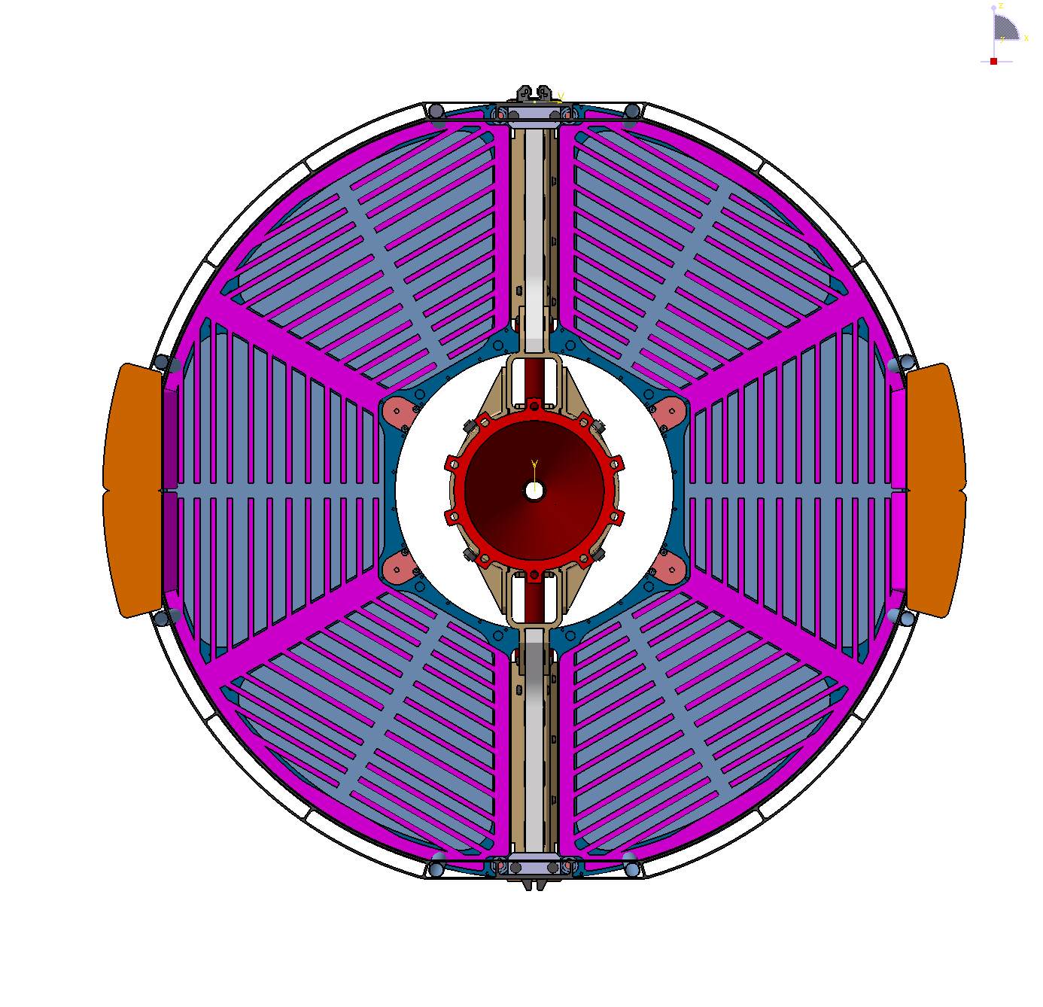
Cable arrangement
5000 mm²
5000 mm²

Slide 19
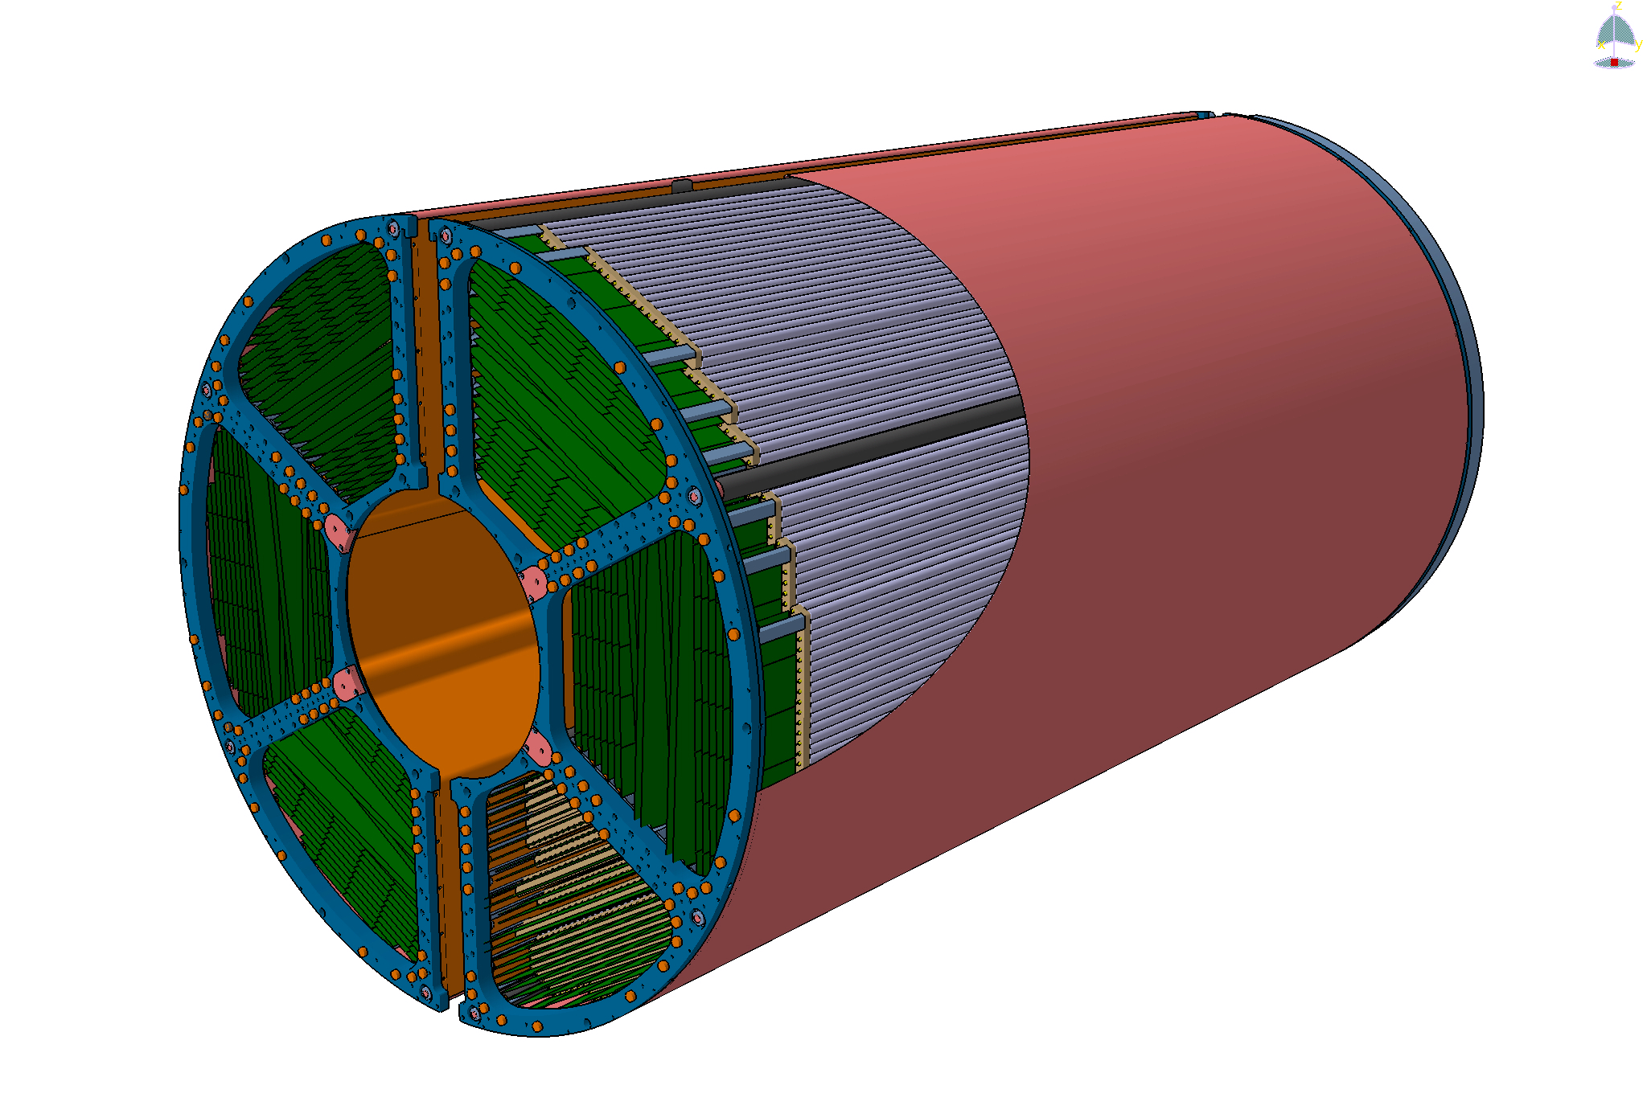
Electronics arrangement

Slide 20
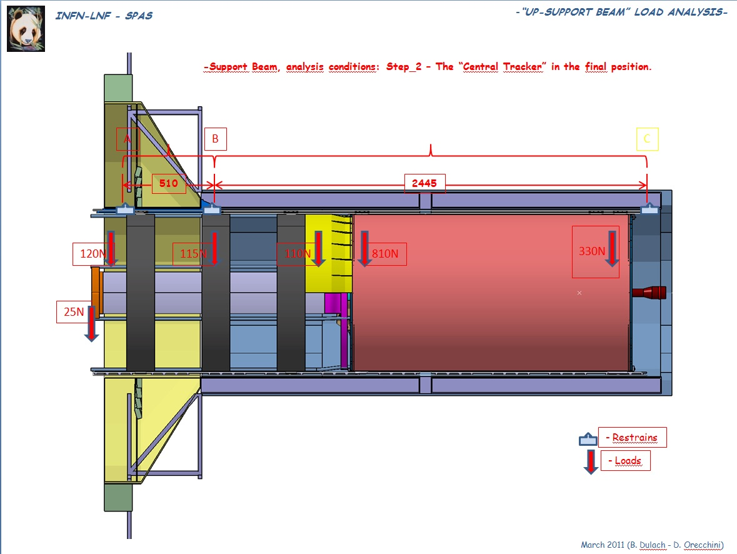
1500mm

Slide 21
Backup

Slide 22
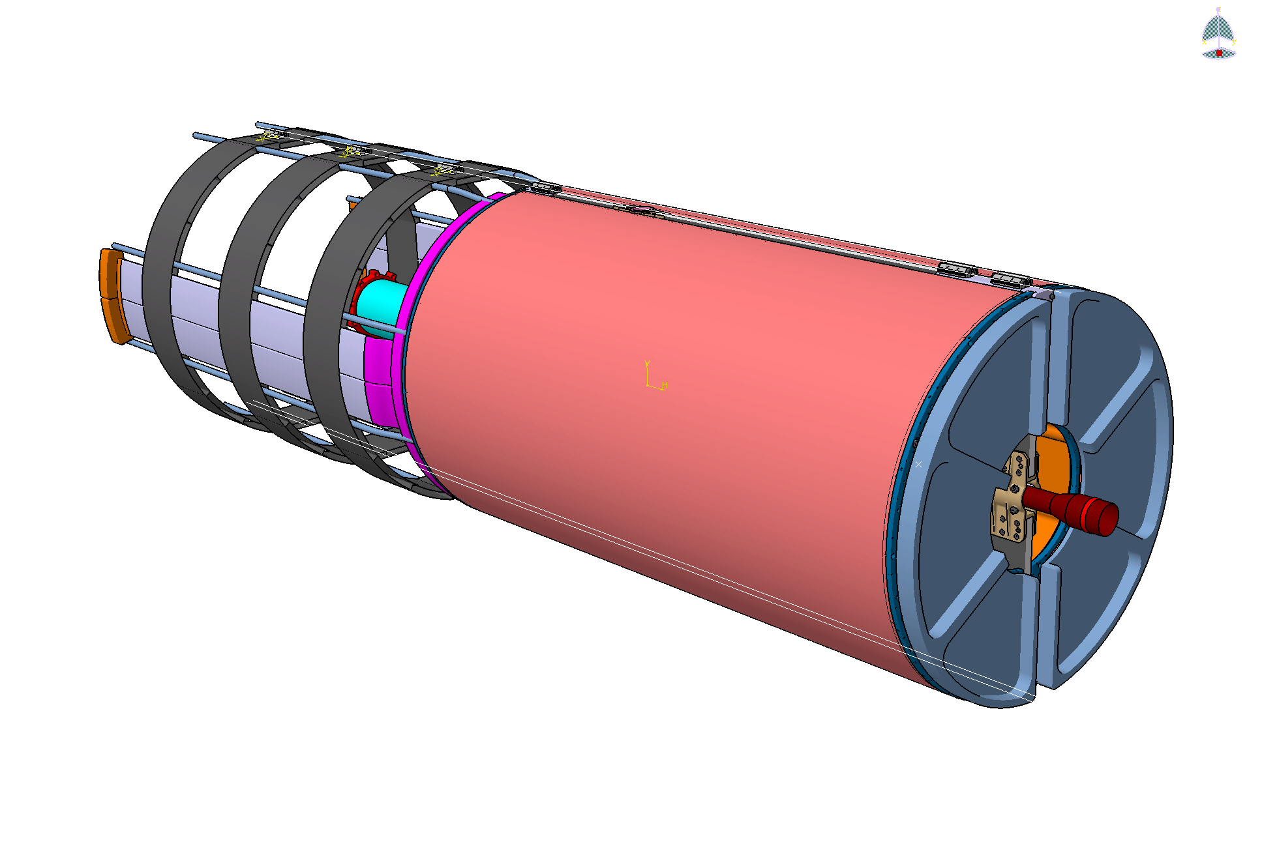

Slide 23
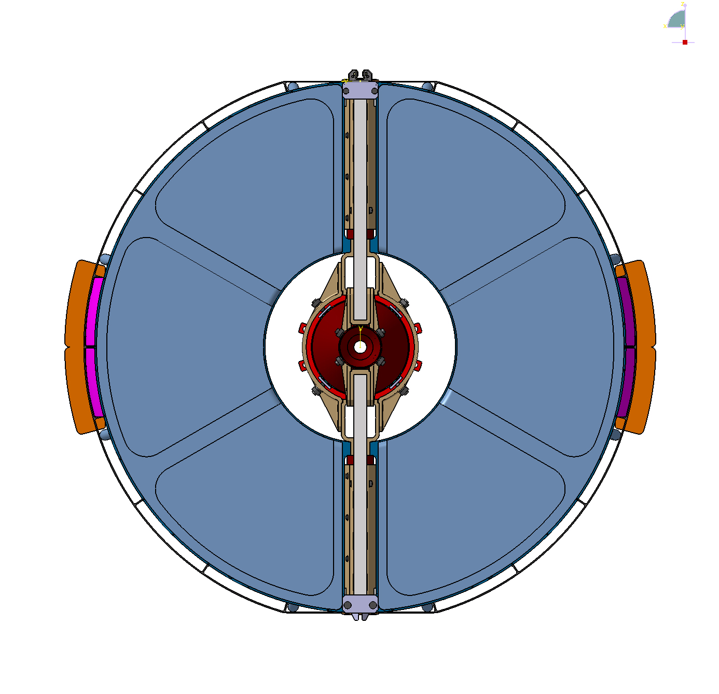

Slide 24
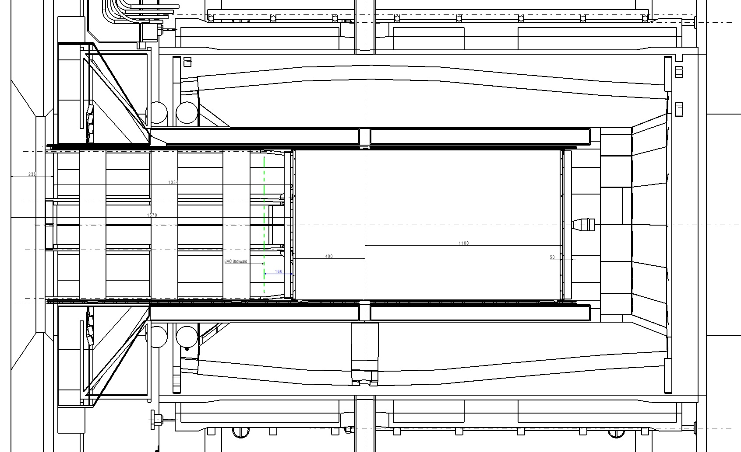

Slide 25
-ANALYSIS FOR AN HALF “SST TRACKER”-
-“STT TRACKER” LOADS ANALYSIS (Half STT houses 2600 straws + preams + HV)-
Straw weight: ----------------------------------------------7,5Kg
Frame structure: ------------------------------------------9,0Kg
Preamp board + short cabling – 2600ch x 10cm + HV:---6,0Kg
Gas manifolds: ---------------------------------------------5,0Kg
FEE boards (discriminators, TDC,….): ---------------------?
Cooling system: ---------------------------------------------?
- See detailed “constrain reactions”
-ANALYSIS FOR AN HALF “SST TRACKER”-
-“ROUTING SUPPORT STRUCTURE” LOADS ANALYSIS (Loads for 1.5m cables)-
- Gas rilsan tubes: 4 dia.20mm (In-Out Main Lines): -----------------------------0,40Kg
Signal cables: signals coax cables - 2100chx3mx0.5mm: -----------------------2,55Kg
HV Cables: for 60 HV channels - (1 mainframe), 3.5mm coax: -----------------12,0Kg
LV cables: 64 LV double-cables - 2.5mmx5m: ----------------------------------1,50Kg
----------------------------------------------------------------------------------------------
TOTAL: --------------------17,00Kg
- Needed space: 5000mm^2

Slide 26
