Slide 1






The TRImP Facility
Testing discrete symmetry violation with radioactive atoms
Lorenz Willmann
KVI, University of Groningen
EXA11, Vienna, 5-9 September 2011
Trapped Radioactive Isotopes: μicro-laboratories for fundamental Physics

Slide 2
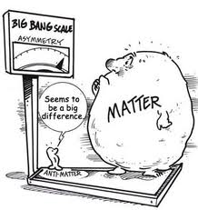
Discrete Symmetries
In the Standard Model of electro-weak interactions
Parity violation
CP violation → δ_{KM} in the SM
CP violation ↔ T violation
Insufficient for
Matter – Anti matter asymmetry
Searches for permanent Electric Dipole moments (EDM) best probe for new sources of CP violation
Trapped Radioactive Isotopes: μicro-laboratories for fundamental Physics
Notes:
However, in the weak interaction,
Parity symmetry is violated in the weak interaction and its most widely-known manifestation is the nuclear beta-decay and atomic parity violation
and CP violation in the K and B-meson decay.
The CP violation could be explained by complex phase in the CKM matrix of the Standard Model.
According to CPT theorem this is equivalent to T-violation.
But, it is insufficient for matter and anti-matter asymmetry observed in the universe. It is pertinent to look for the violation of time reversal symmetry.
Further the CP violation observed is not sufficient to explain the baryogenesis. This can be explored through searches for electric dipole moments.
Searches for pEDMs are a best probe for new sources of CP violation.

Slide 3
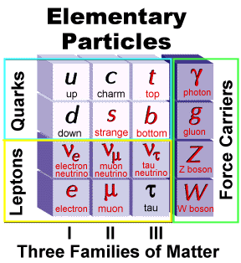
Beyond the Standard Model
Excellent description of all particle
physics experiments
However, no explanation of many facts
  Parity Violation
  CP violation
  Matter-antimatter asymmetry
  …
Large variety of models extending SM
  Supersymmetry
  LeftRight Symmetry
  …
New models provide contain
  Motivation of P violation
  New sources of CP violation
  …
Higgs missing keystone
3 Families
3 Forces
some 30 Parameters
Trapped Radioactive Isotopes: μicro-laboratories for fundamental Physics
Notes:
The SM of te electro weak interactions is an excellent description of all particle physics experiments
Low energy experiments test some of the open questions
Facts: Three generations, number of gauge bosons, 3 forces
Parity violation put in by hand (lefthandednes of neutrinos), no explanation for the origin
Apparent matter antimatter assymmetry. Could be caused by CP violation (Sacharov, deviation from thermal equilibrium is required.) but CP violation in SM is not sufficient. Other sources are required. Extensions to the SM ofter bring in CP violation in a natural way.

Slide 4
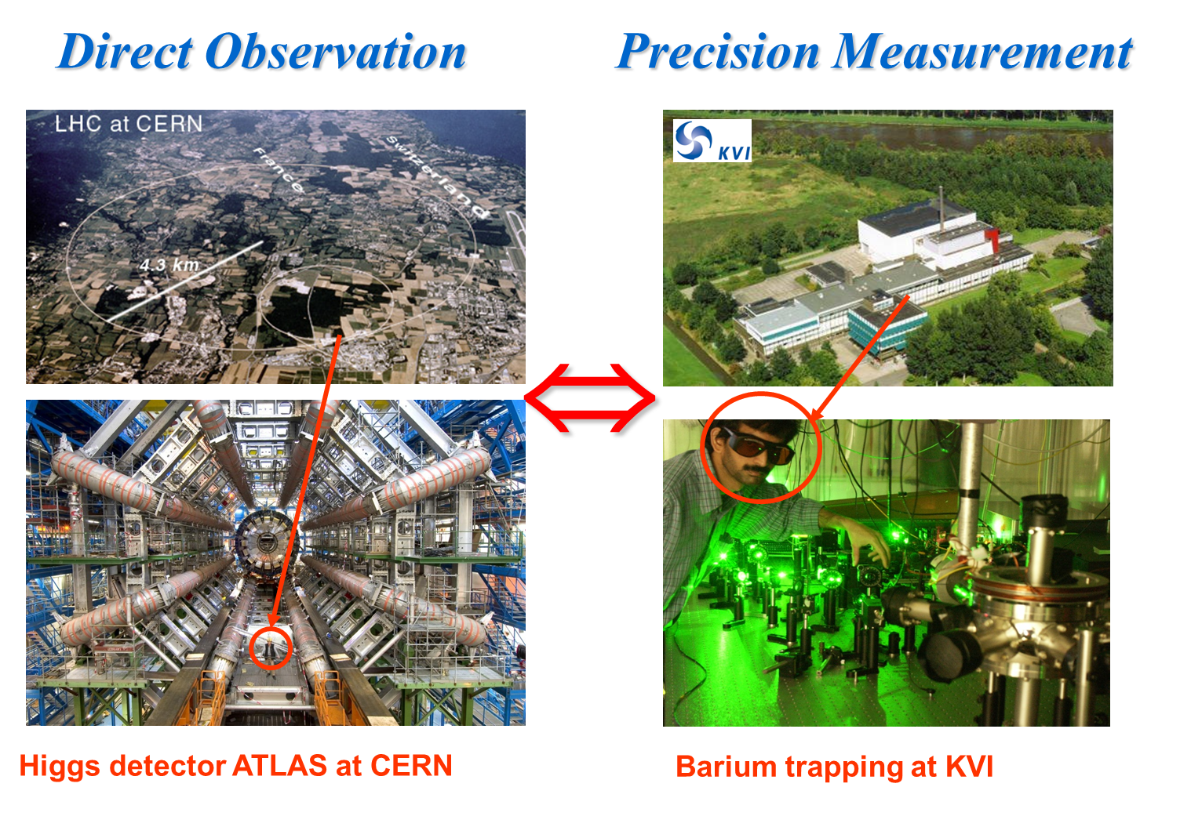
Strategies
Experimentally achievable precision
Theoretically tractable problem
Sensitivity to physical effect
Trapped Radioactive Isotopes: μicro-laboratories for fundamental Physics

Slide 5
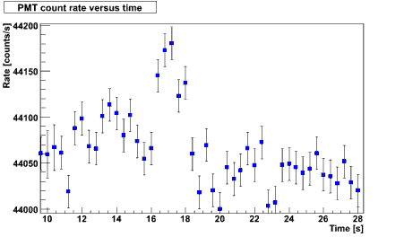
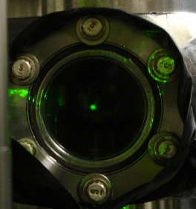
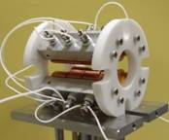
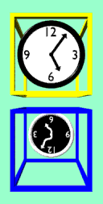
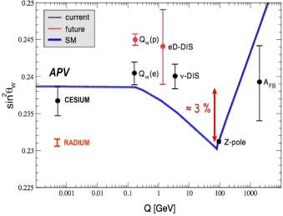
Discrete Symmetries@TRIμP
  CP – violation:
EDMs
Ba/Ra – atom
deuteron
T – violation:
  β-decay
  ²¹Na, ‘a’ & ‘D’ coefficients
/s]
150
Ba MOT
6
[10
100
H. Wilschut
Countrate
²¹Na in trap
50
0
X 100
-80
-60
-40
-20
0
20
Detuning of
λ
1
[MHz]
TRIμP
LW
G. Onderwater
Atomic P – violation:
  Ra Single Ion
sin² ϴ_{W}
Lorentz/CPT - violation:
  Weak Interactions
G. Onderwater
K. Jungmann, LW
Talk S. Müller on Tuesday

Slide 6
Radioactive Isotopes
TRIμP@KVI

Slide 7
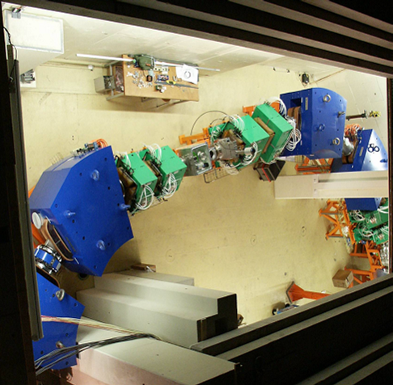


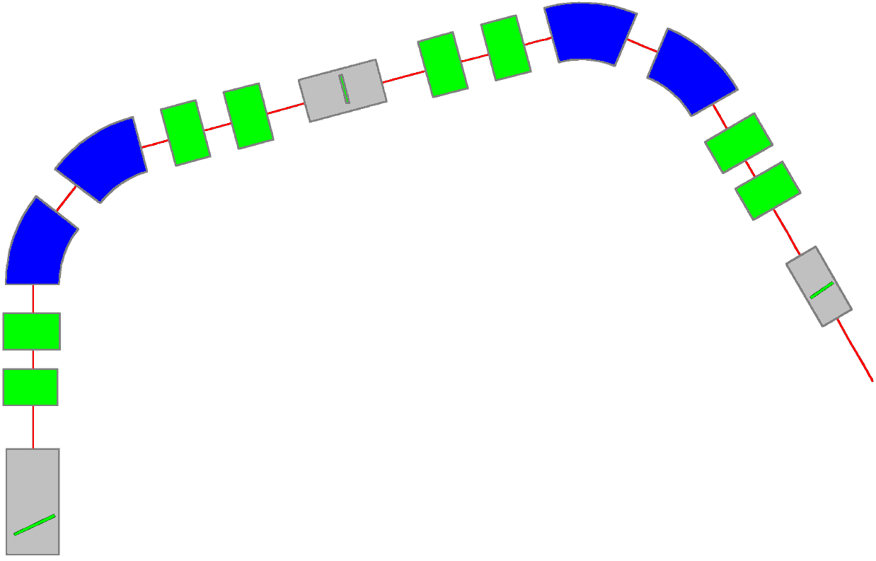
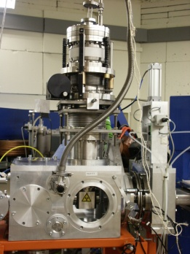
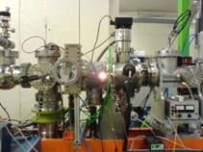

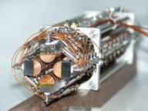
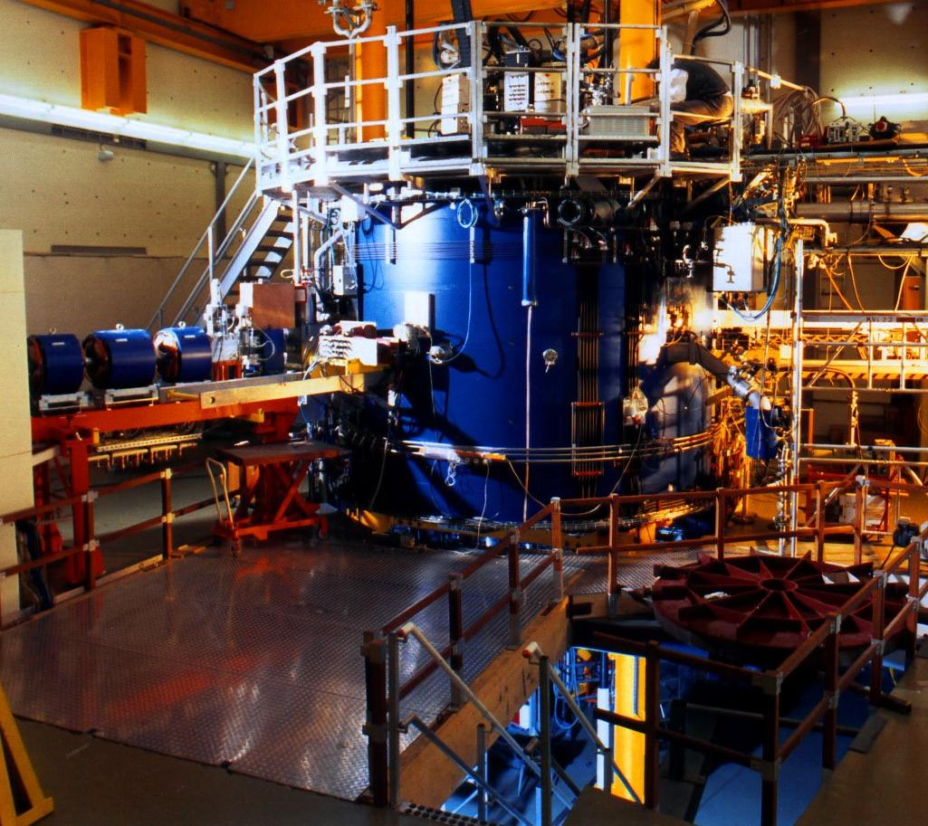


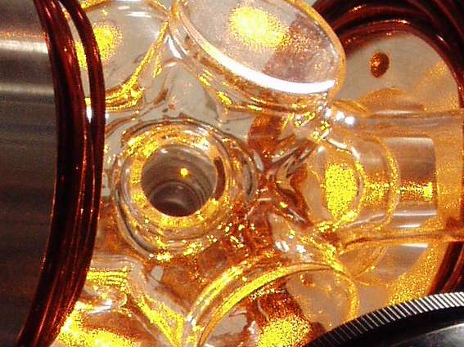



TRIμP project and facility
AGOR
cyclotron
Production
target
Magnetic separator
Production
Target
Q
D
MeV
Q
D
Nuclear Physics
Q
Magnetic
Separator
Q
Q
D
Q
D
Ion
Catcher
keV
Thermal Ionizer
Q
Atomic Physics
Q
RFQ
Cooler
eV
meV
MOT
RFQ buncher
Beyond the Standard Model
TeV Physics
Particle Physics
MOT
AGOR
Low energy
beam line
Trapped Radioactive Isotopes: μicro-laboratories for fundamental Physics
Notes:
The trimp facility is setup to produce short lived isotopes using heavy ion beams from the cyclotron AGOR. On a production target we produce isotopes of interest. In a magnetic separator we can select the specific isotope of interest. The still high energy ion beam in moderated in a thermal ionizer and extracted as a low energy ion beam, which is guided by electrostatic beamline to the experiment, where they can be trapped in neutral atoms traps or ion traps for the experiment. Here are pictures of key devices in the whole setup. The facility produces routinely beam for experiments (not only radium). (While going to the next slide) This is a production side, there is another key ingredient needed for the experiment.

Slide 8
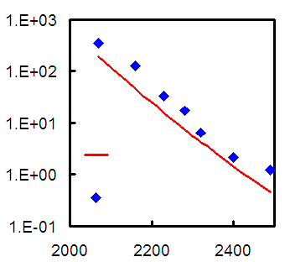
Thermal Ionizer
Cavity@2400 ⁰C
10³
10²
10¹
10⁰
10⁻¹
Diffusion description
Fujioka and Arai
NIM 186 (1981)409
Extraction halflife [s]
²¹Na
²⁰Na
diffusion theory
diffusion theory
²¹Na
Thermal ionizer efficiency (%)
Temperature ⁰C
Concept Works for alkaline and alkaline earth elements.
P.D. Shidling, et al.,
NIM A (2009)
Temperature ⁰C
Trapped Radioactive Isotopes: μicro-laboratories for fundamental Physics

Slide 9
Atomic Parity Violation
Toward precision on Weak Mixing Angle Θ_{W}
Trapped Radioactive Isotopes: μicro-laboratories for fundamental Physics

Slide 10
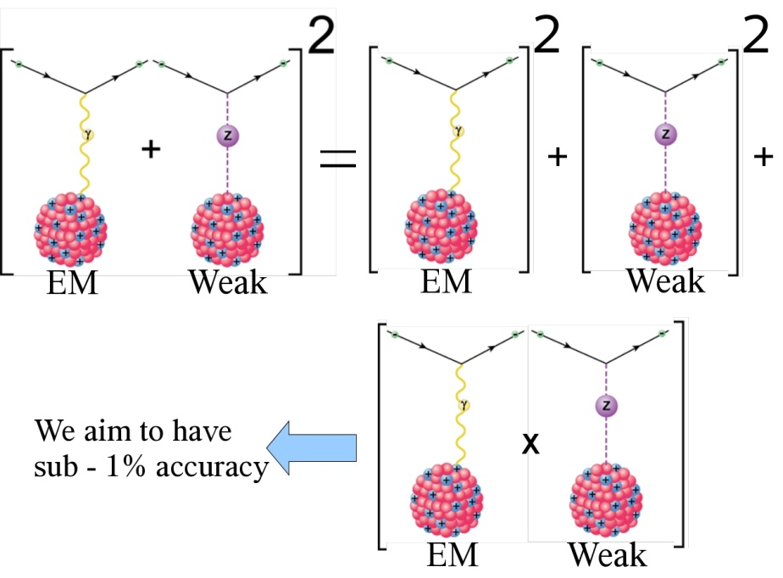
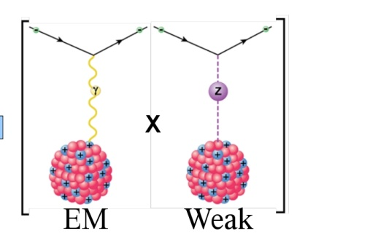
Weak Interaction in Atoms
Interference of EM and Weak interactions
Weak effects measurable due to interference
atomic theory required
Connection to SM
Trapped Radioactive Isotopes: μicro-laboratories for fundamental Physics
Notes:
The interaction between the nucleus and the electrons in an atom mediated by photons but also by the parity violating exchange of Z-bosons. The amplitudes for the em and the weak interaction add up. To calculate transition strength we have to evaluate the square of the matrix element. This leaves us with the dominating em interaction and tiny weak part and the interference term. The measurement can be done in a system with a sufficiently weak em transition strength such that the interference term is not too small.
Theory can connect the measurable E1_{PNC} to the Weinberg angle as it is defined in the SM. Weak charge and role of KVI theory

Slide 11
Weak Interaction in Atoms
Interference of EM and Weak interactions
Ra⁺
7P_{3/2}
7P_{3/2}
7P_{1/2}
Weak
Interaction
7P_{1/2}
6D_{5/2}
6D_{5/2}
6D_{3/2}
6D_{3/2}
E2
E2
E1^{PNC}
~
7S_{1/2}
7S_{1/2}
E1^{PNC} = K_{r} Z³ Q_{w} = K_{r} Z³ (- N + Z (1-4sin² θ_{W}))
Ra⁺@TRIµP
3% accuracy: Theory@KVI
Trapped Radioactive Isotopes: μicro-laboratories for fundamental Physics
Notes:
The interaction between the nucleus and the electrons in an atom mediated by photons but also by the parity violating exchange of Z-bosons. The amplitudes for the em and the weak interaction add up. To calculate transition strength we have to evaluate the square of the matrix element. This leaves us with the dominating em interaction and tiny weak part and the interference term. The measurement can be done in a system with a sufficiently weak em transition strength such that the interference term is not too small.
Theory can connect the measurable E1_{PNC} to the Weinberg angle as it is defined in the SM. Weak charge and role of KVI theory

Slide 12
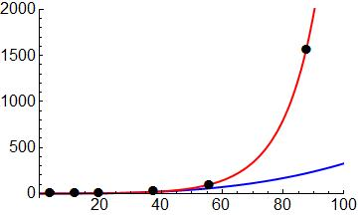
Sensitivity of Ra⁺
increase faster than Z³ (Bouchiat & Bouchiat, 1974)
K_{r} relativistic enhancement factor
Z³K_{r}
Ra⁺
Ra⁺ effects
larger by:
  20 (Ba⁺)
  50 (Cs)
Enhancement
Z³
Ca⁺
Sr⁺
Ba⁺
L.W. Wansbeek et al.,
Phys. Rev. A 78, (2008)
Atomic Number
✦ 5-fold improvement over Cs feasible in 1day
Trapped Radioactive Isotopes: μicro-laboratories for fundamental Physics
Notes:
Why is radium now a good candidate. Parity violating effect grow faster than Z^3. Weak interaction is short range and the propability at the nucleus plays a role. That scales as Z^3. Additional enhancement arises relativistic effects. Here is show that the weak effect in Radium grow faster than Z^3. As a result the weak effects are 50 times larger than for Cs and even 20 times larger than for Ba+. This makes radium a superior candidate for APV.
For an evaluation of the weak

Slide 13
Some APV Activities
Cs The Standard@Bolder
S.C. Bennett, C.E. Wieman, PRL 59, 16 (1999)
Fr Atom traps@Legnaro, Stony Brook TRIUMF
G. Stancari et al., E.Phys.J. 150, 389 (2007); G. Gwinner et al., Hyperf. Int. 172, 45 (2006)
Yb Biggest APV effects observed @Berkeley
K.Tsigutkin et al., PRA 81, 032114 (2010)
Ba⁺ Idea and first steps @Seattle
N. Fortson, PRL 70, 2383 (1993); J.A. Sherman et al., Phys.Rev. A 78, 052514 (2008)
Ra⁺ Ideal system @KVI
O.O. Versolato et al., Phys. Rev. A 82, 010501(R) (2010)
Yb⁺ @Los Alamos
J. Torgerson, Talk at Trento ECT* November 2010,
RaF advantageous molecular system @KVI
Berger, Hoekstra et al., PRA 82, 052521 (2010)
Trapped Radioactive Isotopes: μicro-laboratories for fundamental Physics

Slide 14
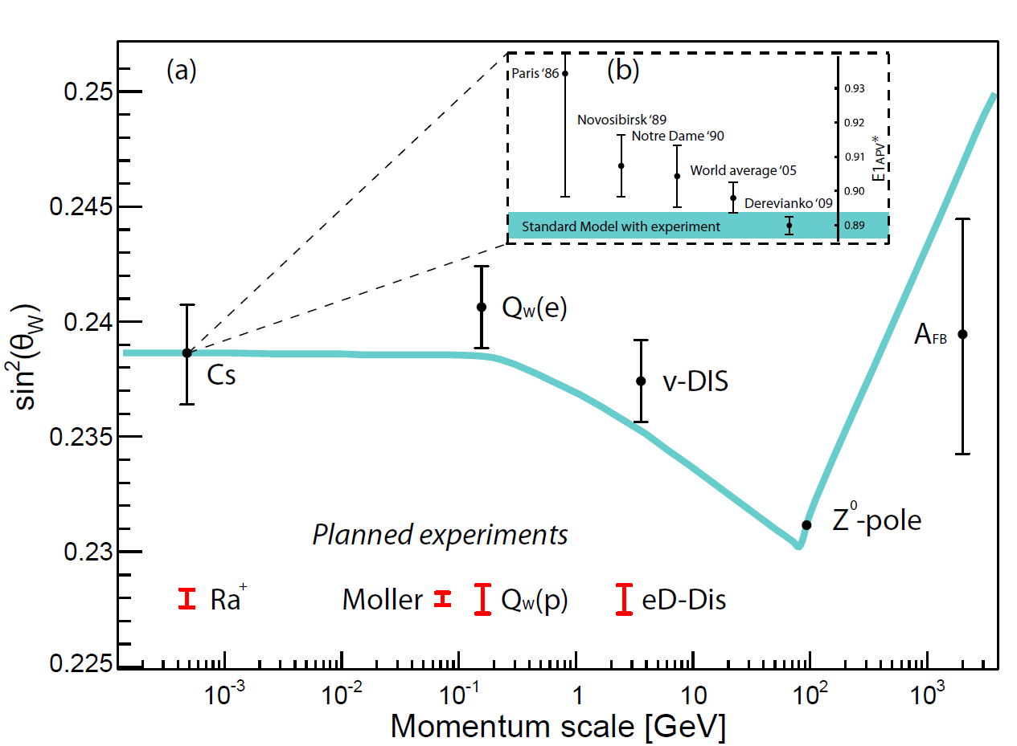
Weinberg Angle θ_{W}
sin²(θ_{W}) = (1 – (M_{W}/M_{Z})²) + rad. corrections + New Physics
Standard Model
5
4
3
Cs
≈ 3 %
5
2
Ra⁺
Q_{W}(p)
eD-DIS
1
Notes:
Weinberg angle is one of the central parameters in the electroweak interaction. It is connected to the strength of the weak interaction. It is given to first order by the ratio of the masses of the vector bosons and its numerical value is around 0.24. In the standard model the weak mixing angle can be calculated for different ranges of momentum transfer and there radiative corrections become visible. The value changes by about 3% from the Z resonance, where it is measured with the highest precision, down to the low momentum transfer region which can be probed by atomic parity violation experiments. The best value arises from an experiment done with Cs atomic beam and there is a long history of its value due to incomplete atomic theory. The latest value of theory (2009) puts the Cs measurement right on top of the SM prediction for the running of the weinberg angle.
There are several experiments planned at different energy scales to test the SM prediction. We are using the Ra ion. A single Ra ion has the potential to increase the precision at low energies by a factor of 5.
It is important to note that a deviation from the prediction of the SM can indicate new physics.
Now I want to introduce the weak interaction in atoms.

Slide 15
Physics Beyond the SM
Extra Z’ boson in SO(10) GUTs:
Additional U(1)’ gauge symmetry
Does not affect ordinary Z and W
physics
Assume no Z-Z’ mixing
Londen en Rosner (1986)
Marciano en Rosner (1990)
Altarelli et al. (1991)
Bounds on M_{Z’} from APV
(68% confidence level, ξ= 52°)
With current Cs result
M_{z’}> 1.2 TeV/c² (Wansbeek et al.. PRA (2010))
Range for Ra⁺ (5-fold improvent)
  > 6 TeV/c²
From High Energy Experiments
Tevatron
M_{Z’}> 0.9 TeV/c²
Expected Range LHC
M_{Z’} ~4.5 TeV/c²
Trapped Radioactive Isotopes: μicro-laboratories for fundamental Physics

Slide 16
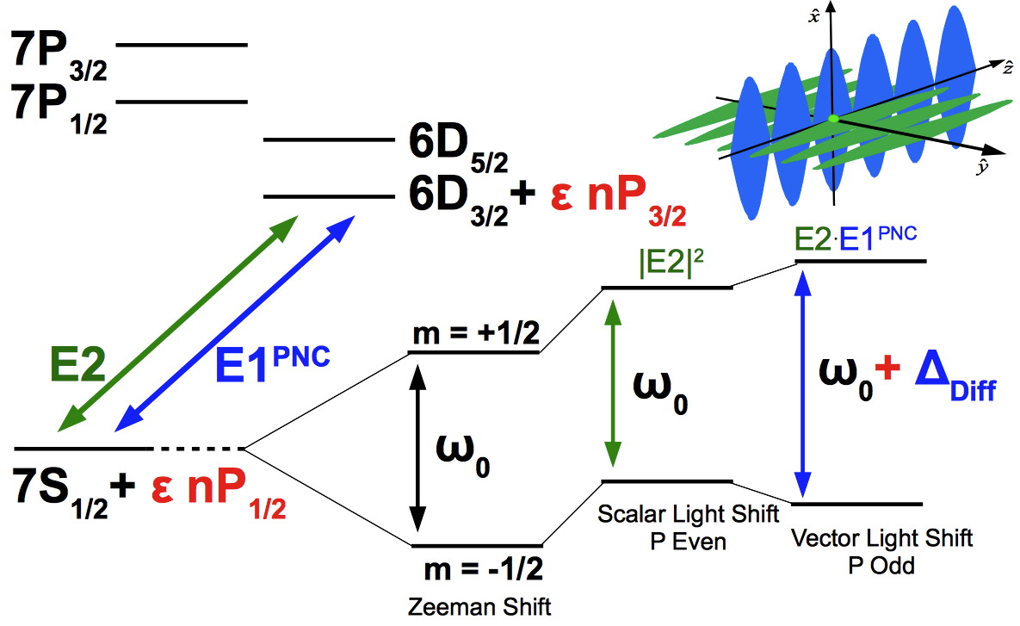
Experimental Method
Differential Light Shift
    N. Fortson (1993)
Trapped Radioactive Isotopes: μicro-laboratories for fundamental Physics

Slide 17
Atomic Structure Status
Relativistic coupled-cluster (CC) calculation of E1_{APV} in Ra⁺
E1_{APV} = 46.4(1.4) · 10⁻¹¹ iea₀ (−Q_{w}/N)
Accuracy (3 %) from comparison with hyperfine structure
L.W. Wansbeek et al., Phys. Rev. A 78, 050501(R) (2008).
Other results:
45.9 · 10⁻¹¹ iea₀ (−Q_{w}/N)
R. Pal et al., Phys. Rev. A 79, 062505 (2009),
Dzuba et al., Phys Rev. A 63, 062101 (2001).
Theoretical Uncertainty in Cs: 0.3 %
SM test requires sub-% accuracy
Spectroscopic data required
ISOLDE @ CERN (1980s)
  TRImP @ KVI
  Isotope shifts of the 7S_{1/2} – 7P_{1/2} line
  Hyperfine structure of this line
  State Lifetimes
Trapped Radioactive Isotopes: μicro-laboratories for fundamental Physics

Slide 18
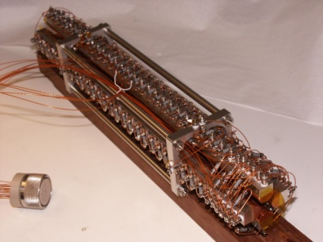
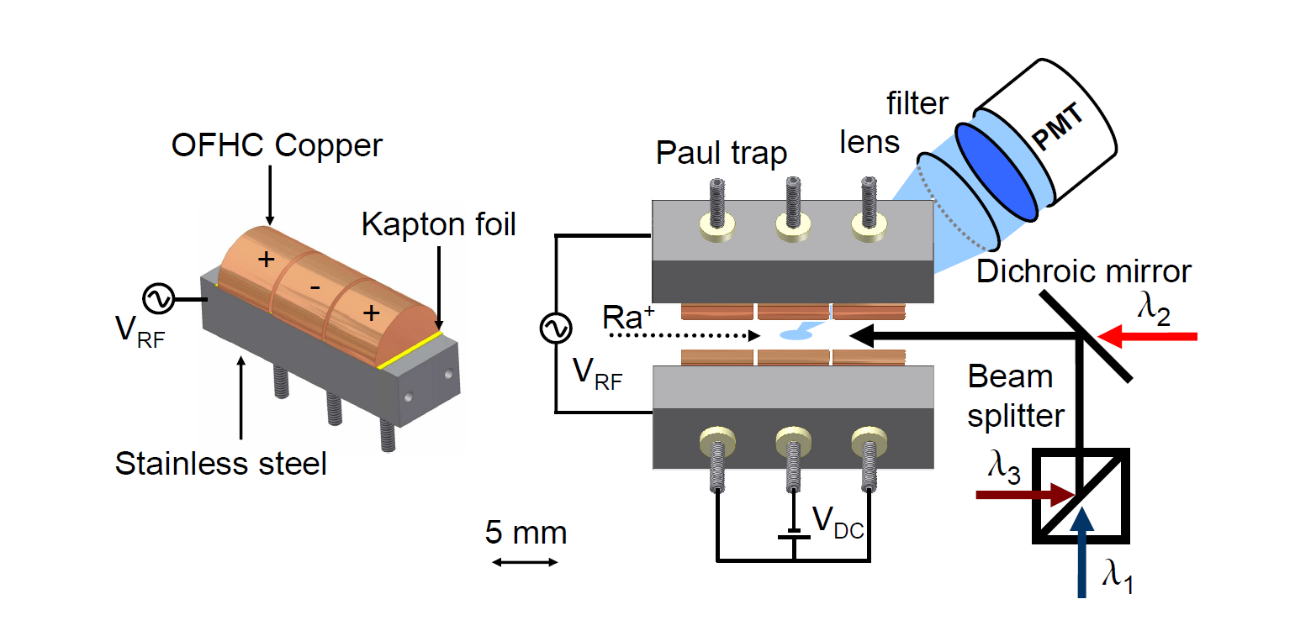
Trapped Ra⁺ Spectroscopy
Radiofrequency Quadrupole (RFQ)
7P_{3/2}
7P_{1/2}
708 nm
1079 nm
6D_{5/2}
6D_{3/2}
468 nm
7S_{1/2}
Level Scheme of Ra⁺
Notes:
RFQ at end RFQ paul trap where ions also interact with laser light. The RFQ and paul trap are filled with buffer gas. In our case we use N2 and Neon. The laser beams are overlapped and sent through the main axis of the trap. We can access three resonances in Ra. The observable in all of the measurements is the fluorescence rate at 468nm, caused by pumping on the S-P and repumping on the D-P (this one plugs a leak to the meta-stable D-state). The lasers were free-running throughout the epx. They were reference to wavelengthmeters, optical cavities and molecular absorption lines.

Slide 19
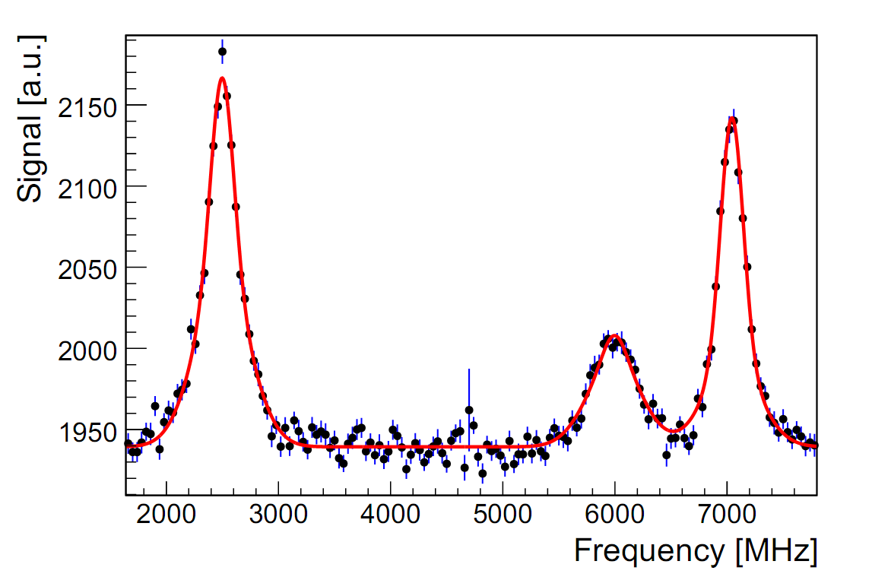
Example: HFS in ²¹³Ra⁺
F’
2
1
1
0
7P_{3/2}
F=2→F’=1
F=1→F’=1
7P_{1/2}
1079 nm
F=1→ F’=0
F
2
1
6D_{5/2}
6D_{3/2}
468 nm
1
7S_{1/2}
0
Experiment Theory
1050(10) MHz 1082 MHz 1086 MHz
R. Pal et al., Phys. Rev. A 79,
062505 (2009).
L.W. Wansbeek et al., Phys. Rev. A 78,
050501(R) (2008).
Trapped Radioactive Isotopes: μicro-laboratories for fundamental Physics
Notes:
Example of the measurement in Radium isotopes. First time spectroscopy of short lived isotopes in an ion trap. About 100 of ion in trap. Input is required for improvements on atomic structure calculations. These many electron systems become treatable. Effective one electron systems. Next reports on this will be on a single laser cooled radium ion in a trap. Well on its way to a APV
Add the lifetime picture

Slide 20
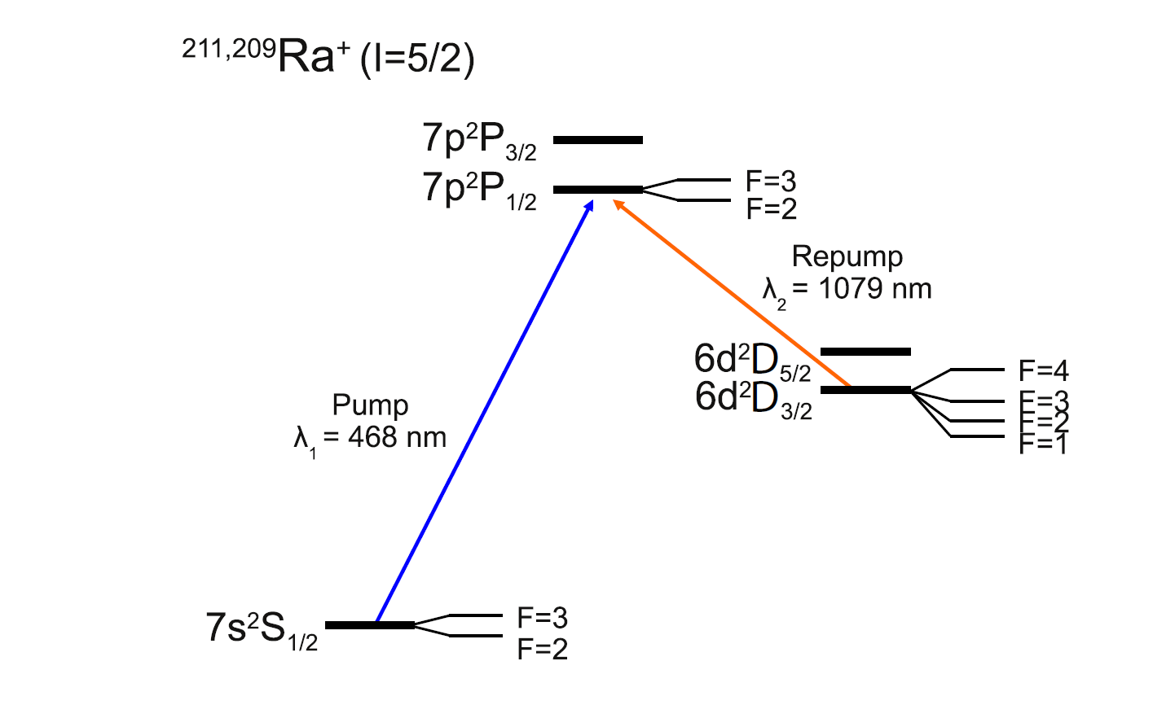
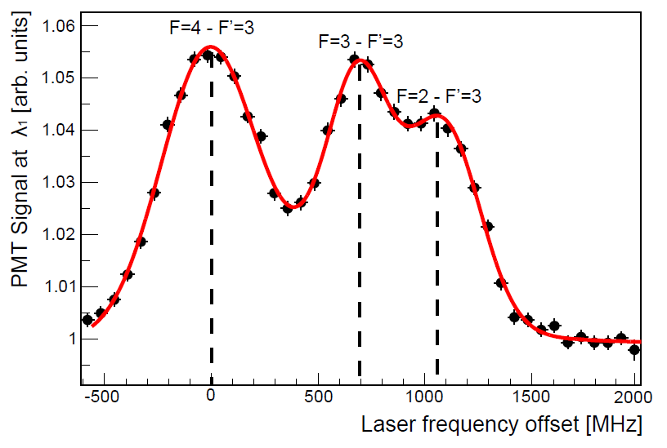
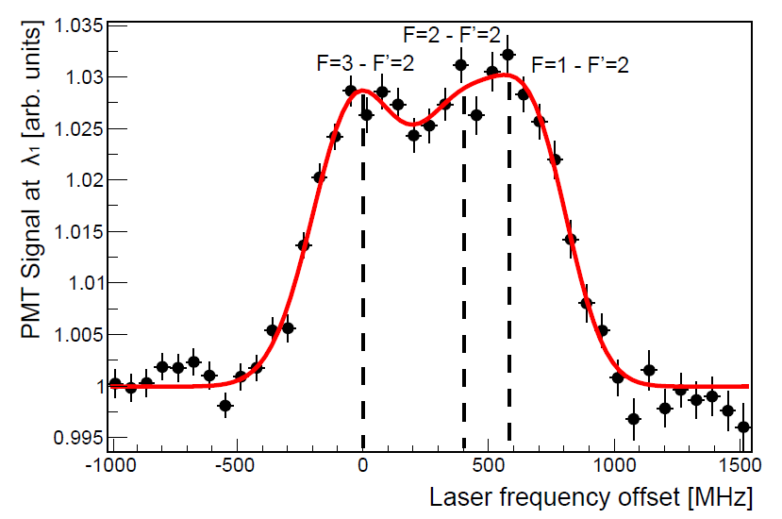
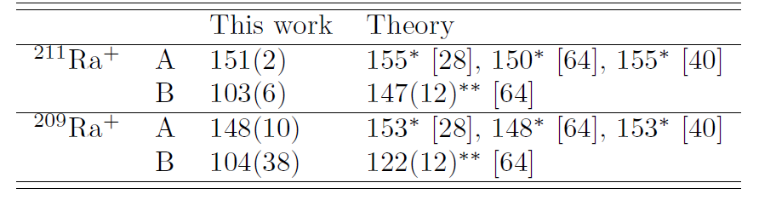
Hyperfine Structure I=5/2
[28] L. Wansbeek et al., PRA78 050501(2008)
[40] R. Pal et al., PRA 79 062505 (2009)
[64] B.K.Sahoo et al., PRA 76, 040504 (2007)
O.O. Versolato, et al., Phys. Lett. B, (2011)
Trapped Radioactive Isotopes: μicro-laboratories for fundamental Physics

Slide 21
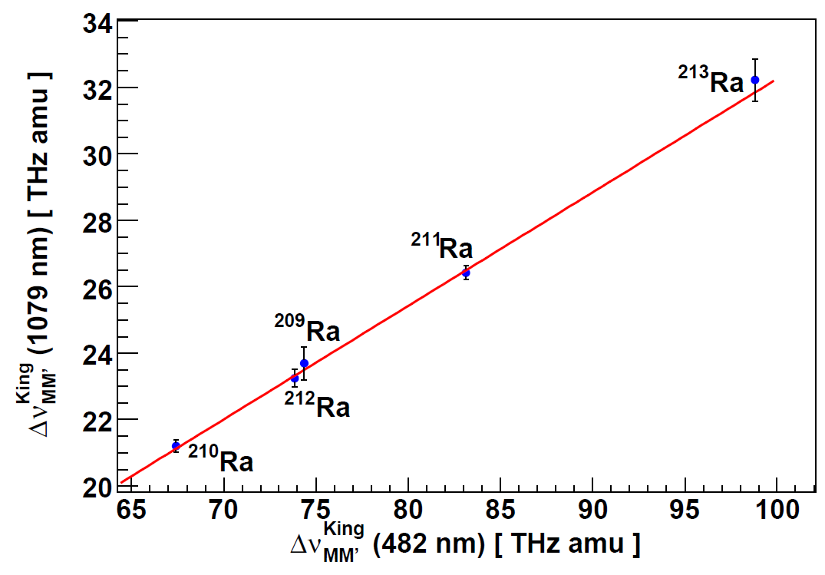
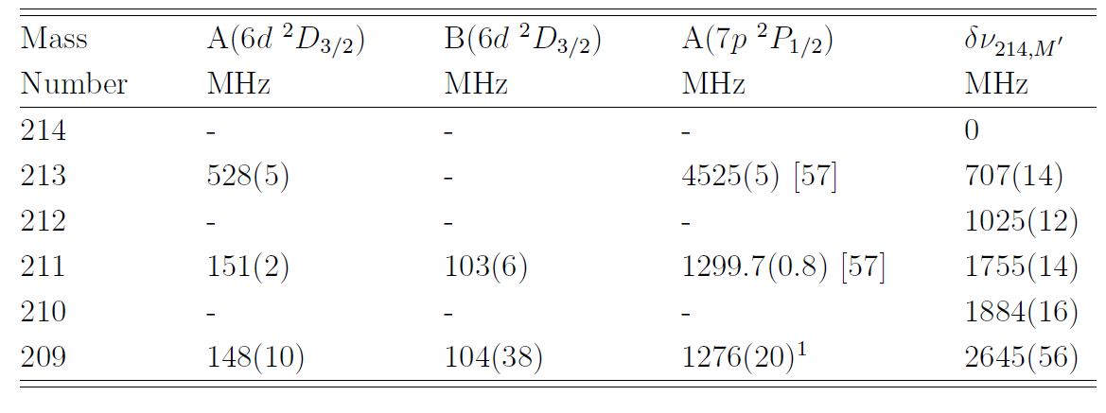
Isotope Shifts
King Plot
Comparison of different transition
Good agreement with
atomic theory on few % level
G.S.Giri et al. , PRA Rapid Communications, (2011)
Trapped Radioactive Isotopes: μicro-laboratories for fundamental Physics

Slide 22
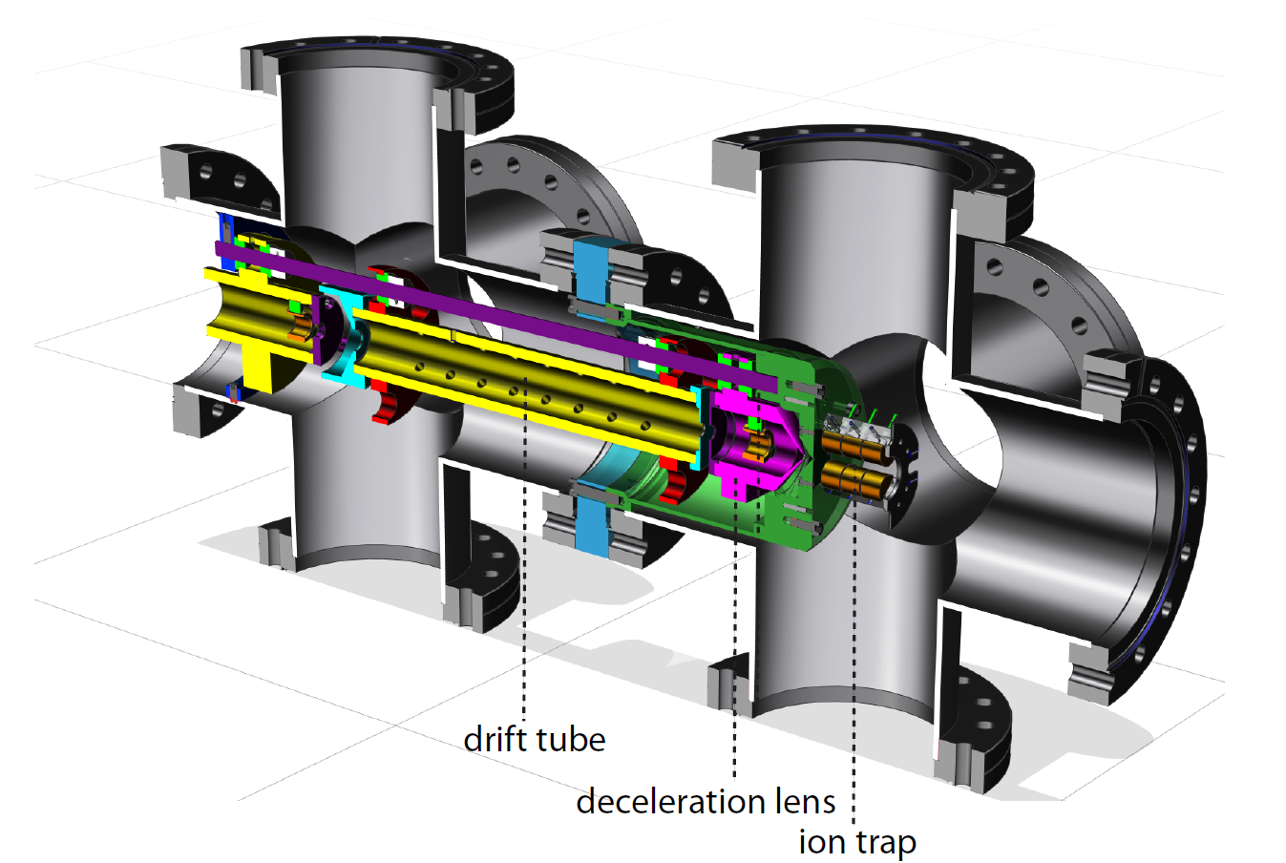
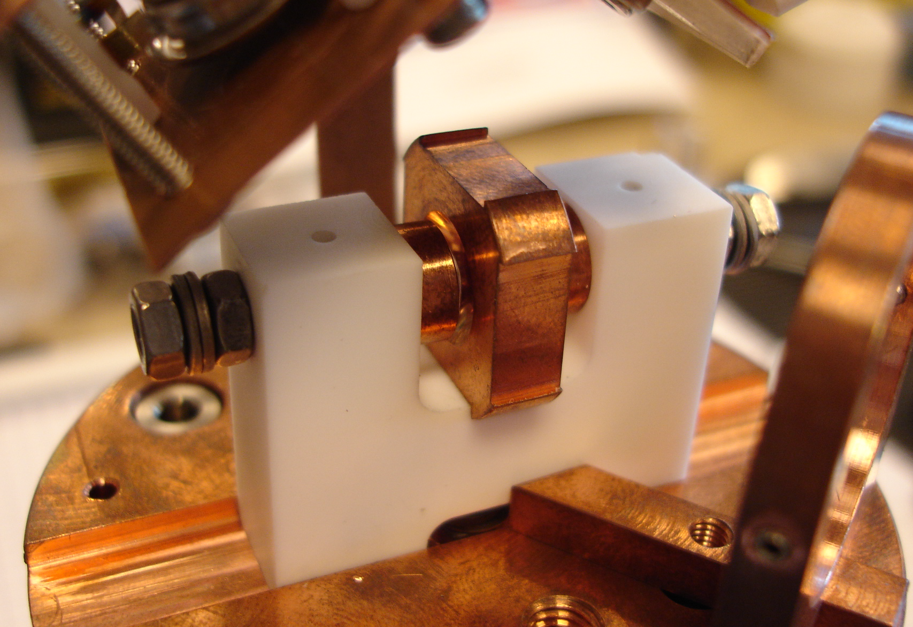
Status
  Trapped Isotopes: ²⁰⁹⁻²¹⁴Ra
  Providing challenges for atomic theory:
  Transitions/Isotope Shifts: (wavefunction near nucleus)
7S_{1/2}-7P_{1/2,} 6D_{3/2}-7P_{1/2,} 6D_{3/2}-7P_{3/2}
Lifetime: (transition matrix elements)
metastable 6D_{3/2} state
NEXT:
Single ion trap and laser cooling
Capturing Ra⁺
Single Ion Trap
Trapped Radioactive Isotopes: μicro-laboratories for fundamental Physics

Slide 23
Permanent Electric Dipole Moments
Atomic Radium

Slide 24
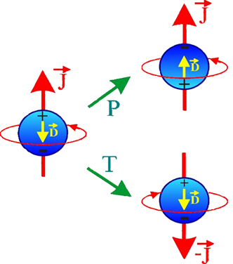
Permanent Electric Dipole Moments
H= -(d E+µ B)·J/J
d - EDM
µ - magnetic dipole moment
J - Nuclear spin
CP/T violation in
Standard Model yield
EDM’s << experimental limits
EDMs violate
- Parity
- Time Reversal
Trapped Radioactive Isotopes: μicro-laboratories for fundamental Physics
Notes:
Permanent electric dipole moments violate both parity and time reversal symmetry.
The parity operator exchanges charges and hence the direction of the charges of the electric dipole moment, but leaves the spin J unchanged.
The time reversal operator changes the sign of the spin and leaves the charges in place.
In both cases the resulting particles would have an electric dipole moment opposite in its direction wrt the spin as compared to the original particle.
The magnetic moment of particle can be measured and the its counter part is dipole moment which is a smaller quantity.
Now, the hamiltonian of a particle interacting with both magnetic and electric can be written as
Under t to –t E does not change direction but both B and I then
Extensions to the SM naturally invoke CP violation which in turn requires the existence of an EDM

Slide 25
EDM in ground state (I=1/2)
H = -(d E + μ B) · I/I
parallel
anti-parallel
m_{I} = 1/2
B
E
B
E
2ω₁
2ω₂
m_{I} = -1/2
ω₁
ω₂
e h
2 m c
Electric Dipole Moment:
d = η I
Precession Frequency:
ω = d · E / h
d = 10⁻²⁶ e cm, E = 100 kV/cm,
⇒
ω = 15 *10⁻⁶ rad/s
Trapped Radioactive Isotopes: μicro-laboratories for fundamental Physics

Slide 26
Experimental EDM Limits
System | Particle | EDM Limit [e.cm] ( 95% C.L.) | Prediction SM [e.cm] | New Physics limit [e.cm]
YbF | electron | <1.0 x 10⁻²⁷ | 10⁻³⁸ | 10⁻²⁷
rest frame E field | muon | <1.8 x 10⁻¹⁹ | 10⁻³⁵ | 10⁻²²
e⁺e⁻→τ⁺τ⁻γ | tau | 2.5 x 10⁻¹⁷ | 10⁻³⁴ | 10⁻²⁰
¹⁹⁹Hg atom | proton | 7.9 x 10⁻²⁵ | 10⁻³¹ | 5 x 10⁻²⁶
Ultra cold neutrons | neutron | <2.9 x 10⁻²⁶ | 10⁻³¹ | 5 x 10⁻²⁶
¹⁹⁹Hg atom | ¹⁹⁹Hg | 3.1 x 10⁻²⁹ | 10⁻³³ | 10⁻²⁹
4 orders of magnitude larger than the Standard Model prediction.
Large window for new physics
Trapped Radioactive Isotopes: μicro-laboratories for fundamental Physics
Notes:
Overview of some of the experimental EDM limits, the system in which they were measured. SM values are also shown. Largest allowed prediction from various SM extensions are also shown

Slide 27

Enhancement Factors in Radium
7s7p ¹P₁
EDM Enhancement
over ¹⁹⁹Hg
~ 40000
7s6d ¹D₂
2
1
0
3
2
7s6d ³D
1
7s7p ³P
482.7 nm
714.3 nm
7s² ¹S₀
Octupole deformation for some isotopes (²²⁵Ra) enhancement
50-500
Ra Atom Level Scheme
Trapped Radioactive Isotopes: μicro-laboratories for fundamental Physics
Notes:
The radium atoms exhibits the largest known enhancement factors for EDM for all atomic systems. The EDM of the atom can be larger the EDM of the constituent fundamental particles by orders of magnitude.

Slide 28
Sensitivity of EDM Experiments
ε Efficiency
T Measurement Time
Spin Coherence Time
E Electric Field
N Average Trap population
Δt measurement cycle time
~ 1
= 10⁵ s
= 10 s
= 10⁵ V/cm
= 10⁶
~ τ
h
Δd =
Ε ε √ N τ T
Δd = 6 10⁻²⁷ e cm (in 1day)
d_{x} = d_{Ra} /enhancement same physics sensitivity as ¹⁹⁹Hg due to enhancement factors
Trapped Radioactive Isotopes: μicro-laboratories for fundamental Physics
Notes:
Then we can rewrite the flux in terms of the average trap population as N/deltat with N the trap population and delta_t a typical measurement cycle time. Essentlially we a posing here that we do not loose the atoms from the trap and we “reuse” them in the next measurement cycle. The optical detection is destructive to the state but does not necessarily lead to a loss of atoms from the trap.
The optical trapping has them only to compensate the losses. The trap populations is (trap loading rate)/(trap lifetime). Thus to get 10⁶ atoms in the trap for a trap lifetime of 100s (which is ambitious) we need a trap loading rate of 10⁴/s. With a trapping efficiency of 10⁻⁵ the required flux is on the order of 10⁹/s.
Use the same atoms longer coherently or use them more often. The latter is the advantage of the trap (it is obvious for a single trapped ion for clocks or PNC that there is no issue with using the same atom multiple times.

Slide 29

Trapping heavy alkaline earth: Ba
Efficient capture from atomic beam: >1%
multi-color, multi level laser cooling
S.De et al. PRA 041402 (2009)
Alternate way pursued at Argonne Lab (Ra): < 10⁻⁶
single color, two-level laser cooling
Guest et al. PRL 98 093001 (2007)
Trapped Radioactive Isotopes: μicro-laboratories for fundamental Physics

Slide 30
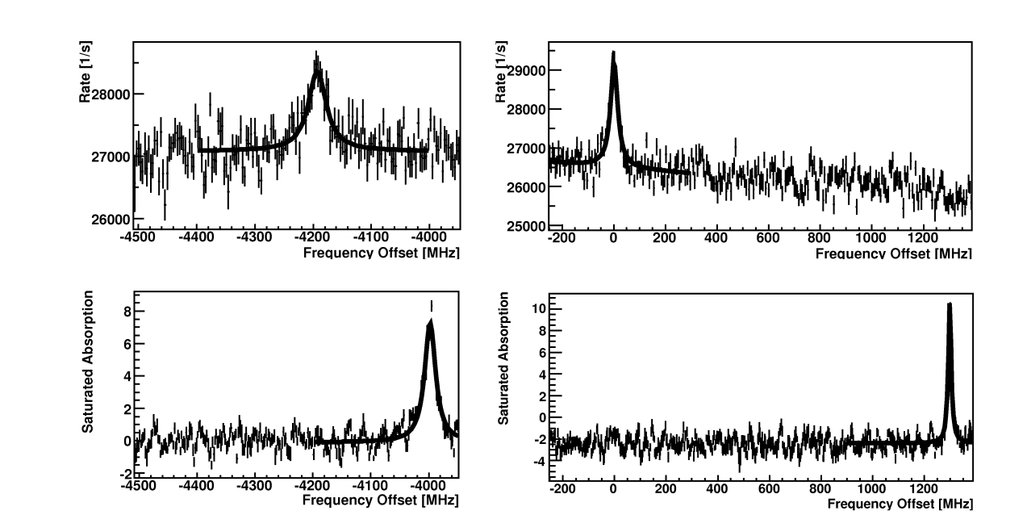
²²⁵Radium Spectroscopy
7s² ¹S₀ - 7s7p ¹P₁: Strong transition, laser cooling
F = 1/2 – F’ = 1/2
F = 1/2 – F’ = 3/2
7s7p ¹P₁
F’
3/2
1/2
7s7p ³P
7s6d ¹D₂
2
1
0
F’
3/2
1/2
¹³⁰Te₂
¹³⁰Te₂
482.7 nm
Accuracy of transition frequency:
4 MHz relative to ¹³⁰Te_{2,}
F=1/2->F’=3/2 @ 20715.7210(1)cm⁻¹
2100 MHz (0.03cm⁻¹) Rasmussen, Z.Phys 87, 607 (1934)
Hyperfine Structure:
    4198(4) MHz
    4195(4)MHz (Wendt et al. Z. Phys. D4, 227 (1987))
F
1/2
7s² ¹S₀
Notes:
30
Laser spectroscopy of the singlet s to singlet p transition in Ra was performed. The hyperfine splitting of the two excited states has been measured, which is 4.2 GHz. Te2 molecule was used as a frequency reference. Accuracy of our measurement is within 4 MHz wrt Te2. This is in good agreement with reported literature values.

Slide 31
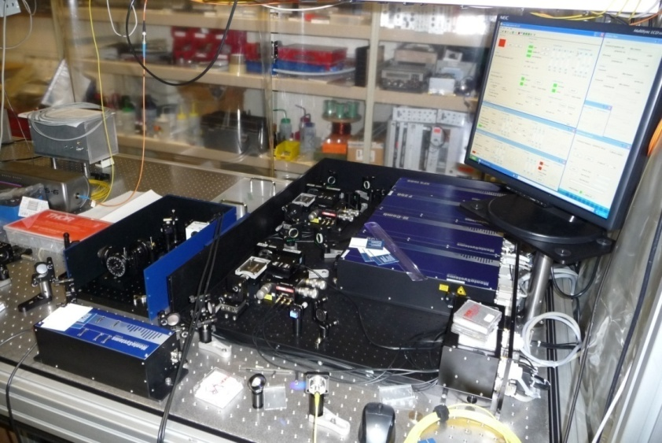
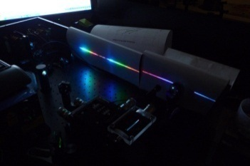
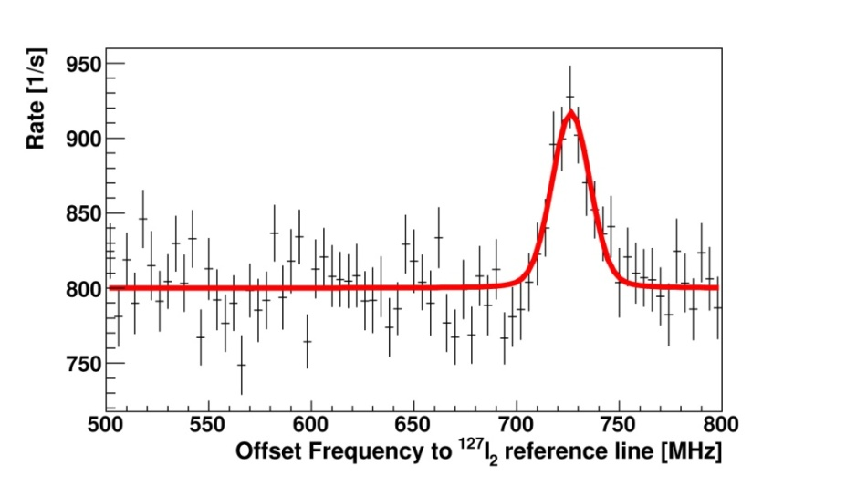
²²⁵Radium Spectroscopy
7s² ¹S₀ - 7s7p ³P₁: Weak transition, trapping
7s7p ¹P₁
F’
3/2
1/2
7s7p ³P
7s6d ¹D₂
2
1
0
F’
3/2
1/2
714.3 nm
F=1/2 – F’=3/2
Absolute Frequency:
Offset from a ¹²⁷I₂ line
702(2)MHz
419687537(4) MHz
Calibration with I₂ transition and frequency comb
F
1/2
Notes:
Similarly, laser spectroscopy of the singlet ’s’ to triplet ’p’ transition in Ra was performed. The absolute frequency is determined using a15 component of the R(116)(2-9) transition in I2 molecule as a frequency reference. The absolute frequency is determined. This is a factor of 6 improvement compared to the reported values.
measure the absolute frequency of the transitions with the comb
31

Slide 32
Summary
Investigation:
  Discrete symmetry violations with radioactive isotopes.
Radium:
  High sensitivity because of large Z and other enhancement factors.
Single ion Atomic Parity Violation:
  Atomic theory tractable
  Potential for 5-fold improvement of Weinberg angle
Discovery potential for nuclear or electron EDM

Slide 33
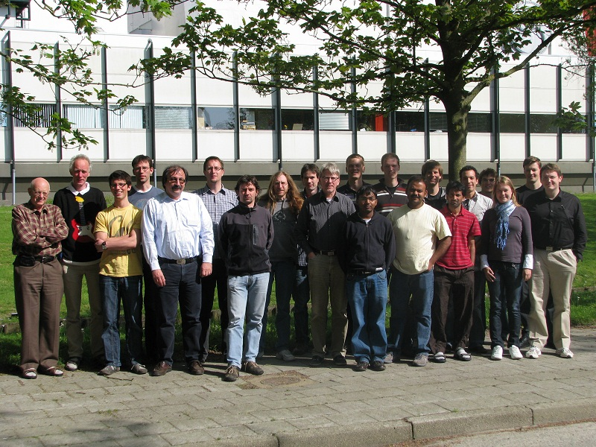
TRIμP Group Members
http://www.rug.nl/kvi/research/kvitrimp/index

Slide 34
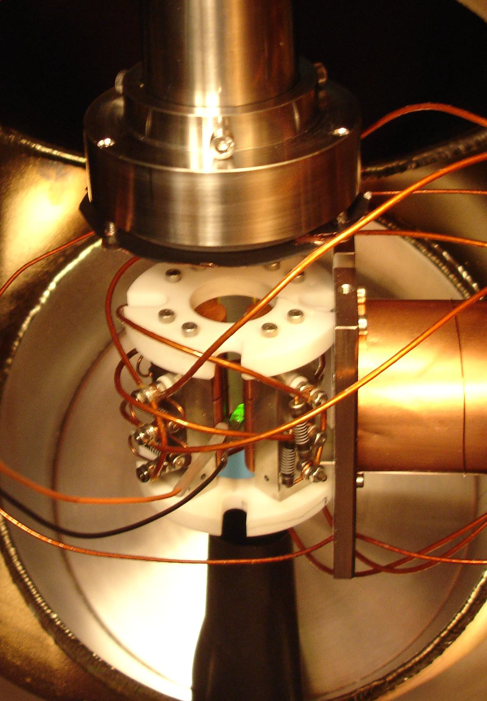
Broken Mirrors and Drifting Constants
W. Ubachs, K. Eikema, W. Vassen, J. Koelemij, H. Bethlem, K. Jungmann, R. Hoekstra, S. Hoekstra, L. Willmann
Precision as tool to find New Physics
  Quantitative theoretical calculations
  Measurable
    Frequency
    Laser Spectroscopy
  Choice of system
    Ease to work with
    Sensitivity to physical effects
  Effects change in a system
    Atomic and molecular parity violation
    Determination of fundamental constants
    Testing QED
  Reducing the travel time VU-KVI to 1ms (Fiberlink VU-KVI)
FOM Programme:
Vrije Universiteit Amsterdam
University of Groningen

Slide 35
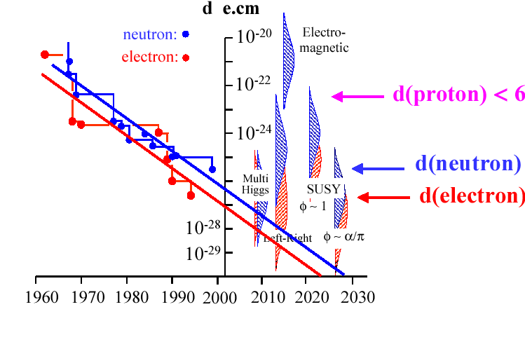

Limit on EDM in Time
Radium has large potential due to biggest atomic enhancement factors
molecules
¹⁹⁹Hg (2009)
•
TRIμP/KVI
Radium EDM
d_{e} (SM) < 10⁻³⁷

Slide 36
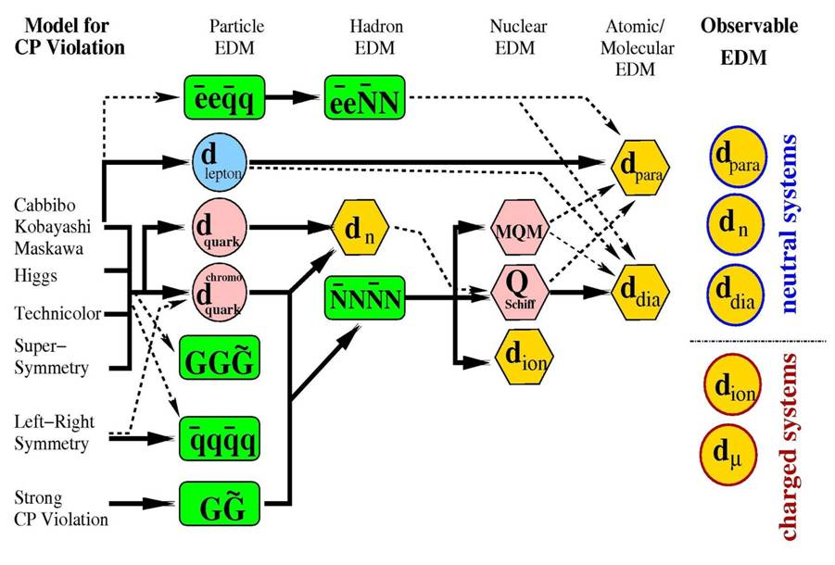
Why many experimental Approaches?
Trapped Radioactive Isotopes: μicro-laboratories for fundamental Physics
Notes:
Why many competing experimental searches?
Where should we expect an electric dipole moment to appear. Here we need guidance from theory. Based on the SM and theories beyond the SM EDM can be calculated. The CP violation in the SM gives rise to EDM’s which are several orders below the current experimental sensitivities, but beyond the SM theories predict EDM’ in a measurable range.
A measurement of an EDM in one system on the other hand does not select a single theory. Thus several experimental appraoches are necessary and followed worldwide. We are focussing on EDM in the hadronic sectors. We work on radium because of its unique intrinsic sensitivity (next sllide).
concentrate on one system (Ra) which has large enhancement factors

Slide 37
Recipe for preparing the sample
Efficient laser cooling on strong transition: 483 nm
  Close leaks with additional lasers
demonstrated with Ba
S.De et al., PRA 79, 041402(R) (2009)
Magneto-optical trapping: 714 nm
J.R. Guest et al., PRL 98, 093001(2007)
  Lower trap temperatures
  Efficient loading to an optical dipole trap
Optical Dipole trapping
Polarize and measure
7s7p ¹P₁
7s7p ³P
7s6d ³D
7s6d ¹D₂
2
1
0
3
2
482.7 nm
Cooling
1
714.3 nm
Trapping
7s² ¹S₀
Trapped Radioactive Isotopes: μicro-laboratories for fundamental Physics

Slide 38
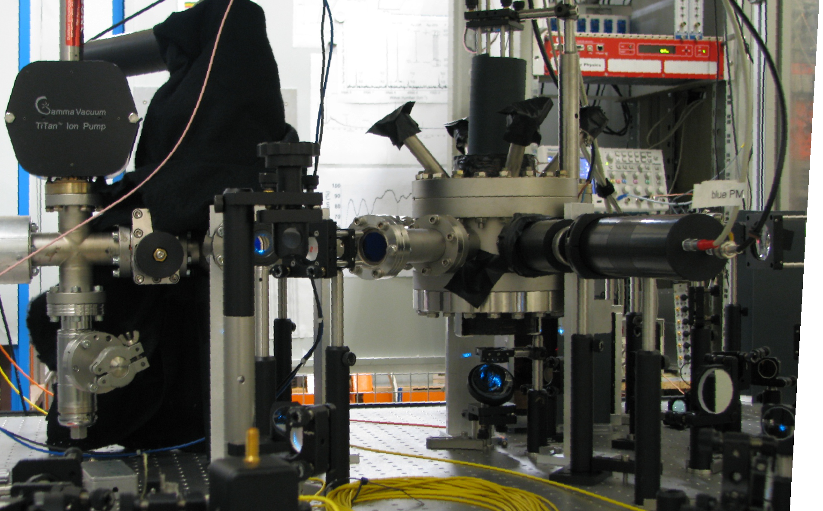
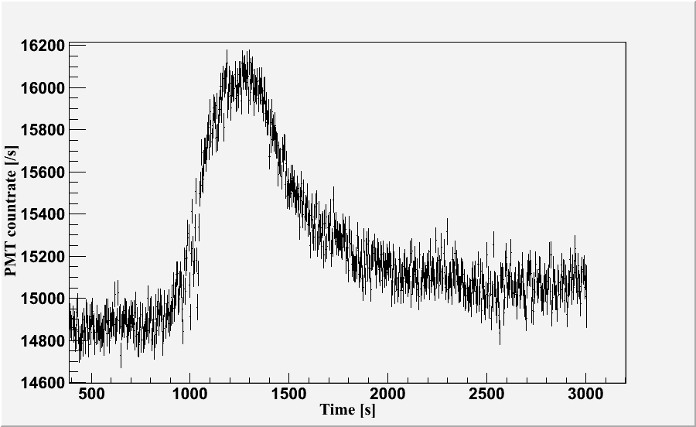

MOT for Radium
²²⁹Th ²²⁵Ra + α
Slowing laser
beams
Ra
Source
483nm +
repumpers
7s7p ¹P₁
7s7p ³P
7s6d ³D
7s6d ¹D₂
2
1
0
3
Ti: Sappire laser @ 966 nm
Second harmonic generation (KNbO₃) @ 483 nm
Semi-conductor Diode lasers @ 714 nm
50mW, several lasers with offset lock
Repump lasers
2
482.7 nm
Cooling
1
714.3 nm
Trapping
7s² ¹S₀
Notes:
38

