Slide 1
Antiprotons at CERN
T.Eriksson
P.Belochitskii
G.Tranquille
CERN, BE department, 1211 Geneva

Slide 2
Abstract
During more than 10 years of regular operation, CERN’s Antiproton Decelerator (AD) has supplied the successful physics program with low-energy antiproton beams at 5.3 MeV kinetic energy. For the medium and long-term future, several options exist for upgrades and consolidation of the facility as well as for extension of the physics program. One of these, the recently approved ELENA ring, is a small post-decelerator to be installed in the existing AD building. ELENA will bring the antiproton energy down to around 100keV and with the help of the built-in electron cooler greatly increase beam density and intensity thereby increasing the number of trapped antiprotons by up to two orders of magnitude.

Slide 3
Contents
Introduction
AD operation
ELENA project
New experiments at AD/ELENA
AD consolidation

Slide 4
Pbars at CERN - timeline
1980-1986 AA
  3.57 GeV/c Antiproton Accumulator ring;
  10^12 pbars stored (peak). p/pbar collisions in SPS
  + low energy experiments in LEAR
1986-1996 AAC (AA+AC)
  Large acceptance Antiproton Collector ring added. Production rate increased 10-fold to 6*10^10 pbars/h
1998-2015 AD
  AC converted from fixed energy storage ring to Decelerator. 5*10^7 pbars slowed down to 100 MeV/c (5.3MeV kinetic). Local experimental areas.
  Many experiments: ASACUSA, ATHENA, ALPHA, ATRAP, ACE, AEgIS

Slide 5
AD
Basic Parameters
  Circumference 182 m
  Production beam 1.5*10¹³ protons/cycle
  Injected beam 5*10⁷ pbars/cycle
  Beam momenta max-min 3.57 – 0.1 GeV/c
  Momenta for beam cooling
    Stochastic 3.57 and 2.0 GeV/c
    Electron 0.3 and 0.1 GeV/c
  Transverse emittances h/v 200 – 1 π.mm.mrad
  Momentum spread 6*10⁻² – 1*10⁻⁴ dp/p
  Vacuum pressure, average 4*10⁻¹⁰ Torr
  Cycle length 100 s
  Deceleration efficiency 85 %

Slide 6
AD Operation statistics
Run time (h) | 2000 | 2001 | 2002 | 2003 | 2004 | 2006 | 2007 | 2008 | 2009 | 2010
Total | 3600 | 3050 | 2800 | 2800 | 3400 | 2925 | 3800 | 3340 | 4600 | 4610
Physics | 1550 | 2250 | 2100 | 2300 | 3090 | 2765 | 3760 | 3140 | 4460 | 4550
md | 2050 | 800 | 700 | 500 | 310 | 160 | 40 | 200 | 140 | 60
Beam available for physics (%) | 86 | 89 | 90 | 90 | 71 | 65 | 76 | 81 | 78 | 87
Uptime AD machine (%) |  |  |  |  | 89 | 74 | 81 | 93 | 92 | 91

Slide 7
2011 AD run
~ identical to 2010
28 weeks of physics
ATRAP, ASACUSA,
ALPHA: 8h periods
ACE 1-2 weeks 24h/24
AEGIS: 3weeks Oct/Nov
T. Eriksson CERN BE/OP

Slide 8
CERN/LHC run planning (provisional)
2013 | LS1 - SPLICE CONSOLIDATION
2014 |  |  |  |  |  |  |  |  | RECOM | RECOM | 1 | 2
2015 | 1 | 2 | 3 | 4 | 5 | 6 | 7 | 8 | 9 | 10 | IONS
2016 |  | 1 | 2 | 3 | 4 | 5 | 6 | 7 | 8 | 9 | IONS
2017 |  | 1 | 2 | 3 | 4 | 5 | 6 | 7 | 8 | 9 | IONS
2018 | LS2
2019 |  | 1 | 2 | 3 | 4 | 5 | 6 | 7 | 8 | 9 | IONS
2020 |  | 1 | 2 | 3 | 4 | 5 | 6 | 7 | 8 | 9 | IONS
2021 |  | 1 | 2 | 3 | 4 | 5 | 6 | 7 | 8 | 9 | IONS
2022 | HL-LHC upgrade
 |  | Tech. stop or shutdown
 |  | Proton physics
 |  | Ion Physics
 |  | Recommissioning
=> Affects LHC injectors and AD !

Slide 9
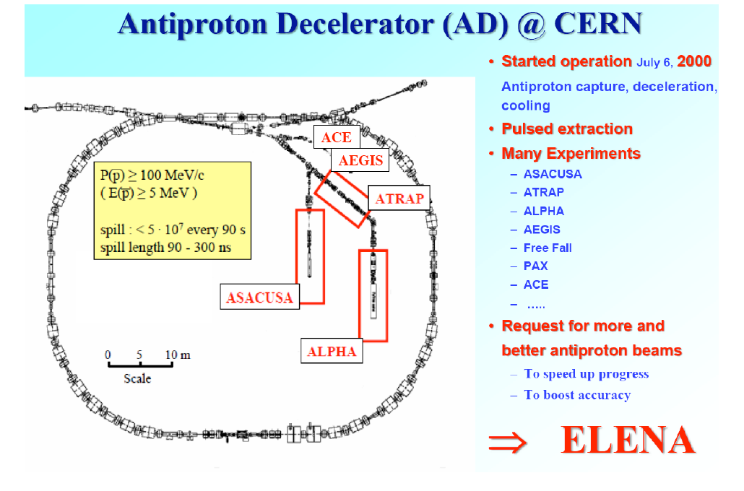
Extra Low ENergy Antiproton ring

Slide 10
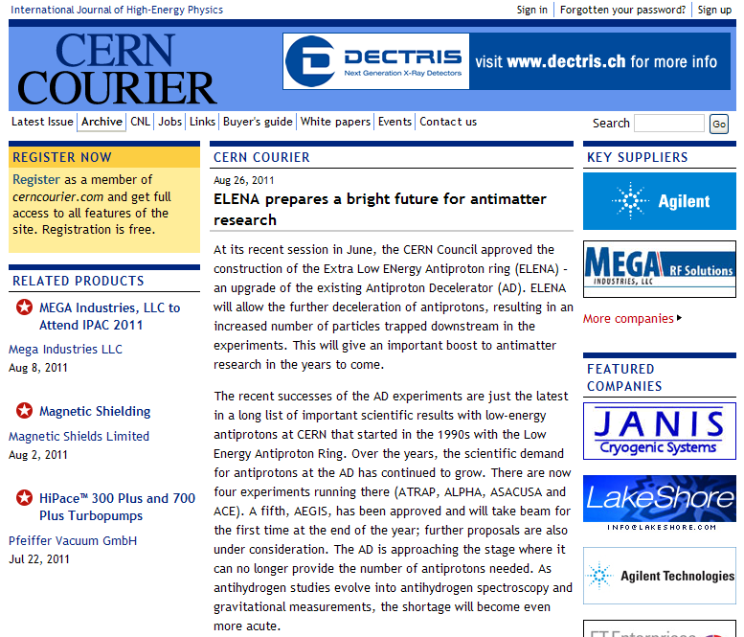

Slide 11
Pbars at CERN - timeline
1980-1986 AA
  3.57 GeV/c Antiproton Accumulator ring;
  10^12 pbars stored (peak). p/pbar collisions in SPS
  + low energy experiments in LEAR
1986-1996 AAC (AA+AC)
  Large acceptance Antiproton Collector ring added. Production rate increased 10-fold to 6*10^10 pbars/h
1998-2015 AD
  AC converted from fixed energy storage ring to Decelerator. 5*10^7 pbars slowed down to 100 MeV/c (5.3MeV kinetic). Local experimental areas.
2016-2026+ AD/ELENA
  Small post-decelerator ring to be added
  Cooling and deceleration to 100 keV
  Electrostatic beamlines and new experiments…

Slide 12
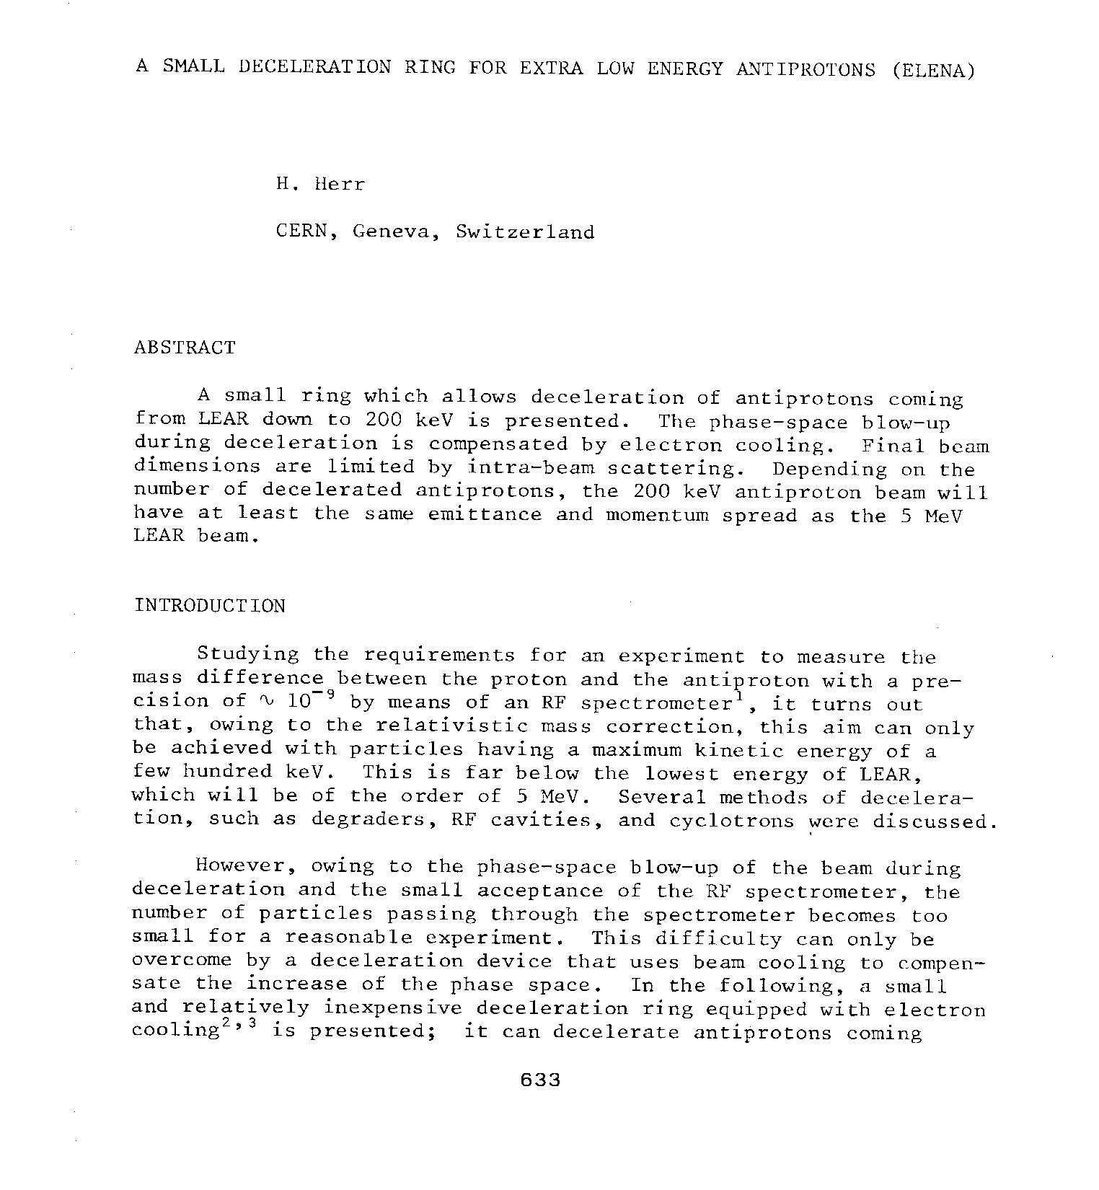
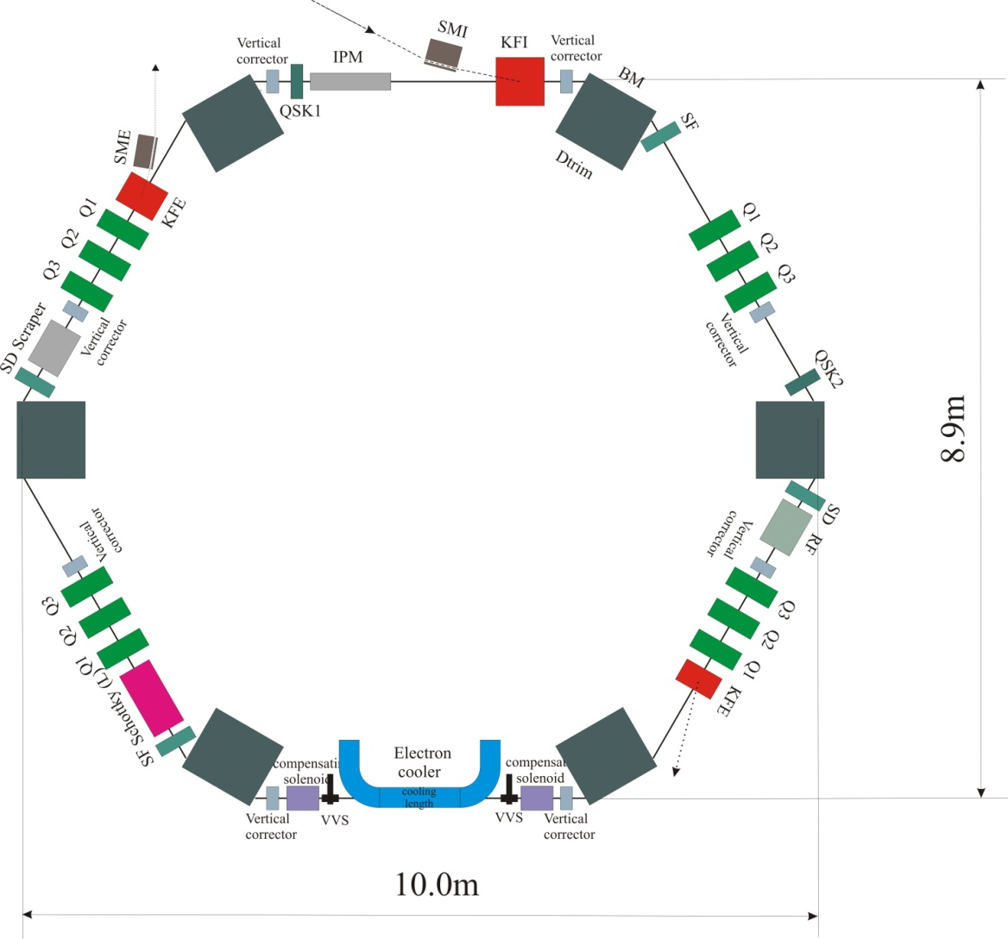
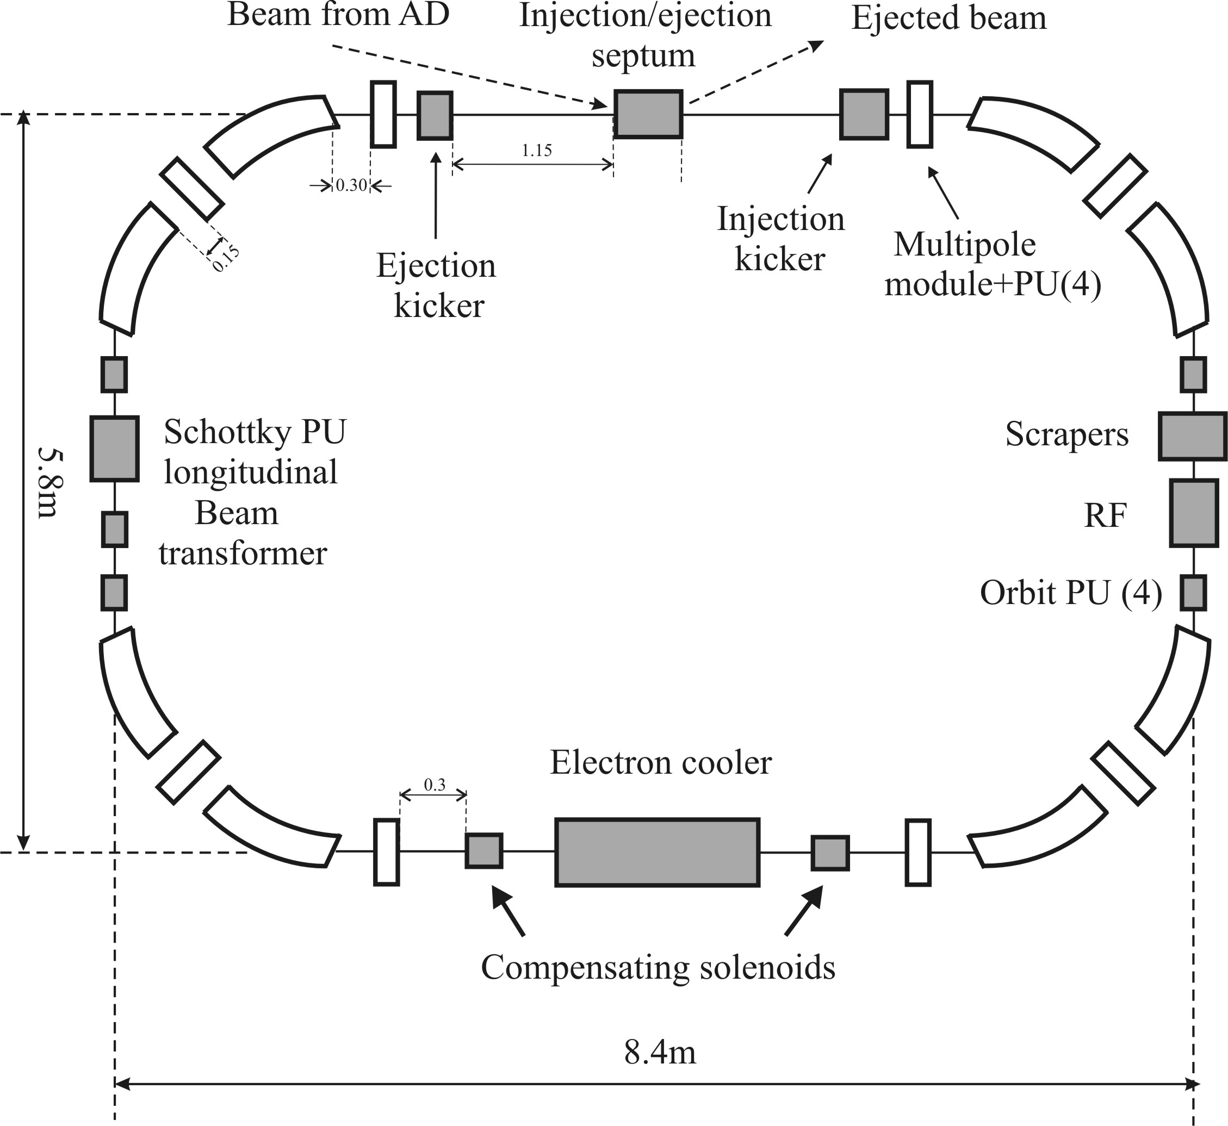
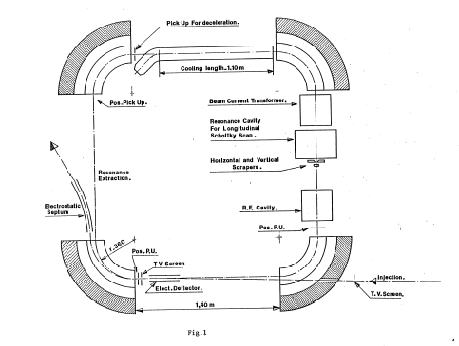
Workshop on Physics
at LEAR with Low Energy
Cooled Antiprotons
Erice, May 9 – 16, 1982
2007

Slide 13
Motivation to build ELENA
Most of AD experiments need antiprotons of 3kV to 5 keV kinetic energy, AD produces them at 5.3 MeV.
How antiprotons are decelerated further down today:
experiments aimed to antihydrogen program (ALPHA and ATRAP) use sets of degraders to slow 5.3 MeV beam from AD further down
poor efficiency due to adiabatic blow up of beam emittances and due to scattering in degraders, less than 0.5 % of AD beam used. Similar efficiency is expected for AEgIS.
How antiprotons are decelerated further down today at ASACUSA:
RFQD is used for antiproton deceleration down to around 100 keV kinetic energy.
deceleration in RFQD is accompanied by adiabatic blow up (factor 7 in each plane) which causes significant reduction in trapping efficiency.
RFQD is very sensitive to trajectory and optics mismatch errors, difficult and time consuming tuning of transfer line from AD to RFQD needed.
About 70% beam is lost after passing through RFQD, transverse beam size is very big (about 160mm), only short beam transport is possible after it (few meters)
about 3-5% of antiprotons are captured after passing through degrader.

Slide 14
Intensity gains with ELENA
Deceleration of the antiproton beam in a small ring down to 100 keV and its cooling by electron beam to high density
Emittances of beam passing through a degrader will be much smaller than now due to electron cooling and due to use of much thinner degrader (100 keV beam instead of 5.3 MeV) => two orders of magnitude gain in intensity is expected for ALPHA, ATRAP and AEgIS.
Due to cooling, beam emittances after deceleration in ELENA will be much smaller than after RFQD => one order of magnitude gain in intensity is expected for ASACUSA
Extra gain for experiments: due to extraction in 4 bunches number of hours/day with available beam increase significantly

Slide 15
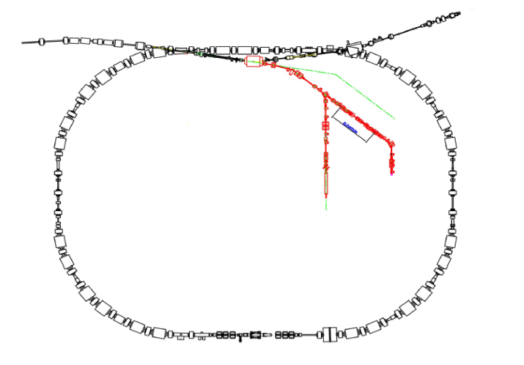
5.3 MeV
antiprotons/
~ 100 sec
~4 keV
antiprotons/
~ 100 sec
~ 1 x 10⁵
ATRAP`s very best value:
1.3x10⁵
~ 3 x 10⁷
2.99 x 10⁷ antiprotons lost
→ efficiency 3 x 10⁻³
100 keV
antiprotons/
~ 100 sec
~4 keV
antiprotons/
~ 100 sec
~ 3 x 10⁷
ELENA
~ 2.5 x 10⁷
~ 1 x 10⁷
2 x 10⁷ antiprotons lost
→ efficiency 3 x 10⁻¹
ELENA efficiency increase: factor ~ 100

Slide 16
coasting beam: 2.5 x 10⁷ p´s
4 bunches, each: 1.3 m / 300 ns:
and 0.625 x 10⁷ p´s
2.5 x 10⁷ p´s to one experiment

Slide 17
0.625 x 10⁷ p´s
to four different experiments
Experiment IV
four experiments served
simultaneously
24 hours/day
Experiment III
Experiment II
Experiment I

Slide 18
ELENA energy range
ELENA injection energy is 5.3 KeV (100 MeV/c) = AD ejection energy
ELENA extraction energy 100 keV (13.7 MeV/c) defined by:
space charge limit for antiproton beam
good quality of electron beam for cooling (limited by space charge of electron beam)
beam lifetime: residual gas, IBS at extraction energy(relaxed with extraction in 4 bunches)
strong requirements to high vacuum in machine 3·10⁻¹²
foil thickness for separation of transfer line and trap vacuum

Slide 19
ELENA configuration and placement
Must be compact to fit in available space inside of AD Hall
One long straight section for electron cooler needed
Must be placed in AD Hall in an optimal way for transfer of antiprotons from AD and deliver them to existing and possible future experimental areas
Placed in AD Hall in a way to minimize reshuffle of existing equipment in the area
Placed inside the AD Hall allows the use of existing experimental areas (great saving!)
The initial part of existing AD ejection line should be used => strong constraint son position and orientation of ELENA ring
The extraction section of ELENA ring should be placed in a way to minimize the distance to experimental areas
Passing through AD shielding for ELENA transfer line should be done in concrete, avoid passing through the steel plates
Space in AD Hall for new (extra) experimental areas has to be foreseen
The Laser Hut of ASACUSA experiment should stay in place

Slide 20
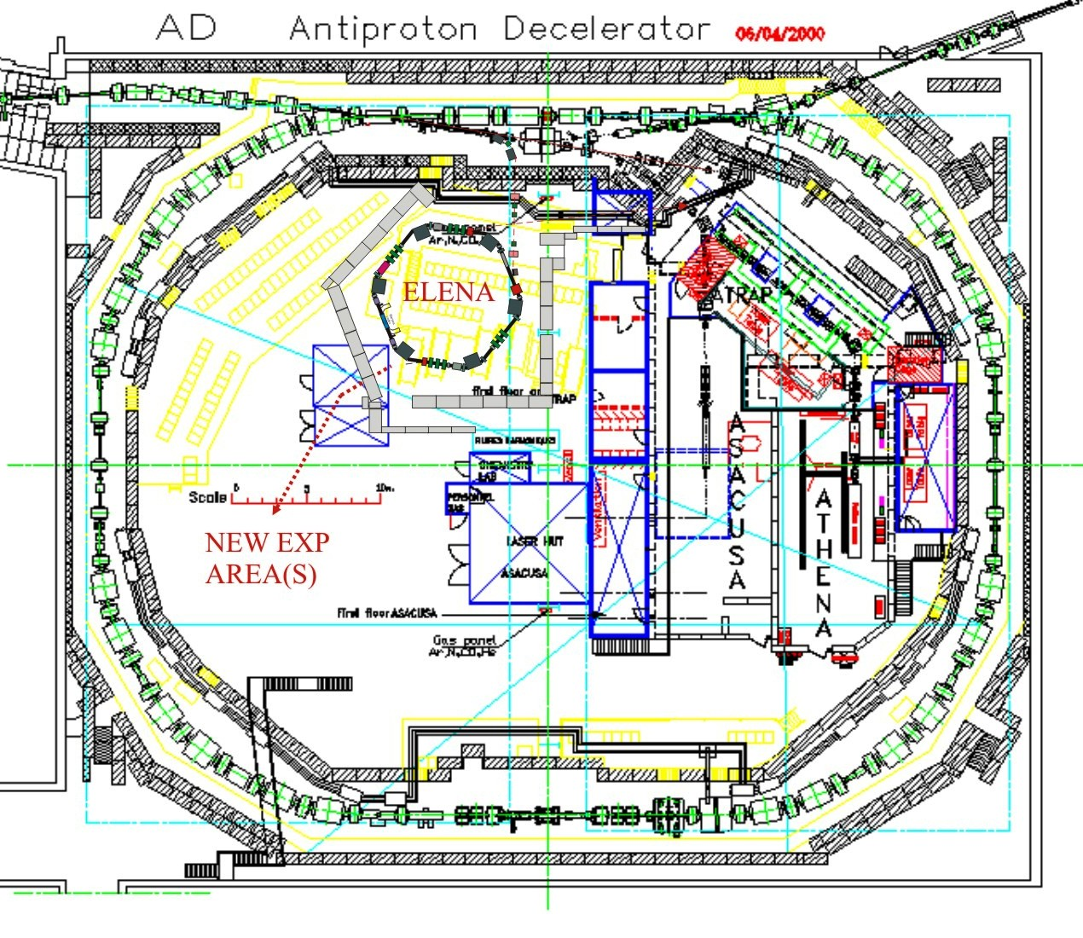
ELENA layout in AD Hall

Slide 21
ELENA ring design
Circumference:
  Must be as small as possible due to limited space in AD Hall
  Should be 1/n (integer) of AD ring (bunch to bucket beam transfer to avoid longitudinal blow up of the beam at injection plateau)
  Evolution in time:
  22.8m, 4-folder ring in 2004 (presented to SPSC in Villars)
  26.1m , 4-folder ring in 2007 (ELENA cost study…)
  30.4m, 6-folder ring since 2010
6-fold ring configuration:
Initial ring circumference was 26.2m (1/7 of AD ring) -> not enough space to place all required equipment, not possible to prepare extra experimental area (SPSC request) -> new circumference is 30.4 (1/6 of AD ring)
Advantages of the new rings:
  More flexibility for injection and extraction with the new layout
  The total length of bending magnets is shorter for hexagonal lattice compared with rectangular lattice -> more space for other equipment
  Minimal magnetic field in bending magnets (at 100 keV) increased form 399 Gs to 493 Gs – essential!
  Optics for 4 fold ring of 30 m long has unfavorable tunes (too much focusing in magnets), wide choice of tunes in 6 fold ring
  Smaller beta function values -> smaller aperture required by beam, relaxed requirement for vacuum

Slide 22
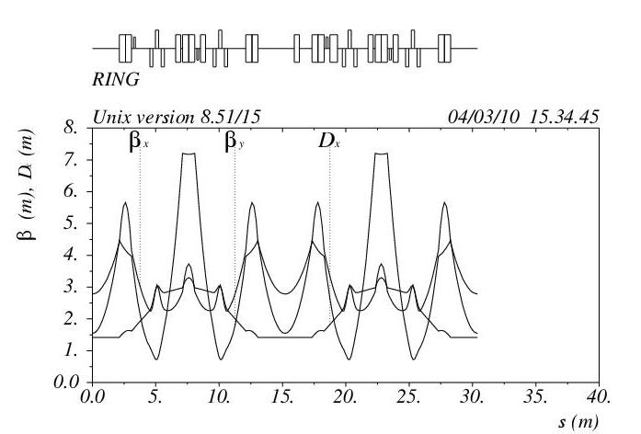
ELENA ring optics

Slide 23
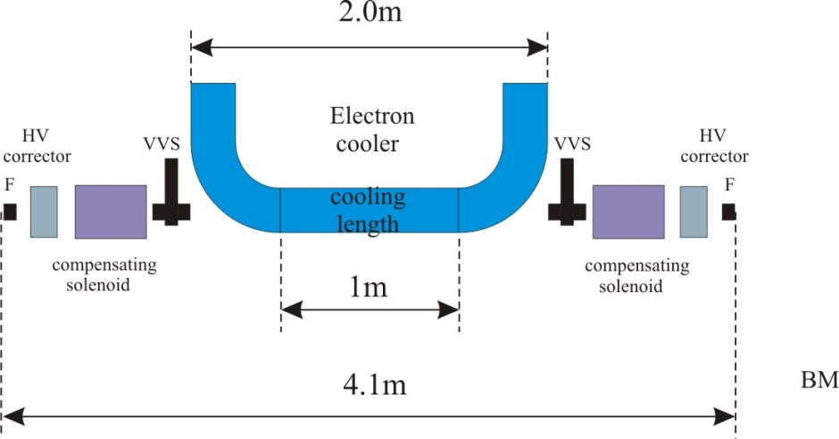
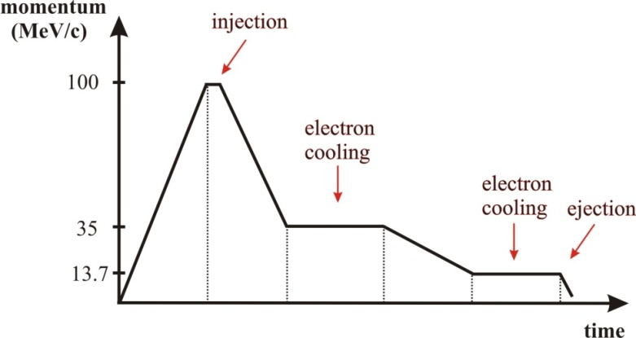
ELENA electron cooler
Cooling length l_{c}, m | 1
Beam cooled at momentum, MeV/c | 35 & 13.7
Electron beam current I_{e}, mA | 15 & 2
Cathode voltage at 100 keV, V | 55
Maximal magnetic field in solenoid B₀, Gs | 100
Electron beam radius a, cm | 2.5

Slide 24
ELENA main parameters
Momentum range, MeV/c | 100 - 13.7
Energy range, MeV | 5.3 - 0.1
Circumference, m | 30.4
Intensity of injected beam | 3 × 10⁷
Intensity of ejected beam | 2.5 × 10⁷
Number of extracted bunches | 4
Emittances (h/v) at 100 KeV, π·mm·mrad, [95%] | 4 / 4
∆p/p after cooling, [95%] | 10⁻⁴
Bunch length at 100 keV, m / ns | 1.3 / 300
Required (dynamic) vacuum, Torr | 3 × 10⁻¹²

Slide 25
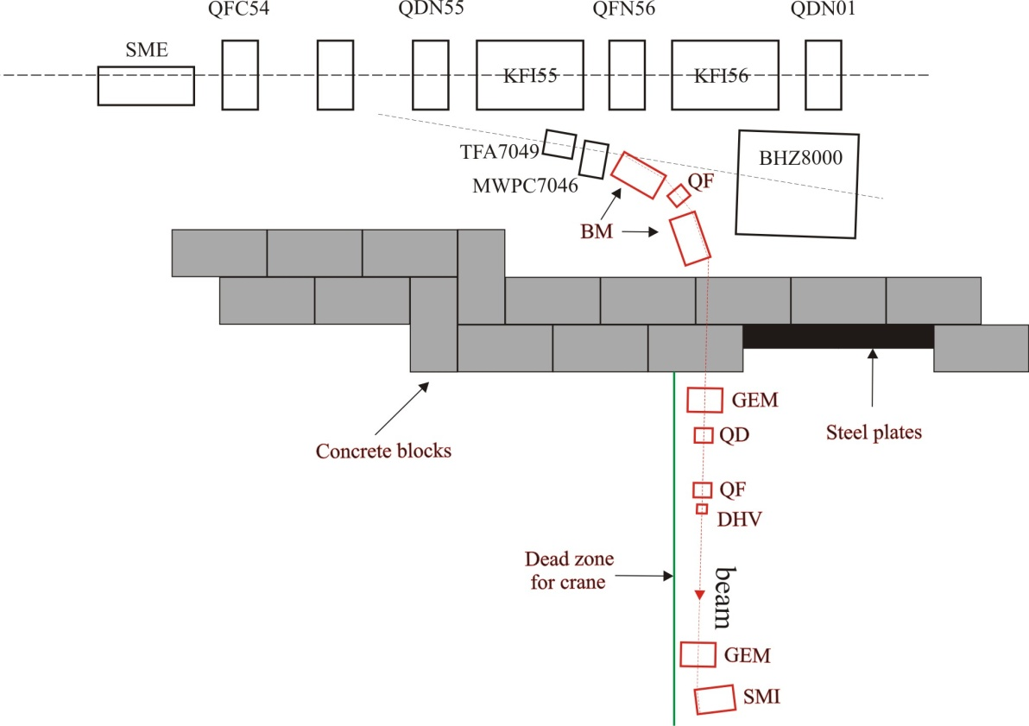
AD to ELENA transfer
Keep existing line for physics with 5.3MeV beam during ELENA commissioning

Slide 26
Planning
Planning stretched in order to minimize impact on physics program
  1. Design, fabrication, installation of ELENA whilst using the existing ejection lines for physics @ 5.3 MeV => ~ 3 years
  2. Commissioning of ELENA in parallel with physics => ~ 6 months
  3. Installation and commissioning of new 100 keV ejection lines (physics stopped) => 0.5 to 1 year
  =>Total duration 4 to 4.5 yrs

Slide 27
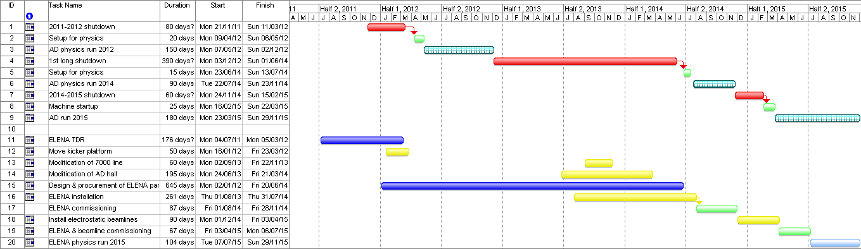
Possible ELENA planning

Slide 28
2010 ELENA cost estimate
Item | Material (kCHF) | Manpower FSU or charged (kCHF) | CERN Manpower FTE (MY) | Needed manpower contribution FTE (MY)
Magnets (ring+inj. line) | 1590(*) | 135 | 2.5 | 2.8
Power converters | 955 |  | 3.8
Injection/ejection septa | 75 |  | 0.3 | 0.7
Injection/ejection kickers | 1706 |  | 6.3 | 2.8
Electron cooler | 1300 |  | 5.0 | 1.0
Vacuum, ring+inj.line | 1475 | 50 | 3.0 | 2.0
RF + Schottky diagnostics | 303 | 30 | 3.8 | 0.4
B-trains | 80 |  | 0.7
Diagnostics | 655 | 85 | 1.2 | 1.3
Controls | 804 |  | 1.0
H- source | 400 |  | 0.5
Experimental area:lines, vacuum, monitors | 4235 |  | 6.3 | 6.5
Mech. Design/Drawings |  | 347kCHF/4 MY (**) |  | 13.0
Div. | 290 |  | 5.0 | 2.0
Total (MCHF/MY) | 13.868 | .647 | 39.4 | 32.5
Grand Total (MCHF/MY) | 14.515 |  | 71.9
Several institutes are interested to contribute to the ELENA project (up to 50% of costs) with manpower and/or money
CERN meeting 28-29 September 2011:
  Press release
  Initiate collaboration with external institutes.

Slide 29
Consolidation – AD machine
A limited consolidation program was launched in 2009 in view of continued AD operation until 2016/17
Out of some 40 items needing attention, 1/3 was prioritized with a total budget of 2.3 MCHF
  E-cooler power supplies, HV equipment and controls interface - done
  Ring/transfer line magnets – in progress
  Ring/transfer line power converters – in progress
  Vacuum system – in progress
  RF (C02/C10) – in progress
  Stochastic cooling – to be started
  Kickers – to be started
  Target area – to be started
With the ELENA approval a new consolidation program will be worked out assuming AD /ELENA will run at least 15 more years

Slide 30
Consolidation
AD Hall+
infrastructure
New storage bdg (2012)
Infrastructure consolidation:
Access control upgade
RP shields upgrade
New gangways for circulation and evacuation improvement
New control rooms for ALARA respect and racks/ storage space increase
Cranes upgrade for more efficient and safer handling
Cryogens distribution audit
Ventilation system audit
Review needs for smoke/ODH detection
Provide long term (bdg 133) and short term (new building) storage facilities
New cafeteria/ toilets / meeting room / parking
New visit itineraries and procedures
Exit
Suppress AEGIS gangway (2011)
Create exit
New access (2011)
Kicker platform ?
ELENA
New control rooms (2011 -12 -13)
Rack space on 2 floors
Rack space on 2 floors
Rack space on 2 floors
Workshop
New gangway (2011)
Visits to AD machine
Crete
Emergency exit
=new access control (5)

Slide 31
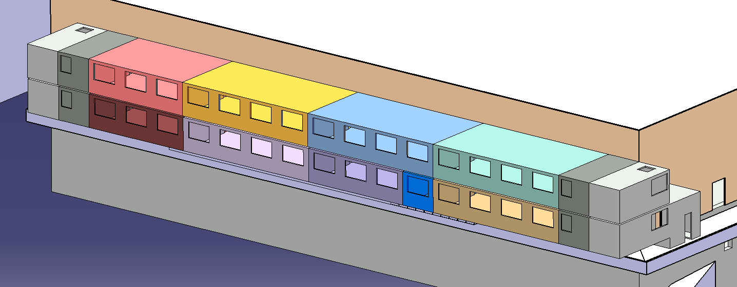
New control rooms for AD experiments
1st Stage (2011):
1.Toilets
2.AEGIS Control Room
3. Entry module level1
4.Technical room
17
16
15
14
9
13
12
8
11
7
10
6
3rd Stage (2013):
9.Stairs exit module level 1
10.Stairs entry module level 2
11.Toilets
12.ASACUSA Control room
13.ALPHA control room
14. Meeting room
15.ELENA related control room
16.Toilets
17.Stairs exit module level 2
5
4
2nd Stage (2012):
5.Cafeteria
6.ATRAP control room
7.ACE Ccontrol room
8.Toilets
2
1
3

Slide 32
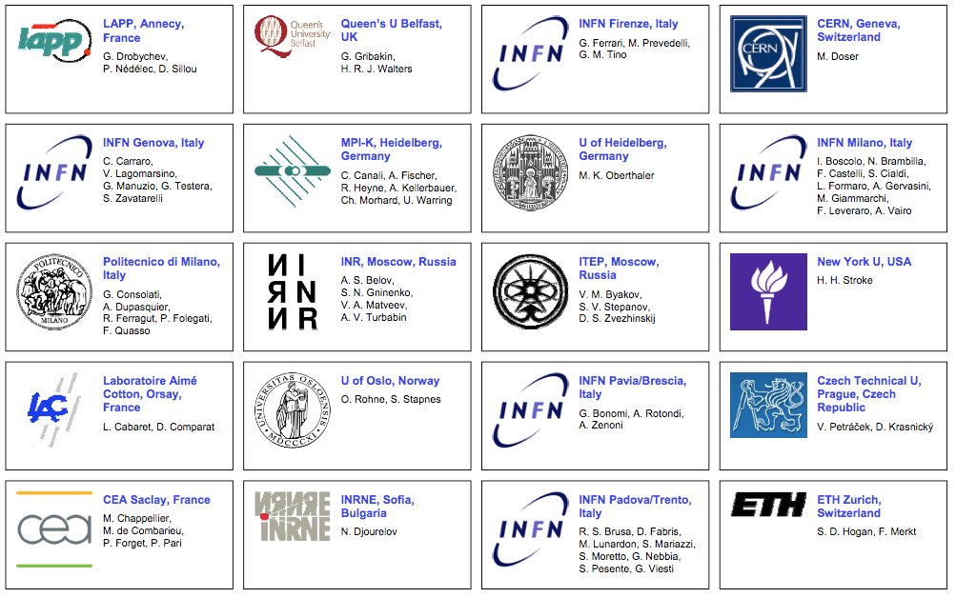
New experiments: AEgIS
Approved experiment: AD-6
Will share beamtime with the 3 existing main users ALPHA, ASACUSA and ATRAP.
Physics goals:
  Measurements of gravitational interaction matter-antimatter
  Hbar spectroscopy
  Etc.

Slide 33
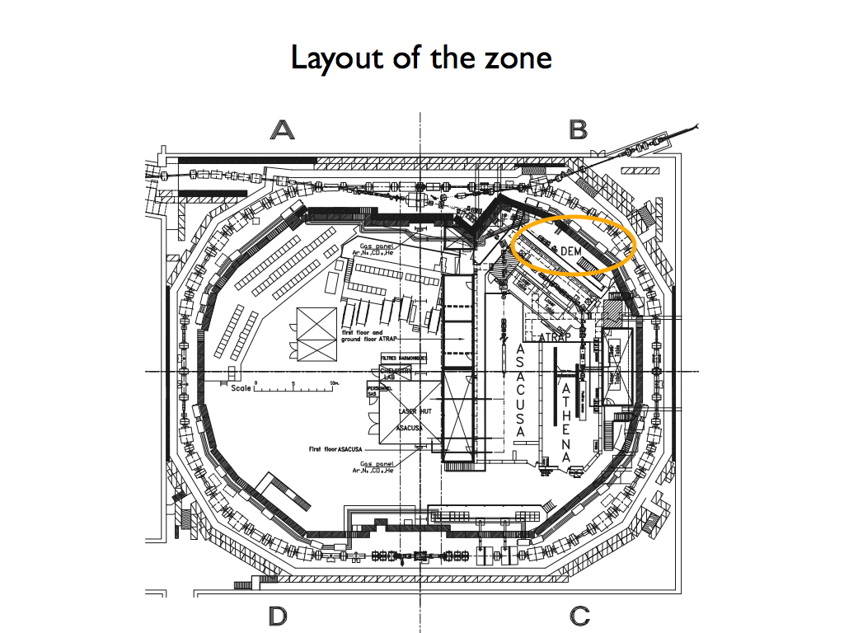
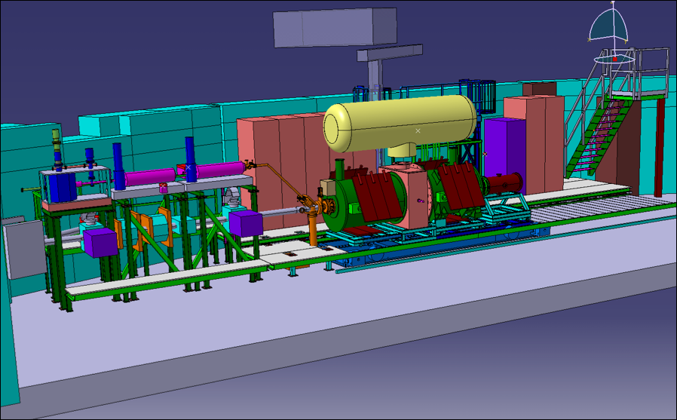
AEGIS

Slide 34
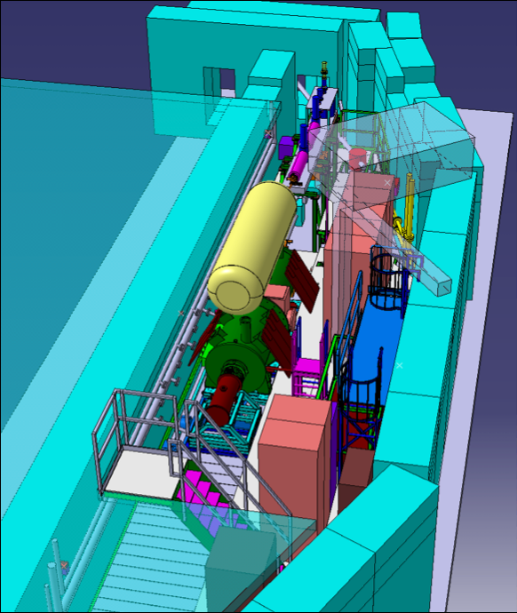
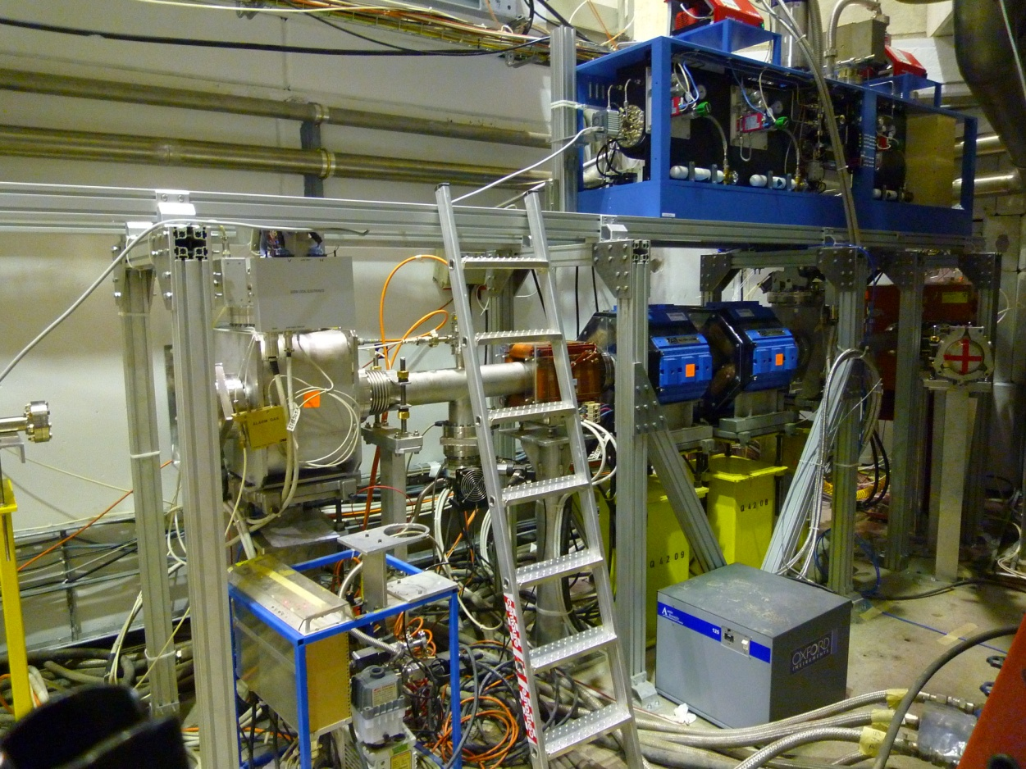
AEGIS – present status
Infrastructure modifications finished
Access system operational
Pbar beamline from AD installed
Beamline tests + optics checks with 100MeV/c pbars finished => beam focused on last monitor
Experimental installations in progress

Slide 35
AEGIS planning
2011:
  June - September: installation of positron accumulator, 5 T magnet, transfer section and traps
  October: cryogenics installation/commissioning
  November: commissioning of trapping of antiprotons
2012:
  January/February/March: installation of the 1T magnet + lasers
  April/May: commissioning
  June-November: commissioning of the different physics processes
2013: work with protons
2014-2016: work with antiprotons, antihydrogen, antihydrogen beam

Slide 36
New experiments: Gbar
Gravitational Behaviour of Antihydrogen at Rest
Saclay project – continuation of SOPHI R&D (Irfu)
Similar goals as AEgIS
Proposal being prepared
Trap tested at Riken
High intensity Positron source (need space in AD hall)
To be installed in the new part of the AD experimental area => re-location of AD kicker platform considered

Slide 37
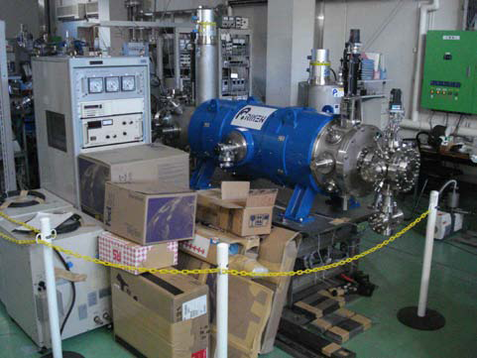
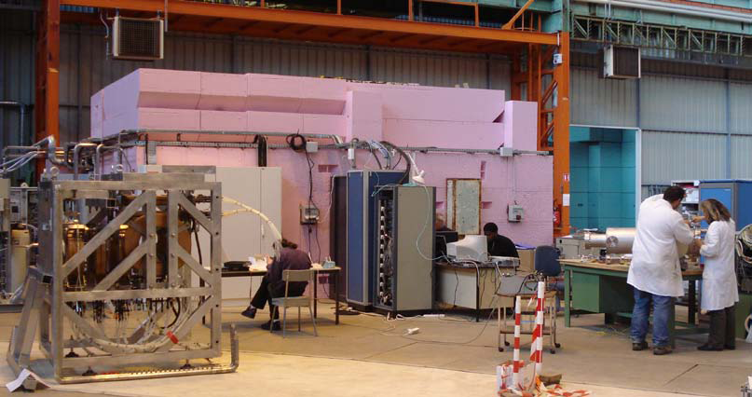
Gbar

Slide 38
Other: new ASACUSA sub-group
New ASACUSA experiment proposal (SPSC in 2011?)
Internal gas-jet target
Explore atomic cross-sections
Requires circulating beam at 40keV
Need only a few thousand turns
Initially planned as new e-static ring in ASACUSA zone
Could it be done in ELENA by deceleration down to 40keV ?
  Deceleration with e-cooler => avoid beam blow-up
  Main B field 500 => 300 G; stability?
  No vacuum improvement needed
Alternatively: installation of new ring in the new experimental zone

Slide 39
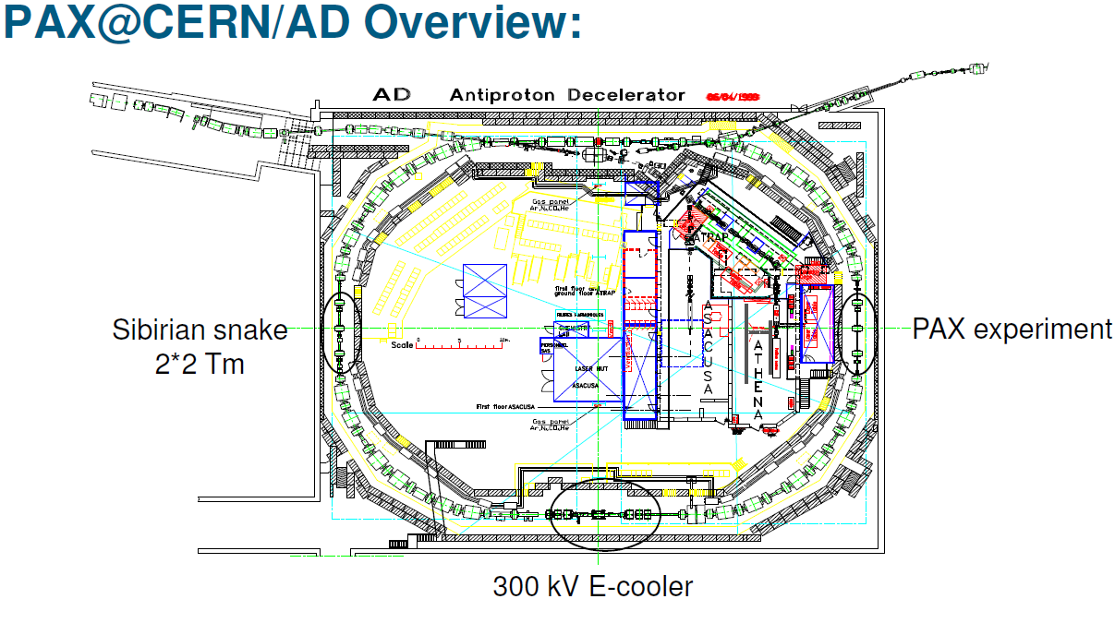
Proposed experiment: PAX
Spin filtering of antiprotons with internal polarized gas target
Build up polarized pbar beams in AD (0.3 to 1 GeV/c)
Low-beta insertion in AD sect.15/16 including openable cell
Upgrade of electron cooler (40 => 300 kV)
Stacking in AD
Siberian snake in sect. 42/43 (longitudinal polarization) to follow
Step-by-step approach proposed for installation
A rough identification has been made of:
  CERN manpower needs (~5 MY)
  Risks
    Set-up duration
    AD performance
    Insertion optics
    Vacuum
  Impact on existing physics program
Proposal not approved by CERN SPSC in 2011

Slide 40
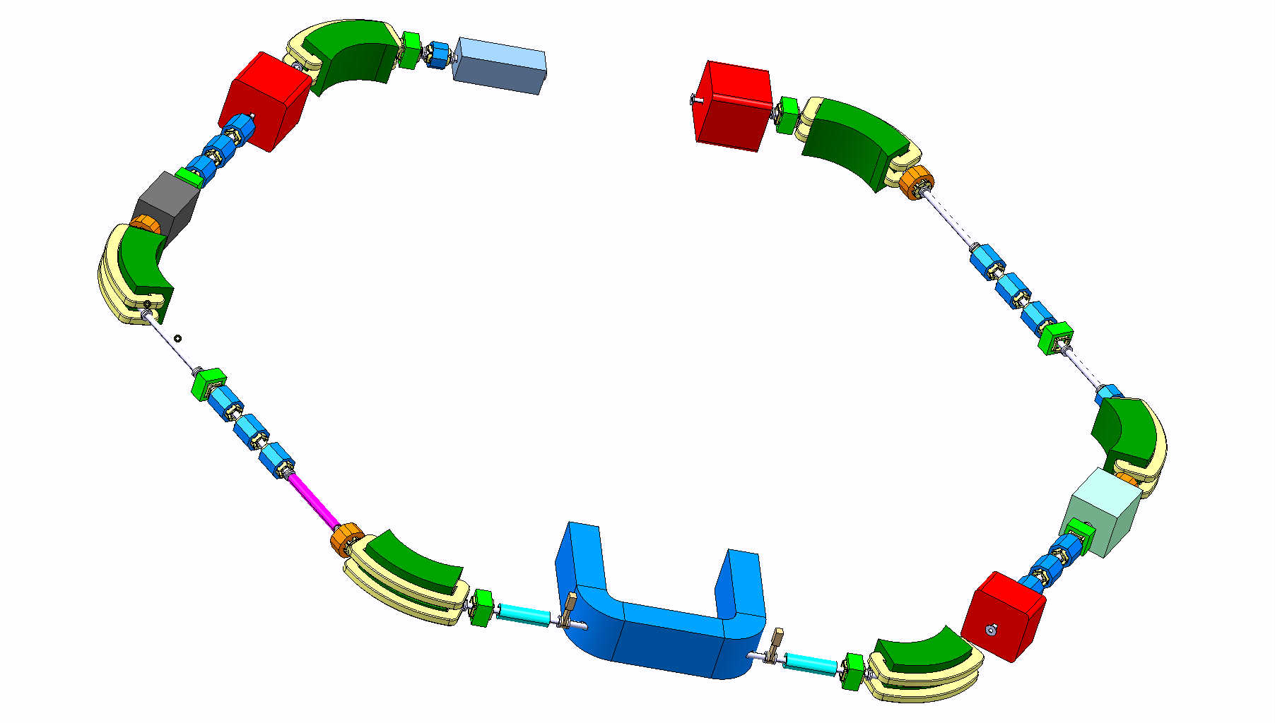
Thanks for your attention !

