Slide 2
Longitudinal Limitations of Beams for the LHC in the CERN PS
H. Damerau
Acknowledgments:
R. Garoby, S. Hancock, E. Shaposhnikova
51
Beam Physics for FAIR
6 July 2010

Slide 3
Outline
Introduction
Coupled-bunch instabilities
Measurement and analysis
Observations in the PS during acceleration and flat-top
Possible cures
Transient beam loading
Summary and outlook

Slide 4
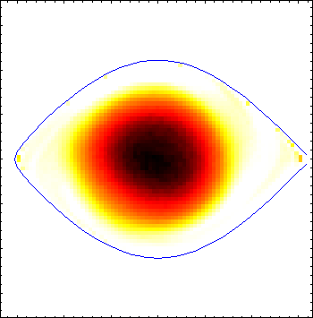
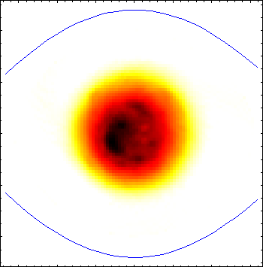
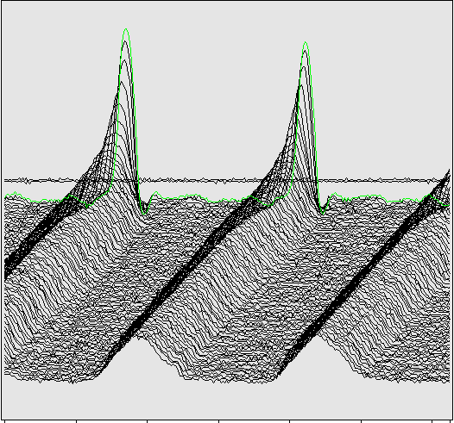
Introduction
Though the CERN PS turns 51 this year, it is an essential element in the injector chain of the LHC:
LINAC2 → PSB → PS → SPS → LHC
It has to convert long bunches (~180 ns) from the PSB to short bunches (~4 ns) digestible by the 200 MHz RF in the SPS
Various bunch spacings at extraction: 25, 50, 75, 150, 525 ns
7.5
Injection
40
Flat-top
Extraction
4 ns
ΔE [MeV]
ΔE [MeV]
0
0
-40
33 ns
-7.5
180 ns
-100
0
100
t [ns]
-30
0
30
t [ns]
-30
0
30
→ High longitudinal and transverse brightness → Instabilities
→ High peak current interacts with RF cavities → Beam loading

Slide 5
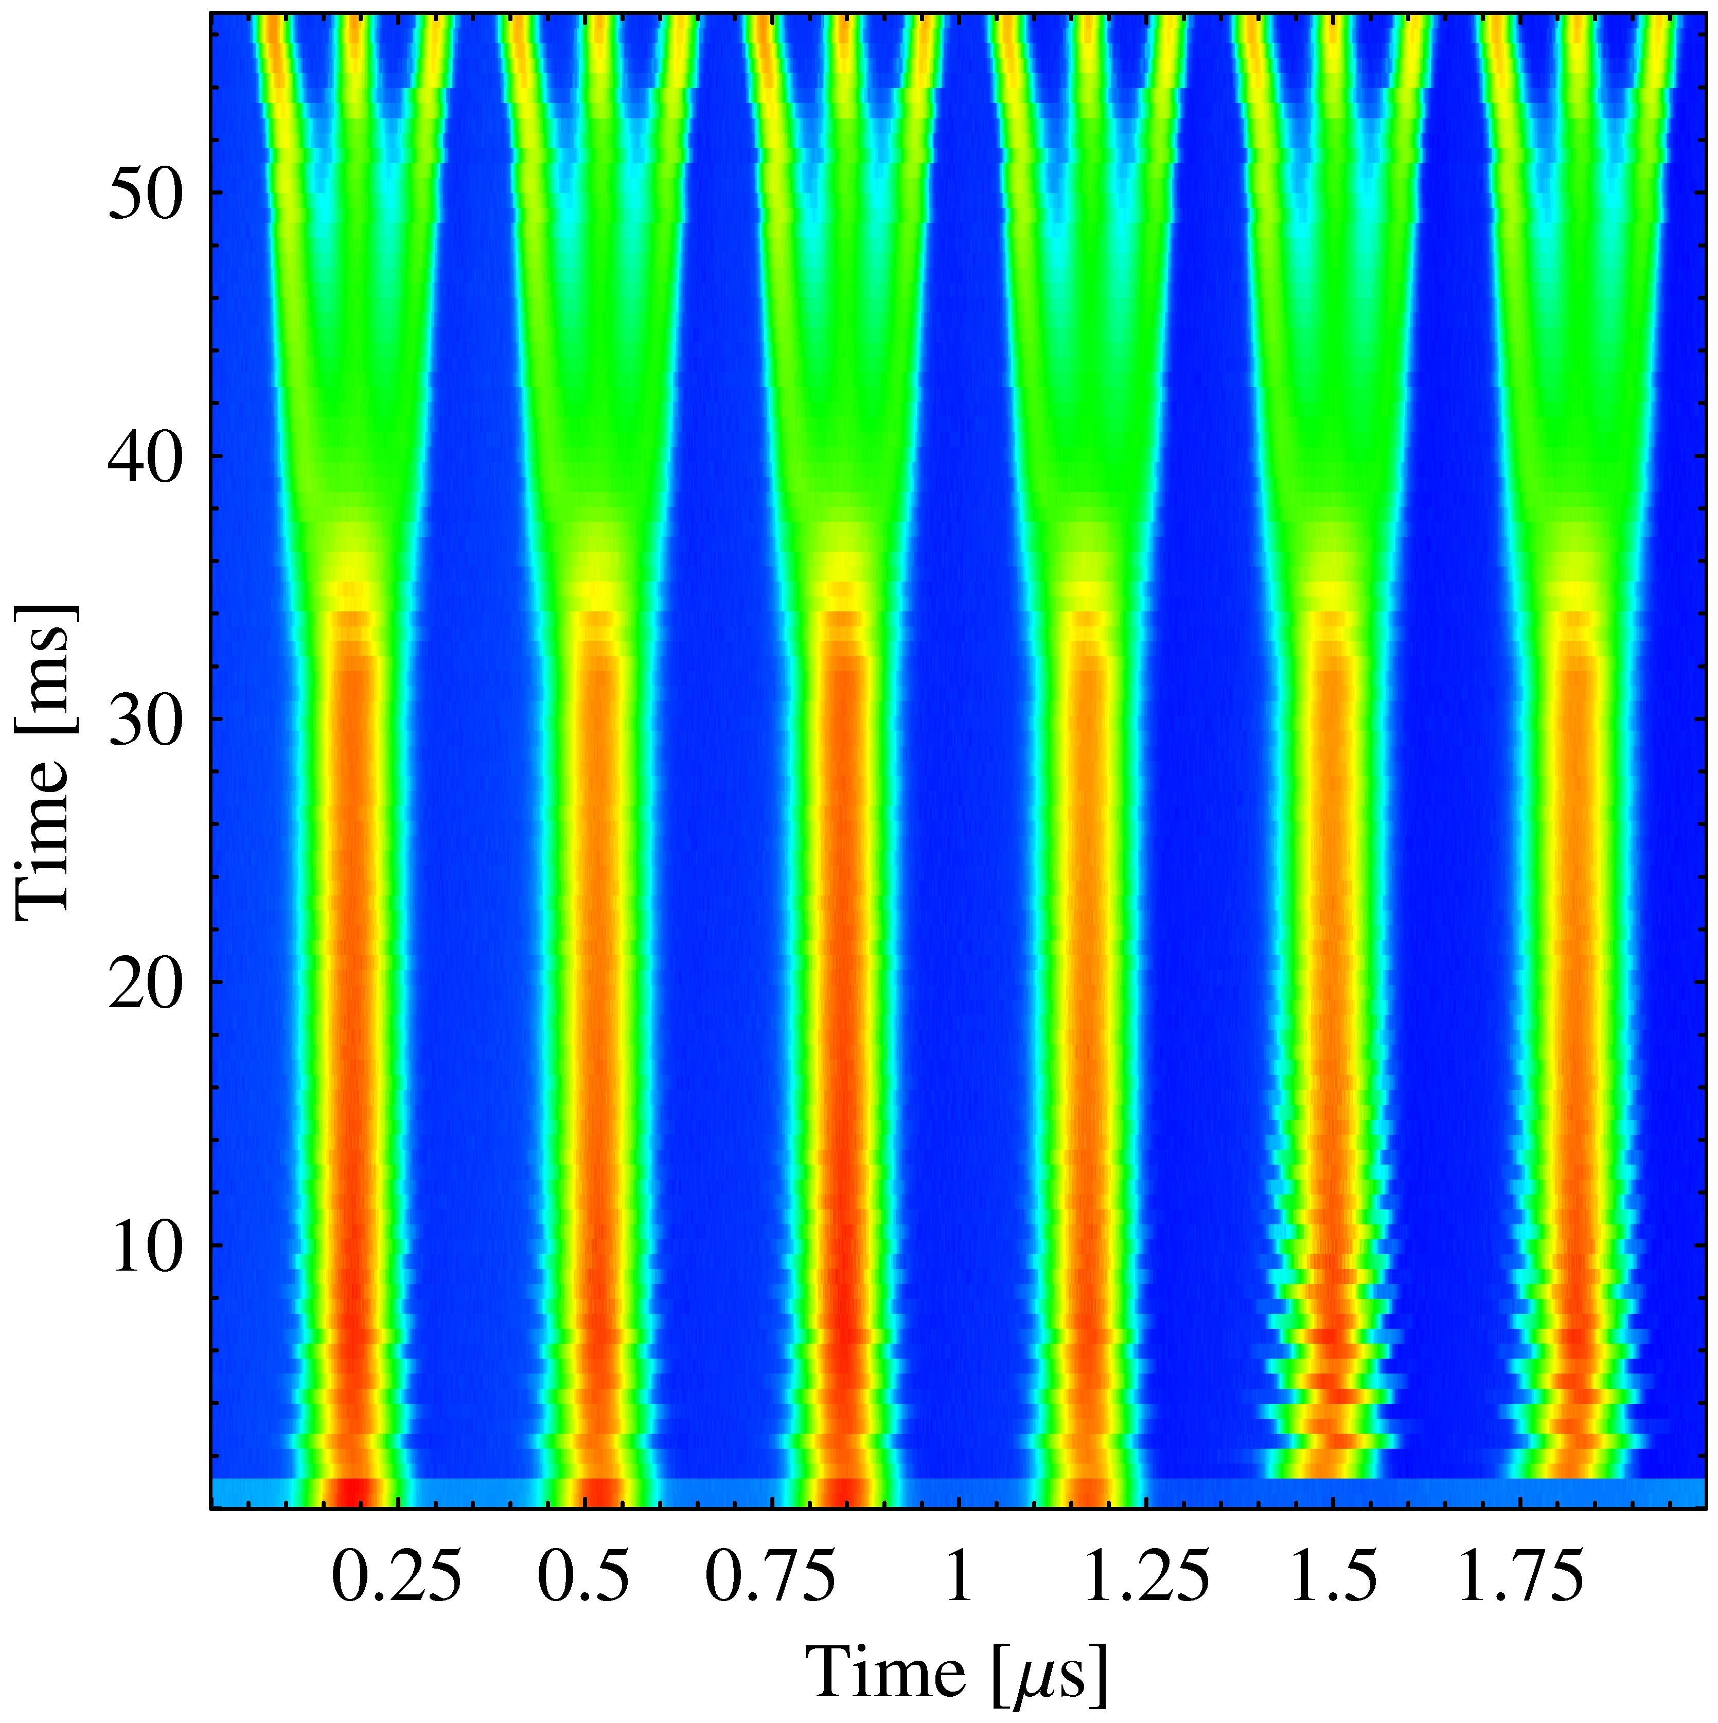
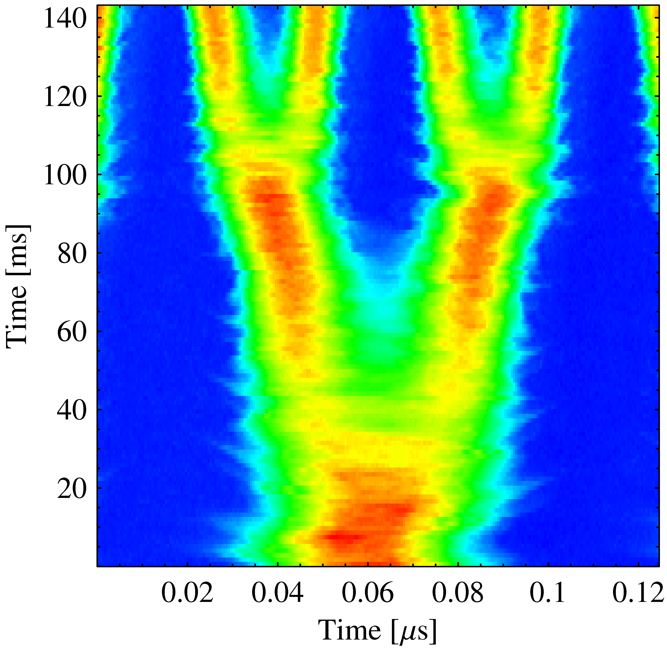
The LHC25 (ns) cycle in the PS
γ_{tr}
Inject 4+2 bunches
Eject 72 bunches
(sketched)
Low-energy BUs
h = 7
h = 21
High-energy BU
h = 84
Triple splitting after 2nd injection
Split in four at flat top energy
2nd injection
1.4 GeV
26 GeV/c
→ Each bunch from the Booster divided by 12 → 6 × 3 × 2 × 2 = 72

Slide 6
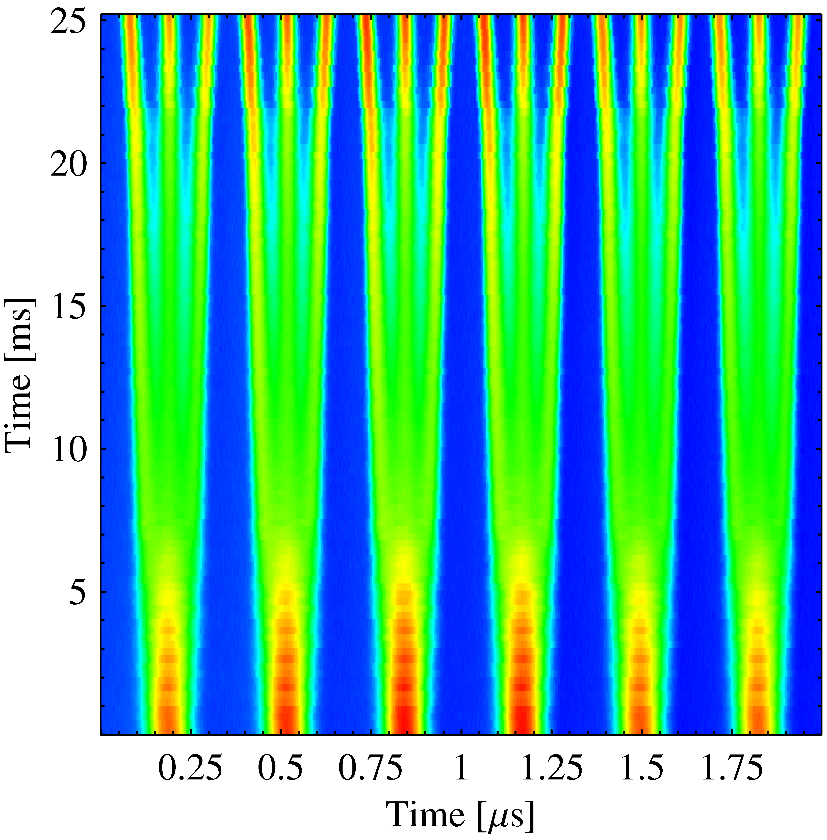
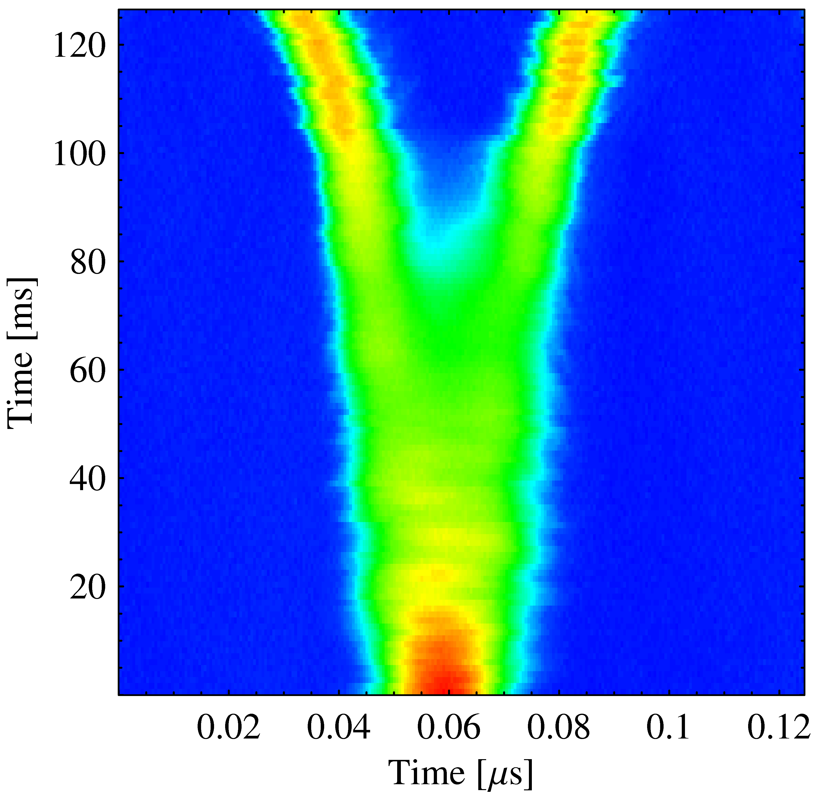
The LHC50 (ns) cycle in the PS
Inject 3×2 bunches
Eject 36 bunches
(sketched)
γ_{tr}
h = 21
h = 7
h = 84
Low-energy BUs
Triple splitting after 1st injection
Split in two at flat top energy
1st injection
1.4 GeV
26 GeV/c
→ Each bunch from the Booster divided by 6 → 6 × 3 × 2 = 36

Slide 7
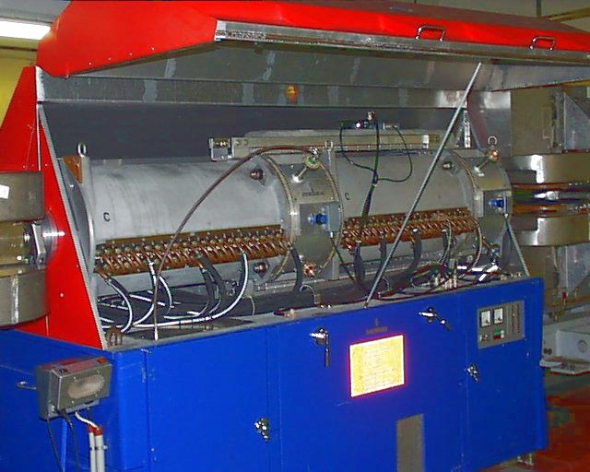
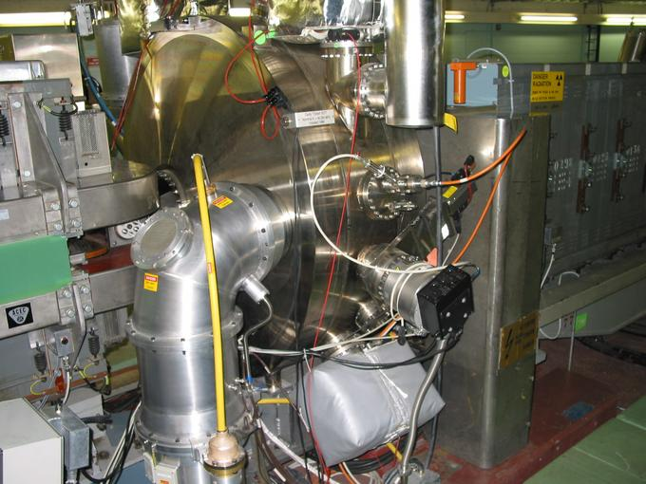
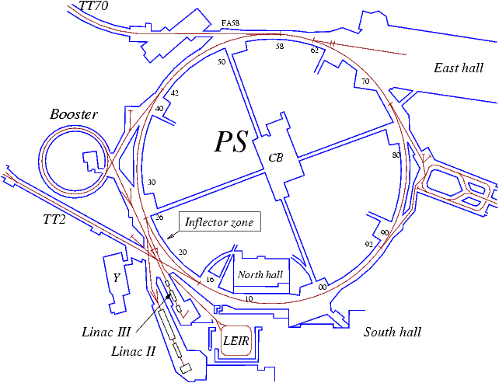
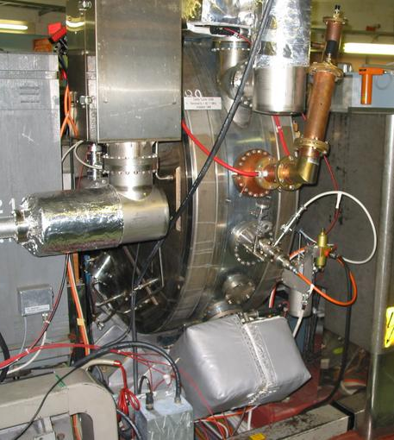
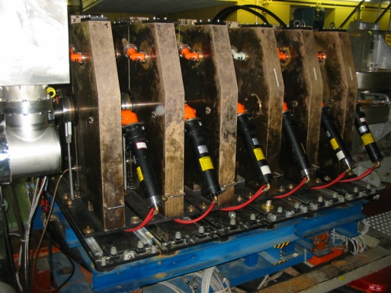
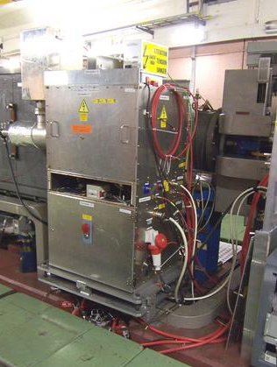
6
RF Systems to perform those manipulations
RF Manipulations
2.8 – 10 MHz
40 MHz
Acceleration
to SPS
PS
80 MHz
200 MHz
Longitudinal blow-up
RF Manipulations
13/20 MHz
→ 24 cavities from 2.8 to 200 MHz

Slide 8
Emittance budgets of beams for LHC
LHC25ns LHC50ns LHC75ns
Injection, h = 7 1.3 eVs 0.9 eVs 0.9 eVs
After 1st blow-up no blow-up 1.3 eVs 1.2 eVs
Splitting on flat-bottom triple triple double
After splitting 0.45 eVs 0.45 eVs 0.65 eVs
After 2nd blow-up 0.65 eVs 0.65 eVs no blow-up
Intensity per bunch 5.2 · 10¹³ ppb 2.6 · 10¹³ ppb 2.6 · 10¹³ ppb
Acceleration h = 21 h = 21 h = 14
After 3rd blow-up 1.3 eVs no blow-up no blow-up
Splitting on flat-top quadruple double double
Final emittance per bunch 0.35 eVs 0.35 eVs 0.35 eVs
Total emittance increase +225 % +133 % +55 %
Independent from bunch spacing at extraction:
N_{b} = 1.3· 10¹¹ p, ε_{l} = 0.35 eVs, 4σ = 4 ns per bunch to SPS/SPS
Longitudinal density N_{b}/ε_{l} during acceleration after transition

Slide 9
Outline
Introduction
Coupled-bunch instabilities
Measurement and analysis
Observations in the PS during acceleration and flat-top
Possible cures, passive and active
Transient beam loading
Summary and outlook

Slide 10
9
Analyze coupled-bunch mode oscillations
Why not measuring in frequency domain with a spectrum analyzer?
Revolution frequency f_{rev} sweeps along the cycle
Lots of spurious f_{rev} lines due to 6/7 filling (18 bunches in h = 21)
Synchrotron side-bands very close to strong f_{rev} lines (f_{s} ~ 350 Hz)
Measurement in time domain:
1. Fit position of each bunch during each frame
2. Dipole oscillations: fit sinusoidal function to motion of bunch centres
→ 18 oscillation amplitudes τ_{n}, 18 phases θ_{n} + synchrotron frequency
3. Discrete Fourier transformation
→ 18 mode amplitudes τ_{k}, 18 mode phases θ_{k}

Slide 11
Observations: acceleration and flat-top
Stable beam until transition crossing, bunch oscillations slowly excited during acceleration with only slightly reduced ε_{l}
Measure bunch profiles starting after last blow-up to arrival on flat-top every 70 ms (for 15 ms, 5-7 periods of f_{s})
γ_{tr}
h = 7
h = 21
High-energy BU
a)
b)
Analyze mode spectrum of 10 cycles at each point and average

Slide 12
a) Mode spectra during acceleration
Does the coupled-bunch mode spectrum change at certain points in the cycle? Excitation of resonant impedances?
LHC25
5.2 · 10¹² ppb, ε_{l} = 0.9 eVs
Below nominal
LHC50
2.6 · 10¹² ppb, ε_{l} = 0.5 eVs
• Modes close to bunch (~ h_{RF}f_{rev}) frequency (n = 1, 2, 16, 17) strongest
• Form of mode spectrum remains unchanged all along acceleration
• Similar instabilities with LHC25 and LHC50 suggest scaling ~ N_{b}/ε_{l}

Slide 13
Outline
Introduction
Coupled-bunch instabilities
Measurement and analysis
Observations in the PS during acceleration and flat-top
Possible cures, passive and active
Transient beam loading
Summary and outlook

Slide 14
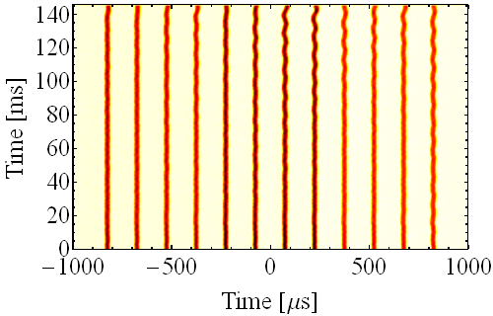
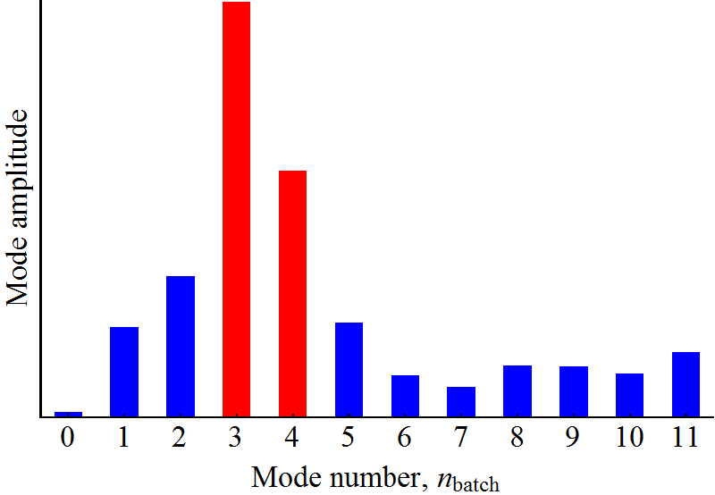
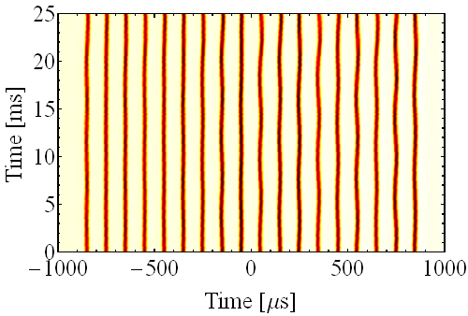
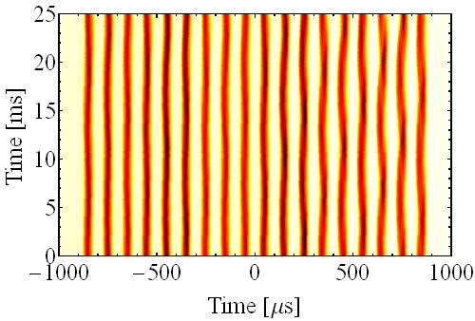
b) Observations on the flat-top (no splitting)
Coupled-bunch oscillations also observed on the flat-top, when RF voltage is lowered before splitting starts
Mode spectrum, LHC75
10 cycle average
LHC75, V_{RF} = 20 kV, h = 14
LHC50, V_{RF} = 20 kV, h = 21
LHC25, V_{RF} = 10 kV, h = 21

Slide 15
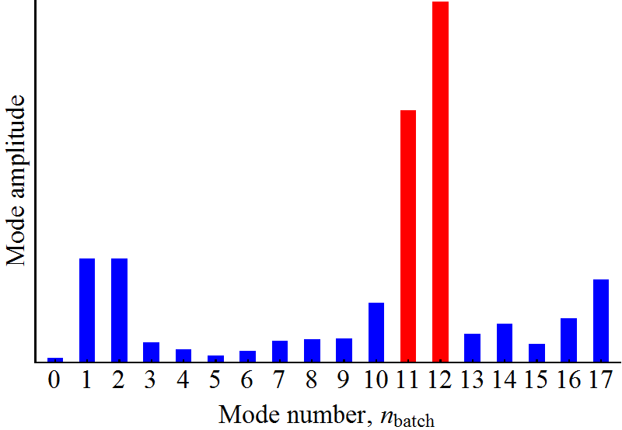
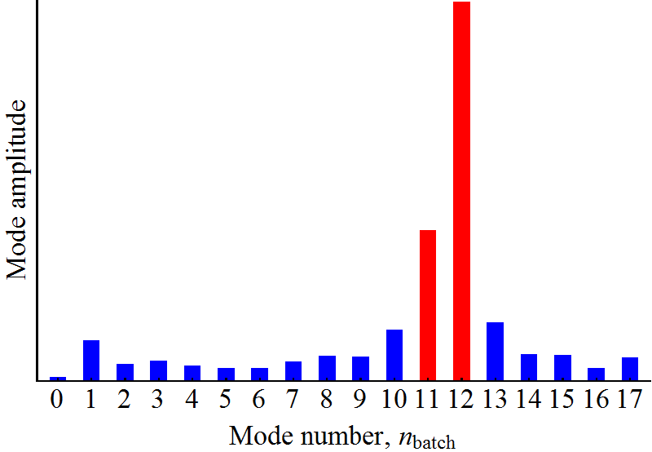
b) Mode spectra of oscillations on the flat-top
Compare both LHC beam variant with 18 bunches in h = 21 on flat-top:
h = 11 · 7/6 = 12.8
h = 12 · 7/6 = 14
→ 6.1 MHz
→ 6.7 MHz
LHC50
LHC25
V_{RF} = 20 kV, 2.6 · 10¹² ppb, ε_{l} = 0.65 eVs
V_{RF} = 10 kV, 5.2 · 10¹² ppb, ε_{l} = 1.3 eVs
• Very different from mode spectrum during acceleration
• Coupled-bunch mode spectrum reproducible and similar in both cases
• Mode spectrum very similar for the same longitudinal density ~ N_{b}/ε_{l}

Slide 16
Outline
Introduction
Coupled-bunch instabilities
Measurement and analysis
Observations in the PS during acceleration and flat-top
Possible cures: passive and active
Transient beam loading
Summary and outlook

Slide 17
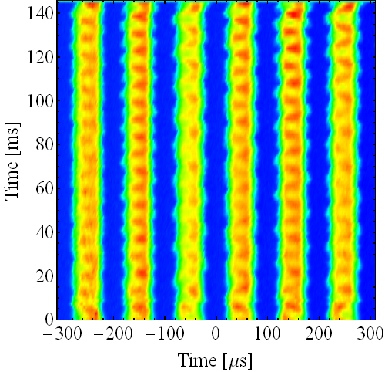
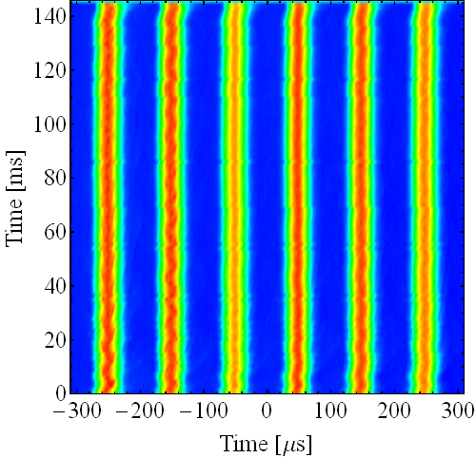
Passive: Double-harmonic RF to stabilize?
Stability of bunches in double harmonic RF, h = 21/42, V_{RF} = 10/5 kV
Bunch lengthening mode 10 + 20 MHz in counter-phase
Bunch shortening mode 10 + 20 MHz in-phase
N = 9 · 10¹² ppp, LHC25, first six bunches
Studies together with Chandra Bhat, FNAL
As expected, no stability improvement in bunch-lengthening mode
Stability only improves in bunch shortening mode
Useless in the PS since bunch splitting requires counter-phased RF

Slide 18
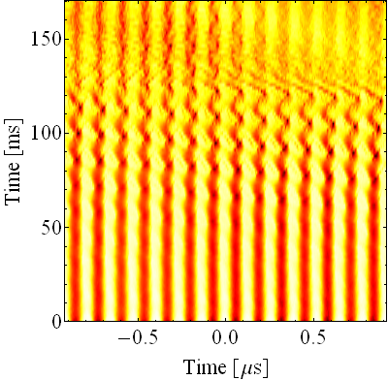
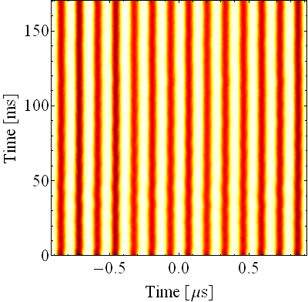
Passive: Park unused 10 MHz cavities
Detune unused 10 MHz cavities to frequency far away from RF harmonic
1 + 4 cavities open, h = 16
…and 4 tuned to h = 6.5
N = 1.5 · 10¹³ ppp
Tuning unused cavities to a parking frequency reduces their impedance, even when the gap relay is closed (fixed target beam)
Preliminary test showed improvement of stability also with LHC-type beam on the flat-top
Improve short-circuit with gap relays?

Slide 19
Outline
Introduction
Coupled-bunch instabilities
Measurement and analysis
Observations in the PS during acceleration and flat-top
Possible cures, passive and active
Transient beam loading
Summary and outlook

Slide 20
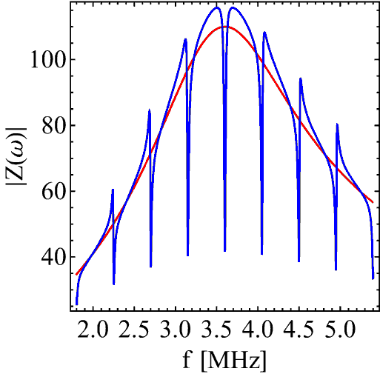
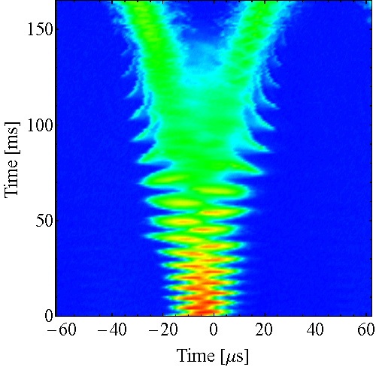
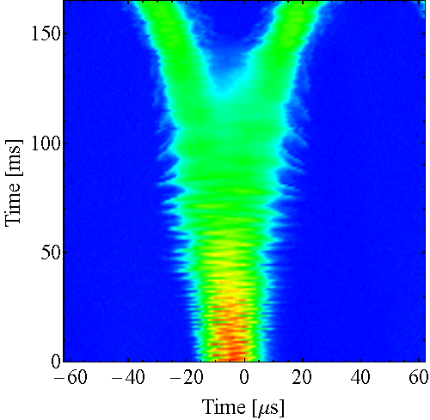
Active: One-turn delay feedback
Z [Ω]
Comb-filter FB: Decreases residual impedance at f_{rev} harmonics
Local feedback around each of the 10 MHz cavities (ten systems)
LOCAL
f [MHz]
F. Blas, R. Garoby, PAC91, pp. 1398-1400
LHC50ns ultimate, splitting on flat-top
FB OFF
FB ON
Especially effective on the flat-top → Impedance source 10 MHz cavities
More measurements with LHC-type beams required

Slide 21
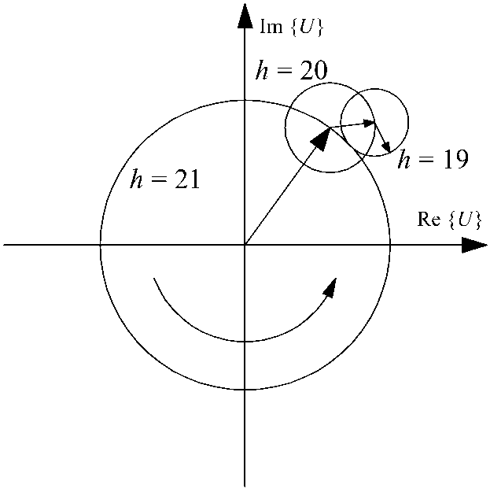
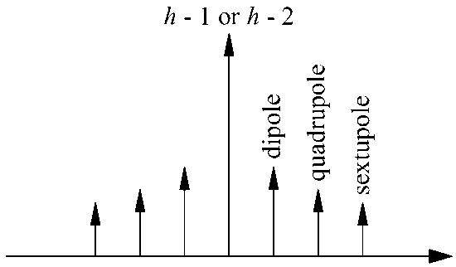
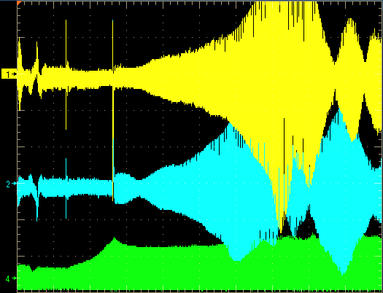
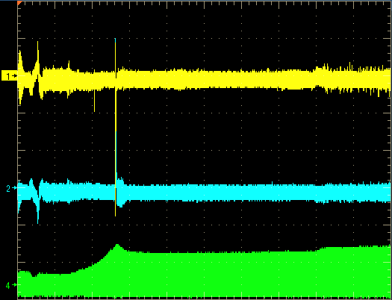
Active: Coupled-bunch feedback
Actively reduce spectral components of the beam, no matter which impedance source excites them
Global feedback working in frequency domain
GLOBAL
Suppress strong line
Total voltage vector:
J.-L. Vallet
ω_{S}
f
→ Correction to RF cavities
Spectral lines to damp
100 ms/div
100 ms/div
Beam, h = 20
FB ON
Beam, h = 19
Beam, wideband

Slide 22
Outline
Introduction
Coupled-bunch instabilities
Measurement and analysis
Observations in the PS during acceleration and flat-top
Possible cures
Transient beam loading
Summary and outlook

Slide 23
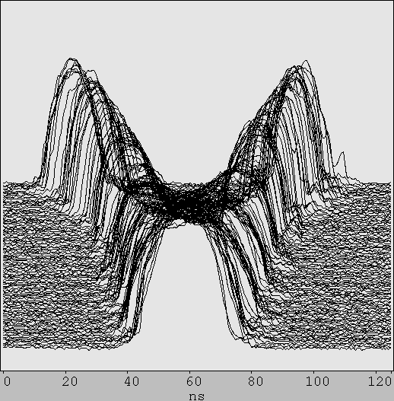
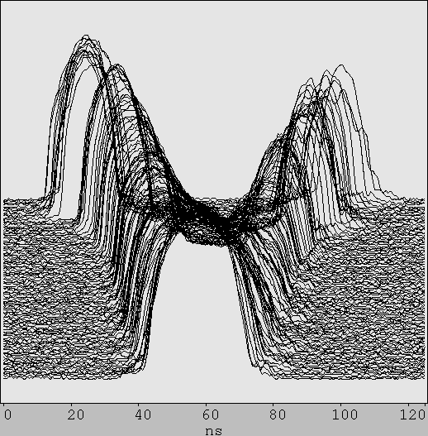
Splitting extremely sensitive to phase errors
Symmetric adjustment
5º phase error
N = 2.6 · 10¹¹ ppb, LHC75
Small relative phase errors during splitting cause significant intensity differences of resulting bunches
Transient beam loading in RF cavities may show up as phase error along the batch
Beam quality degradation: bunch-to-bunch intensity variation
Small effect with nominal intensity (1.3 · 10¹¹ ppb/SPS). Ultimate?

Slide 24
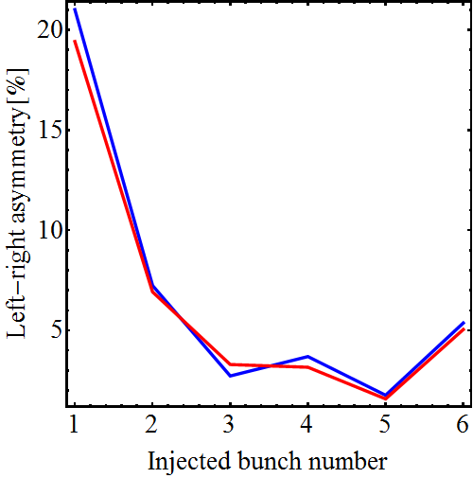
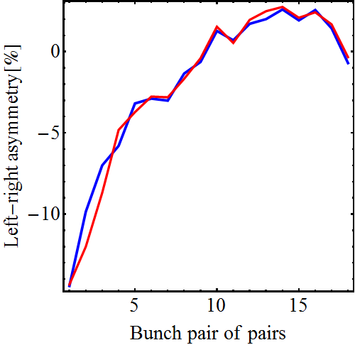
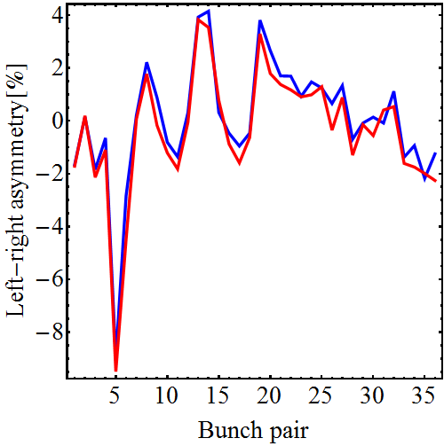
Effect of transient BL on ultimate-like beam
Bunch profile integral
Gauss fit integral
Averaged over ten cycles
Triple split
1st double split
2nd double split
Transient beam-loading causes relative intensity errors of up to 20 % per splitting at the head of the bunch train

Slide 25
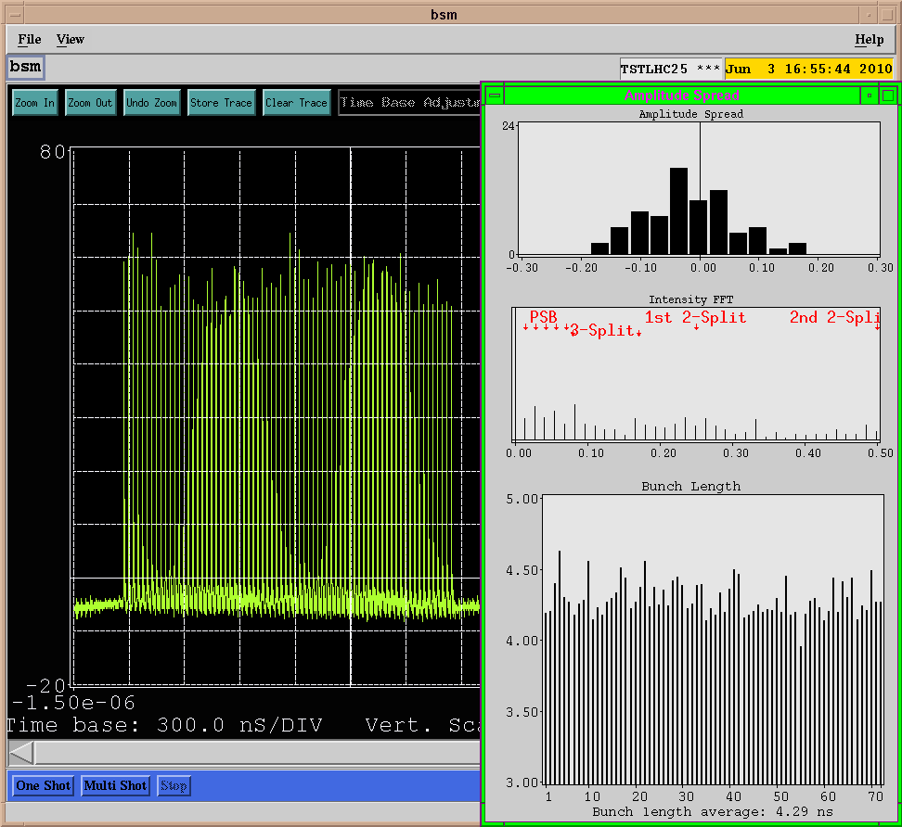
Beam quality at extraction
N ≅ 1.8 · 10¹¹ ppb
Best achieved so far with 50% more than nominal intensity per bunch

Slide 26
Summary and outlook
• The high density of LHC-type beams in the PS makes them prone to longitudinal instabilities (beyond nominal intensity)
• Coupled-bunch oscillations during acceleration and on the flat-top well
identified; RF cavities as impedance sources partly understood
• LHC25/LHC50 behave extremely similar → scaling ~ N_{b}/ε_{l}
• Effects of 40/80 MHz cavity impedance still to be understood
• Possible cures, passive and active being investigated to stabilize beams up to ultimate bunch intensities (~ 1.8 · 10¹¹ ppb)
• Implement passive techniques to optimize impedance visible to beam
• Improve active feedbacks (1-turn delay, coupled-bunch FB)
• Transient beam loading: bunch-to-bunch intensity variation
• Feed-forward phase modulation? More measurements needed
Even in a ‘not so young’ accelerator like the CERN PS, there is still room for new ideas and performance improvements

Slide 27
Thank you for your attention!

