Slide 1
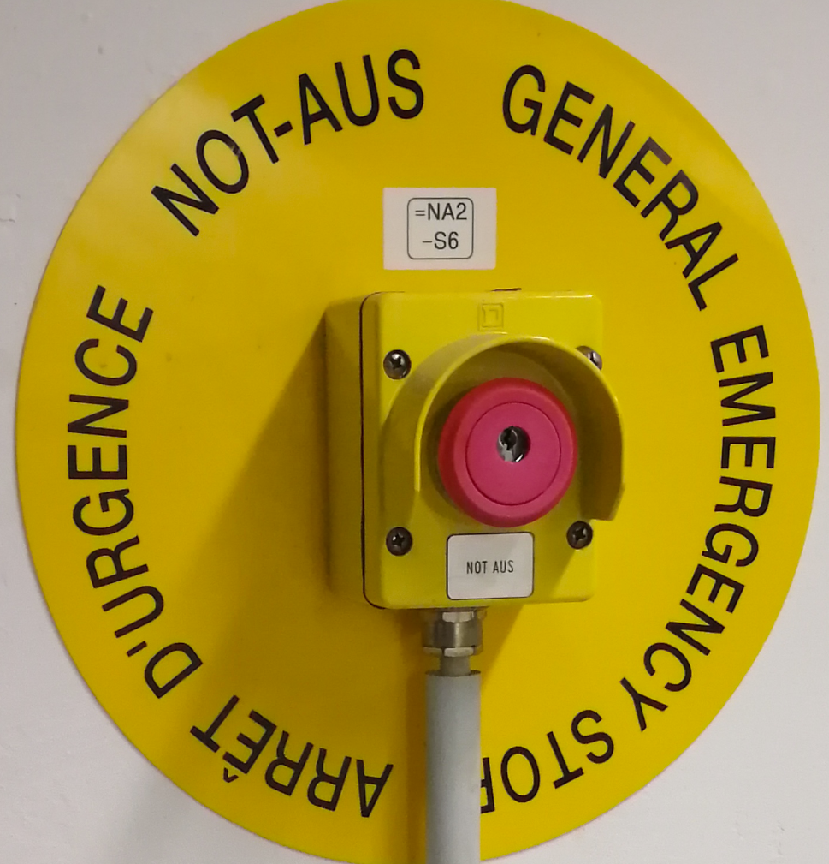
Emergency Stop System at the GSI
Andreas Engling 10.2019

Slide 2
Emergency Stop System GSI
At the moment there are several independent emergency stop systems in the GSI.
In the course of renewal, these emergency stop systems are to be converted into a centrally monitored system
In the first phase, the NA- emergency stop system in the old GSI building has to be renewed.

Slide 3
Emergency Stop System „Altbau“
The NA emergency stop system covers the areas of the ion source up to the old experimental hall and is divided into the following trip areas.
- siehe Bilder –
NA1 -> Unilac- Tunnel (TU0 and TU1)
HLI Cave (SH1.1)
NA2 -> Ion Souce (BH1.0,BH1.1)
Technology area ( VR.0, VR.1)
HLI Cave (SH1.1)
NA3 -> Experemetal area (EH.0, EH1)
NA4 -> Transfer chanal (TK)

Slide 4
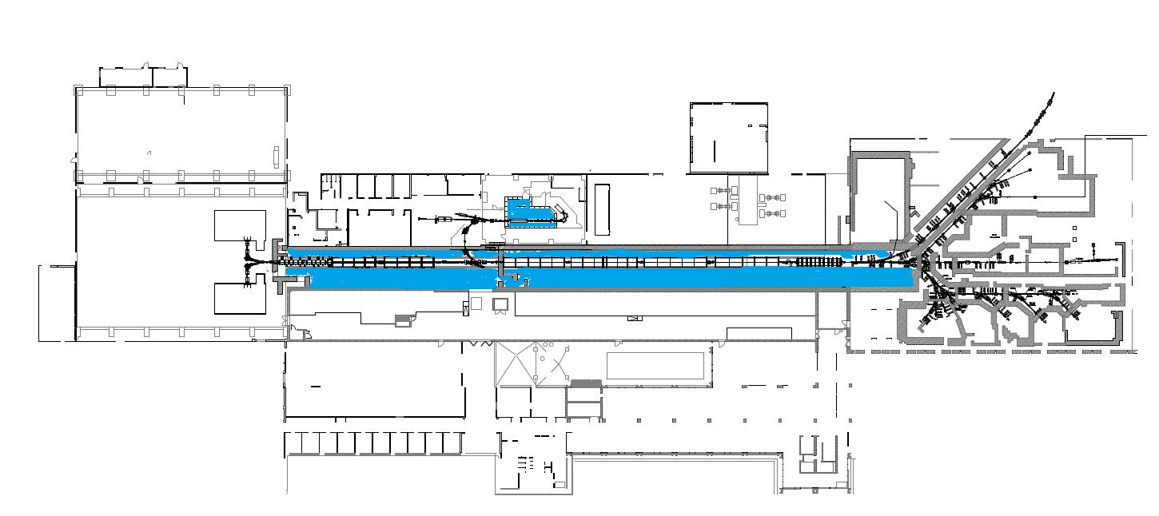
Emergency Stop System „Altbau“
NA1 -> Unilac- Tunnel TU0 and Tu1
HLI Cave (SH1.1)

Slide 5
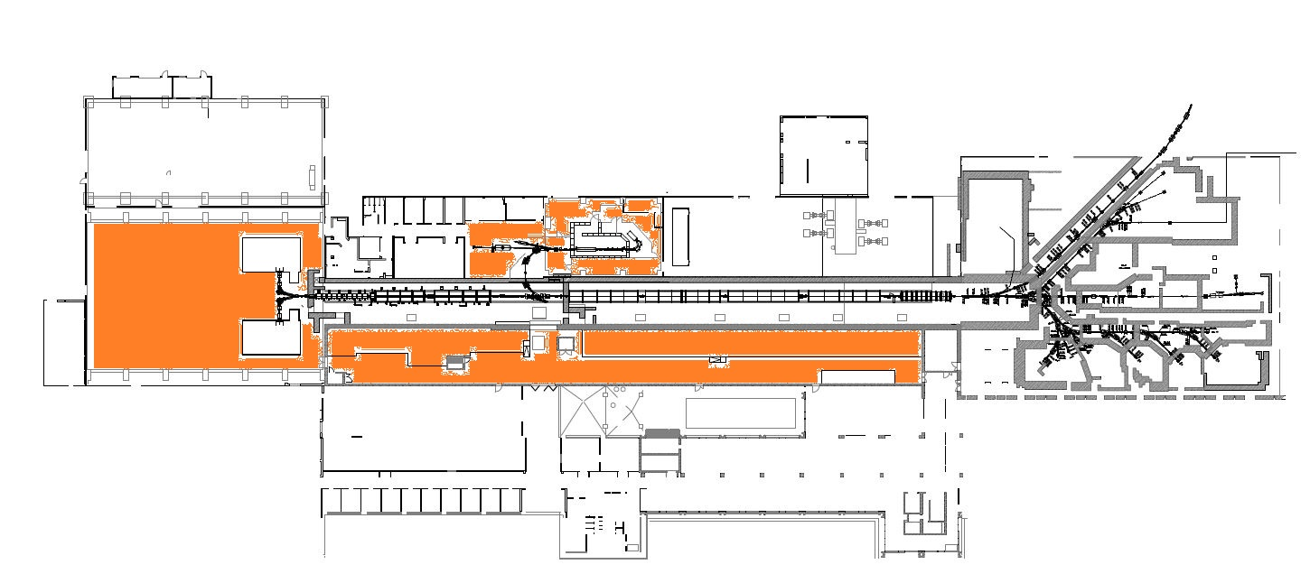
Emergency Stop System „Altbau“
NA2 -> Ion Source (BH1.0,BH1.1)
Technology area ( VR.0, VR.1)
HLI Cave (SH1.1)

Slide 6
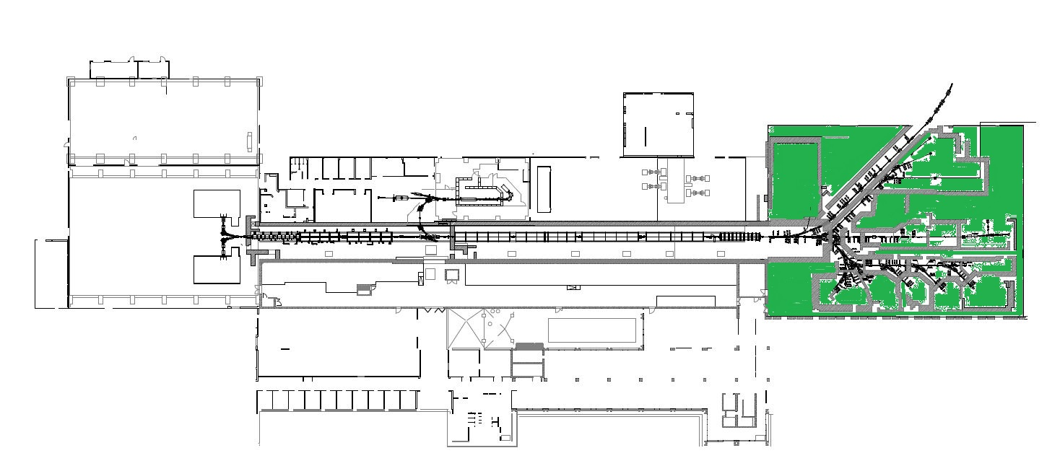
Emergency Stop System „Altbau“
NA3 -> Experimental area (EH.0, EH1)

Slide 7
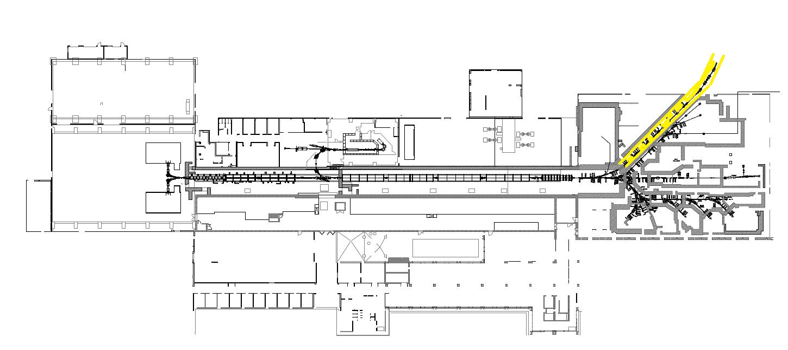
Emergency Stop System „Altbau“
NA4 -> Transfer chanal (TK)

Slide 8
Emergency Stop System „Altbau“
Special feature of the NA emergency stop system
- siehe Bild –
- The area NA1 is superordinate to the area NA2, NA3 and NA4.
In case of activation an emergency stop at the NA1 area, the
NA2,NA3 and NA4 area also switched off
- The NA2 area has no impact on other areas.
- The NA3 area also triggers the NA4 area.
- The NA4 area has no impact on other areas.

Slide 9
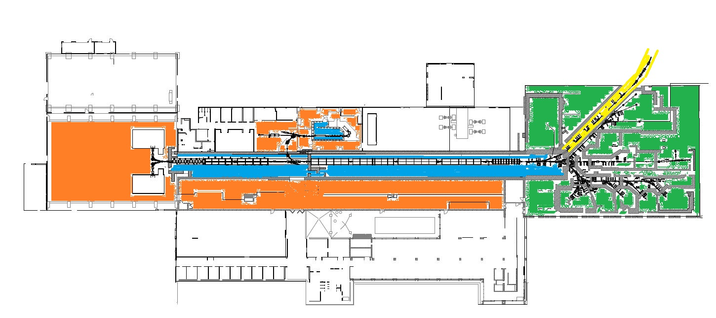
Emergency Stop System „Altbau“
Aktueller Stand Not-Aus System -NA- in der GSI
NA1 -> Unilac- Tunnel TU0 und Tu1 HLI Cave (SH1.1)
NA2 -> Ion Souce (BH1.0,BH1.1) Technology area ( VR.0, VR.1) HLI Cave (SH1.1)
NA3 -> Experimental area (EH.0, EH1)
NA4 -> Transfer chanal (TK)

Slide 10
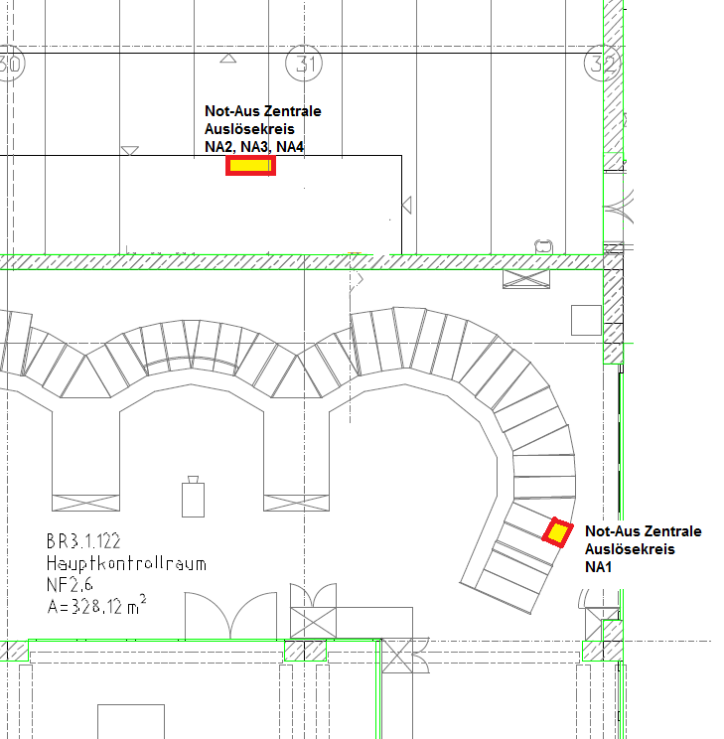
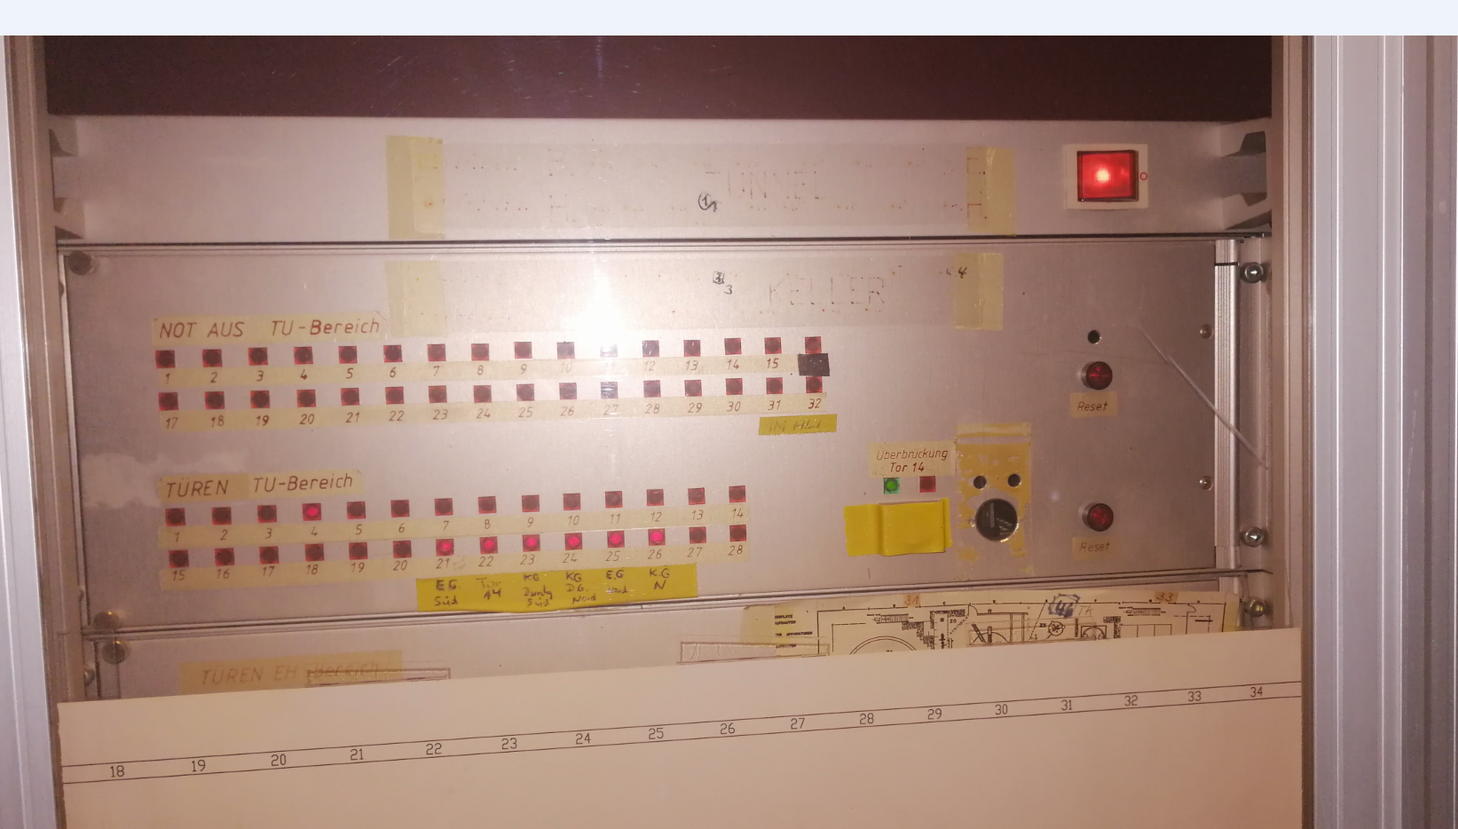
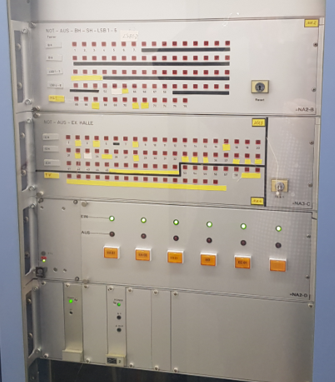
Emergency Stop System „Altbau“
The emergency stop system consists of two emergency stop control panels for
- Trip circuit NA1, in the main control room, and for the - Trip circuit NA2, NA3 and NA4, in rack 12 in VR1.1 Gallery.
Auslösekreis
NA1
Auslösekreise
NA2, NA3, NA4

Slide 11
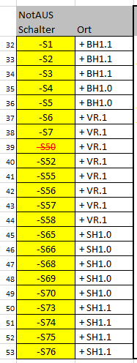
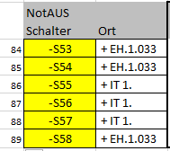
Emergency Stop System „Altbau“
The 4 emergency stops circuits consist of approx. 90 emergency stops.
These are located in the buildings
NA1 NA2 NA3 NA4
BH1.0 / BH1.1
TU.0 / TU.1
VR.1
SH1.
EH.0 / EH.1
SH1
BH1
TU
VR.1
EH

Slide 12
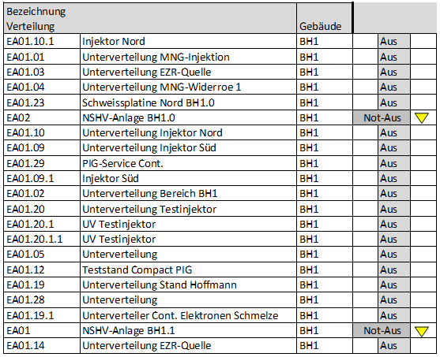
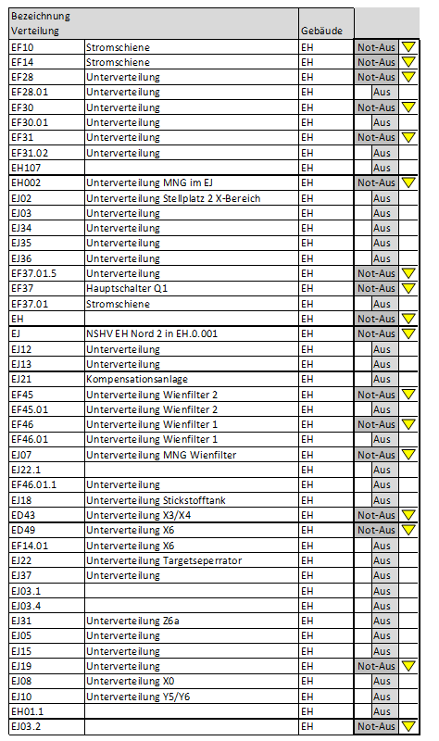
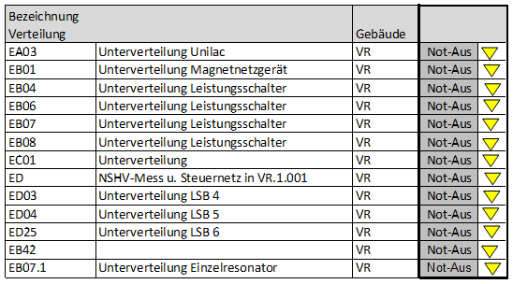
NA-Not-Aus System „Altbau“
34 low voltage distributions will be switched directly and 50 switched off indirectly
Low voltage distributions that are direct switched off by the emergency stop system are marked with an

Slide 13
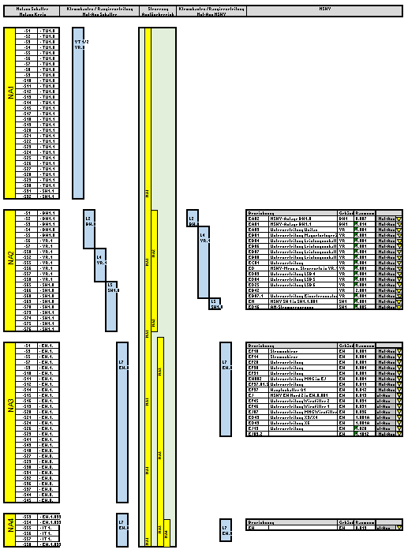
Emergency Stop System „Altbau“
The emergency stop switches are connected to 5 local distribution boards these are routed to a central marshalling cabinet.
There the emergency stop panel processes the signals and control over the same periphery the circuit breakers.

Slide 14
Emergency Stop System „Altbau“
Planned replacement
In the course of the planned replacement of the GSI emergency stop systems, a modular and decentralized system should be used, that centrally visualizes and controls all information and states of the system.
In addition, the decentralized information should also be able to be displayed and controlled.
An expansion of the systems must work simply and without interruption

Slide 15
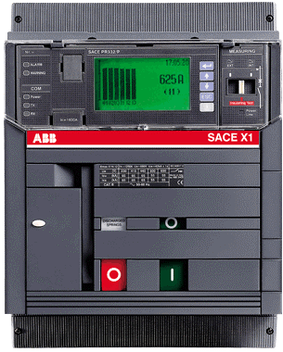
Emergency Stop System „Altbau“
PSS-PLC
PMI
ca. 17 St
PSS-I/O
ca. 17 St
ca. 55 St
ca. 30 St

Slide 16
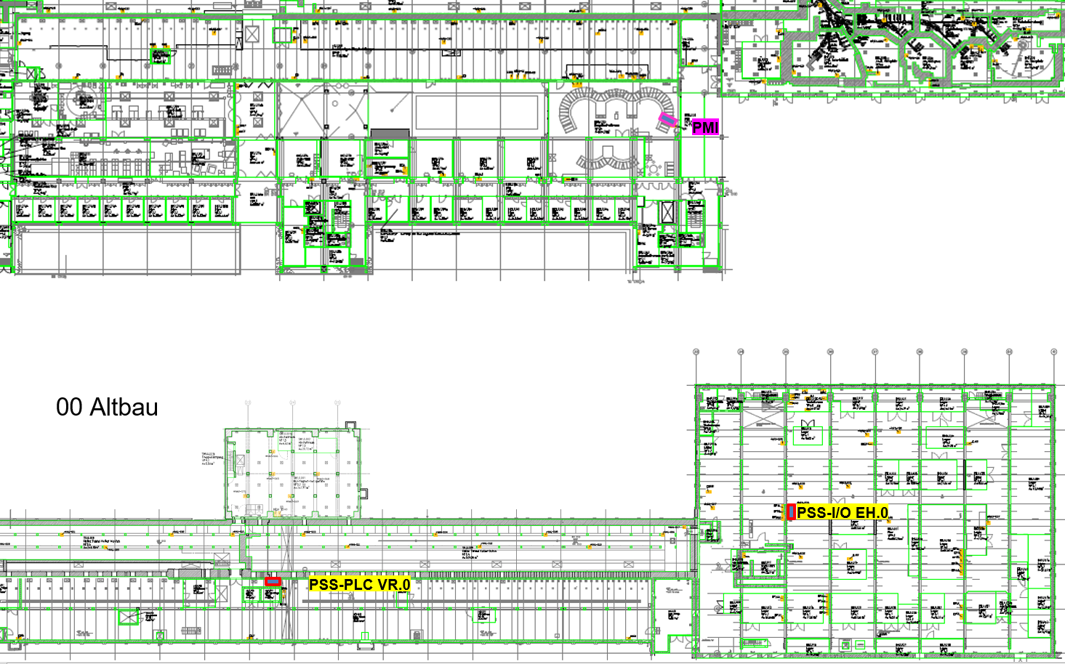
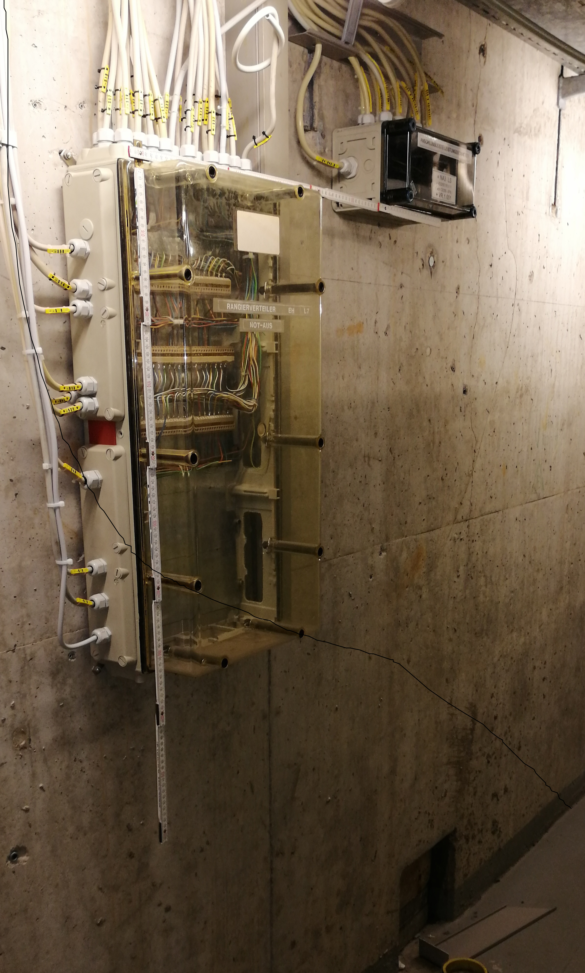
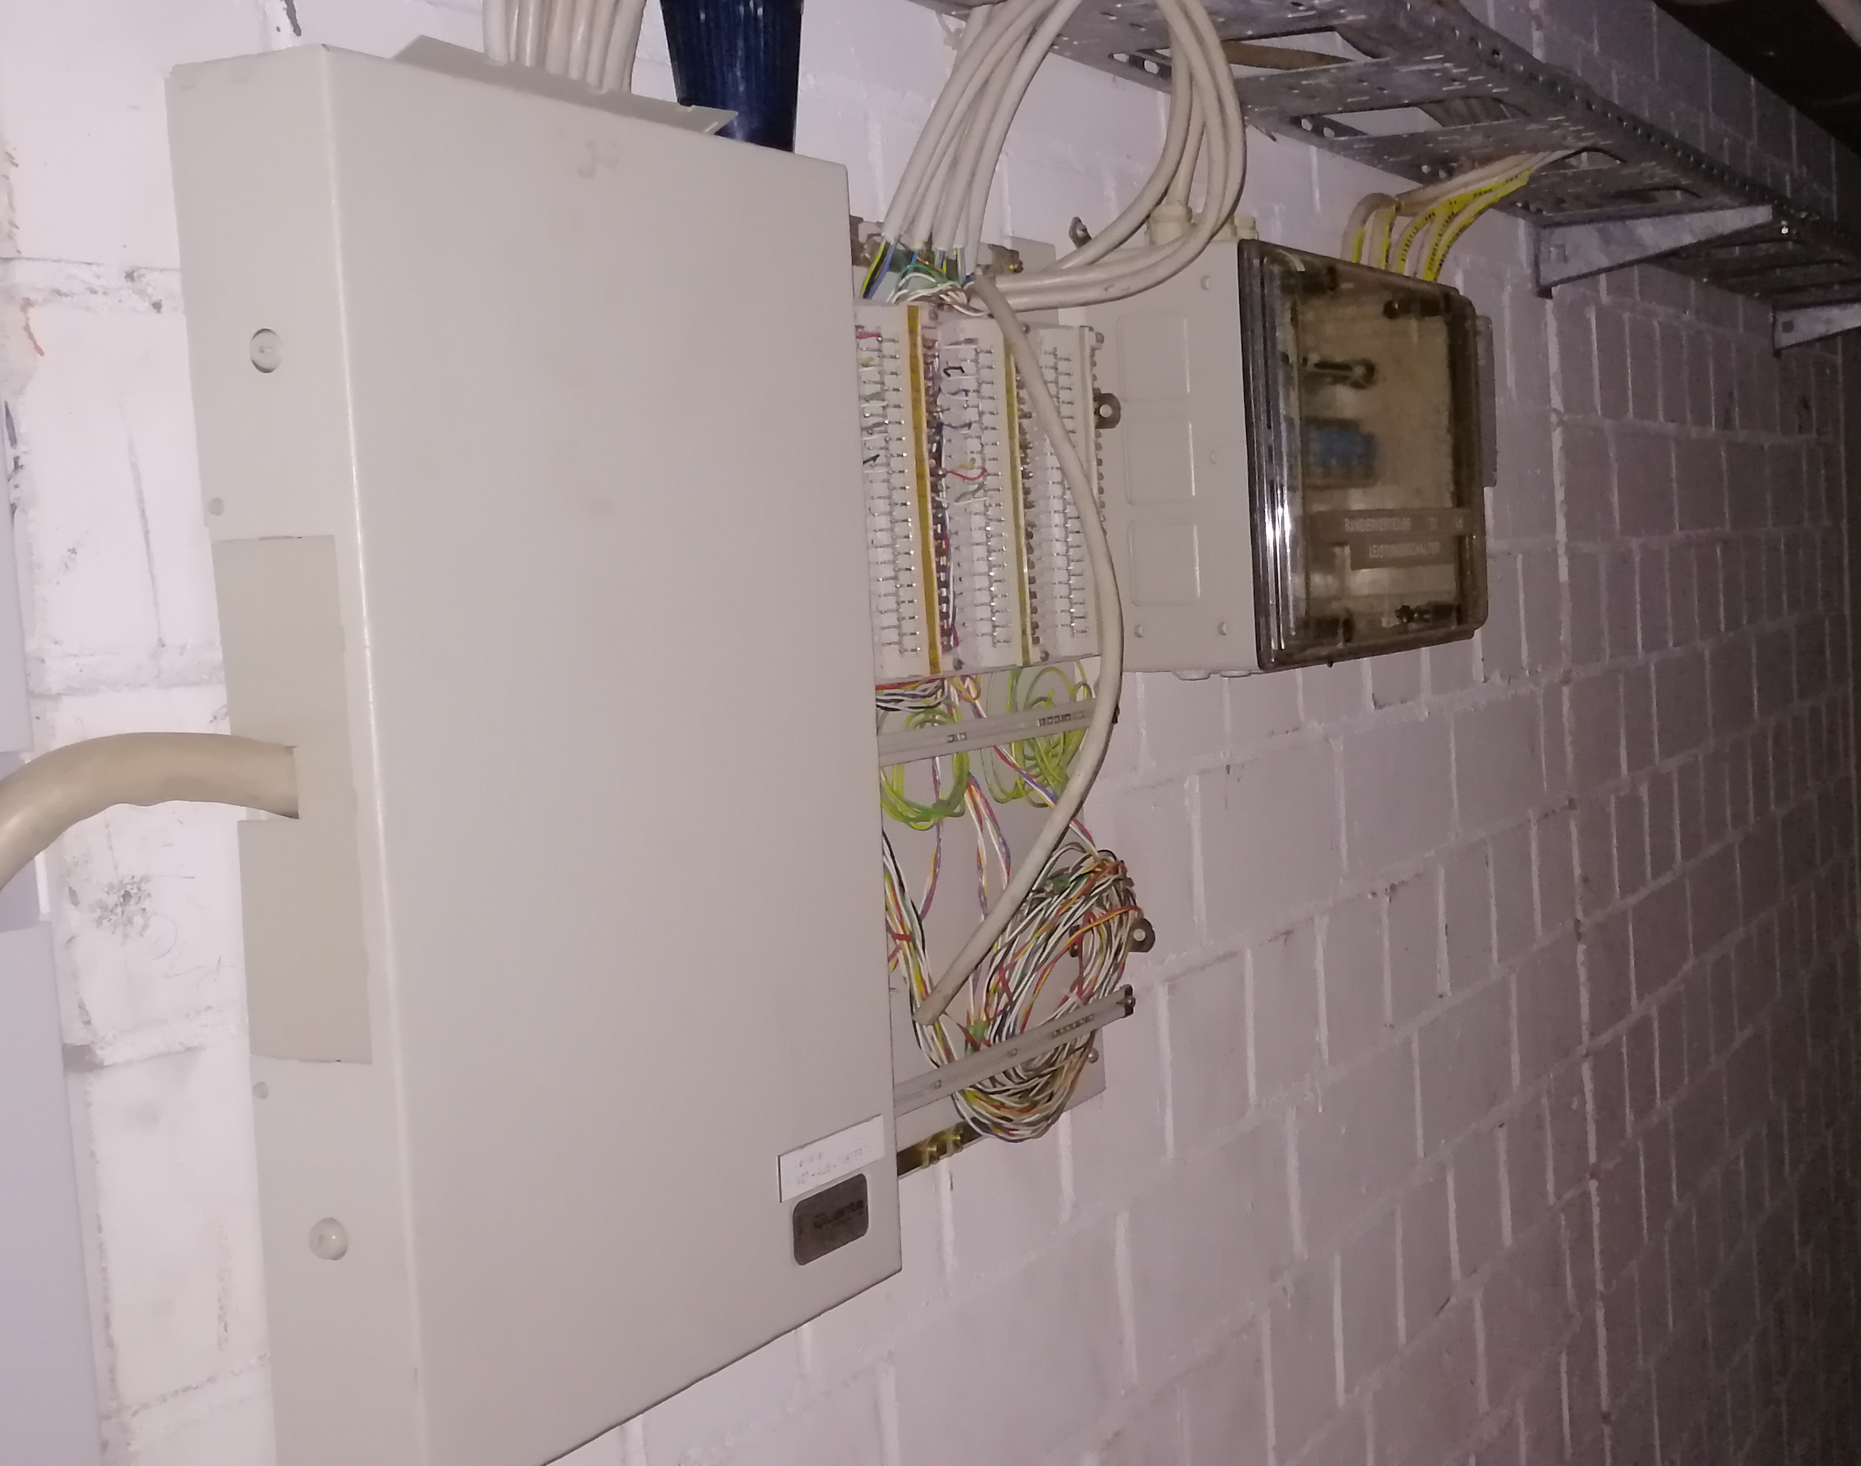
Emergency Stop System „Altbau“

Slide 17
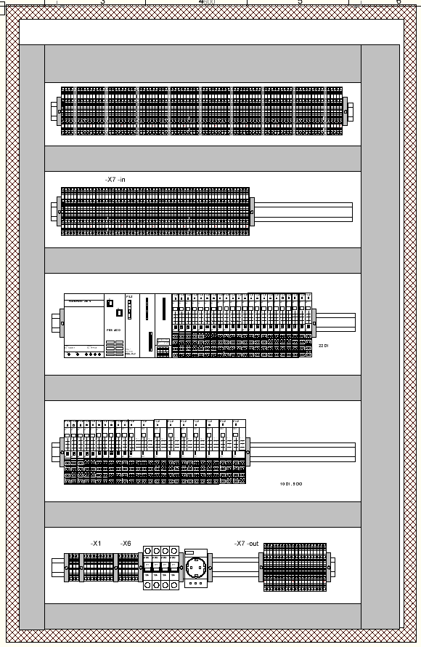
Emergency Stop System „Altbau“
PSS 4000 PLC
Striebel und John
TwinLine-W
800x1200x350

Slide 18
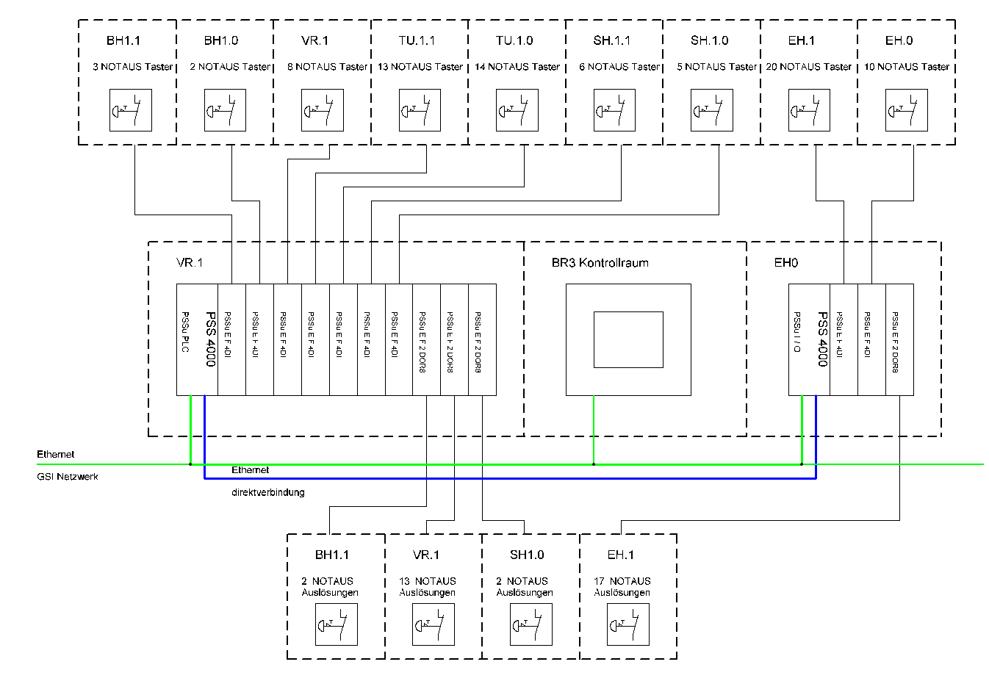
Emergency Stop System „Altbau“
17
17
51
30

Slide 19
Emergency Stop System „Altbau“

Slide 20
Emergency Stop System „Altbau“

