Slide 1
FAIR Operation Modes
Dr. Sabrina Appel, Accelerator Physics Department, GSI, Darmstadt
Notes:
Optimierung der Multi-Turn-Injektion in Schwer-Ionen-Synchrotrons

Slide 2
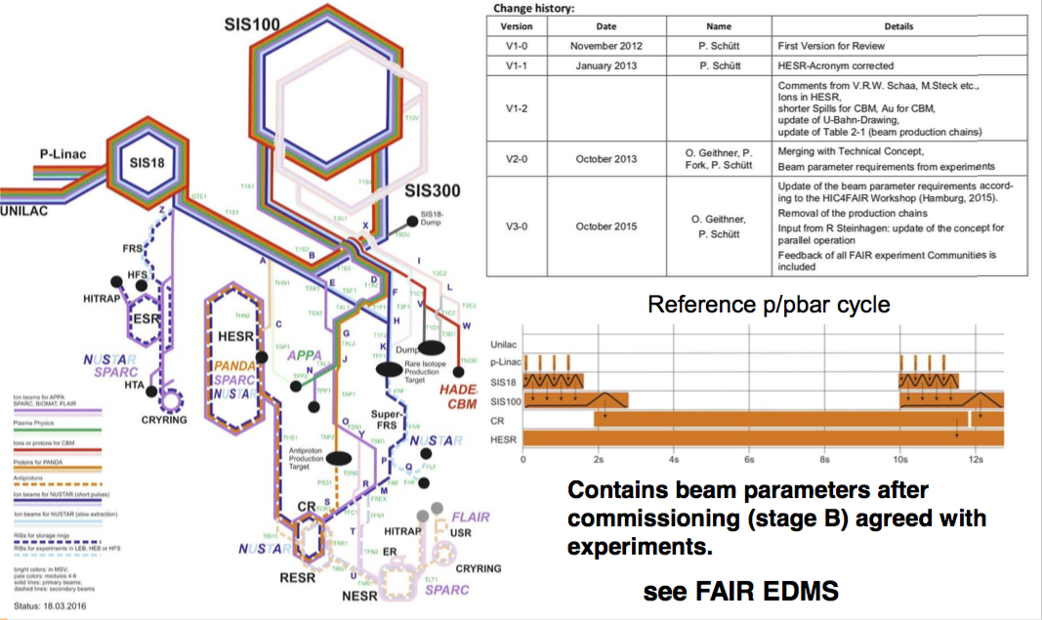
FAIR Operation Modes (April 2016)
Revision

Slide 3
History
Version | Date | Name | Details
V1-0 | November 2012 | P. Schütt | First Version for Review
V1-1 | January 2013 | P. Schütt | HESR-Acronym corrected
V1-2 |  |  | Comments from V.R.W. Schaa, M.Steck etc., Ions in HESR, shorter Spills for CBM, Au for CBM, update of U-Bahn-Drawing, update of Table 2-1 (beam production chains)
V2-0 | October 2013 | O. Geithner, P. Fork, P. Schütt | Merging with Technical Concept, Beam parameter requirements from experiments
V3-0 | October 2015 | O. Geithner, P. Schütt | Update of the beam parameter requirements according to the HIC4FAIR Workshop (Hamburg, 2015). Removal of the production chains Input from R Steinhagen: update of the concept for parallel operation Feedback of all FAIR experiment Communities is included
V4-0 | 2020 | S. Appel + O. Boine-Frankenheim | Revision for EDMS release. Feedback of all FAIR experiment communities and machine coordinates is included. Update of beam parameters requirements according to the reference beam parameters booklet version 5. Update of U-Bahn-Drawing.
V3-0 can be found under https://edms.cern.ch/document/1688183/1 (unapproved)

Slide 4
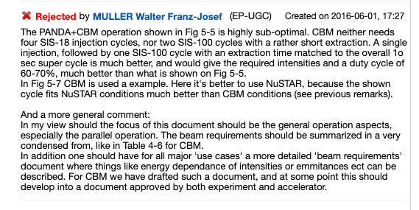
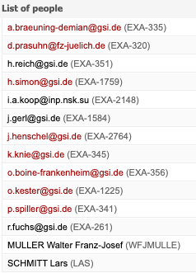
History: EDMS rejection
Example
Level 1 Team (2016)
The PANDA+CBM operation shown in Fig 5-5 is highly sub-optimal. CBM neither needs four SIS-18 injection cycles, nor two SIS-100 cycles with a rather short extraction. A single injection, followed by one SIS-100 cycle with an extraction time matched to the overall 1o sec super cycle is much better, and would give the required intensities and a duty cycle of 60-70%, much better than what is shown on Fig 5-5.
In Fig 5-7 CBM is used a example. Here it's better to use NUSTAR, because the shown cycle fits NUSTAR conditions much better than CBM conditions (see previous remarks).
....
V4-0: All EDMS remarks has been considered

Slide 5
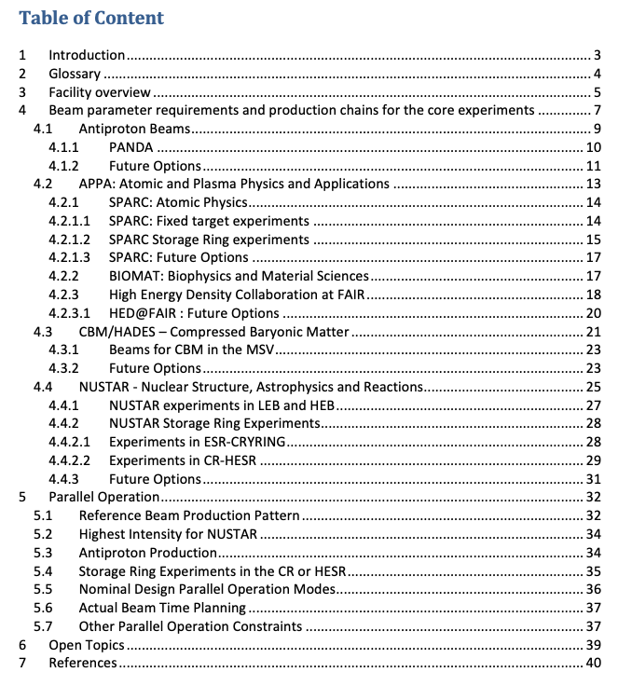
Table of Content
Introduction
Antiproton Beams
APPA
CBM/HADES
NUSTAR
Parallel Operation

Slide 6
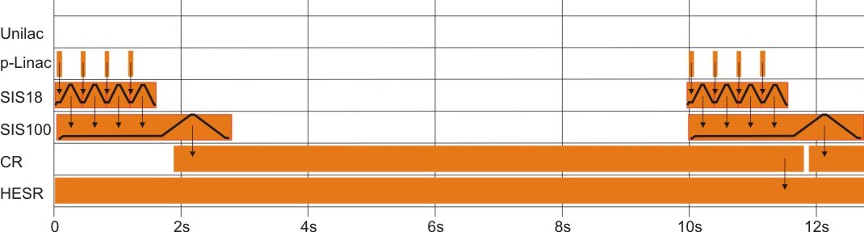
Example: Antiproton Beams
Short description of experiment
Detailed description of beam chain
Beam parameters for Commissioning + MSV
Future Options (after MSV)

Slide 7
Open topics
for EDMS release in 1-2 month
Experiment requirements for reference ions (p, U, Au) and for selected intermediate Z ions
Current limitations due to ion sources, not due to intensity effects.
Has been address in many meetings since the HIC4FAIR Workshop in Hamburg 2015
Source performance for selected ions still to be discussed: C, Ca, Au, Bi, Pb
Compromise has been found last week for CBM

Slide 8
CBM requirements in operation mode document
Table 4‑8: CBM Experiment requirements for the beam parameters from SIS100
CBM Experiment requirements¹
Beam Parameters | Ion type²
 | Ref. Ion p |  | ⁴⁰Ar | ⁴⁰Ar | ⁵⁸Ni | ¹⁰⁷Ag | Ref. Ion ¹⁹⁷Au | Ref. Ion p | ¹²N | ⁴⁰Ar | ⁵⁸Ni | ¹⁰⁷Ag | Ref. Ion ¹⁹⁷Au
 | Commissioning |  |  |  |  |  |  | Operation in MSV
Time structure | slow extraction
Spill length [s] | 5 | 10 |  |  |  |  |  | 5 | 10
Number of ions per cycle | 10¹⁰ |  |  | 4x10⁸ |  | 2x10⁸ | 10⁸ | 10¹² | 10¹¹ | 4x10¹⁰ |  | 2x10¹⁰ | 10¹⁰
Energy range³ [GeV/u] | 5-11, 14-29 | 3-11 |  |  | 2-11 |  |  | 5-11, 14-29 | 3-11 |  | 2-11
Ref. energy [GeV/u] | 29 | 11 |  |  |  |  |  | 29 | 11
Transverse emittance (2σ) [mm mrad] | 1 x 0.6
Momentum spread (2σ) | 5 x 10⁻⁴
Beam spot radius on target [mm] | 1
^{[1]} HADES experimental requirements are more moderate than for CBM, hence they are not followed here.
There is a part of the program for which ⁴⁰Ca is desirable. The require intensities are currently be examined.
^{[2]} As the maximum energy has to be achieved in SIS100, the ions have to be completely stripped.
^{[3]} For low beam energies at SIS100, below 4GeV/u, the beam emittance will be too large for extraction. Slow extraction is not available near gamma transition, within a window of 11-14 GeV/u

Slide 9
NUSTAR requirements in operation mode document
Comment by R. Holinger
Inert gas ions are produced with required intensities by MUCIS source. The heavy metallic projectiles Au, Bi and Pb are produced by VARIS ion source. Recent VARIS developments have improved the high current output. Nevertheless, the pulse rate is presently limited to 1 Hz.
Table 4‑10: Requirements for the primary beam in front of the Super-FRS target
Requirement of NUSTAR Experiments in HEB and LEB
Beam Parameters | Ion type¹
 | Ref. Ion: U²⁸⁺ | Bi²⁶⁺ , Pb²⁶⁺, Au²⁵⁺ | Xe²¹⁺, Kr¹⁶⁺ | Ar¹⁰⁺ | p | Ref. Ion: U²⁸⁺ |  | Bi^{26+,} Pb²⁶⁺, Au²⁵⁺ ² | Xe²¹⁺, Kr¹⁶⁺ | Ar¹⁰⁺ | p³
 | Commissioning |  |  |  |  | Operation in MSV
Time structure | Slow extraction
Spill length [s]⁴ | 1-10
Number of ions per cycle | 2x10¹⁰ | 3x10⁹ | 7x10⁹ | 8x10¹⁰ | 10¹¹ |  | 5x10¹¹ |  | 7x10¹¹ |  | 5x10¹²
Energy Range [GeV/u] | 0.4-2.7
Ref. energy [GeV/u] | 1.5 |  |  |  | 2.5 |  | 1.5 |  |  |  | 2.5
Momentum spread (2σ) | ≤10³
Transverse emittance (2σ) [mm mrad] | 2(h)- 5(v)
Beam spot radius on target [mm] | 1(h)x2(v)
^{[1]} Due to boundary condition form parallel operation the ion charge state can be slightly different
^{[2]} The intensity for those ions cannot be guaranteed at this stage. Ions source R&D is necessary for providing the required intensity. The pulse rate for VARIS source is presently limited to 1 Hz.
^{[3]} Highest Proton intensity must be clarified with radiation protection authorization for Super-FRS.
^{[4]} Spill lengths shorter than 2 s for the highest beam intensities require development of a radiation resistant septum with thin wires.
Proposal

Slide 10
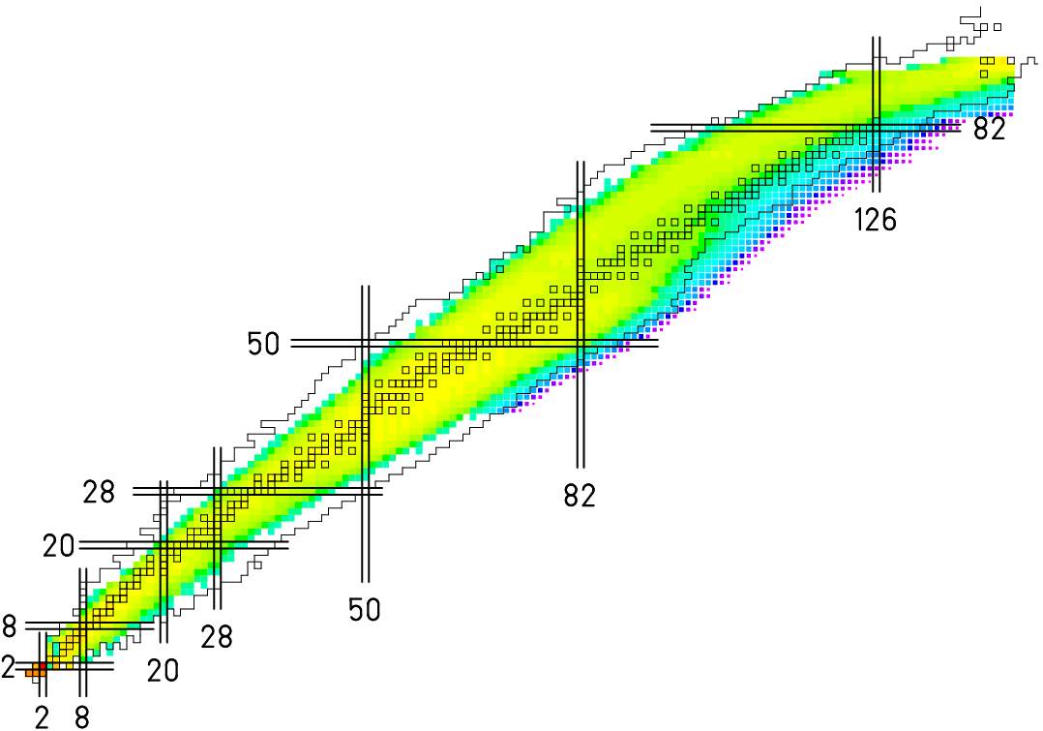
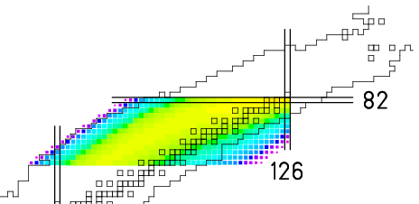
Why Lead for NUSTAR ?
FAIR Highlight: Measurement of waiting point nucleus at the magic neutron number N=126
3x10¹¹/s for all beams, including acceptance, ABRABLA from A. Kelic
²³⁸U --> ¹²C target
Z
N
²⁰⁸Pb --> ¹²C target
Z
N

